Slide 1
The God of Creation
Who is He?

Slide 2
Some Very Important Questions
Origin : Where did I come from?
Meaning : Why am I alive?
Morality : How to know right from wrong?
Destiny : What happens after I die?
The answer to the first question is critical to all of the others!

Slide 3

If you saw some blocks stacked on a table, what would you think?
Where did they come from?
How did they get stacked up like this?
Are you 100% certain?

Slide 4

A man comes to the hospital with chest pain…
* The doctor decides what is the problem and what to do.
* Is the doctor 100% certain?
* What would you do?

Slide 5
100% Certainty Is Rare
We often choose between two options based on “most probable.”
We don’t have enough time to get perfect information.
Life requires choices – sometimes, with very important results

Slide 6
You decide which is most probable
Evolution and Creation can both be studied logically, but both require faith (believing unseen events from the past).
We have been taught that evolution is fact proven by science. This is NOT true.
Be open to think for yourself.
Life requires choices – sometimes, with very important consequences!
Notes:
For the scientific method to work well, things must be observable, measureable, repeatable. Since the origin of the universe and life are none of these, we must use the evidentiary method to evaluate the questions of origin.

Slide 7
Where did everything come from?
Two Ideas:
Evolution Creation
Everything came from A powerful Creator
nothing made everything
Life began by accident Life was created
Complex creatures Each living creature was
evolved by a series designed and made by
of random accidents an intelligent Creator

Slide 8

If you hear a loud “BANG,” which is the most probable cause:
OR

Slide 9
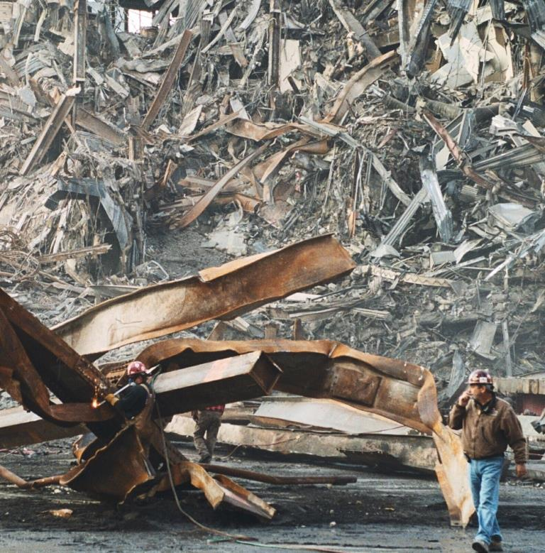

If you have an uncontrolled explosion, what is the most probable result:
OR

Slide 10
Two realities of science:
1. Something doesn’t come from nothing
(first law of thermodynamics)
2. Intelligent designs do not arise by accident
(statistical information theory)

Slide 11
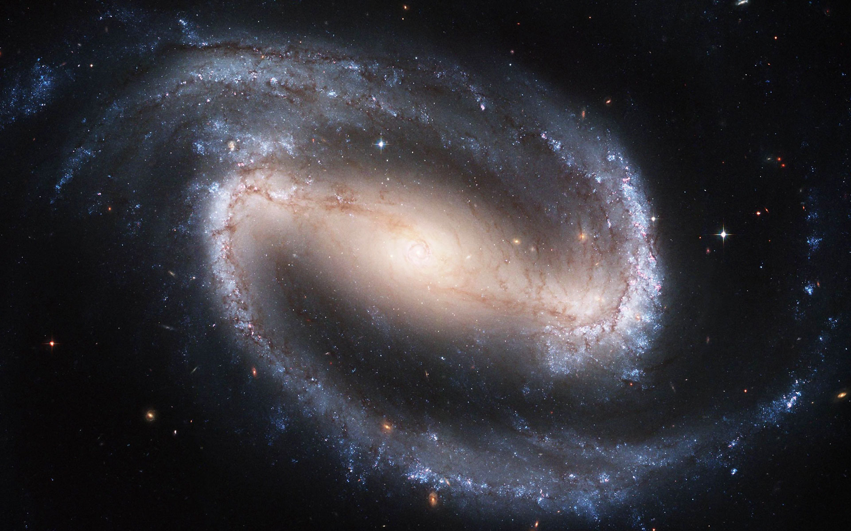
Did this come from nothing?

Slide 12
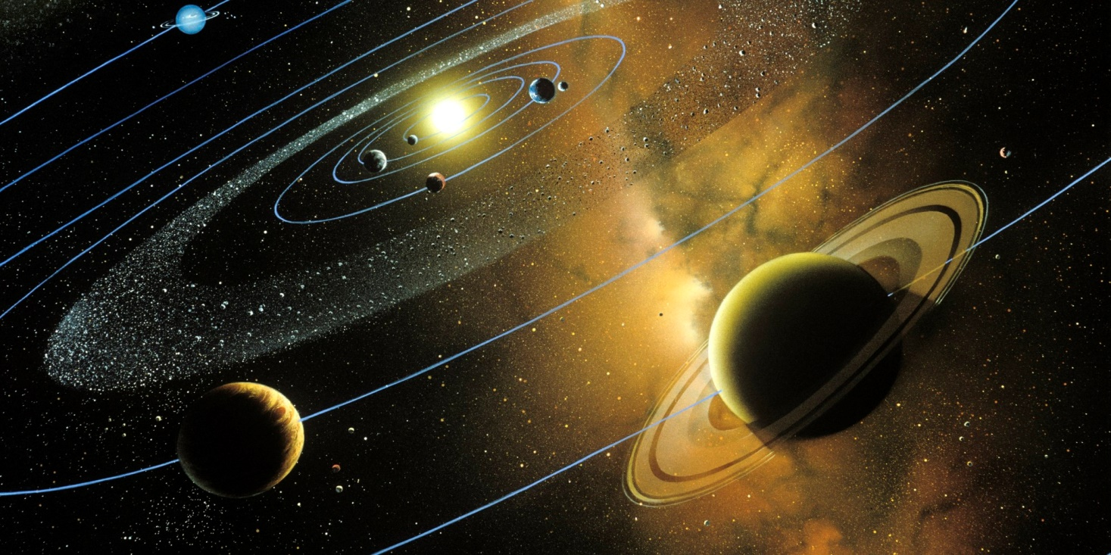
Did this design arise by accident?

Slide 13
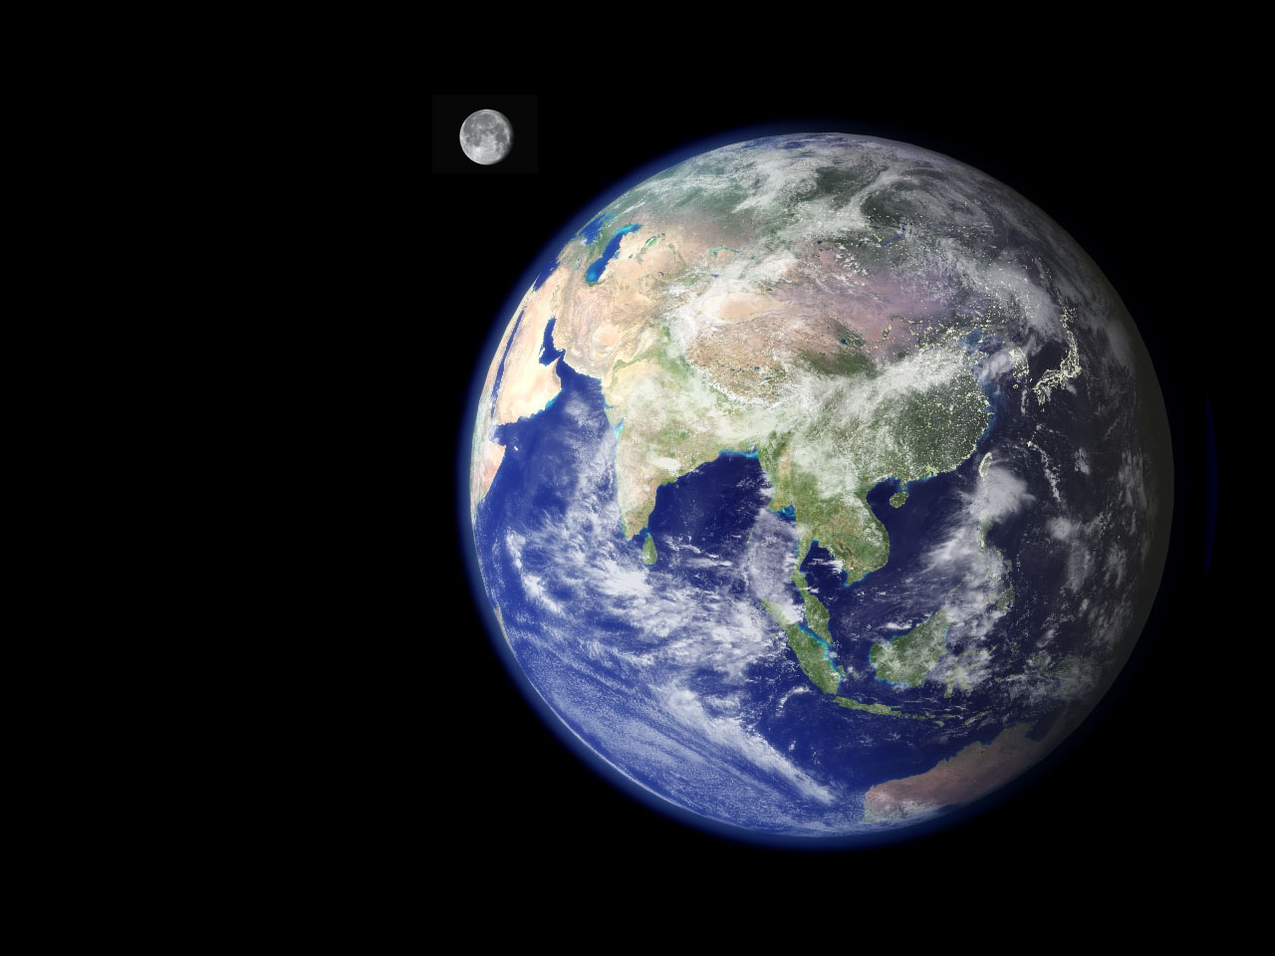
Was this planet designed for life?

Slide 14
You decide – which is most probable?
Evolution Creation
Everything came from A powerful Creator
nothing made everything

Slide 15

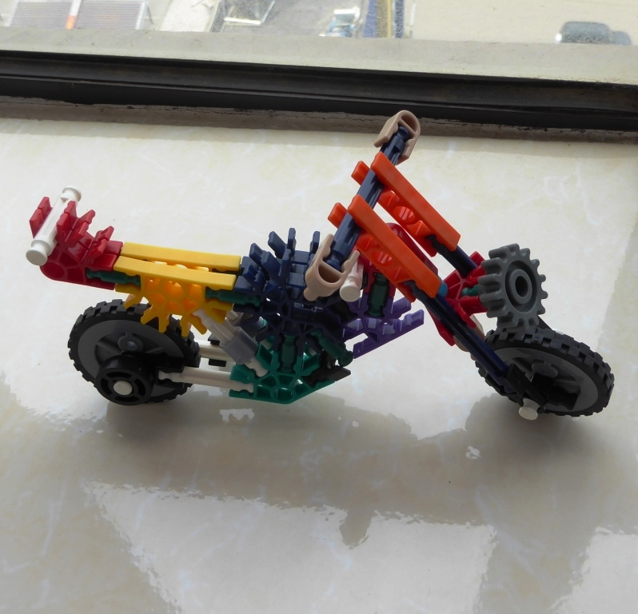
What is the difference?
How do you change this…
into this?
Can it happen by random accidents?

Slide 16
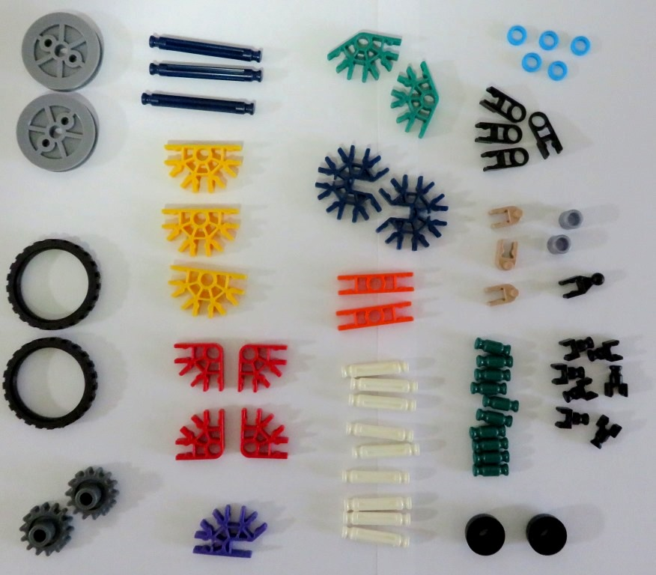
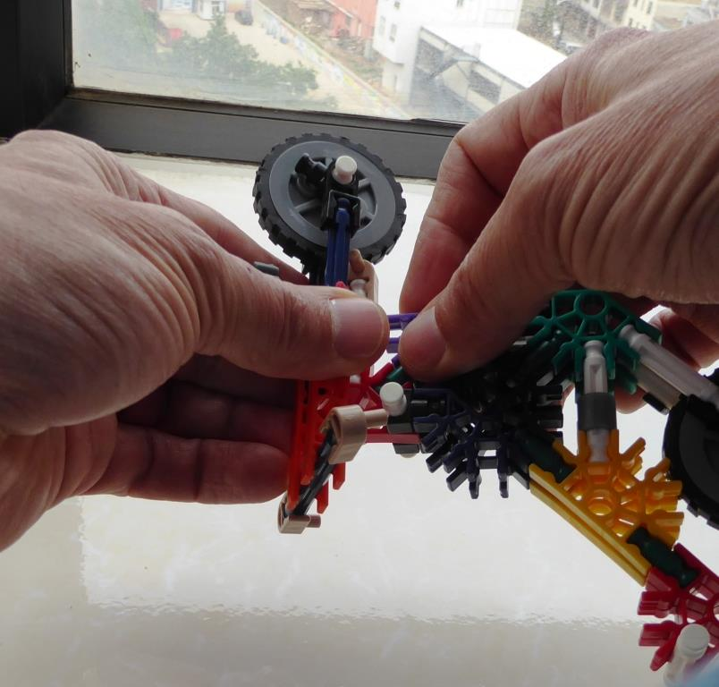
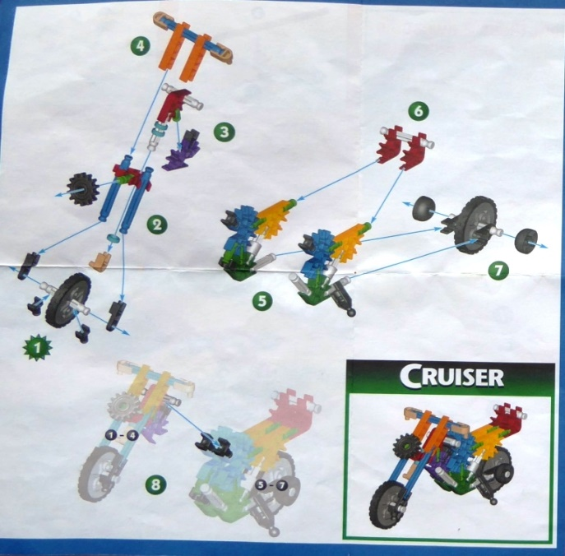
You need
this:
this:
and this:
The Right Pieces,
(66 pieces / 19 types)
a Design,
and a Process

Slide 17
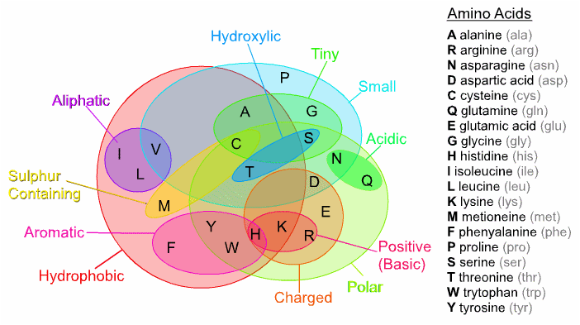
Every living thing is made of Proteins
Proteins are made from Amino Acids

Slide 18
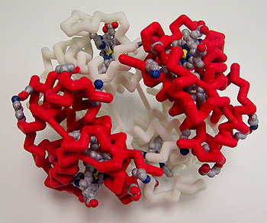
Hemoglobin protein, essential for life

Slide 19
What is the difference?
Not much!
Similar number of parts
Must be assembled in exact order to work

Slide 20
How to make this?
You need:
The right pieces
A design
A process

Slide 21
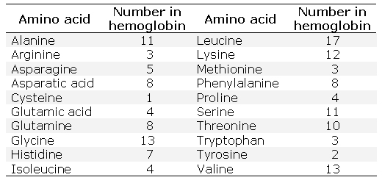
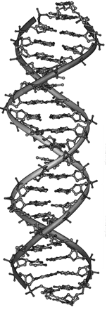
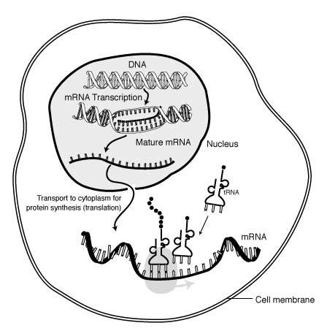
Specifically, you need: this this, and this
The Right Pieces,
(148 pieces / 20 types)
the Design,
and a Process

Slide 22
You decide – which is most probable?
Evolution Creation
Everything came from A powerful Creator
nothing made everything
Life began by accident Life was created

Slide 23


Every complex thing requires a design and a builder
No design + No builder = No house

Slide 24
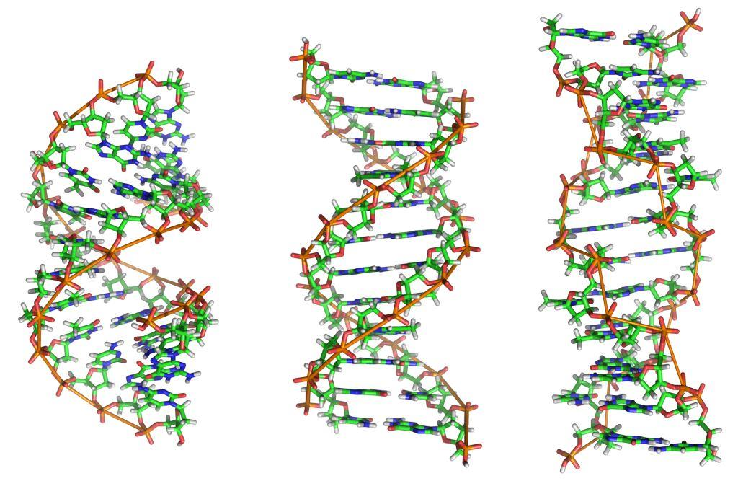
The design of life : DNA

Slide 25

Evolution requires unguided, step-by-step improvements
But even simple machines do not work without all of the pieces in the right places

Slide 26
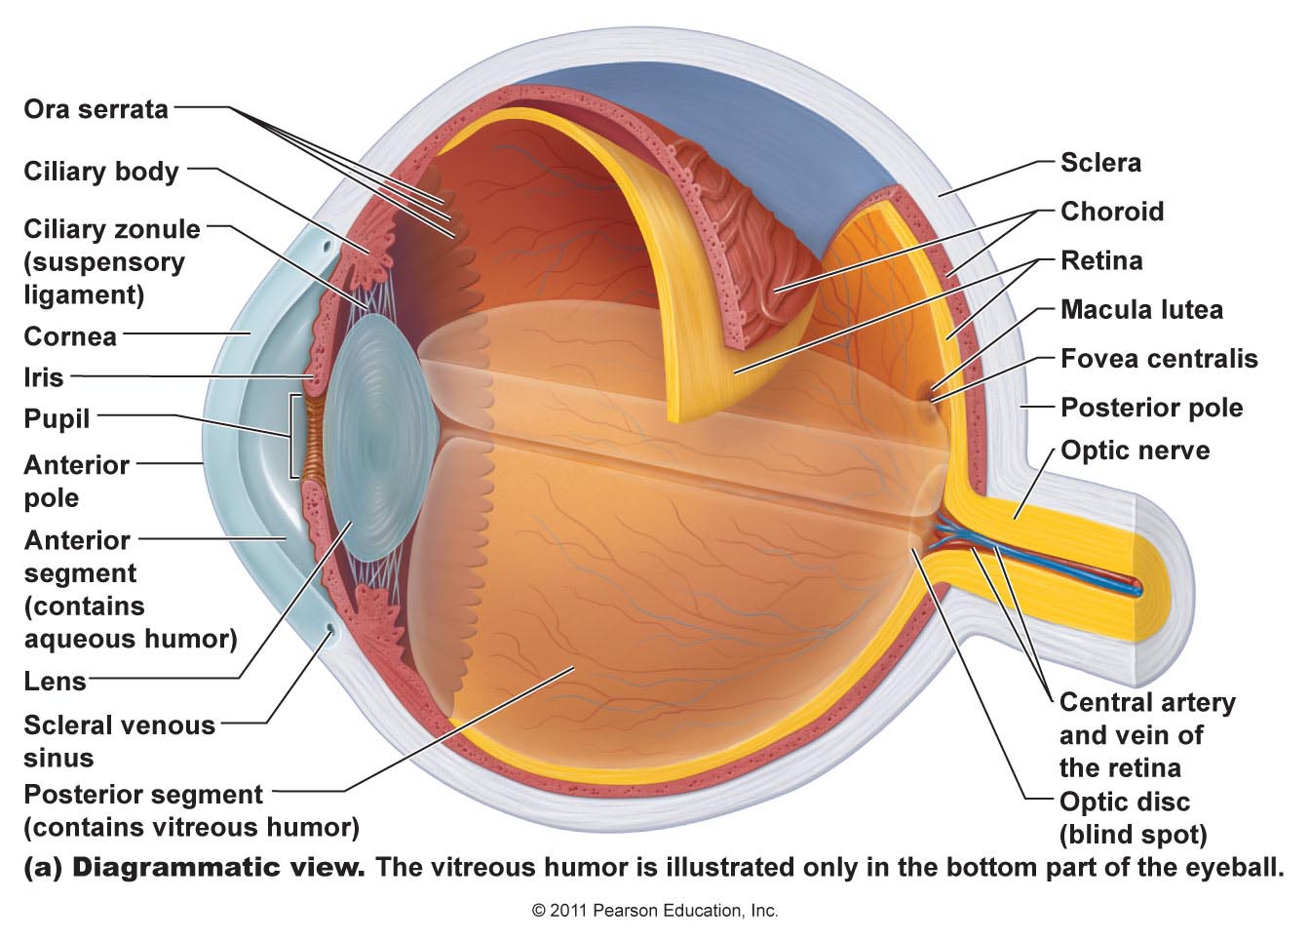
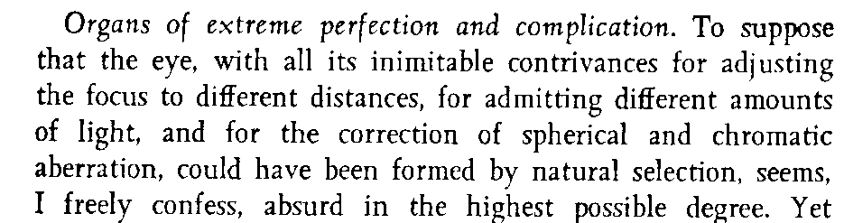
Your eye – a very complex machine
Origin of the Species – Charles Darwin

Slide 27
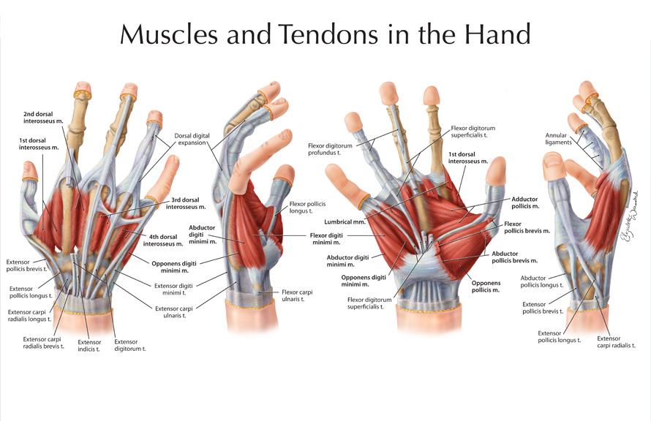
What does this look like to you?
Design or Accident?

Slide 28

Is it reasonable to think this book could emerge by accident?
How about the human body it describes?

Slide 29
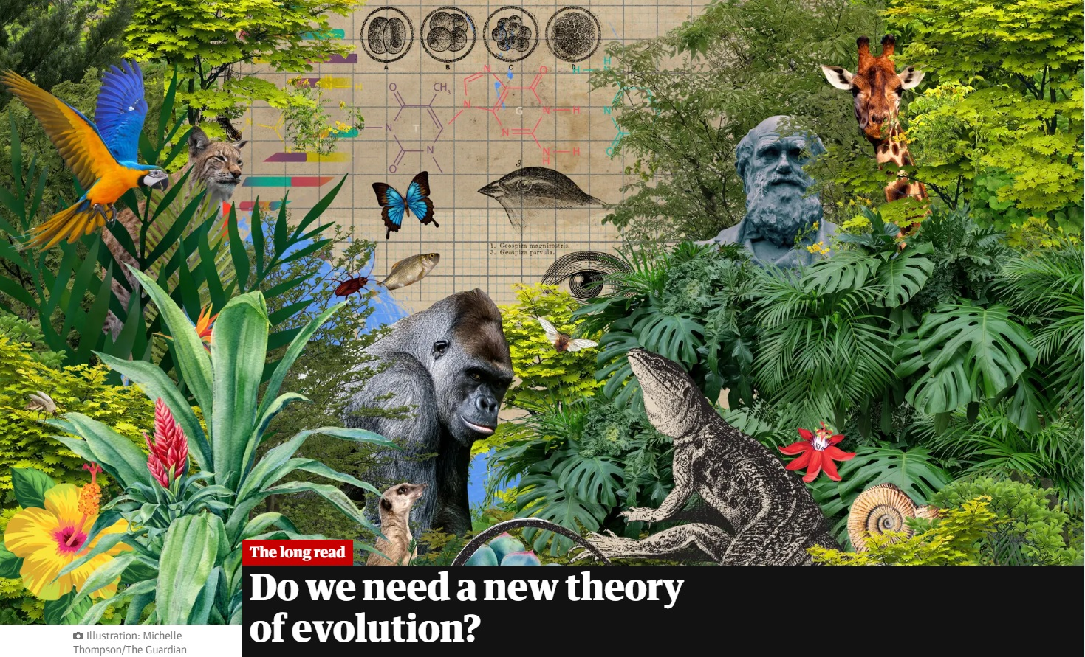
The Guardian Stephen Buranyi, 28 Jun 2022
“This is the basic story of evolution, as recounted in countless textbooks and pop-science bestsellers. The problem, according to a growing number of scientists, is that it is absurdly crude and misleading.”
“This classic idea of gradual change, one happy accident at a time, has so far fallen flat.”
“The issue at stake,” says Arlin Stoltzfus, an evolutionary theorist at the IBBR research institute in Maryland, “whether the idea of a grand story of biology is a fairytale we need to finally give up.”

Slide 30
You decide – which is most probable?
Evolution Creation
Everything came from A powerful Creator
nothing made everything
Life began by accident Life was created
Complex creatures Each living creature was
developed by a series designed and made
of random accidents by their Creator

Slide 31
From the Bible
Genesis 1:1
In the beginning, God created the heavens and the earth.

Slide 32
What is Faith?
Faith : believing something that you can’t see
(everyone has faith in something)
By faith we understand that the universe was created by the word of God, so that what is seen was not made out of things that are visible.
Hebrews 11:3

Slide 33
The Story of Creation – Genesis 1
Light (v.3-5), separated light / dark to make day / night.
Atmosphere (v.6-8), oxygen and clouds
Dry land and plants (v.9-13)
Sun, moon, and stars (v.14-19)
Fish and birds (v.20-23), reproduce after their own kind.
Animals (v.24-25) and People (v.26,27)
Each time God created something, He said, “It is good.”
Romans 1:20 – in the beauty of creation, we see the power and “fingerprints” of God.

Slide 34
Made in His Image
How can physical people be made in the image of a spiritual God? God gave us:
Mind – Intellect (Gen 2:19,20)
  To hear and understand God’s words
Heart – Deep Feelings (Gen 2:23)
  To respond to God with love
Will – Ability to Choose (Gen 2:16,17)
  To choose to follow God
Strength – Rule over the Earth (Gen 1:28)
  Responsibility to serve Him
Notes:
Guess why God has given us these four attributes of Himself?
“And you shall love the Lord your God with all your heart and with all your soul and with all your mind and with all your strength.” Mark 12:30

Slide 35
Period of Time – Why?
What is the physical reason for each of these?
One year
One month
One day
One week
“So God blessed the seventh day and made it holy, because on it God rested from all His work that He had done in creation.” (Genesis 2:3)

Slide 36
Made in God’s Image – Very Special
God gave us His breath of life (Genesis 2:7):
  “then the LORD God formed the man of dust from the ground and breathed into his nostrils the breath of life, and the man became a living creature.”
He gave us an eternal destiny (Ecclesiastes 3:11)
  “He has made everything beautiful in its time. Also, He has put eternity into man's heart,”

Slide 37
We live on a very good planet
“And God saw everything that He had made, and behold, it was very good.”
Genesis 1:31a

Slide 38
But we are small…

Slide 39
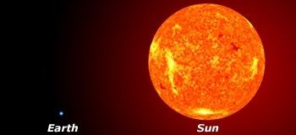
But we are small…

Slide 40
We are very small !

Slide 41
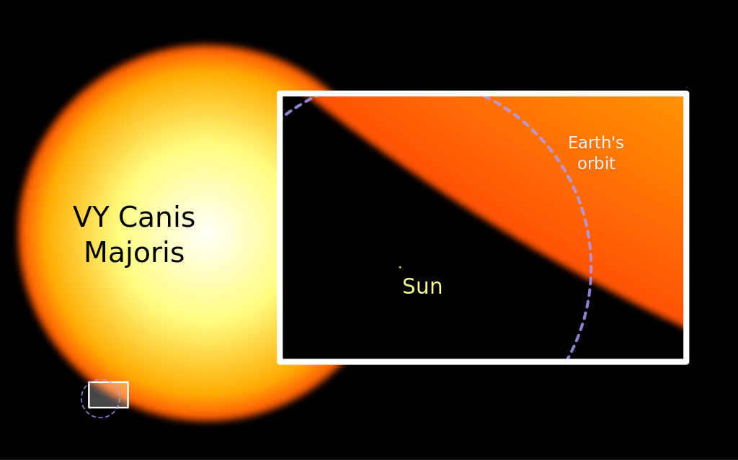
We are very small !

Slide 42
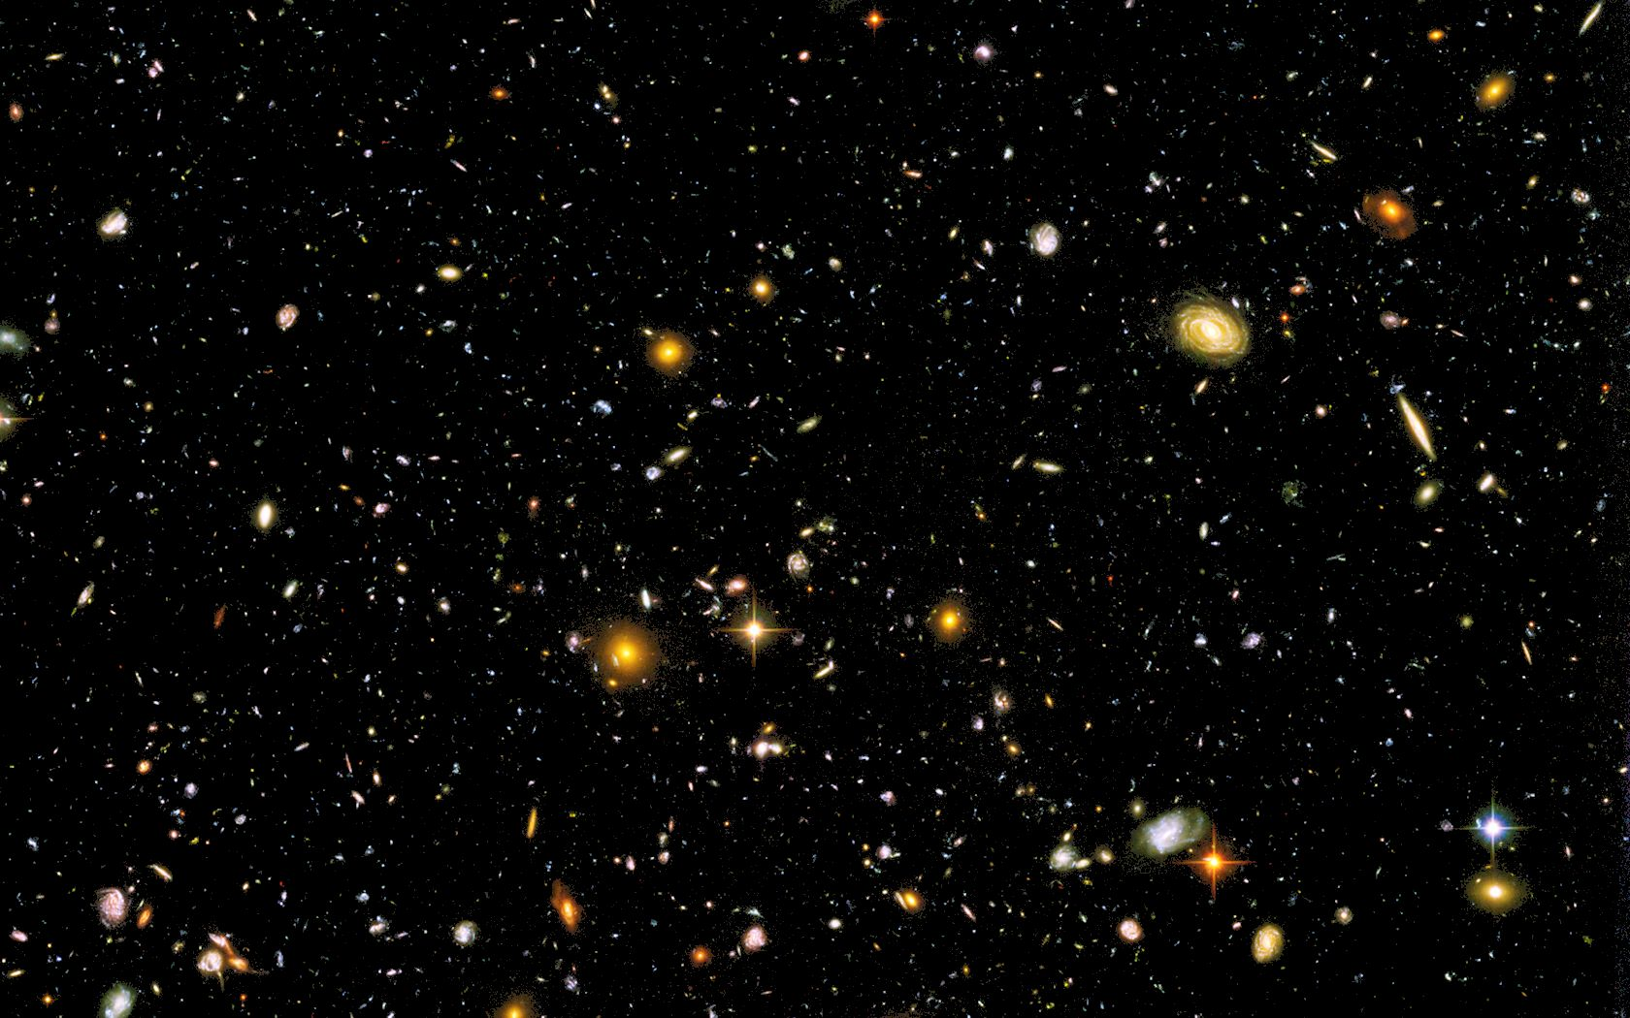
…in a Very Big Universe!
We are very, very small !

Slide 43
But everything is small when compared to God…
The heavens declare the glory of God,
and the sky above proclaims his handiwork.
Day to day pours out speech,
and night to night reveals knowledge.
There is no speech, nor are there words,
whose voice is not heard. Psalm 19:1-3

Slide 45
Why do people choose Evolution?
It is NOT because of what they see through the telescope of the microscope
It is NOT based on scientific evidence
It is a choice from the heart:
“For although they knew God, they neither glorified him as God nor gave thanks to him, but their thinking became futile and their foolish hearts were darkened. Although they claimed to be wise, they became fools. They exchanged the truth about God for a lie, and worshiped and served created things rather than the Creator.” (Romans 1:21,22,25)

