Slide 1
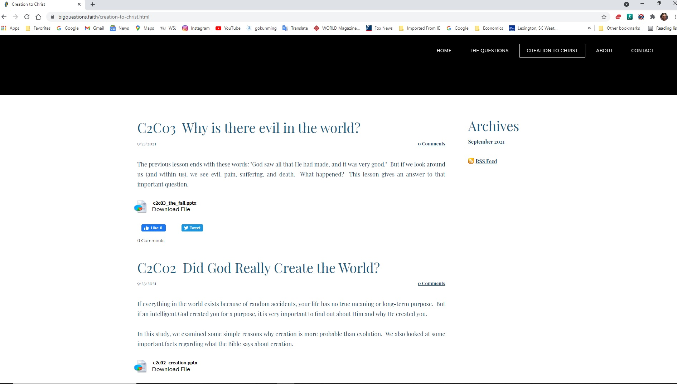
https://bigquestions.faith/creation-to-christ.html

Slide 2
Spirits and the Origin of Evil
It was very good, but then…

Slide 3
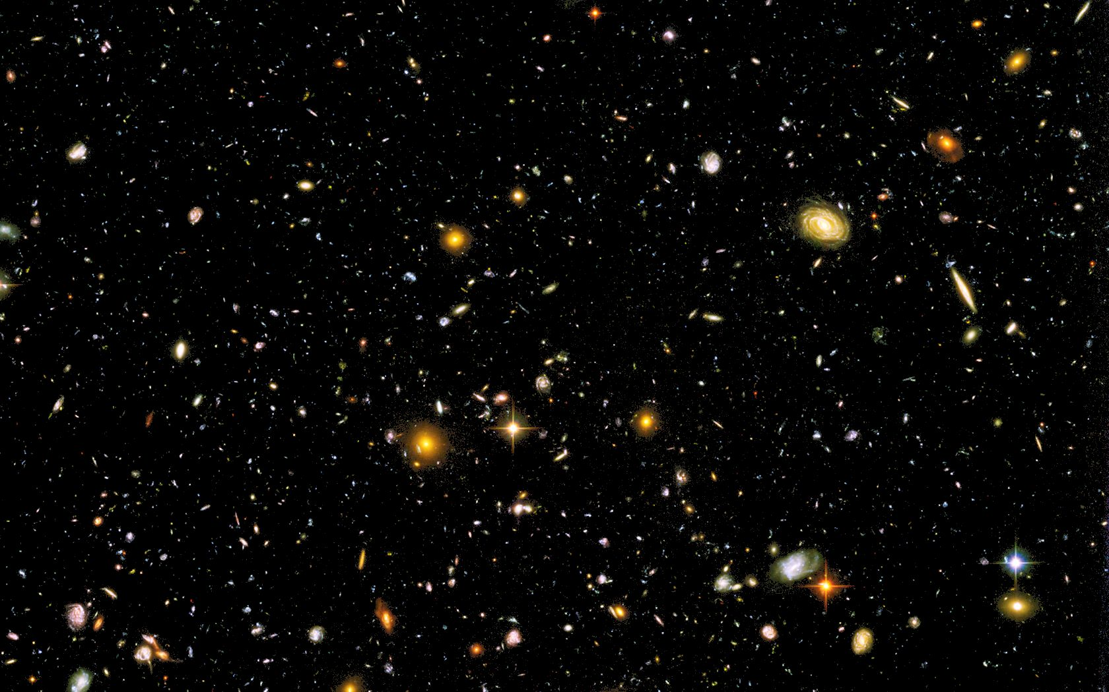
The Awesome, Perfect, Eternal God
To whom then will you compare me,
that I should be like him? says the Holy One.
Lift up your eyes on high and see: who created these?
He who brings out their host by number,
calling them all by name, by the greatness of his might,
and because he is strong in power not one is missing.
Isaiah 40:25,26
Notes:
As we begin, I want to remind you that every created thing had a beginning. As we back up into history, we eventually come to something that did not begin to exist – the only One who is eternally existing – the “first cause” of everything else. Of course, we are talking about the Awesome, Eternal God. Read these verses from Isaiah 40:25,26 and remember who He is and who we are by contrast. He is the center of all attention, not us. When we get that reversed, we set ourselves up for confusion and despair.

Slide 4
From Last Week:
In the beginning, God created… (Genesis 1:1)
God Spoke: “Let there be light…” (Gen 1:3)
Notes:
Last week, we saw three important things in Genesis 1:1 – In the beginning, God, and created. In verse 3, we saw the first example of what God often does – He sends forth His word into darkness, bringing light (physical and spiritual). Genesis 1:26 shows us how God made people special: in His image. He gave them a mind, a will, emotions, and authority.

Slide 5
From Last Week:
In the beginning, God created… (Genesis 1:1)
God Spoke: “Let there be light…” (Gen 1:3)
  In a world of darkness, God sends His word to bring light (physical and spiritual)
  Example: John 1:1-5

Slide 6
Also From Last Week:
God created people in His image (Gen 1:26)
  A mind to listen and learn about Him
  A will to choose to follow Him
  Emotions to love Him
  Authority to care responsibly for His creation
“God saw all that He had made, and it was very good.” (Gen 1:31)
Notes:
Genesis 1:26 shows us how God made people special: in His image. He gave them a mind, a will, emotions, and authority.
We ended by looking at Genesis 1:31 – God made a wonderful world, a beautiful garden (Eden), and created people in his image for an unhindered relationship with Himself. It was all “very good.” But when we look at our world today, it is far from perfect.

Slide 7
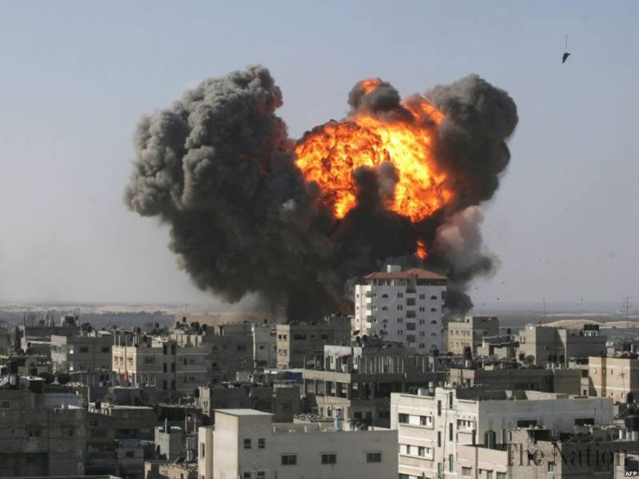
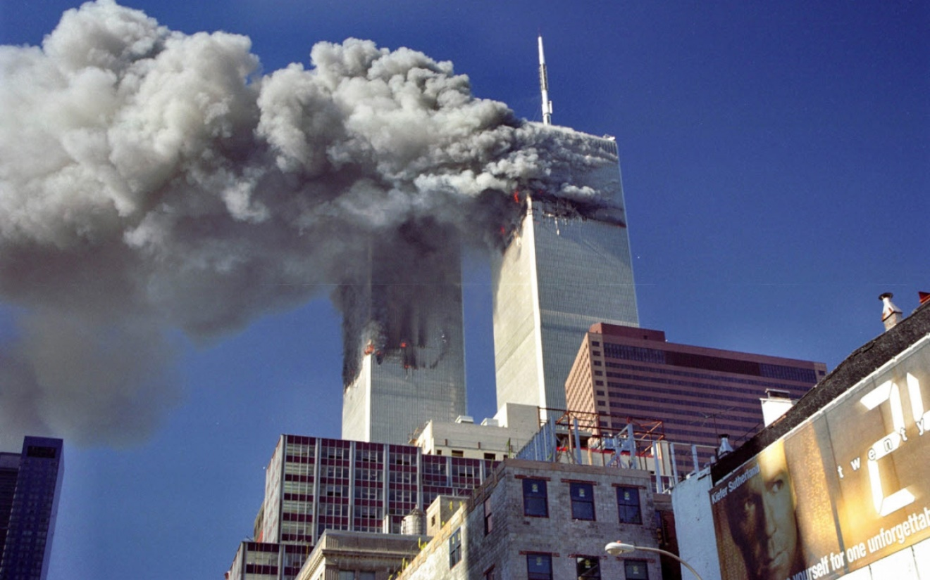
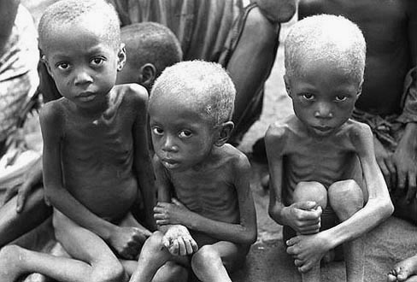
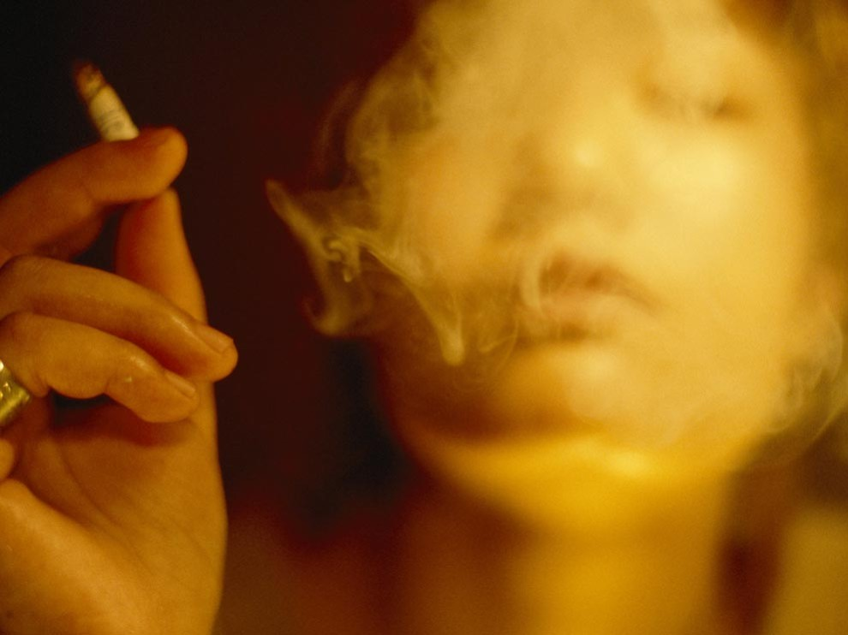
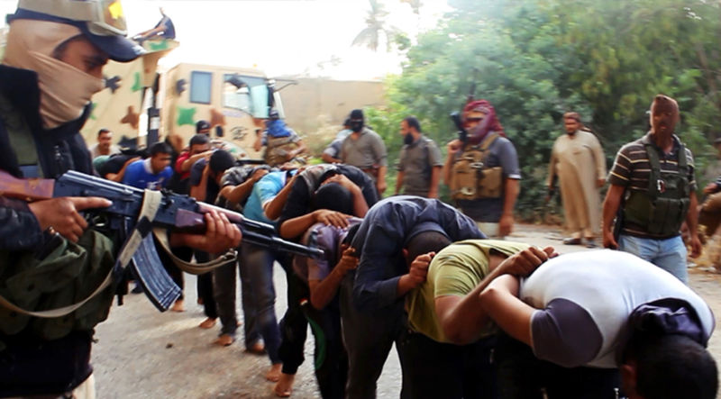
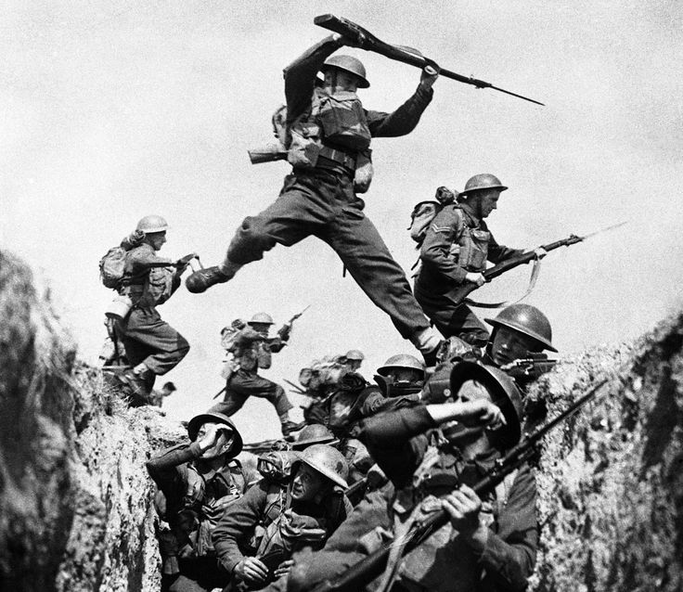
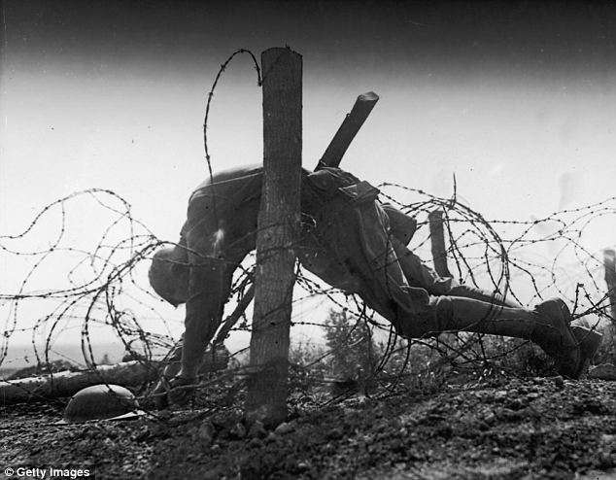
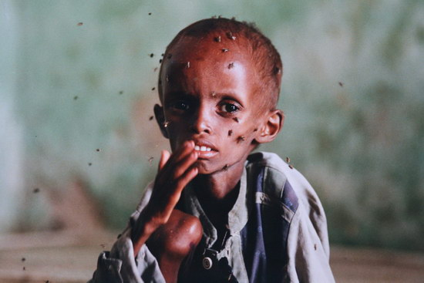
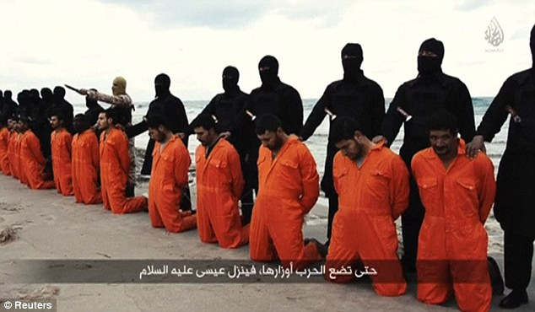

What happened?
We see evil all around us,
and
We see evil inside of us
Why…?
Notes:
We see evil all around us: terrorism, abuse, disease, and death. And if we’re honest, we sense the evil within us: greed, lying, lust, and rebellion. What happened?

Slide 8
Before God created people…
God created Angels
  John 1:3 – God made everything
  Psalm 103:20,21 – servants and messengers
Not all Angels are the same
Lucifer, a powerful and beautiful angel
  Ezekiel 28:13-15 – a guardian cherub
  Isaiah 14:12-14 – “I will be like God”
Notes:
Even before God created people, He created spirits to be His servants. God is greater than the spirits - He lived before them eternally, He made them, He gave them life. Spirits do not have physical bodies, like us - they can move about wherever they want to. In the beginning, the spirits were all God’s angels. Angels means “messengers” or “servants.”
John 1:3 - All things came into being through Him, and without Him not one thing came into being. Psalm 103:20, 21 - Bless the LORD, O you His angels, … all His hosts, His ministers that do His will.
God didn't create all the spirits exactly the same. Some were more beautiful, some were more powerful than others. The greatest angel was called Lucifer. Lucifer means “morning star.”

Slide 9
Moving away from the light of God
Into the darkness of rebellion
Lucifer
Satan
“Morning Star”
Enemy, Accuser
“I will ascend to heaven”
“I will raise my throne”
“I will make myself like the Most High”
Notes:
God gave Lucifer a place of great authority over the other angels in Heaven. Lucifer was created blameless and perfect, but after a time, Lucifer became proud of his beauty and position and wanted to be “like the Most High.”
God is perfectly good. But when a creature chooses to go their own way, they move away from His light into darkness, choosing to be their own god. Lucifer was the first one to do this evil, an action for which he has been judged and will be condemned. Lucifer is also called Satan which means “enemy, adversary, opponent, or accuser.” Other angels followed Lucifer in his rebellion, and are now called demons. (2 Peter 2:4)

Slide 10
A Choice in the Garden
God did not make people like robots
  True love requires a choice
Genesis 2:16,17
  The man and woman could have anything they wanted in the garden
  They had a perfect relationship with God and each other (Gen 2:25)
  Only one rule : do not eat the fruit of the forbidden tree
Notes:
As we said above, life in the Garden of Eden was very good – perfect. Adam and Eve had everything they needed. God put Adam in position of manager over all the creation. God gave them a variety of plants and fruits and vegetables to eat, and they had a perfect friendship and fellowship with God and with each other (Genesis 2:25).
Because Adam was created in the image of God, he was given a will – the ability to choose obedience or disobedience. Therefore, God gave him the privilege to eat from any tree in the entire garden except for one: Genesis 2:16,17
God could’ve created Adam and Eve like the animals or like robots, only programmed to do good. But true love requires a choice, so he gave people a will – the ability to choose to follow Him or someone else. Satan knew about God’s warning to Adam concerning the one tree. Because Satan hates God, he wanted to destroy the man and woman God made in His image. Therefore, Satan planned to deceive Eve.

Slide 11
Satan tempted Eve
Genesis 3:1 – “Did God really say…?”
  He wanted Eve to doubt God’s Word
  He tempted Eve to doubt God’s love
Genesis 3:2-5 – “You will not die…”
  “You will be like God” (Satan’s original sin)
  “Believe in yourself - rule your own life!”
But God did not make us to live apart from Him. He made us to be guided by His word.
Notes:
Genesis 3:1 Why did Satan ask Eve this question? – Two reasons: to create doubt about the truthfulness of God’s word, and to tempt them to think that God really didn’t love and care for them.
Satan is a deceiver. He tries to make what is good appear useless or evil, and what is evil appear good. Satan deceived Eve by coming to her in the form of a snake. Up until that time, the animals had not been harmful in any way to Adam and Eve or to each other, so Eve was not afraid (2 Corinthians 11:14).
Genesis 3:2-5 Satan had already rebelled against God’s authority. He wanted to be independent of God and rule his own life. Now Satan was suggesting to Eve that she should also rebel against God. Satan said that eating the fruit would make Eve like God in knowing good and evil. Satan wanted Eve to believe that she wouldn’t need God to tell her what was right and wrong. But the truth is that God did not make people to live by their own ideas and thoughts, and He made us to be guided by His own Word.

Slide 12
Eve and Adam make a choice
Genesis 3:6 – The woman saw:
  The fruit looked like it would taste good
  The fruit was attractive to the eyes
  Eating could increase her wisdom and power
She ate, and then Adam ate
1 John 2:16 – the same temptation
  Feels good, looks good, makes you proud
Notes:
Genesis 3:7,8 What did God say would happen to them if they ate of the tree? – He told them that they would die. Even though Adam knew that God had said not to eat it, he deliberately disobeyed God’s command. Adam turned away from depending on God. Up to this point, he had personal experience with the goodness of God. Now, because he had chosen to follow Satan, he will become personally familiar with evil.
The Bible has an amazing consistency from beginning to end. We face these same three temptations today, ones which are described in 1 John 2:16.

Slide 13
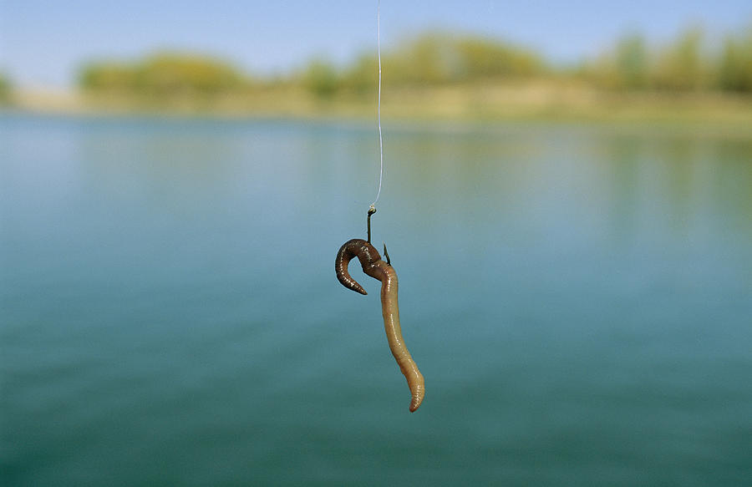
The bait might look tasty, but the hook is deadly

Slide 14
Moving away from the light of God
Into the darkness of rebellion
Satan
Enemy, Accuser
Man and Woman
“I will ascend to heaven”
“I will raise my throne”
“I will make myself like the Most High”

Slide 15
What is Death?
Genesis 2:16,17 – what did God say would happen whey they ate from the tree?
Isaiah 59:2 – sin separates us from God
  When someone dies physically, their soul is separated from their body
  When someone dies spiritually, their spirit is separated from God
Genesis 3:7,8 – they hid themselves from God
Death = separation from life
Notes:
When something dies, it becomes separated from the source of life. Physical death is the time when a person’s spirit is separated from their body. Spiritual death is the time when a man becomes separated from God (Isaiah 59:2). The first sign of separation from God we read about is that they tried to hide from God.

Slide 16
The results of sin (Genesis 3):
Verses 10-12 > Three Things:
  Fear – “I was afraid”
  Shame – “I was naked”
  Guilt – “I ate”
The Curses on People and Creation
  Verse 16 > woman: painful childbirth and loss of freedom
  Verse 17-18 > man: thorns, pain, sweat, hard work
  Verses 19 > man and woman: death
  Romans 8:20-22 > all creation suffers
Notes:
When Adam and Eve sinned, three things happened to them: fear (I was afraid), shame (I was naked), and guilt (I ate). All over the world, we see these three results of evil.
Could God see where they were hiding? Why did God call out? – He loved them, and wanted to give them an opportunity to confess their sin. We are responsible for our actions. Do you think God needed to ask them to find out what happened? No, but He was giving them an opportunity to agree with Him that what He said was truth and that they were wrong in believing and following Satan.
When God created Adam and Eve, He did not intend for them to die. Even though man did not die physically on the day that he ate from the tree, his genetics were now changed, eventually leading him to physical death. Death would now be routine for everything on earth.

Slide 17
Bad news for all of us
Romans 5:12
  We all inherit sin – it’s not just what we do, it’s who we are
  Because of sin, we all are dead spiritually
  Because of sin, we all will die physically
The end of last lesson: “It was very good”
The end of this lesson: we are separated from God and will die because of our sin
The important question: Is there any hope?
Notes:
Romans 5:12 “Therefore, just as sin entered the world through one man, and death through sin, and in this way, death came to all men because all sinned.”
Even though tonight’s lesson began with the words “very good,” it ends on a very sad note: men have been separated from God and are now destined to live in a cursed world of evil and death. The question is this: is there any hope for mankind?

Slide 18
Some clues of hope…
Genesis 3:9 > God came to the man and called out to him
  “Where are you?”
  God gives people an opportunity to confess sin and ask forgiveness
Genesis 3:21 > God covered their shame
  What did God do to make their clothing?
  God killed a substitute for the man to cover his shame
The Bible is not just a book of rules
The Bible is the story of God seeking man.
Notes:
The answer: yes, there is hope found in two clues above:
Even when man was hiding from God, God was calling out to him, giving him an opportunity to repent
God shed the blood of a substitute in order to cover the shame of the man
Now that you understand the problem of death, it helps you to better understand the message of the Bible. It is not just a book of rules to try and help sinful people get along better with each other. It is the story of God seeking man. It is the amazing story of what God will do to restore His relationship with people who turned away from Him.

Slide 19
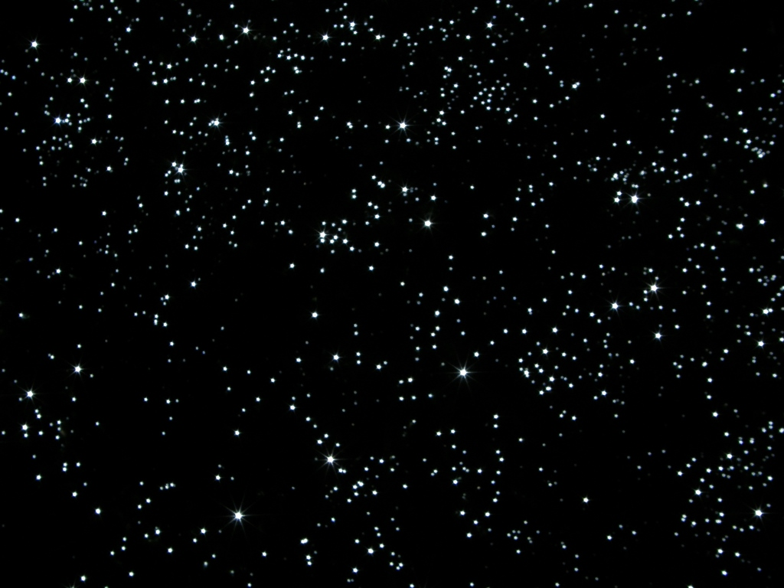
耶和华我们的主啊！你的名在全地是多么威严，你把你的荣美彰显在天上。 我观看你手所造的天，和你所安放的月亮和星星。 啊！人算什么，你竟记念他？世人算什么，你竟眷顾他？ Psalm 8:1,3,4
Remember: He is God, we are not God
O LORD, our Lord, how majestic is your name in all the earth!
You have set your glory above the heavens. When I look at your heavens, the work of your fingers, the moon and the stars, which you have set in place, what is man that you are mindful of him, and the son of man that you care for him?
Notes:
As we conclude, I want you to remember an important fact, one that Satan confused in the mind of Adam and Eve: God is God and we are not God Psalm 8:1,3,4
He is the center of all things, and we only exist because He has chosen to make us. When we keep our attention clear about this, it changes everything!

