Slide 1
Why is Israel so Important?
The birth of the nation of Israel
(A necessary history lesson)
Notes:
Tonight, you will see how God used a small nation in the Middle East to provide a permanent solution to this problem. According to Deuteronomy 7:7, God chose this nation because they were not large and powerful. Otherwise, they would boast about themselves instead of God.

Slide 2
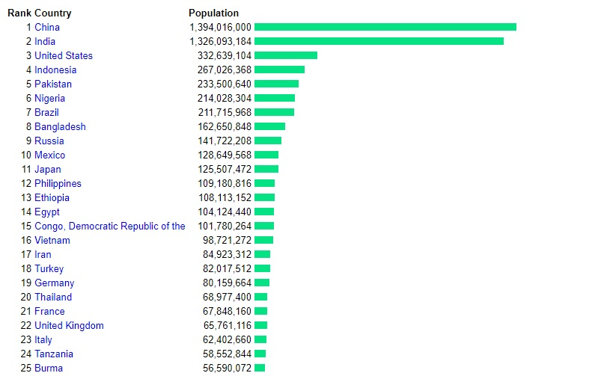
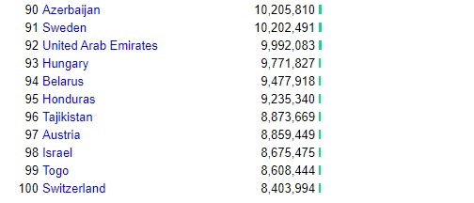
Why did God choose Israel?
The LORD did not choose you because you were more numerous than other peoples, for you were the fewest of all peoples. Deuteronomy 7:7
Notes:
Data from about 2019
1 Corinthians 1:27-29 God often chooses the weak

Slide 3
Last Week : Things to Remember
Even the very best efforts of man cannot please God. He is God – His way is the only right way.
In the midst of judgment for sin, God shows mercy, providing a safe place.
God created people for His glory, but people are proud and seek their own glory.
Evil is real and always pulls people away from God. We have only one hope – God must bring us back to Himself.
And now, more about God’s plan…
Notes:
Our last lesson showed us that, although God created people for His glory (Isaiah 43:7), people seek after their own glory (Genesis 11:4). God continues to call men back to Himself, but they quickly drift away. It is quite clear: people, in their own strength, are not capable of returning to God.

Slide 4
The call of Abram
~ 2100 BC – start of Xià Cháo (夏朝)
Genesis 12:1-3 > God spoke to Abram
  Verse 1 : what did God tell Abram to do?
  A strong faith is required to go on a journey without a clear destination! (Hebrews 11:8)
  Verses 2-3 : what promise did God make to Abram?
  Who would be blessed by the offspring of Abram?
Genesis 12:10-13 > Abram was not perfect!
  What did Abram tell his wife to do?
  The Bible tells the truth about people – even the heroes are sinful.
Notes:
We begin by looking at the historical record of Abraham in Genesis 12:1-3. The story begins about 2100BC, just before the start of the Xia Dynasty (Xià cháo) (2070-1600BC). In verse 1, what did God tell Abram to do? We see that Abram was told he was going to go into a different land where none of his family lived. Can you imagine how hard it would be to tell you family that you were going to follow God, but didn’t really know your exact destination? This would take a huge amount of faith (Hebrews 11:8).
In verses 2-3, what did God promise to Abram? God promised that He would bless Abram, and Abram would be a blessing. How could one man and his descendants be a blessing to all families of the entire earth? We will soon see that a distant relative of Abram’s would be a very special child from God.
But Abram was not a perfectly good man – he was sinful. When his journey takes him to Egypt, he is afraid and lies about his wife (Genesis 12:10-13). Here is something that you will see in the Bible – the human “heroes” are all sinful: none of them are perfect. It is the true story of real people.

Slide 5
God’s Gifts to Abram
Genesis 15:1-5 > The promise
  Verse 2 : What was Abram’s problem?
  Verse 4 : What was God’s promise?
Genesis 15:6 > Righteousness “credited”
  Righteousness does not come from perfect behavior
  Righteousness comes from God through belief (faith)
Genesis 15:13-14 > A prophecy of the future
Notes:
If Abram was sinful, how could he be a blessing to the entire world? God made a very important promise to him in Genesis 15:1-5. Even though it was humanly impossible for him and his wife to bear children, God promised a miracle (a supernatural act). And in Genesis 15:6, we learn a very important truth: righteousness does not come from perfect behavior – it comes from faithful belief.
God also reveals something else to Abram in Genesis 15:13-14. Keep this in mind for our lesson next week!

Slide 6
Some things to remember
Righteousness does not come from perfect behavior – it comes from God through belief

Slide 7
Promises Fulfilled
Genesis 17:5,15-16 > New names for old people
Abram → Abraham: “father of a multitude”
Sarai → Sarah: “mother of many nations”
Genesis 21:1-5 > The promise comes true
  Verse 2 : What happened to Sarah?
  God is faithful : “at the very time God promised”
  Verse 5 : How old was Abraham?
Notes:
Abram was 99 years old when God changed his name from Abram to Abraham. Abraham means “father of a multitude of children.” God also changed Sarai’s name to Sarah. Sarah was 90 years old when God changed her name, meaning “mother of many nations.” (Genesis 17). And finally, in Genesis 21:1-5, we see that God gave Abraham and Sarah a son. Abraham named his son Isaac. Abraham was 100 years old when Isaac was born.

Slide 8
An unexpected sacrifice (Genesis 22)
Verses 1-2 : What did God tell Abraham to do?
  Sacrifice his only son, the one that he loves
  The special child of promise
Verses 3-5 : What did Abraham do?
  Started the journey early the next morning
  “We will worship and then we will come back”
  Abraham didn’t understand, but he trusted God
Notes:
But then, in Genesis 22, God does something entirely unexpected. In verses 1-2, God tells Abraham to take his only son and offer him up as a sacrifice. This is shocking for (at least) two reasons: first, throughout the Bible, God always condemns human sacrifice. And second, this is the child of promise, the one through whom all nations would be blessed. How could Abraham do something like this to his special, only beloved son? But look at his response in verses 3. Did Abraham begin to obey God right away? Here is evidence of Abraham’s faith.
The three day journey gave Abraham plenty of time to look at his precious son Isaac and change his mind. A couple of servants came along to help, but when they reach the mountain, Abraham asks them to stay behind (22:4,5). He makes a bold statement to those he leaves behind: “We will worship and then we will come back to you.” Even though he was expecting to kill Isaac, he believed that, somehow, God would bring him back alive. In fact, look at Hebrews 11:17-19 for confirmation of what Abraham was thinking. Even though Abraham did not understand what God was doing (or how, or why, etc), he acted in faith.

Slide 9
An unexpected sacrifice (Genesis 22)
Verses 6-8 : What did Abraham say about the offering?
  Remember this image: the only son carries wood up the mountain for his own sacrifice.
Verses 9-11 : Abraham faithfully obeyed
Verses 12-13 : God provides a substitute
Verse 14 : The Lord Will Provide (He did provide, and He will provide)
Notes:
So Abraham puts the wood on the back of his son Isaac and they climb the mountain (vs 6‑8). What did Isaac ask his father and what was Abraham’s answer? When Isaac asked about the lamb for the sacrifice, Abraham told him the truth: that there would be one provided. At this point, Isaac was a young man, trusting and submitting to the will of his father.
In verses 9-12, Abraham does exactly as God commanded, but God stops him at the last minute. Why did God stop Abraham – what had he proved to God? God wanted Abraham to show how much he feared God. Abraham obeyed God by being willing to sacrifice his only son. God was having Abraham act on his faith. And as promised, God provides a sacrifice Himself (vs 13‑14). Here is another important clue to remember: the only son of a Father climbed a mountain with wood on his back as a sacrifice, and “the Lord will provide.”

Slide 10
Some things to remember
Righteousness does not come from perfect behavior – it comes from God through belief
The only son of a father climbed the mountain with the wood of sacrifice on his back
On the mountain of the Lord, a lamb will be provided

Slide 11
Isaac and Jacob
Genesis 25:24-26 > When Isaac was 60 years old, his wife had two sons: Esau and Jacob
Genesis 28:10-14 > God speaks to Jacob
  Verse 12: a stairway into heaven
  Verse 13: Jacob’s descendants will inherit this land
  Verse 14 : his offspring will bless the entire earth
Genesis 35:23-26 > Jacob had four wives and 12 sons (not God’s design for marriage!)
God changed Jacob’s name to Israel
Notes:
When Isaac was 60 years old, he and wife Rebecca gave birth to twin boys. The first one born was red and hairy so they named him Esau and the second one was named Jacob. God planned to pass on the promise of blessing through Jacob. Jacob has an important dream in Genesis 28:10-14, seeing a stairway into heaven and the glory of God (a clue of a future event!). He then receives the same promise as his grandfather Abraham. But Jacob was also a sinful man, tricking his father, brother, and father-in-law. By now, we are learning that God is able to use imperfect people (like us) to accomplish His perfect plan.
Jacob had 12 sons from 4 wives. The names of Jacob’s sons are Reuben, Simeon, Levi, Judah, Issachar, Zebulun, Joseph, Benjamin, Dan, Naphtali, Gad, and Asher. Later on, God changed Jacob’s name (deceiver) to “Israel” (one who wrestles with God).

Slide 12
Some things to remember
Righteousness does not come from perfect behavior – it comes from God through belief
The only son of a father climbed the mountain with the wood of sacrifice on his back
On the mountain of the Lord, a lamb will be provided
From the land of Israel: A stairway into heaven and blessing to all people

Slide 13
Israel and Joseph
Genesis 37 > Joseph had some problems
  Verse 2 : he was a “tattletale”
  Verse 3 : his father treated him special
  Verse 4 : his brothers hated him
  Verses 5-8 : he was proud, telling them he will be their ruler
Genesis 37 > Joseph’s brothers take action
  Verses 19-20 : they decide to kill him
  Verses 25-28 : they sell him as a slave to Egypt
  Verses 31-33 : they cover up their crime
Notes:
Let’s continue the story by reading about one of Jacob’s youngest sons, Joseph (Genesis 37:2-4). We start off by seeing two problems: Joseph is proud and says bad things about his brothers, and Israel shows favoritism to Joseph.
Although his brothers hate him for his pride, Joseph continues to boast (Genesis 37:5-8). Their anger grows, until one day, they take action.
In Genesis 37, Jacob tells Joseph to check on his brothers who were watching the flocks far from home. When his brothers saw him, they decided to kill him (verses 19-20). But then they changed their minds and decided to sell him as a slave (verses 25-28) for 20 shekels of silver. To cover up their actions, they bloodied Joseph’s coat and brought it back to their father (vs 31‑33). As you can tell, the sons of Israel were just as sinful as everyone else.

Slide 14
Joseph in Egypt
Genesis 39 > In the house of Potiphar
  Verses 2-4 : The Lord was with him
  Verses 7-8 : Refused his master’s wife’s temptation
  Verses 11-12 : falsely accused and sent to prison
Genesis 40:12-15 > Interpreting dream in prison
Genesis 41 > In the presence of Pharaoh
  Verses 15-16 : Only God can interpret dreams
  1 Peter 5:5-7 : Now humble and useful
  Verses 28-30 : 7 years of plenty and famine
  Verses 39-40 : Joseph in charge of Egypt
Notes:
In Genesis 39:1-2, we see that Joseph was sold to Potiphar, an Egyptian who was one of Pharaoh’s officials. Potiphar trusted Joseph, and made him in charge of his household with everything he owned. But Potiphar’s wife made false accusations against Joseph and he was put into prison. The warden put Joseph in charge of all those held in the prison, and he was made responsible for all that was done there. Two of the prisoners were a cupbearer and a baker. Genesis 40 tells us about these 2 men having dreams, and Joseph interprets them through the power of God. Just as Joseph said, the cupbearer was released and started to work for Pharaoh again, but the baker was killed. Joseph asked the cupbearer to remember him once he was out of prison, but he did not.
In Genesis 41:1-8, we see that 2 years passed since the cupbearer had been released. Pharaoh had a dream, but none of the wise men of Egypt or any of the magicians he asked could interpret the dream. Then the cupbearer told Pharaoh about the dream he had in the past and how Joseph was able to interpret it. So Pharaoh commanded Joseph to be brought to him from out of the dungeon (Genesis 41:15-16). Could Joseph give the answer in his own power? Notice how Joseph changed during his time as a slave and in prison – he is no longer proud and self-centered, but is humble and God-fearing (1 Peter 5:5-7).
In, Genesis 41:25-32, Joseph interpreted Pharaoh’s dream. Joseph told Pharaoh that seven years of great abundance are coming throughout the land of Egypt, but seven years of famine would follow them. The abundance in the land would not be remembered, because the famine that followed would be so severe. Joseph encouraged Pharaoh to carefully save grain to prepare for the famine, so Pharaoh made Joseph second in command over all of Egypt (vs 39,40).

Slide 15
Israel comes to Egypt
Genesis 42 > Joseph’s brothers
  Verses 1-3 : The famine brings the brothers to Egypt
  Verses 6-7 : The brothers bow to Joseph
  Verses 21-22 : The brothers feel guilty about their sin
Genesis 45:3-5 > Joseph reveals his identity
Genesis 45:7-8 > God is in control of everything
Genesis 47:5-6 > Israel welcomed as guests in Egypt
Notes:
The famine was also a problem back in the land of Canaan. So Jacob recommends that his sons go there to buy grain (Genesis 42:1-3). Joseph was in charge of selling grain. So when Joseph’s brothers went in Egypt, they had to deal with Joseph. Joseph recognized his brothers, but he pretended to be a stranger (verses 6-9) and spoke harshly to them. Although Joseph recognized his brothers, they did not recognize him.
In order to test them, Joseph keeps one of the brothers as a prisoner (Simeon) and sets the others free. Even though it was many years ago, the brothers still carry the guilt of what they did to Joseph (Genesis 42:21,22).
They return to their home country, but soon come back for more grain. This time, Joseph tests to see if they will betray their youngest brother, but Judah offers himself as a substitute (Genesis 44:33), indicating that a future substitute will arise from his offspring. It appears that there has also been a change in the heart of some of Joseph’s brothers.
It was now time for Joseph to reveal his true identity (Genesis 45:3-9). Rather than treating his brothers as their deeds deserved, Joseph explained to them that God was in control of the situation, and that He had used the brothers’ horrible actions to work for good. Then Joseph’s brothers went back to their home country and told their father these things. Jacob then moved the whole family as well as all of his possessions to Egypt.
In order to show his gratefulness for Joseph’s blessing to Egypt, Pharaoh welcomes them to live on their very best land. But the Egyptian kings will not always be kind to the sons of Israel…

Slide 16
History is not random events
God has a plan for the future
  Genesis 15:13-14 – Israel would be slaves in a foreign land 400 years, but God will come to rescue them
  Genesis 50:24 – Joseph reminds them of the promise
Some clues of the future:
  Righteousness does not come from perfect behavior – it comes from God through belief
  The only son of a father climbed the mountain with the wood of sacrifice on his back
  On the mountain of the Lord, a lamb will be provided
  From the land of Israel: A stairway into heaven and blessing to all people
God is in control of history (“His story”) … →
Notes:
God knows what is going to happen. God always keeps His promises. Many years before, God had told Abraham that his descendants would go to another country. And now, they have become guests of the land of Egypt.
As the book of Genesis closes, please notice two important promises:
Genesis 49:10 – the Ruler of nations (the blessing from Abraham) would descend from the offspring of Judah
Genesis 50:24-25 – God will come to the aid of the Israelites and deliver them from Egypt
Also, remember the truths and clues in this lesson:
righteousness does not come from perfect behavior – it comes from faithful belief.
the only son of a Father climbed a mountain with wood on his back as a sacrifice, and “the Lord will provide.”
A stairway into heaven will come from a descendent of Jacob in the land of Israel.

Slide 17
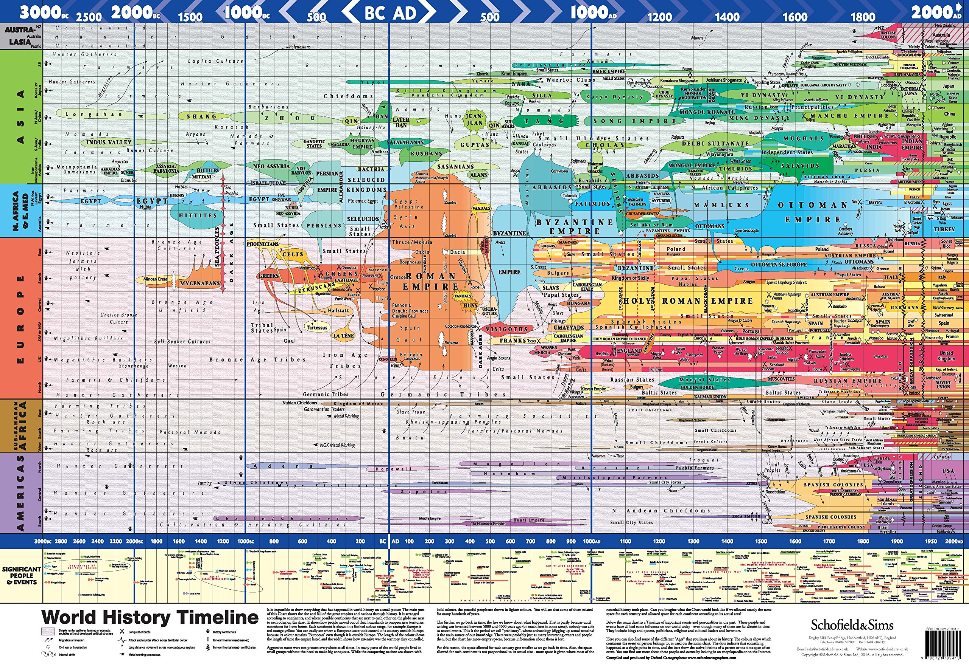
耶和华啊！你是我的 神，我要尊崇你，称谢你的名，因为你以信实真诚作成了奇妙的事，就是你远古以前所计划的事。
O LORD, you are my God; I will exalt you; I will praise your name, for you have done wonderful things, plans formed of old, faithful and sure. Isaiah 25:1
Notes:
Remember that God is guiding the events of history, preparing a way to restore the broken relationship with Himself. In spite of the sinfulness of man, God is still in control and will accomplish His purpose (Isaiah 25:1; Job 42:1,2).

