Slide 1
Did Jesus really rise from the dead?
Is it true beyond a reasonable doubt?
Notes:
Deep in all of our hearts, we sense that our life has a purpose – a meaning that extends beyond this physical world. Perhaps you have been lying awake at night wondering about this, but eventually, you get discouraged or distracted and try to ignore the biggest questions of life: Where did I come from? Why am I here? What will happen after I die?
Tonight, I want to talk about someone who died and came back to life. This is the most important historical event ever, and you need to know why.

Slide 2
Ladies and Gentlemen of the Jury:
The Claim: Jesus was dead and buried. But after three days, his living body came out of the grave.
The Evidence: Arguments will be presented in favor and in opposition of this claim.
The Decision: You must examine the evidence and decide if the claim is true or false beyond a reasonable doubt.
The Impact: “And if Christ has not been raised, your faith is futile and you are still in your sins. Then those also who have died in Christ have perished.” 1 Corinthians 15:17,18
Notes:
In the United States, court cases are usually decided by a jury, a group of 6 or 12 regular people like you. After hearing the evidence, the judge tells the jury to make their decision “beyond a reasonable doubt.” He does not tell the jury that they must be 100% certain if a criminal is guilty. If 100% certainty was required, the jails would be empty. Instead, the judge tells the jury to make a decision “beyond a reasonable doubt.”
The central claim of Christianity is this: Jesus came to earth as the Savior of mankind. In order to accomplish this amazing task, He had to do two things:
He had to take the punishment for every violation of God’s laws by every person (death), and He had to bring dead (and dying) people back to their source of life (God) by rising from the grave and conquering death. Among all major religions, only Jesus claims to have risen from the grave. Look with me at 1 Corinthians 15:12-14. If the resurrection is not true, what does this say about the Christian faith? It is useless! Since this is the heart of the gospel, you should examine the evidence and decide if it is indeed true.
And that’s the same way that we choose to follow Christ. God created the world and makes the rules, and according to His rule book, salvation comes through faith. According to Hebrews 11:6 “…without faith it is impossible to please God, because anyone who comes to him must believe that he exists and that he rewards those who earnestly seek him.” If you are waiting for perfect knowledge, you are waiting for something that God does not promise nor require. Not only is this OK, but it is the way that things must be. God is the judge of this courtroom called “earth,” and this is His design. And it’s not enough to believe that He exists – you must also believe that He knows and rewards those who seek Him. (Interestingly, most people do not doubt on the basis of evidence, they reject belief for personal or emotional reasons).

Slide 3
The Resurrection Arguments
Reasons to doubt | Reasons to believe
I didn’t see it with my own eyes | Prophecy foretold that it would happen
People in 33 AD were easier to trick | The bodily resurrection was a unique claim
The Bible only gives a one-sided legend | The tomb was empty
Jesus really didn’t die on the cross | The disciples were changed
Jesus wasn’t really buried in the tomb | Worship shifted to Sunday
Jesus’ body was stolen from the tomb | Post resurrection appearances
Notes:
In a courtroom, there are two lawyers: each one brings their best arguments to try and convince you of their side of an issue. When it comes to the resurrection, there are good questions on both sides of the argument – reasons to doubt the resurrection and reasons to believe the resurrection. Here are some of the reasons that I have heard on both sides. Beginning with the opposing side, let’s look at some of these arguments and see which ones are reasonable. When we are finished, you must make your own decision “beyond a reasonable doubt.”

Slide 4
Arguments Against the Resurrection
Reasons to doubt | Reasons to believe
I didn’t see it with my own eyes
People in 33 AD were easier to trick
The Bible only gives a one-sided legend
Jesus really didn’t die on the cross
Jesus wasn’t really buried in the tomb
Jesus’ body was stolen from the tomb

Slide 5
I didn’t see it with my own eyes
Daily activities require trust. We believe many things without seeing them. We drink a soda and trust the producer. We eat a burger and trust the cook. We have “faith” in the people who make the labels. We believe many things without seeing them.
Our life depends on trust. Whenever we fly on an airplane, we trust the unseen pilot in the cockpit. When we drive on the highway, we trust other drivers to follow the rules. We trust the elevator to safely take us up and down. We put our faith (and lives) in their hands.
Many things happen at different times and space. We believe that Alexander the Great conquered Persia in 330BC; we believe that Julius Caesar crossed the Rubicon in 49BC and controlled the Roman Empire; we believe that George Washington was the first president of the US. We believe consistent, accurate reports, even though we don’t see something.
Here is the point – we believe many things that we don’t see, so this argument should not guide our decision.
Notes:
{Open a can of Coke and take a sip} We believe many things without seeing them. When we drink a soda, we don’t usually look inside to see if the real stuff is in here. We have faith in the people who make the labels. We believe many things without seeing them.
Whenever we get on an airplane, we buckle our seatbelts and trust that there is skilled pilot in the cockpit. We will trust that the navigator knows how to get to the destination. We believe all of this, even though we have never seen the crew. We put our faith (and lives) in their hands.
We also believe many things in the past, not because we saw them, but because people have given us consistent reports about them. Do you believe in the Empress Dowager Cixi and that she was one of the final rulers of the Qing dynasty? Do you believe that George Washington was the first president of the US? Here is the point – we believe many things that we don’t see, so this argument should not guide our decision.

Slide 6
People in 33 AD were easier to trick
Three Groups of People to Trick:
  Greeks and Romans: Because of the influence of Plato, they strongly believed that, at death, the “evil” body would remain in the grave to free up the “good” spirit .
  Jewish Sadducees: Did not believe in a bodily resurrection (Matthew 22:23).
  Jewish Pharisees: Believed in a resurrection, but only at the end of time.
It would take very strong proof for all of these groups to change their views.
Notes:
In our pride, we often assume that “modern” people are better able to identify a hoax than the people of the first century. But the actual truth is this: the Greeks and Romans thought that a bodily resurrection was foolish. They strongly believed that, at the point of death, the “evil” body would remain in the grave to free up the “good” spirit (influence of Plato).
At the time, there were two kinds of Jewish thought: the Sadducees and the Pharisees. The Sadducees did not believe that there would be a resurrection (Matthew 22:23). The Pharisees believed in a bodily resurrection, but expected it to only occur at the end of time. So it would take a very convincing argument for Jews, Greeks, or Romans to believe.

Slide 7
The Bible only gives a one-sided legend
Legends develop when stories are passed down orally over hundreds of years. But:
  The accounts of the resurrection were written by either eye-witnesses or first-person interviewers of eye-witnesses within 50 years of the death of Jesus.
  A detailed historical account of the resurrection was carefully recorded 25 years after the event in 1 Corinthians 15.
Secular literature from the same time period gives identical accounts, by Ignatius (50-115AD), Justin Martyr (100-165AD), Tertullian of Carthage (160-220AD), and Josephus (circa 100AD).
British scholar WM Smith writes, "We know more about the burial of the Lord Jesus than we know of the burial of any single character in all of ancient history.”
Notes:
It’s important to realize that the accounts of the resurrection were written by either eye-witnesses or people who spent a great deal of time with eye-witnesses (Luke 1:1-4). It takes hundreds of years for legends to develop, but all four gospels were all written within 50 years of the death of Jesus.
Even among skeptics, some of the Biblical writings are considered factual. One such book is 1 Corinthians, written by a known scholar 25 years after the crucifixion. And in 1 Corinthians 15:3-5, the resurrection is clearly described as historical fact.
You may only be familiar with the resurrection information in the Bible. But secular literature gives identical accounts. Writings by Ignatius (50-115AD), Justin Martyr (100-165AD), Tertullian of Carthage (160-220AD), and Josephus (circa 100AD) give identical accounts. In fact, WM Smith writes, "We know more about the burial of the Lord Jesus than we know of the burial of any single character in all of ancient history".

Slide 8
Jesus really didn’t die on the cross
Maybe they got the wrong guy. But:
  To confirm Jesus’ identity, he was kissed on the face by a close friend.
  He passed through multiple trials by Jewish and Roman courts who knew him well.
Maybe he didn’t really die on the cross. But:
  He was whipped by Romans, which often killed a victim
  He was nailed to a cross all day
  After pronouncing him to be dead, the Roman guard still pierced his dead body with a spear, producing a rush of blood and water, indicating death by rupture of the heart.
Notes:
Just to be sure they got the right guy in the dark, the Roman soldiers brought along one of Jesus' own disciples to identify Him, right in his face with a kiss. Matthew 26:47-50 describes the scene as they bind Jesus and take him in for judgment. From here, He endured a sleepless night with no food, mock trials and beatings, scourging with a cat-o-nine-tails, a painful climb up a mountain, and the anguish and embarrassment of death on a Roman cross. As recorded in John 19:33,34, the soldiers (who were accustomed to seeing dead men) pierced the dead body of Christ and out flowed blood and water, indicating death by rupture of the heart.

Slide 9
Jesus wasn’t really buried in the tomb
Usually, the bodies of crucified criminals were left on the cross to be eaten by birds or tossed into a mass grave.
But not Jesus. The Roman governor gave his body to Joseph of Arimathea and Nicodemus (John 19:38-42), members of the Sanhedrin, the ruling council of the day (well known representatives of Jewish authority).
To ensure Jesus’ body stayed in the tomb, the Jewish leaders were careful to be sure everything was done properly. The body was put into the tomb, it was sealed and protected by Roman guards (Matthew 27:62-66).
Notes:
Usually, the bodies of crucified criminals were left on the cross to be eaten by birds or tossed into a mass grave. But not Jesus. For some “strange” reason, the Roman governor treated the body with unusual care, handing it over to Joseph of Arimathea and Nicodemus (John 19:38-42). This is important, because they were both members of the Sanhedrin, the ruling council of the day. They were not just nameless people of questionable integrity – they were well known representatives of Jewish authority.
Because the Jews feared the disciples would steal Jesus’ body and falsely claim He rose from the dead, they were careful to be sure everything was done properly and that the correct grave was sealed and guarded (Matthew 27:62-66). We can be thankful that these Jewish leaders took this step, adding strength to the claims of resurrection.

Slide 10
Jesus’ body was stolen from the tomb
Where were Jesus’ followers?
  When Jesus was captured, they all ran away (Mark 14:50).
  Only two apostles had the courage to go outside and see if reports of His resurrection was really true (John 20:2,3).
  They continue to hide behind locked doors for fear of the Jews (John 20:19).
  Conclusion: this is not an aggressive, grave robbing gang.
It’s also interesting that the linen wrappings which bound Christ's body in were still in the empty grave (John 20:6,7). If someone had taken the body of Christ (or if He got up and walked away), why take off His clothes?
Notes:
What were the apostles actually doing when all this was going on? It probably would have set the minds of the Pharisees at ease to know that they had “all gone away” (Mark 14:50). And even when the news of his potential resurrection reached them, only two apostles had the courage to go outside and see if it was really true (John 20:2,3). And even when they do gather, they still hide behind locked doors for fear of the Jews (John 20:19). In other words, these are hardly your aggressive, grave robbing gang of followers.
I also think it's interesting that the linen wrappings which Nicodemus and Joseph bound Christ's body in were still in the empty grave (John 20:6,7). If someone had taken the body of Christ (or if He got up and walked away), why take off His clothes? Remember, this is an eyewitness account of John, and very descriptive of this all-important scene.

Slide 11
Arguments In Favor of Resurrection
Reasons to doubt | Reasons to believe
 | Prophecy foretold that it would happen
 | The bodily resurrection was a unique claim
 | The tomb was empty
 | The disciples were changed
 | Worship shifted to Sunday
 | Post resurrection appearances

Slide 12
Prophecy foretold that it would happen
Isaiah 53:9,10 (Old Testament): 600 years earlier
“And they made his grave with the wicked and with a rich man in his death, although he had done no violence, and there was no deceit in his mouth.
“Yet it was the will of the LORD to crush him; he has put him to grief; when his soul makes an offering for guilt, he shall see his offspring; he shall prolong his days; the will of the LORD shall prosper in his hand.”
Notes:
The Old Testament prophets clearly said that the Messiah would die and come back to life. If Jesus really was the Messiah, He must arise!

Slide 13
Prophecy foretold that it would happen
Jesus predicts his resurrection at least 16 times. Examples include:
Matthew 16:21 “From that time Jesus began to show his disciples that he must go to Jerusalem and suffer many things from the elders and chief priests and scribes, and be killed, and on the third day be raised.”
Matthew 20:18,19 “’See, we are going up to Jerusalem. And the Son of Man will be delivered over to the chief priests and scribes, and they will condemn him to death and deliver him over to the Gentiles to be mocked and flogged and crucified, and he will be raised on the third day.’”
Some people can estimate the timing of their death, but no one else can predict their resurrection
When challenged about his authority, Jesus said that the resurrection would prove He is God (John 2:18-22)
Notes:
Of all the prophets, perhaps the most credible of all is Jesus himself. I counted over 16 places where he prophesied of His resurrection. Look at Matthew 16:21; Matthew 20:18,19; and Luke 9:22. I think we can safely say that Christ was certain about the coming events, including the resurrection. And when the Jews demanded he give a sign to verify that He was indeed who He claimed to be, He prophesied of His greatest sign of all: John 2:18-22. In doing this, Christ staked His whole claim to deity on the resurrection.

Slide 14
Bodily Resurrection was a Unique Claim
Of all world religions, only Christianity claims that its founder rose from the dead.
It would have been easy to claim a “spiritual” resurrection, but he did not.
If someone ever found the body of Jesus, Christianity would self-destruct.
Notes:
If you look at all of the known religions in the world, only Christianity claims that its founder rose from the dead. Because this really did happen, Christianity truly stands apart as unique.
If the disciples really wanted to create an illusion, they would have probably simply claimed that Jesus spiritually rose from the dead. This would have been the “easy way” out. But by claiming that Jesus rose bodily from the dead, the disciples set themselves up for complete destruction of their movement when people would find the body of Jesus.

Slide 15
Burial Places of Famous Leaders

Slide 16
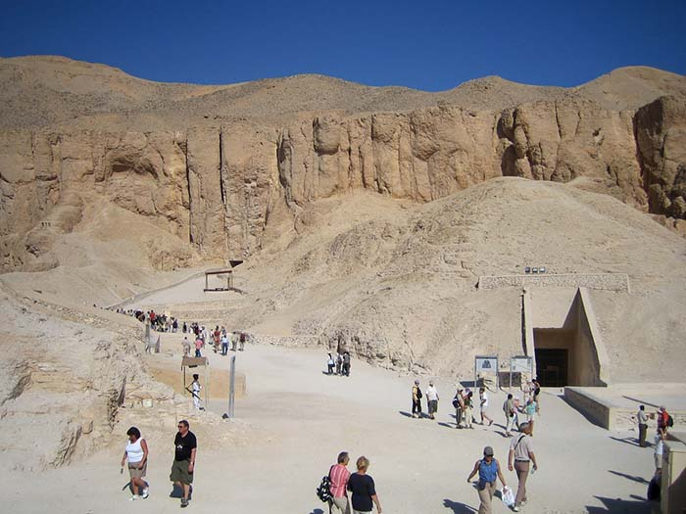
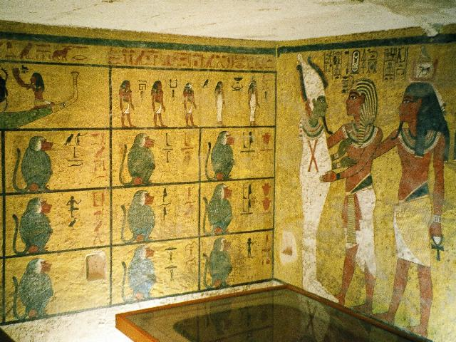
Tomb of Tutankhamun
(Egyptian Ruler until 1323 BC)
Notes:
Tutankhamun (/ˌtuːtənkɑːˈmuːn/;[3] alternatively spelled with Tutenkh-, -amen, -amon) was an Egyptian pharaoh of the 18th dynasty (ruled c. 1332–1323 BC in the conventional chronology), during the period of Egyptian history known as the New Kingdom or sometimes the New Empire Period. He has since his discovery been colloquially referred to as King Tut. His original name, Tutankhaten, means "Living Image of Aten", while Tutankhamun means "Living Image of Amun". In hieroglyphs, the name Tutankhamun was typically written Amen-tut-ankh, because of a scribal custom that placed a divine name at the beginning of a phrase to show appropriate reverence.[4] He is possibly also the Nibhurrereya of the Amarna letters, and likely the 18th dynasty king Rathotis who, according to Manetho, an ancient historian, had reigned for nine years—a figure that conforms with Flavius Josephus's version of Manetho's Epitome.[5]

Slide 17
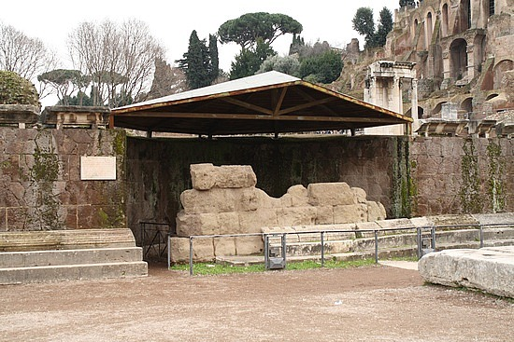
Tomb of Julius Caesar
(Roman Ruler until 42 AD)
Notes:
The Temple of Caesar or Temple of Divus Iulius (Latin Aedes Divi Iuli or Templum Divi Iuli, Italian Tempio del Divo Giulio) also known as Temple of the Deified Julius Caesar, delubrum, heroon or Temple of the Comet Star,[1] is an ancient structure in the Roman Forum of Rome, Italy, located near the Regia and the Temple of Vesta.
It was begun by Augustus in 42 BC after the senate deified Julius Caesar posthumously. Augustus dedicated the prostyle temple (it is still unknown if it was Ionic, Corinthian or Composite) to Caesar (his adoptive father) on August 18, 29 BC, after the Battle of Actium. It stands on the east side of the main square of the Roman Forum (Forum), between the Regia, Temple of Castor and Pollux and the Basilica Aemilia, on the site of Caesar's cremation (Caesar's testament was read at the funeral by Mark Antony).
Caesar was the first resident of Rome to be deified and so honored with a temple.[2] A fourth flamen maior was dedicated to him after 44 BC and Mark Antony was appointed as his flamen.

Slide 18
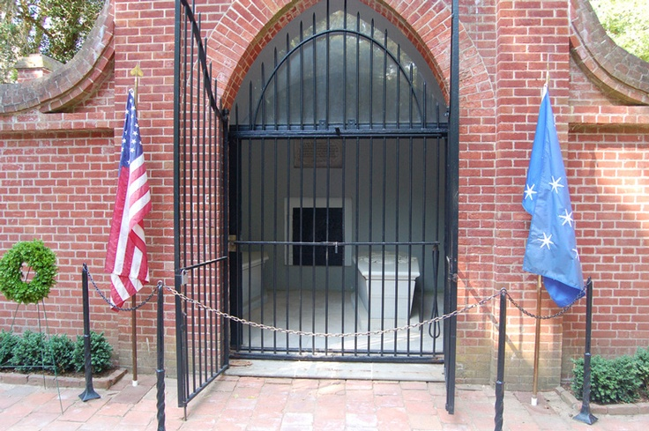
Tomb of George Washington
(First President of USA until 1797)
Notes:
George Washington (February 22, 1732 [O.S. February 11, 1731][b][c] – December 14, 1799) was the first President of the United States (1789–97), the Commander-in-Chief of the Continental Army during the American Revolutionary War, and one of the Founding Fathers of the United States. He presided over the convention that drafted the current United States Constitution and during his lifetime was called the "father of his country".[4]
Widely admired for his strong leadership qualities, Washington was unanimously elected president in the first two national elections. He oversaw the creation of a strong, well-financed national government that maintained neutrality in the French Revolutionary Wars, suppressed the Whiskey Rebellion, and won acceptance among Americans of all types.[5] Washington's incumbency established many precedents, still in use today, such as the cabinet system, the inaugural address, and the title Mr. President.[6][7] His retirement from office after two terms established a tradition that lasted until 1940, when Franklin Delano Roosevelt won an unprecedented third term. The 22nd Amendment (1951) now limits the president to two elected terms.

Slide 19
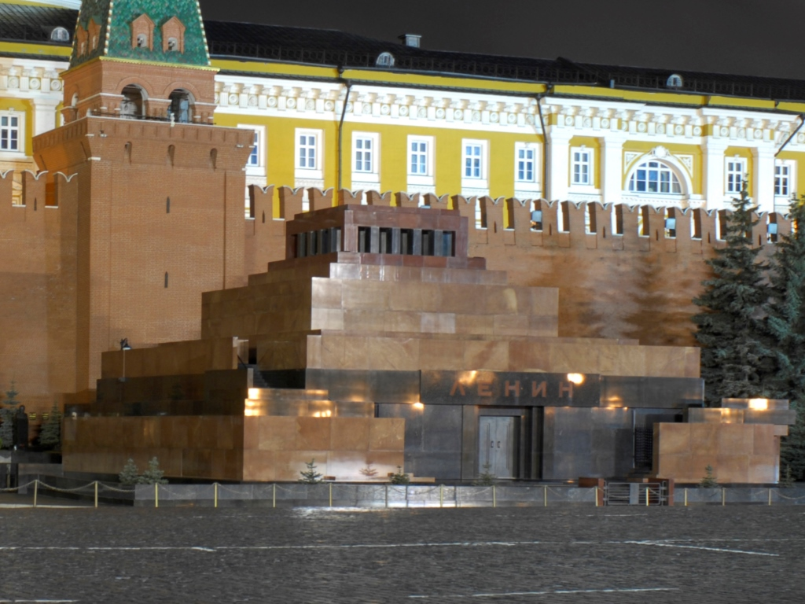
Tomb of Vladimir Lenin
(Leader of Soviet Union until 1924)
Notes:
Lenin's Mausoleum (Russian: Мавзоле́й Ле́нина, tr. Mavzoléy Lénina; IPA: [məvzɐˈlʲej ˈlʲenʲɪnə]), also known as Lenin's Tomb, situated in Red Square in the center of Moscow, is the mausoleum that serves as the current resting place of Vladimir Lenin. His embalmed body has been on public display there since shortly after his death in 1924 (with rare exceptions in wartime). Aleksey Shchusev's diminutive but monumental granite structure incorporates some elements from ancient mausoleums, such as the Step Pyramid and the Tomb of Cyrus the Great.

Slide 20
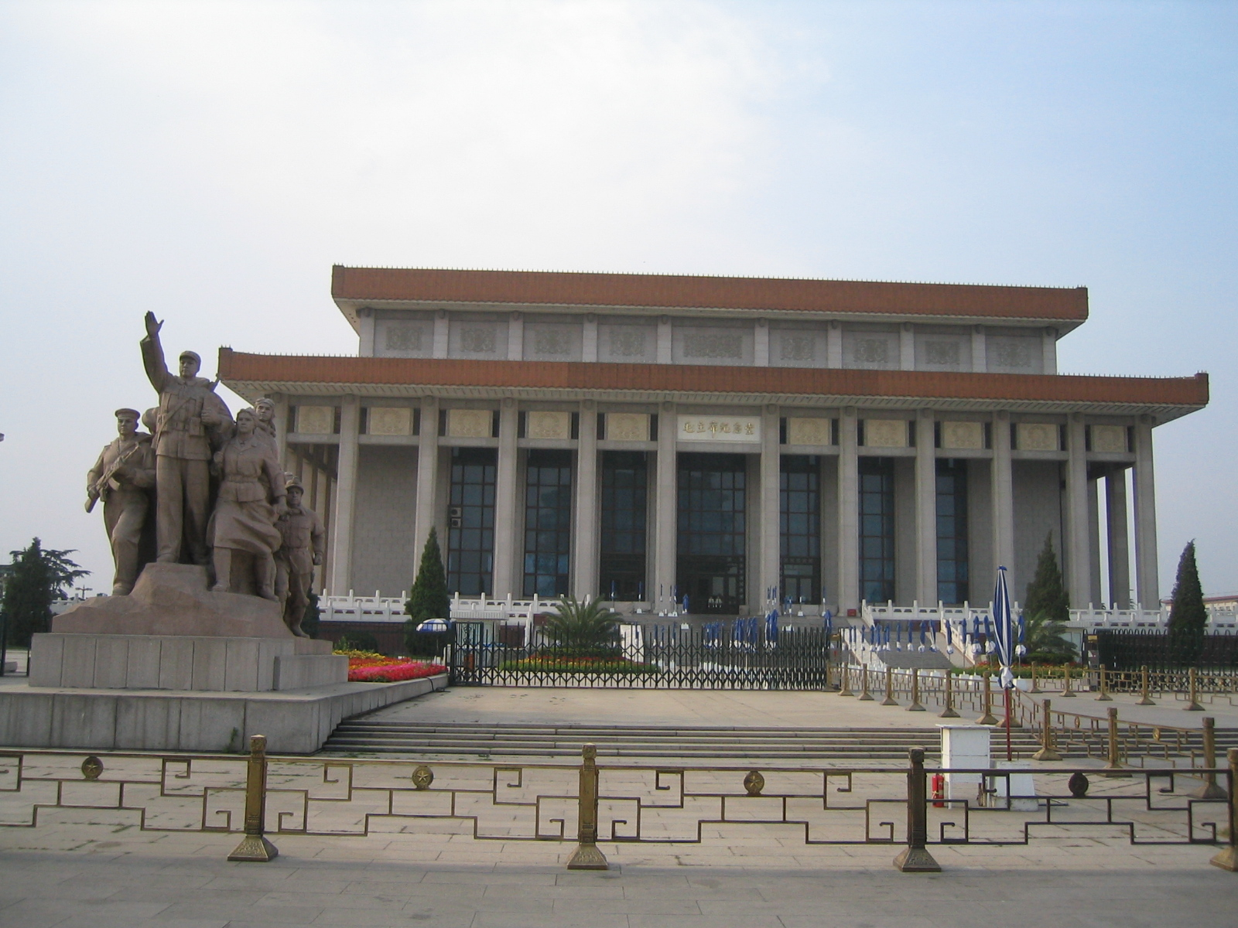
Tomb of Mao Zedong
(Founder of Peoples Republic of China)
Notes:
Mao Zedong (Listeni/ˈmaʊ zəˈdʊŋ, dzə-/), also transliterated as Mao Tse-tung and commonly referred to as Chairman Mao (December 26, 1893 – September 9, 1976), was a Chinese Communist revolutionary and the founding father of the People's Republic of China, which he governed as Chairman of the Communist Party of China from its establishment in 1949 until his death in 1976. His Marxist–Leninist theories, military strategies, and political policies are collectively known as Marxism–Leninism–Maoism or Mao Zedong Thought.

Slide 21
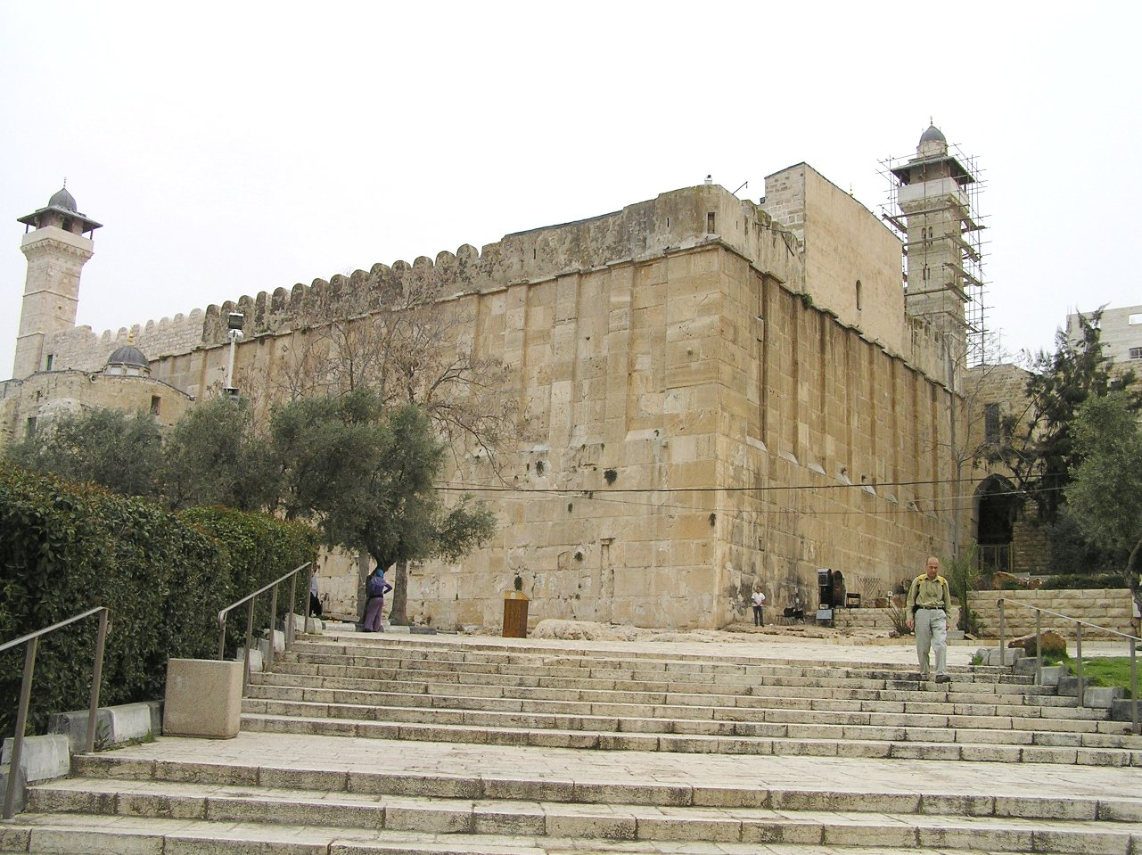
Tomb of Abraham, Isaac, and Jacob
(Founders of Judaism)
Photo by Eman, 2007
Notes:
Abraham (a.k.a. Abram) is generally considered the founder of Judaism. His burial is related in Genesis 25:7-10, "And his sons Isaac and Ishmael buried him in the cave of Machpelah, in the field of Ephron". Moses is also sometimes credited with founding Judaism when the Torah was written.
The exact location of the grave of Moses is unknown, but according to Deuteronomy 34:6 it is on or near Mount Nebo just east of the Jordan river, now in the kingdom of Jordan.
The Cave of the Patriarchs is located in the ancient city of Hebron (which lies in the southwest part of the West Bank, in the heart of ancient Judea), and is generally considered by Jews, Christians, and Muslims to be its spiritual center. Jewish, Christian, and Islamic tradition holds that the compound encloses the burial place of four Biblical couples: Adam and Eve; Abraham and Sarah; Isaac and Rebekah; Jacob and Leah. According to Midrashic sources, it also contains the head of Esau, the brother of Jacob.

Slide 22
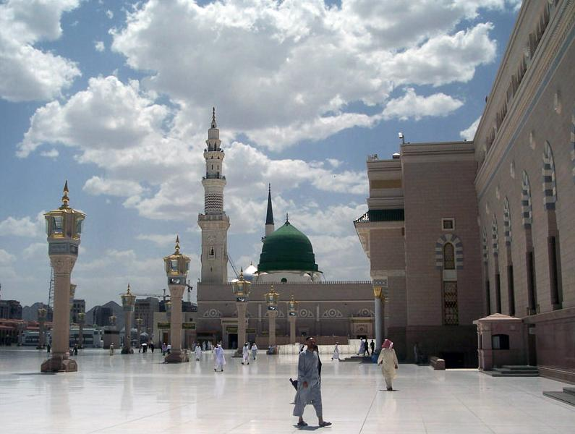
The Green Dome – tomb of Muhammad
(founder of Islam)
Photo by Noumenon, 2006
Notes:
Muhammad is buried in the Al-Masjid an-Nabawi ("Mosque of the Prophet") in the city of Medina in Saudi Arabia. Muhammad's grave lies within the confines of what used to be his wife Aisha's and his house. During his lifetime it adjoined the mosque, which was expanded during the reign of Caliph al-Walid I to include his tomb.[2] The first two caliphs, Abu Bakr and Umar, are buried next to Muhammad. Umar was gifted a spot next to Muhammad by his wife Aisha, which she had intended for herself.
Muhammad's grave itself cannot be seen as the area is cordoned off by a gold mesh and black curtains. As per Islamic tradition, the grave itself is not embellished or decorated and is two cubits high. The grave is marked by an austere green dome above it, built by the Ottoman Turks, and was earlier white in color. This dome has become universally emblematic of both Muhammad himself, as well as the city of Medina.
Muhammad's grave is an important reason for the particularly high sanctity of the mosque. Millions of visitors come to visit it every year because it is traditional to visit the mosque when going on the pilgrimage to Mecca.

Slide 23
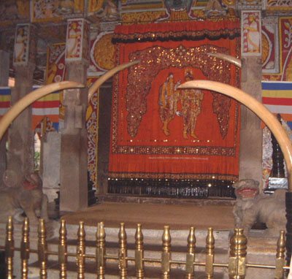
Temple of the Tooth of Buddha
(contains some remains from Buddha)
Photo by Jimfbleak, 2010
Notes:
The Buddha's body was cremated and the relics were placed in monuments or stupas, some of which are believed to have survived until the present. For example, the Temple of the Tooth or Dalada Maligawa in Sri Lanka is the place where the right tooth relic of Buddha is kept at present.

Slide 24
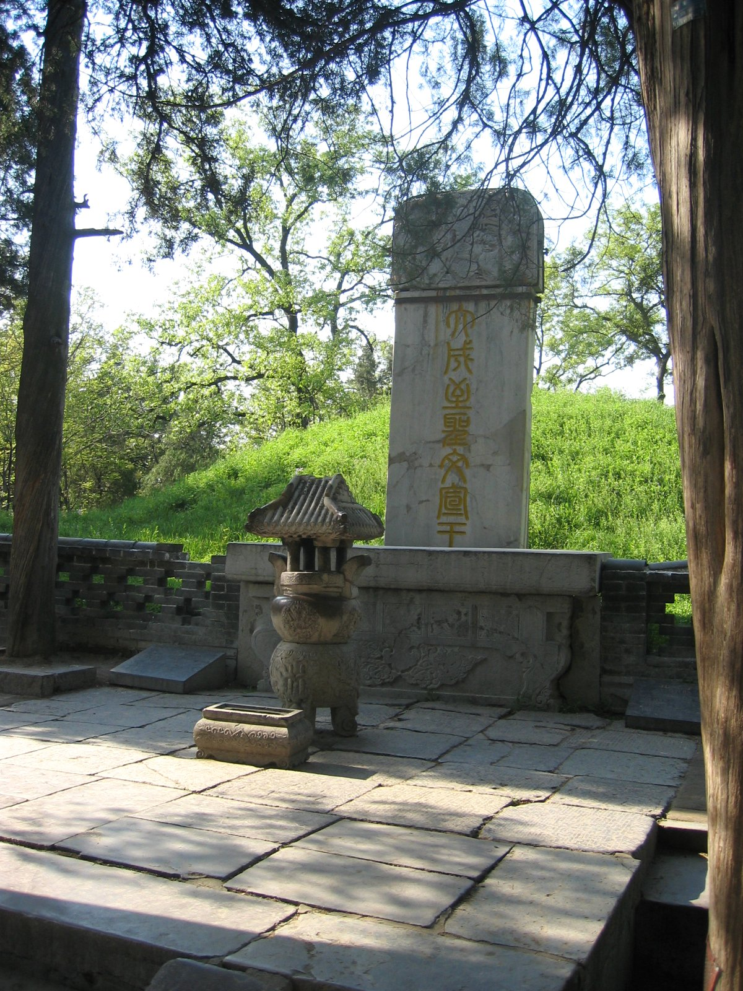
Tomb of 孔子 (Confucius)
(in Qufu, Shandong Province)
Photo by Rolf Mueller, 2005
Notes:
The grave of Confucius (Kǒngzǐ), founder of Confucianism, is in his home town of Qufu, Shandong Province, China. The grave of Confucius is located in a large cemetery where more than 100,000 of his descendants are also buried.

Slide 25
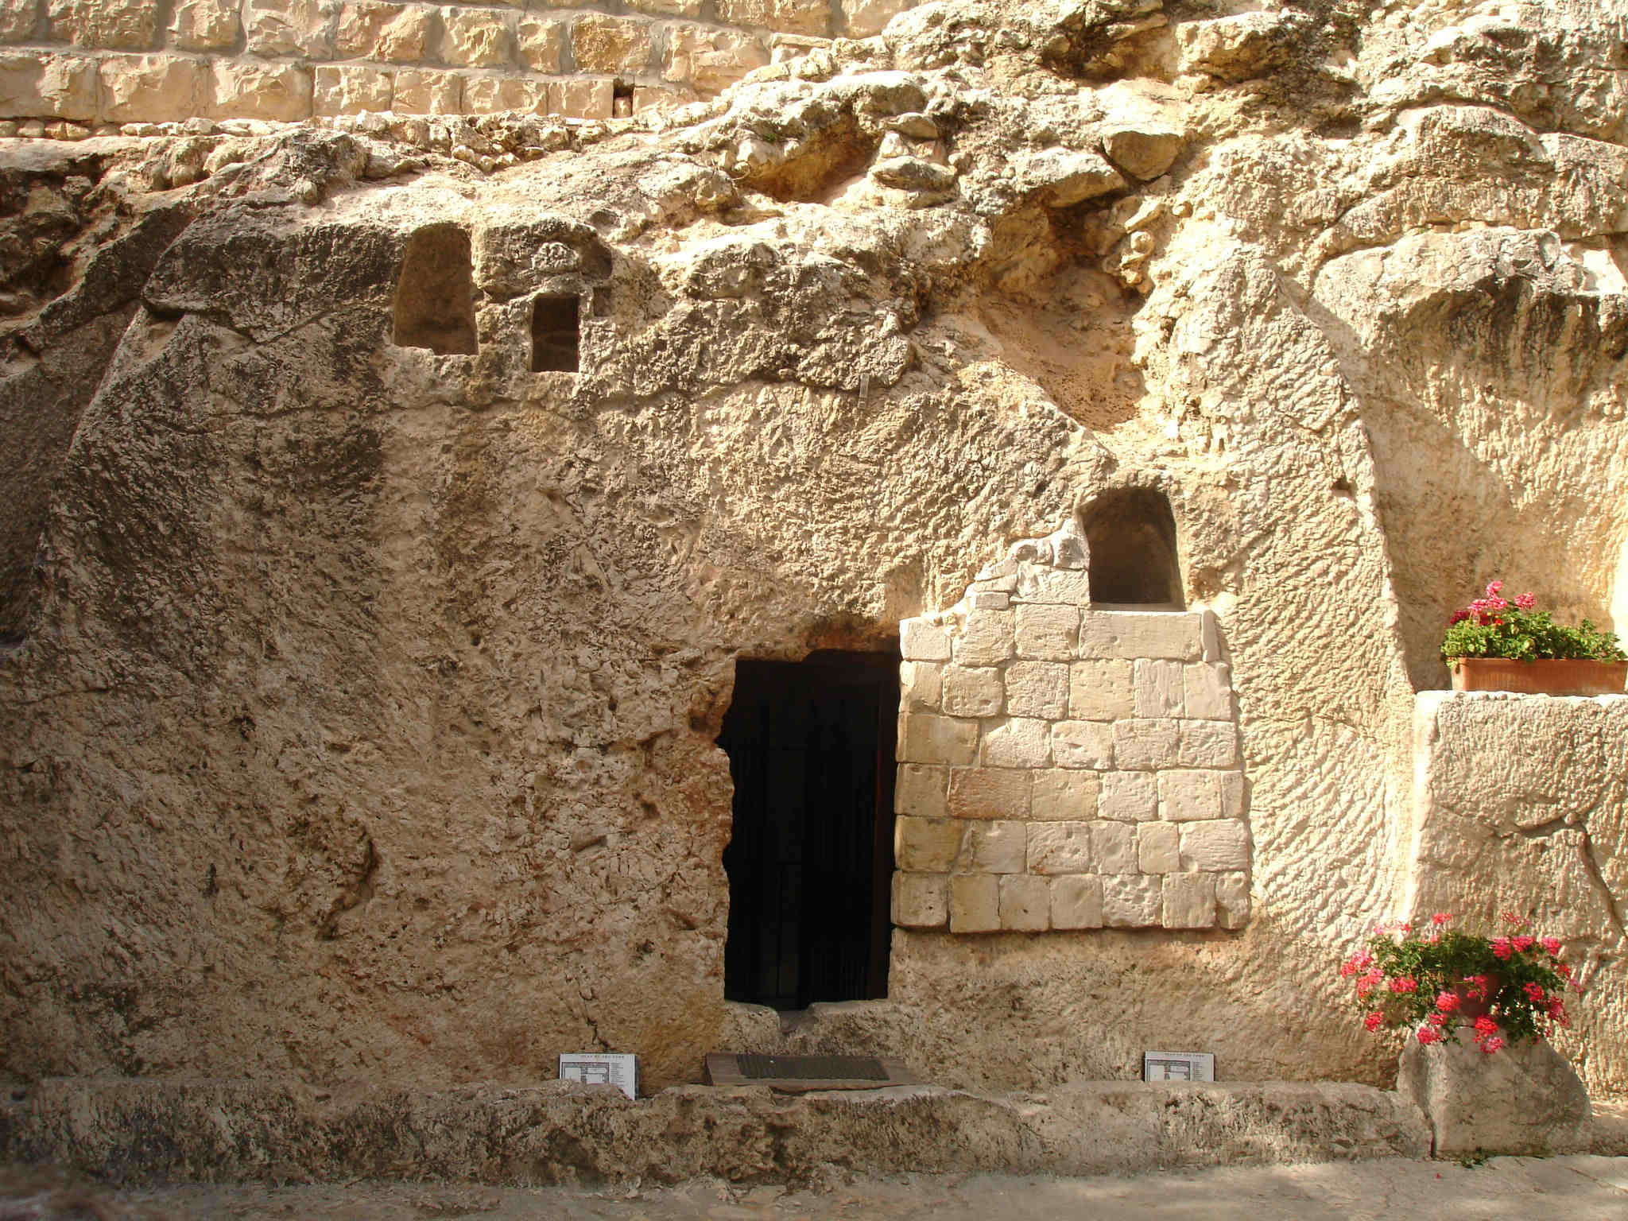
Tomb of Jesus?
(Founder of Christianity)
Photo by Cambene, 2008
Notes:
“When someone famous dies, their grave is memorialized. When a famous religious leader dies, their grave is enshrined.” (Mark Driscoll)
Because Jesus rose from the grave, His tomb was no longer significant to His followers. It was not preserved and did not become a place of worship. Although people speculate about which tomb might have been His “short term burial spot,” no one is really sure.
No religious figure in history has made the claims that Jesus made with the authority and hard proof to back it up. And no other religious figure in history has proved his authority over life and death by dying and coming back to life.

Slide 26
The tomb was empty
The Jewish leaders never disproved the empty tomb – they just made up an impossible story, claiming that while the Roman guards were sleeping, Jesus’ followers came and stole the body (Matthew 27:62; 28:2-4,11-15)
Why was the stone was removed? So that we could look in and believe (He had power to pass through closed doors…)
As Peter preaches about the resurrection of Jesus 50 days later, 3000 people believe (Acts 2:32,41)! They were just a short walk from the tomb and could easily go to check it out.
Even some of the Pharisees who initially spread the lies became believers. (Acts 15:5)
When famous people die, their grave is made into a monument or temple. But since Jesus’ tomb was empty, it was quickly forgotten (and probably reused).
Notes:
Perhaps the most convincing evidence to me was the response of the Jewish leaders who had Him killed in the first place (Matthew 27:62,62; 28:2-4,11-15). First, I think that it's interesting that the leaders never did disprove the empty tomb, or the resurrection of Jesus. And as an answer, they circulated a lie to cover for the truth. Have you ever wondered why the stone was removed? It was not so that Jesus could get out – it was so that we could look in and believe.
It’s also helpful to see the response of people just a short time after they saw Him die on the cross. As Peter preaches the truth about the resurrection of Christ at Pentecost, 3000 people believe (Acts 2:32,41)! And recognize that they were just a short walk from the tomb. I'm sure many who had seen Him die went to check it out (I know I would have). And there in the same city with the empty tomb, many thousand more believe, even some of the Pharisees who initially spread the lies (Acts 15:5). When a famous person or religious leader dies, their grave is made into a beautiful building or monument. But since Jesus’ tomb was empty, it was quickly forgotten (and probably reused).

Slide 27
The disciples were changed
At first, the disciples were hiding behind closed doors in fear (John 20:19 ).
Two months later, Peter stands before the same massive crowd, accuses them of killing Jesus and tells them to repent (Acts 2:22,23) – Why?
“On the evening of that day, the first day of the week, the doors being locked where the disciples were for fear of the Jews, Jesus came and stood among them and said to them, “Peace be with you.” When he had said this, he showed them his hands and his side. Then the disciples were glad when they saw the Lord. Jesus said to them again, “Peace be with you. As the Father has sent me, even so I am sending you.” (John 20:19-21)
They were so strongly convinced about Jesus’ resurrection that each one was willing to die for this truth.
Notes:
I find the transformation of the apostles as one of the unique events to occur after Christ's resurrection. In John 20:19, they were hiding behind closed doors in fear. In John 21:3, they went back to a life of fishing. But in Acts 2:22,23, Peter boldly accuses the same massive crowd that condemned Jesus of killing the Messiah, and instructed them to repent. What changed their minds? Acts 1:3,8 gives a good reason – they were instructed and empowered by the risen Christ to go and preach the gospel. And they believed it so strongly that each one was willing to die for this truth.

Slide 28
Worship shifted to Sunday
Mark 3:2 The last day of the week (Saturday) was strongly revered by Jews as the day of worship and rest for 1000+ years.
Acts 20:7 Christian Jews quickly shifted to worshiping on resurrection Sunday – “The Lord’s Day”
Other than the resurrection, historians have no other rational explanation as to why thousands of people would quickly shift over to worship on the first day of the week.
Notes:
Speaking of the resurrection, historians have devised no other rational explanation why thousands of people who had staunchly observed the Sabbath for centuries would quickly shift over to worship on the first day of the week (Acts 20:7).

Slide 29
Post-resurrection appearances
Many times the Bible speaks of appearances that Christ made following His resurrection, for example:
“He presented himself alive to them after his suffering by many proofs, appearing to them during forty days and speaking about the kingdom of God.” (Acts 1:3)
“Christ died for our sins in accordance with the Scriptures, he was buried, he was raised on the third day in accordance with the Scriptures, and he appeared to Peter, then to the twelve. Then he appeared to more than five hundred brothers at one time, most of whom are still alive, though some have fallen asleep.” (1 Corinthians 15:6)
One sad person might imagine that a loved one has returned from the dead, but 500 witnesses are enough to convince a court of law, transform the city of Jerusalem, and eventually, change the entire world.
Notes:
Many times the Bible speaks of appearances that Christ made following His resurrection, and they're well summarized by Paul in 1 Corinthians 15:6. He claims that Christ appeared to over 500 people, and says that most of them were still alive at the time of his writing. Many people today would dismiss reports of Christ's post resurrection appearances as dreams by people with a strong desire to see Him. While a single, sad person might imagine (or hallucinate) that a loved one has returned from the dead, 500 witnesses are enough to convince a court of law, and were enough to transform the city of Jerusalem (and the entire world).

Slide 30
The Resurrection Arguments
Reasons to doubt | Reasons to believe
I didn’t see it with my own eyes | Prophecy foretold that it would happen
People in 33 AD were easier to trick | The bodily resurrection was a unique claim
The Bible only gives a one-sided legend | The tomb was empty
Jesus really didn’t die on the cross | The disciples were changed
Jesus wasn’t really buried in the tomb | Worship shifted to Sunday
Jesus’ body was stolen from the tomb | Post resurrection appearances
Notes:
Ladies and gentlemen of the jury, the decision is up to you. I hope that you will agree that there is reasonable proof that He actually did rise from the grave. This is not a small decision, but a decision of life and death. Don’t make it lightly. Acceptance of Jesus’ resurrection is an amazing thing - it permits us to have a relationship with a risen Savior. God calls us to believe something that we did not see (faith), but doesn’t leave us without evidence. Faith in the person of Christ and in His resurrection is the most important faith you will ever have (Romans 10:8,9).

Slide 31
So What?
The Christian hope is based on an historical fact.
We have the amazing privilege of praying to a risen, living Savior!
There is reasonable evidence that Jesus actually did rise from the grave.
God calls us to believe something that we did not see (faith), but doesn’t leave us without evidence.
Faith in Jesus and in His resurrection is the most important faith you can have (Romans 10:8,9).
Notes:
Research also shows that there is benefit to being a part of a religious community. Religious people tend to have better careers, healthier marriages, and longer lives. Our ability to believe in something is a very powerful ability – something that helps people succeed and change the world.
But regardless of your happiness or success, at the end of your life, only one thing really matters – is it true? Did I build my life around a myth or was my belief grounded on truth?

