Slide 1
Family Relationships:
Parents and Children
Honor and Respect

Slide 2
How can Parents and Adult Children Respect Each Other?
How does the Parent-Child relationship change as we age?
What “stress points” can exist between Parents and their adult children?
What does Respect look like?
How is the Parent-Child relationship affected if I become a Christian?

Slide 3
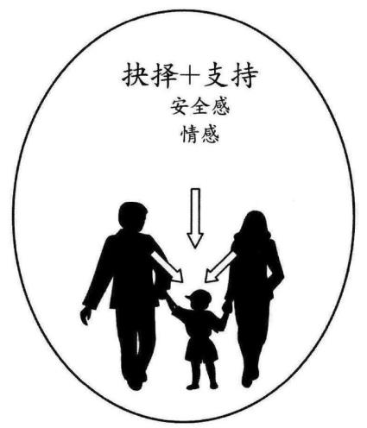
Parents and Young Children
Meet our physical and emotional needs
Set appropriate boundaries and make wise decisions
Provide stability and good role models
Show unconditional love
Decisions + Support
Encouragement
Affection
Comfort
Security
From “The Marriage Course”, 2015 Alpha International, London, UK

Slide 4
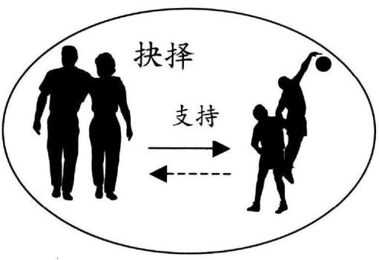
Parents and Teenage Children
Give increasing independence: allow decisions and failure
Continue meeting physical and emotional needs
Set appropriate boundaries
Teach us about their needs and start to give something back
Decisions
Support
From “The Marriage Course”, 2015 Alpha International, London, UK

Slide 5
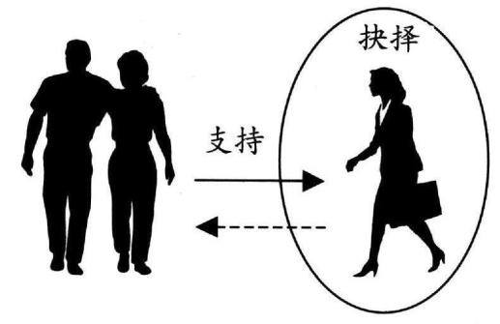
Parents and College/Young Adult Children
Give support and advice
Allow independence and encourage us to make our own big decisions
Make transition into adult relationships
Decisions
Support
From “The Marriage Course”, 2015 Alpha International, London, UK

Slide 6
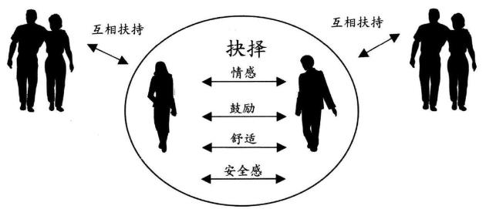
Parents and Newly Married “Children”
Establish new decision-making structures
Parents relate to “we” not “me”
Set appropriate boundaries to build marriage unity while supporting needs of parents
Mutual Support
Mutual Support
Decisions
affection
encouragement
“Therefore a man shall leave his father and his mother and hold fast to his wife, and they shall become one flesh.”
Genesis 2:24
comfort
security
From “The Marriage Course”, 2015 Alpha International, UK

Slide 7
Parents and Adult Children
Possible “stress points”
Children cannot discuss issues in a way that brings understanding and mutual respect
Education is king – everything else must wait.
Pressure to marry a certain person and have a child.
Pressure to buy a house and remain within parent’s social community.
Parents unfavorably compare you with others
Pressure to seek a prestigious career (or a stable job) that brings pride (or security) to parents.
Constant, guilty reminders of duty and obligation.
Pressure to “do what is expected,” not “do what seems right to me”
Something else…?
Notes:
Before we examine some Bible passages, I want to ask you this: In your culture, what is generally expected about how parents relate to their children (and vice versa)? In your family, what specific things might have been different vs. general cultural expectations?
What things do your parents need the most from you? Advice, Companionship, Conversation, Encouragement, Practical Help, Security, Understanding, Other Needs?

Slide 8
Culture and the Bible
Shame-honor cultures describe collectivistic cultures (common in the East), where people are shamed for not fulfilling group expectations and seek to restore their honor before the community.
Guilt-innocence cultures are individualistic societies (mostly Western), where people who break the laws are guilty and seek justice or forgiveness to rectify a wrong.
Fear-power cultures refer to animistic contexts (typically tribal), where people afraid of evil and harm pursue power over the spirit world through magical rituals.
Israel and Bible
Notes:
I want to remind you that the Bible was written in an ancient Asian culture (not a modern Western one). In those days and in that culture, children were under absolute obligation to do whatever their parents told them. According to Dionysius of Halicarnassus, a historian at the time of the early church, fathers could imprison, enslave, scourge, or kill their children under Roman law, regardless of the child’s age. Just when you thought your parents had excessive control over their children, recognize that it could be worse!

Slide 9
The Ten Commandments : Exodus 20
Verse 3: You shall have no other gods before Me
Verses 4-6: You shall not make and worship idols
Verse 7: You shall not misuse the name of God
Verses 8-10: Remember the Sabbath day, to keep it holy
Verse 12: Honor your father and mother
Verse 13: You shall not murder
Verse 14: You shall not commit adultery
Verse 15: You shall not steal
Verse 16: You shall not lie
Verse 17: You shall not covet
Notes:
If you turn to Exodus 20, you will quickly recognize the Ten Commandments in this passage. Notice that the first four commandments are focused on our relationship to God. The second six commandments focus on our relationship to people. Notice that the very first command has to do with the relationship between children and parents. By putting this command to honor father and mother in the front of the passage, it is obviously giving it a very high level of importance. The key to social stability is respect for parents and their authority.

Slide 10
Children’s Responsibility
“Honor your father and your mother, so that you may live long in the land the LORD your God is giving you.” Exodus 20:12
“Children, obey your parents in the Lord, for this is right. “Honor your father and mother” — which is the first commandment with a promise — “so that it may go well with you and that you may enjoy long life on the earth.” Ephesians 6:1-3
Notes:
But we can’t stop here and be true to the Bible. Look at Ephesians 6:1-3. The passage begins by reminding the child of their obligation to obey and honor their parents, consistent with the truth taught throughout the Bible. But it also includes the important phrase “in the Lord.” What does this mean? Note that Paul is writing this letter to the church – to Christians. When he writes this command, he is assuming that the requests of parents to their children will be consistent with scriptural principles and oriented to kingdom priorities.

Slide 11
“Children’s” Responsibility
“He [Jesus] also said to them, “You completely invalidate God’s command in order to maintain your tradition! For Moses said: Honor your father and your mother; and Whoever speaks evil of father or mother must be put to death.” Mark 7:9-10
“But you say, ‘If a man tells his father or mother: Whatever benefit you might have received from me is Corban’ (that is, a gift committed to the temple), you no longer let him do anything for his father or mother.”
“You revoke God’s word by your tradition that you have handed down. And you do many other similar things.” Mark 7:11-13
Notes:
Jesus had some strong words to say against the religious leaders of His day because of their lack of respect for their parents. In Mark 7:9-13, Jesus criticized the leaders for using their religious tradition to avoid taking care of their parents. They decided that if they dedicated land, property, or money to God for use in the temple, it could not be used to take care of their parents. They used this excuse of the “Corban” tradition to avoid obedience to God’s command of honoring parents.

Slide 12
What does Honor/Respect look like?
Looks like this:
Not like this:
Be polite in words, attitudes and actions.
Listen carefully to words and emotions, ask questions, and think before speaking.
Be helpful, always being ready to lend a hand in big and small ways.
Accept wise counsel, being ready to change your plan and try something new.
Try to resolve issues, forgive and forget.
Protect the dignity of others.
Love people – use things.
Ignoring higher social position.
Disrespectful behaviors (e.g. rolling eyes, interrupting, or ignoring).
Anger, bitterness, complaining and shouting.
Refusing to listen to counsel.
Critical “behind the back.”
Love things – use people.

Slide 13
Parent’s Responsibility
“Love the LORD your God with all your heart and with all your soul and with all your strength. These commandments that I give you today are to be on your hearts. Impress them on your children. Talk about them when you sit at home and when you walk along the road, when you lie down and when you get up.” Deuteronomy 6:5-7
“Fathers, do not exasperate your children; instead, bring them up in the training and instruction of the Lord.” Ephesians 6:4
Notes:
The relationship between children and parents was not entirely one-sided, but the parents also have a strong responsibility to their children. Deuteronomy 6:4-9 commands the parents to take the law of God into their hearts and train up their children in His ways. It was not just an occasional activity, but one that must saturate every area of life.
In Ephesians 6:4, he goes on to give further instruction to fathers: do not exasperate your children, but bring them up in the training and instruction of the Lord.” Not only should a father care about what a child does, be he must also be concerned about how the child feels. It’s not enough to simply have your child’s obedience, a father must also be concerned about his heart. Imagine the amount of cultural stress that these words introduced during those days!

Slide 14
12 Year Old Jesus (Luke 2:41-51)
“Every year Jesus’ parents went to Jerusalem for the Festival of the Passover. When he was twelve years old, they went up to the festival, according to the custom. After the festival was over, while his parents were returning home, the boy Jesus stayed behind in Jerusalem, but they were unaware of it.”
“Thinking he was in their company, they traveled on for a day. Then they began looking for him among their relatives and friends. When they did not find him, they went back to Jerusalem to look for him. After three days they found him in the temple courts, sitting among the teachers, listening to them and asking them questions.
“Everyone who heard him was amazed at his understanding and his answers. When his parents saw him, they were astonished. His mother said to him, “Son, why have you treated us like this? Your father and I have been anxiously searching for you.”
“Why were you searching for me?” he asked. “Didn’t you know I had to be in my Father’s house?” But they did not understand what he was saying to them.”
“Then he went down to Nazareth with them and was obedient to them. But his mother treasured all these things in her heart.”
Notes:
Let’s look at an interesting example of this early in the life of Jesus. We don’t have very many stories about Jesus as a child, but Luke 2 provides an interesting contrast. Notice that, without telling his parents, he stayed in the temple and interacted with the teachers (verses 41-48). His mother was obviously upset with Him, criticizing Him for how He had treated them. But Jesus explains his reason and purpose in verse 49: He put priority on God’s work before obedience to His parents. However, in the very next verse, (51), notice that Jesus was obedient to His parents (even though I’m sure they asked Him to do some things that He probably knew weren’t perfect).

Slide 15
30+ Year Old Jesus
“Then Jesus entered a house, and again a crowd gathered, so that he and his disciples were not even able to eat. When his family heard about this, they went to take charge of him, for they said, “He is out of his mind.” Mark 3:20-21
“Then Jesus’ mother and brothers arrived. Standing outside, they sent someone in to call him. A crowd was sitting around him, and they told him, “Your mother and brothers are outside looking for you.” Mark 3:31-32
“Who are my mother and my brothers?” he asked. Then he looked at those seated in a circle around him and said, “Here are my mother and my brothers! Whoever does God’s will is my brother and sister and mother.” Mark 3:33-35
Notes:
Let’s look at another example of how Jesus related to his mother, this time when he was an adult (30+ years old). Because of the power of Jesus, He would always draw a crowd and have plenty of work to do. In Mark 3:20,21, Jesus’ earthly family came to “rescue Him” from His overworked schedule, assuming that “He is out of His mind.” They obviously didn’t recognize the reality of who He was – the almighty Son of God. Eventually, they get a message through the crowd (verses 31-35). And His response is clear: there is something more important than physical family relationships: spiritual family relationships.

Slide 16
Jesus on the Cross
“Standing by the cross of Jesus were His mother, His mother’s sister, Mary the wife of Clopas, and Mary Magdalene. “
“When Jesus saw His mother and the disciple He loved standing there, He said to His mother, ‘Woman, here is your son.’ Then He said to the disciple, ‘Here is your mother.’”
“And from that hour the disciple took her into his home.” John 19:25-27
Notes:
I don’t want you to think about Jesus as disrespectful to His mother – He was simply clear about the distinction between obedience to God and honoring his mother. Even as He is dying on the cross in John 19:25-27, Jesus shows respect for His mother by asking John to take care of her.

Slide 17
If a person is a Christian…
“Now great crowds accompanied him, and he turned and said to them, ‘If anyone comes to me and does not hate his own father and mother and wife and children and brothers and sisters, yes, and even his own life, he cannot be my disciple.’” Luke 14:25-26
“No one can serve two masters, for either he will hate the one and love the other, or he will be devoted to the one and despise the other. You cannot serve God and money.” Matthew 6:24
“And whoever does not carry their cross and follow me cannot be my disciple.” Luke 14:27
Notes:
We see that large crowds of people were following Jesus. There is no question that these people were interested in what Jesus said and what He did. But the larger question was this: were they really willing to put their faith in Him? With that context, Jesus is about to say some very difficult words.
Verse 26 challenges our understanding of what the Bible says about loving and honoring our family. How can He tell us to hate the very ones that He has commanded us to love? Jesus is using some very strong words here to make a very important point. Look at Matthew 6:24. Money has a very strong power over people, quickly attracting their love and devotion. Jesus is saying that we cannot serve God and money, because we will love one and hate the other. He uses the same word in Luke 14:26, telling His followers that they must clearly establish the top priorities in life. If we don’t do that, we will constantly struggle to be fully surrendered followers of Christ.
When we consider the important things in our lives, we could probably put them into three categories: our family, ourselves, and our things. Most of the important decisions that we make focus in these three areas. We try to do the best we can to serve and care for our families. We try to educate ourselves and pursue excellence in our careers. And we try to use our money wisely to get and use good things.
In verse 26, this is what Jesus is saying: “If you want to be My disciple (not just a disciple), do not expect Me to have one equal voice in the management of your life. You must be fully devoted to Me as your top priority.” No relationship, no matter how important or wonderful, must compete with my allegiance to the Lord.
He goes even further in verse 27. This picture was very clear to every first-century Jew under the authority of the Romans. A person carrying a cross was on his way to execution. He was not a person living for his own comfort and convenience. What Jesus is saying is this: “If you want to be My disciple, your life will be shaped by My mission, not your own personal goals.”

Slide 18
If a person is a Christian…
“As Jesus walked beside the Sea of Galilee, he saw Simon and his brother Andrew casting a net into the lake, for they were fishermen. “Come, follow me,” Jesus said, “and I will send you out to fish for people.” At once they left their nets and followed him.” Mark 1:16-18
“When he had gone a little farther, he saw James son of Zebedee and his brother John in a boat, preparing their nets. Without delay he called them, and they left their father Zebedee in the boat with the hired men and followed him.” Mark 1:19-20
When we follow Jesus, He may call us to something different (and in a different place) than our parents.
Notes:
But when we ask Jesus to be our Lord and Savior, He becomes the One that guides our decisions. Look at Mark 1:19-20 for every Asian parent’s nightmare: Jesus calls James and John to follow Him and they leave their family business and their father. They didn’t leave him helpless (there were still hired men to do the work), but when Jesus called them, they chose to follow, probably contrary to their father’s career expectations.

Slide 19
If a person is a Christian…
“Therefore, if anyone is in Christ, he is a new creation; old things have passed away, and look, new things have come.” 2 Corinthians 5:17
“But the fruit of the Spirit is love, joy, peace, patience, kindness, goodness, faith, gentleness, self-control. Against such things there is no law.” Galatians 5:22-23
Your parents should see good difference in your life!
Notes:
So, with that as background, how to we relate to our parents and their expectations of us? First, recognize that when a person becomes a Christian, God changes them into a new person (2 Corinthians 5:17). They begin to show the fruit of the Spirit in their life as described in Galatians 5:22-23. When we believe in Jesus, the way that we treat our parents should be a great improvement, in actions and in attitude. It should be noticeably different, a difference that blesses our parents.

Slide 20
Is the Price Too High?
“The kingdom of heaven is like treasure hidden in a field. When a man found it, he hid it again, and then in his joy went and sold all he had and bought that field.” Matthew 13:44
Imagine how this man’s family thought about his behavior?
“Again, the kingdom of heaven is like a merchant looking for fine pearls. When he found one of great value, he went away and sold everything he had and bought it.” Matthew 13:45-46
Your family might be thinking, “Don’t be so strange! Just live like everyone else!”
Notes:
Just in case you missed it, these parables are telling us that the cost of being a Christian is very high. You might be wondering, “Is there anything worth such a high cost?”. To answer that question, let’s look at two more very short parables in Matthew 13:44-46. Just in case you didn’t figure this out, both stories are about the same treasure. They are both describing how different people find the most valuable treasure of all – the gift of eternal salvation offered by Jesus Christ. This is not telling us how we earn the privilege of becoming a child of God. Our personal sacrifice can never achieve His forgiveness and gift of eternal life. It is describing how we receive this great treasure, a treasure that He bought for us by His sacrifice.
Take a minute and consider how strange the man in the first story might have looked to his family. He is quickly selling everything he has, probably for low prices, just to buy a regular looking field. They probably thought that he was crazy. Why was he willing to do something so serious? Why not just live like everyone else?

Slide 21
Some closing thoughts…
The Bible is clear: Honor your parents and obey them in the Lord.
When you become a Christian, your parents should see a wonderful difference in your life. They should feel more love and respect, not grumbling obedience.
When you become a Christian, you have a new Lord.
If you ever feel that you must choose between obedience to Jesus or obedience to your parents, be careful! Spend time in prayer, study the Bible, and seek counsel from mature Christians.
Notes:
In closing, I’d like to remind you that the Bible makes it clear: we should honor our parents “in the Lord.” As we’ve said before, when a person becomes a Christian, he/she should become a much better son/daughter, with a new love and new spirit. The parents should see a difference in your life. But you also have a new Lord.
Don’t make the same mistake that the Jewish religious leaders made – elevating their religious traditions above the commandment of God to honor parents. We must exercise great care before assuming that our parents’ guidance conflict with God’s commands. A genuine conflict does not exist unless our parents’ demands contradict God’s desire for an immediate, specific, and absolute response (e.g. Worship and follow Christ).
When you feel you must choose between obedience to Christ and obedience to parents, be very careful. Recognize that our attitudes and decisions can often be clouded by our own resentments, desires, and passions. So before making any decisions, spend plenty of time in prayer, carefully study the Scriptures, and seek counsel from mature believers of all cultural backgrounds and ages.

