Slide 1
Is God in Control of Everything?
If so, how should we think about Planning and Prayer?

Slide 2
Some starting thoughts
“Any concern too small to be turned into a prayer is too small to be made into a burden.” Corrie Ten Boom
“I have so much to do that I shall have to spend the first three hours [of the day] in prayer.” Martin Luther
“If there is one maverick molecule in all the universe, then God is not sovereign. And if God is not sovereign, He is not God.” R.C. Sproul

Slide 3
Vocabulary Words
Eternal: existing for all time, without beginning or end ( )
Everlasting: never ending ( )
Sovereign: having total authority or power

Slide 4
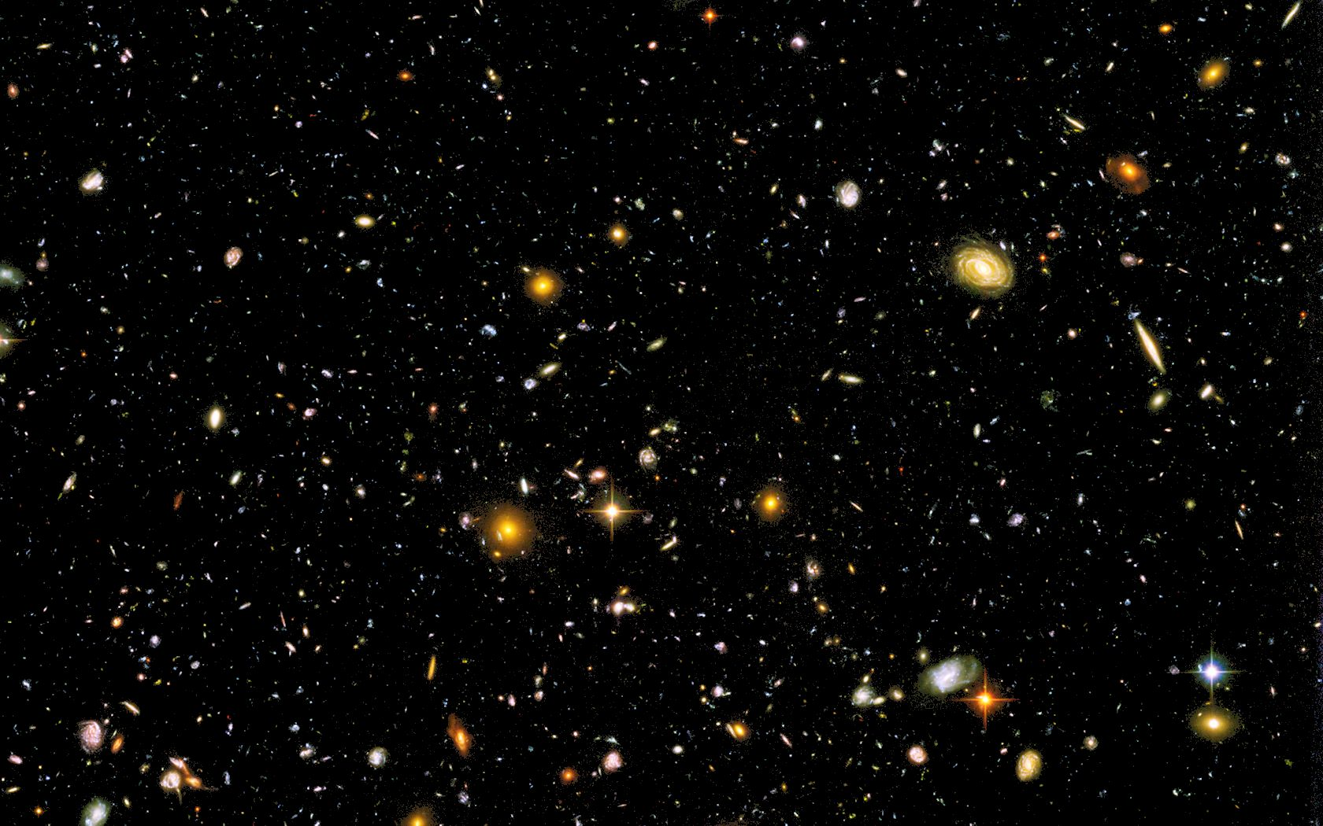
God Created Space and Time
(from our last study)
“For thus says the One who is high and lifted up, who inhabits eternity, whose name is Holy” Isaiah 57:15
“in the hope of eternal life, which God, who does not lie, promised before the beginning of time,” Titus 1:2
“But you, Daniel, roll up and seal the words of the scroll until the time of the end.” Daniel 12:4
Eternity
Beginning
End
Notes:
Time is that dimension in which cause and effect phenomena take place. (Hugh Ross, The Creator and the Cosmos)

Slide 5
God Sees All History at Once
Eternity
Beginning
End
“I make known the end from the beginning, from ancient times, what is still to come. I say, ‘My purpose will stand, and I will do all that I please.” Isaiah 46:10
“With the Lord a day is like a thousand years, and a thousand years are like a day.” 2 Peter 3:8

Slide 6
God’s Absolute Knowledge
“You have searched me, LORD, and you know me. You know when I sit and when I rise; you perceive my thoughts from afar. You discern my going out and my lying down; you are familiar with all my ways. Before a word is on my tongue you, LORD, know it completely.” Psalm 139:1-4
“And even the very hairs of your head are all numbered.” Matthew 10:30
“Before I formed you in the womb I knew you, and before you were born I consecrated you; I appointed you a prophet to the nations.” Jeremiah 1:5

Slide 7
God’s Sovereign Power
“The LORD foils the plans of the nations; he thwarts the purposes of the peoples. But the plans of the LORD stand firm forever, the purposes of his heart through all generations.” Psalm 33:10,11
“The lot is cast into the lap, but its every decision is from the LORD.” Proverbs 16:33
“Are not two sparrows sold for a penny? Yet not one of them will fall to the ground outside your Father’s care.” Matthew 10:29

Slide 8
God’s Sovereignty in…
Big Things: “Pilate said. ‘Don’t you realize I have power either to free you or to crucify you?’ Jesus answered, ‘You would have no power over me if it were not given to you from above.’” John 19:10,11
Small Things: “Jesus sent Peter and John, saying, ‘Go and make preparations for us to eat the Passover.’ ‘Where do you want us to prepare for it?” they asked. He replied, ‘As you enter the city, a man carrying a jar of water will meet you. Follow him to the house that he enters, and say to the owner of the house, “The Teacher asks: Where is the guest room, where I may eat the Passover with my disciples?” He will show you a large room upstairs, all furnished. Make preparations there.’” Luke 22:8-13 (see also Luke 19:30-32)

Slide 9
God’s Sovereignty in Our Plans
“The heart of man plans his way, but the Lord establishes his steps.” Proverbs 16:9
“Trust in the Lord with all your heart, and do not lean on your own understanding. In all your ways acknowledge him, and he will make straight your paths.” Proverbs 3:5,6
“LORD, I know that people’s lives are not their own; it is not for them to direct their steps.” Jeremiah 10:23
“For you created my inmost being; you knit me together in my mother’s womb. Your eyes saw my unformed body; all the days ordained for me were written in your book before one of them came to be. ” Psalm 139:13,16
Notes:
Matthew 23:37 “Jerusalem, Jerusalem, you who kill the prophets and stone those sent to you, how often I have longed to gather your children together, as a hen gathers her chicks under her wings, and you were not willing.”
2 Peter 3:9 “The Lord is not slow in keeping his promise, as some understand slowness. Instead he is patient with you, not wanting anyone to perish, but everyone to come to repentance. “

Slide 10
How to Think about Plans
Develop plans and use your time wisely, but be ready for God to change your plans:
  “Teach us to number our days, that we may gain a heart of wisdom.” Psalm 90:12
  “Be very careful, then, how you live—not as unwise but as wise, making the most of every opportunity,” Ephesians 5:15,16
Never make a plan apart from God’s leadership and constant involvement:
  “Now listen, you who say, ‘Today or tomorrow we will go to this or that city, spend a year there, carry on business and make money.’ Why, you do not even know what will happen tomorrow. What is your life? You are a mist that appears for a little while and then vanishes. Instead, you ought to say, ‘If it is the Lord’s will, we will live and do this or that.’” James 4:13-15

Slide 11
God’s Sovereignty in Prayer
“As for God, his way is perfect: The LORD’s word is flawless; he shields all who take refuge in him.” 2 Samuel 22:31
“your Father knows what you need before you ask him.” Matthew 6:8
“I know that you can do all things, and that no purpose of yours can be thwarted.” Job 42:2
“For the LORD Almighty has purposed, and who can thwart him? His hand is stretched out, and who can turn it back?” Isaiah 14:27
Question: Since God has all knowledge and perfect plans, why should we pray?

Slide 12
How to Think about Prayer
God doesn’t need us, but allows us to participate in His perfect plans (sharing gospel – Acts 8:26-40; deliverance – Esther 4:12-14; His story – Luke 19:30-32, etc)
God has commanded us to pray and has chosen to use our prayers for His purposes:
  “Do not be anxious about anything, but in every situation, by prayer and petition, with thanksgiving, present your requests to God.” Philippians 4:6
  “Then he said to his disciples, ‘The harvest is plentiful but the workers are few. Ask the Lord of the harvest, therefore, to send out workers into his harvest field.’” Matthew 9:36-38
Our prayers are part of His plan. Be joyful that God has chosen to include your prayers in His plan!

Slide 13
Some Final Thoughts…
When you face something hard, don’t be surprised if you will eventually look back on it and see that it worked together for good.
“And we know that in all things God works for the good of those who love him, who have been called according to his purpose. For those God foreknew he also predestined to be conformed to the image of his Son,” Romans 8:28,29
“But if serving the LORD seems undesirable to you, then choose for yourselves this day whom you will serve … But as for me and my household, we will serve the LORD.” Joshua 24:15

