Slide 1
The Crucifixion and Resurrection of Jesus
Easter 2020

Slide 2
The Bible: a Book of Contrasts
A Pharisee and a Tax Collector
Houses on the Rock and the Sand
Good Soil and Bad Soil
Wheat and Tares
Wide and Narrow Gates
Rich Man and Lazarus
Sinful, Wicked People and Holy, Loving God

Slide 3
Fickle Wicked People
(quickly changing opinion)
Mark 11:8-10 A Joyful Welcome
Mark 15:12-15 Crucify Him!
Mark 15:29-30 Shouting and Cursing
Why?
  He didn’t do what they expected
  Do we get angry when God doesn’t follow our plan?

Slide 4
Ignorant Wicked People
(low value for human life)
Mark 15:16-20 Torture and Mocking
Genesis 3:17-19 Bearing our Curse
Mark 15:24 What can I get for Myself?

Slide 5
Religious Wicked People
(looking good while ignoring truth)
John 11:47-50,53 Silencing the truth
Mark 14:61-65 An illegal trial
Mark 15:31 He saved others, but not Himself
Mark 15:32 Knowing His claims while leading the curses

Slide 6
The Holy, Loving God
(He chose not to save Himself)
Luke 23:34 “Father, forgive them…”
And they were forgiven:
Luke 23:47 From ignorance to belief
Acts 2:36,37 From fickle to faithful
Acts 6:7 From religion to relationship
Romans 5:10 We were His enemies, but are now His children

Slide 7
Burial Places of Famous Leaders

Slide 8
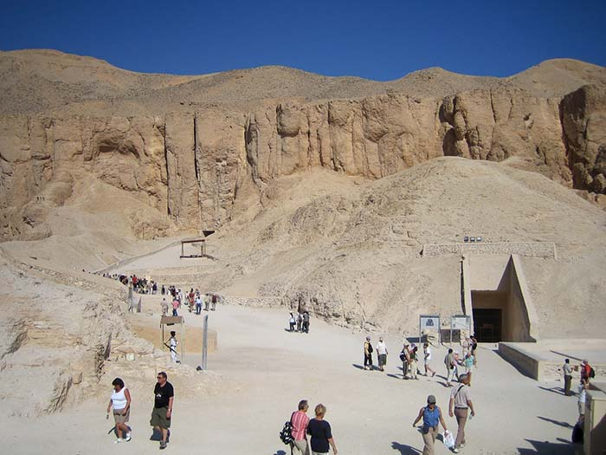
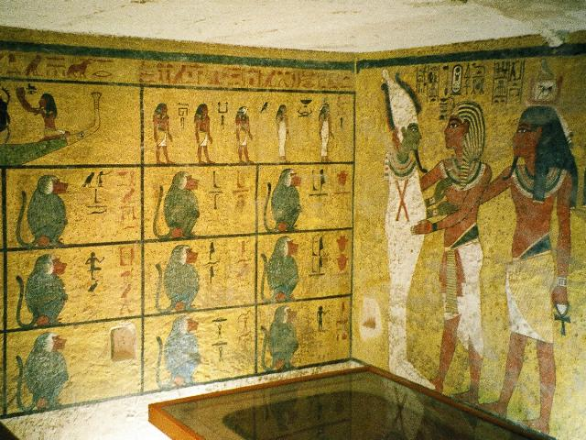
Tomb of Tutankhamun
(Egyptian Ruler until 1323 BC)
Notes:
Tutankhamun (/ˌtuːtənkɑːˈmuːn/;[3] alternatively spelled with Tutenkh-, -amen, -amon) was an Egyptian pharaoh of the 18th dynasty (ruled c. 1332–1323 BC in the conventional chronology), during the period of Egyptian history known as the New Kingdom or sometimes the New Empire Period. He has since his discovery been colloquially referred to as King Tut. His original name, Tutankhaten, means "Living Image of Aten", while Tutankhamun means "Living Image of Amun". In hieroglyphs, the name Tutankhamun was typically written Amen-tut-ankh, because of a scribal custom that placed a divine name at the beginning of a phrase to show appropriate reverence.[4] He is possibly also the Nibhurrereya of the Amarna letters, and likely the 18th dynasty king Rathotis who, according to Manetho, an ancient historian, had reigned for nine years—a figure that conforms with Flavius Josephus's version of Manetho's Epitome.[5]

Slide 9
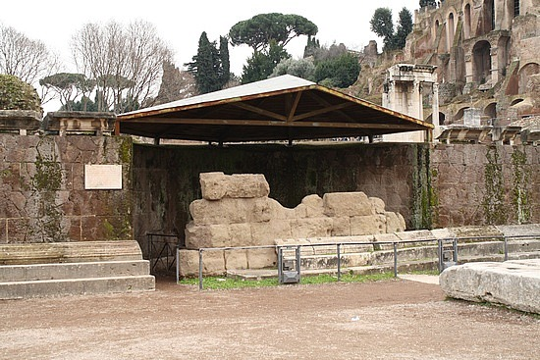
Tomb of Julius Caesar
(Roman Ruler until 42 AD)
Notes:
The Temple of Caesar or Temple of Divus Iulius (Latin Aedes Divi Iuli or Templum Divi Iuli, Italian Tempio del Divo Giulio) also known as Temple of the Deified Julius Caesar, delubrum, heroon or Temple of the Comet Star,[1] is an ancient structure in the Roman Forum of Rome, Italy, located near the Regia and the Temple of Vesta.
It was begun by Augustus in 42 BC after the senate deified Julius Caesar posthumously. Augustus dedicated the prostyle temple (it is still unknown if it was Ionic, Corinthian or Composite) to Caesar (his adoptive father) on August 18, 29 BC, after the Battle of Actium. It stands on the east side of the main square of the Roman Forum (Forum), between the Regia, Temple of Castor and Pollux and the Basilica Aemilia, on the site of Caesar's cremation (Caesar's testament was read at the funeral by Mark Antony).
Caesar was the first resident of Rome to be deified and so honored with a temple.[2] A fourth flamen maior was dedicated to him after 44 BC and Mark Antony was appointed as his flamen.

Slide 10
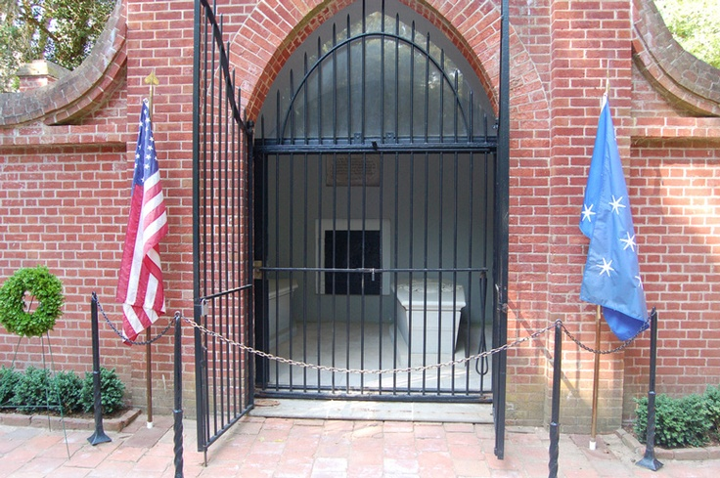
Tomb of George Washington
(First President of USA until 1797)
Notes:
George Washington (February 22, 1732 [O.S. February 11, 1731][b][c] – December 14, 1799) was the first President of the United States (1789–97), the Commander-in-Chief of the Continental Army during the American Revolutionary War, and one of the Founding Fathers of the United States. He presided over the convention that drafted the current United States Constitution and during his lifetime was called the "father of his country".[4]
Widely admired for his strong leadership qualities, Washington was unanimously elected president in the first two national elections. He oversaw the creation of a strong, well-financed national government that maintained neutrality in the French Revolutionary Wars, suppressed the Whiskey Rebellion, and won acceptance among Americans of all types.[5] Washington's incumbency established many precedents, still in use today, such as the cabinet system, the inaugural address, and the title Mr. President.[6][7] His retirement from office after two terms established a tradition that lasted until 1940, when Franklin Delano Roosevelt won an unprecedented third term. The 22nd Amendment (1951) now limits the president to two elected terms.

Slide 11
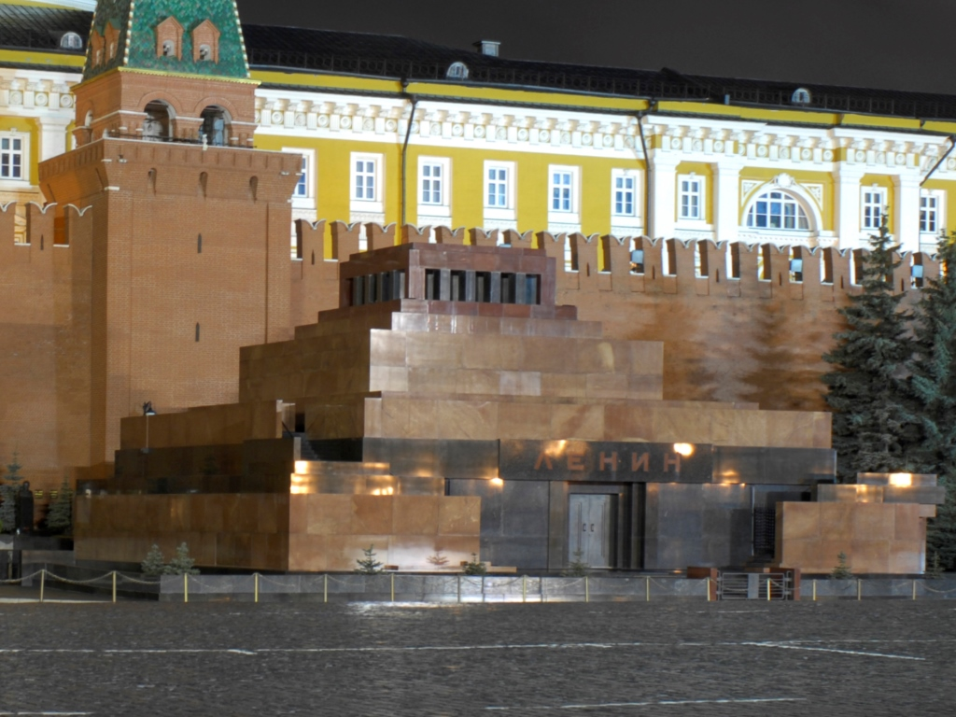
Tomb of Vladimir Lenin
(Leader of Soviet Union until 1924)
Notes:
Lenin's Mausoleum (Russian: Мавзоле́й Ле́нина, tr. Mavzoléy Lénina; IPA: [məvzɐˈlʲej ˈlʲenʲɪnə]), also known as Lenin's Tomb, situated in Red Square in the center of Moscow, is the mausoleum that serves as the current resting place of Vladimir Lenin. His embalmed body has been on public display there since shortly after his death in 1924 (with rare exceptions in wartime). Aleksey Shchusev's diminutive but monumental granite structure incorporates some elements from ancient mausoleums, such as the Step Pyramid and the Tomb of Cyrus the Great.

Slide 12
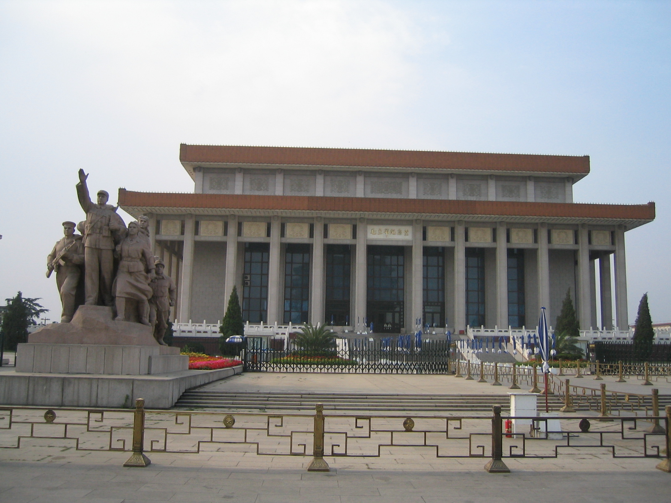
Tomb of Mao Zedong
(Founder of Peoples Republic of China)
Notes:
Mao Zedong (Listeni/ˈmaʊ zəˈdʊŋ, dzə-/), also transliterated as Mao Tse-tung and commonly referred to as Chairman Mao (December 26, 1893 – September 9, 1976), was a Chinese Communist revolutionary and the founding father of the People's Republic of China, which he governed as Chairman of the Communist Party of China from its establishment in 1949 until his death in 1976. His Marxist–Leninist theories, military strategies, and political policies are collectively known as Marxism–Leninism–Maoism or Mao Zedong Thought.

Slide 13
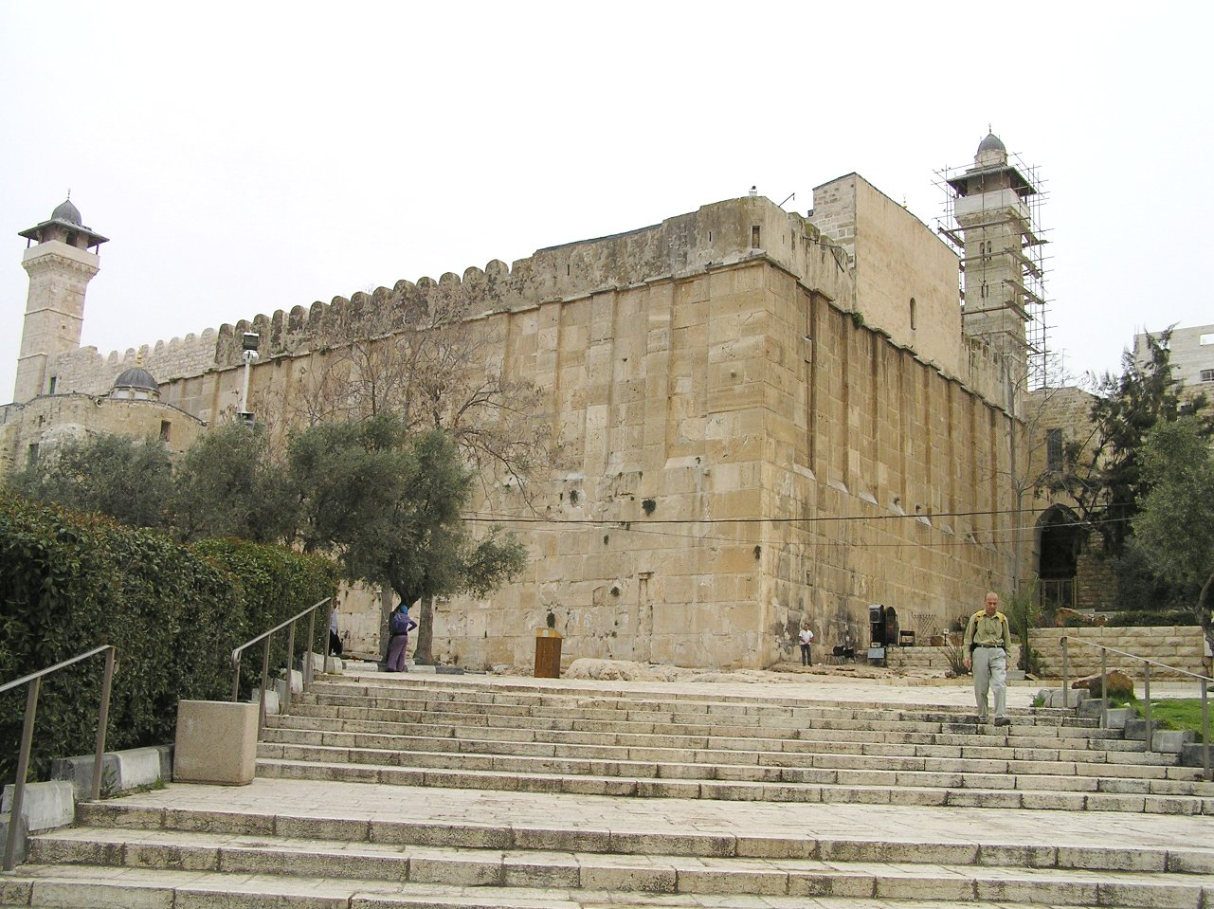
Tomb of Abraham, Isaac, and Jacob
(Founders of Judaism)
Photo by Eman, 2007
Notes:
Abraham (a.k.a. Abram) is generally considered the founder of Judaism. His burial is related in Genesis 25:7-10, "And his sons Isaac and Ishmael buried him in the cave of Machpelah, in the field of Ephron". Moses is also sometimes credited with founding Judaism when the Torah was written.
The exact location of the grave of Moses is unknown, but according to Deuteronomy 34:6 it is on or near Mount Nebo just east of the Jordan river, now in the kingdom of Jordan.
The Cave of the Patriarchs is located in the ancient city of Hebron (which lies in the southwest part of the West Bank, in the heart of ancient Judea), and is generally considered by Jews, Christians, and Muslims to be its spiritual center. Jewish, Christian, and Islamic tradition holds that the compound encloses the burial place of four Biblical couples: Adam and Eve; Abraham and Sarah; Isaac and Rebekah; Jacob and Leah. According to Midrashic sources, it also contains the head of Esau, the brother of Jacob.

Slide 14
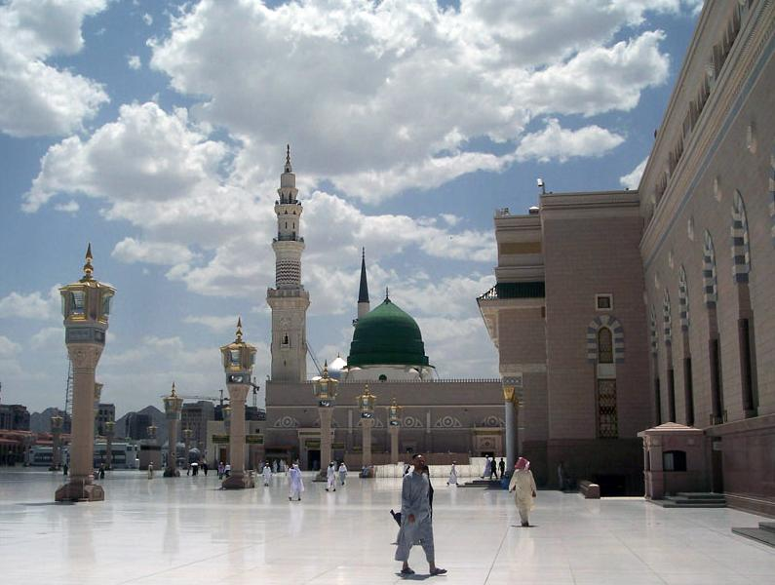
The Green Dome – tomb of Muhammad
(founder of Islam)
Photo by Noumenon, 2006
Notes:
Muhammad is buried in the Al-Masjid an-Nabawi ("Mosque of the Prophet") in the city of Medina in Saudi Arabia. Muhammad's grave lies within the confines of what used to be his wife Aisha's and his house. During his lifetime it adjoined the mosque, which was expanded during the reign of Caliph al-Walid I to include his tomb.[2] The first two caliphs, Abu Bakr and Umar, are buried next to Muhammad. Umar was gifted a spot next to Muhammad by his wife Aisha, which she had intended for herself.
Muhammad's grave itself cannot be seen as the area is cordoned off by a gold mesh and black curtains. As per Islamic tradition, the grave itself is not embellished or decorated and is two cubits high. The grave is marked by an austere green dome above it, built by the Ottoman Turks, and was earlier white in color. This dome has become universally emblematic of both Muhammad himself, as well as the city of Medina.
Muhammad's grave is an important reason for the particularly high sanctity of the mosque. Millions of visitors come to visit it every year because it is traditional to visit the mosque when going on the pilgrimage to Mecca.

Slide 15
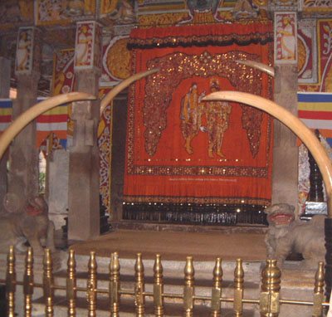
Temple of the Tooth of Buddha
(contains some remains from Buddha)
Photo by Jimfbleak, 2010
Notes:
The Buddha's body was cremated and the relics were placed in monuments or stupas, some of which are believed to have survived until the present. For example, the Temple of the Tooth or Dalada Maligawa in Sri Lanka is the place where the right tooth relic of Buddha is kept at present.

Slide 16
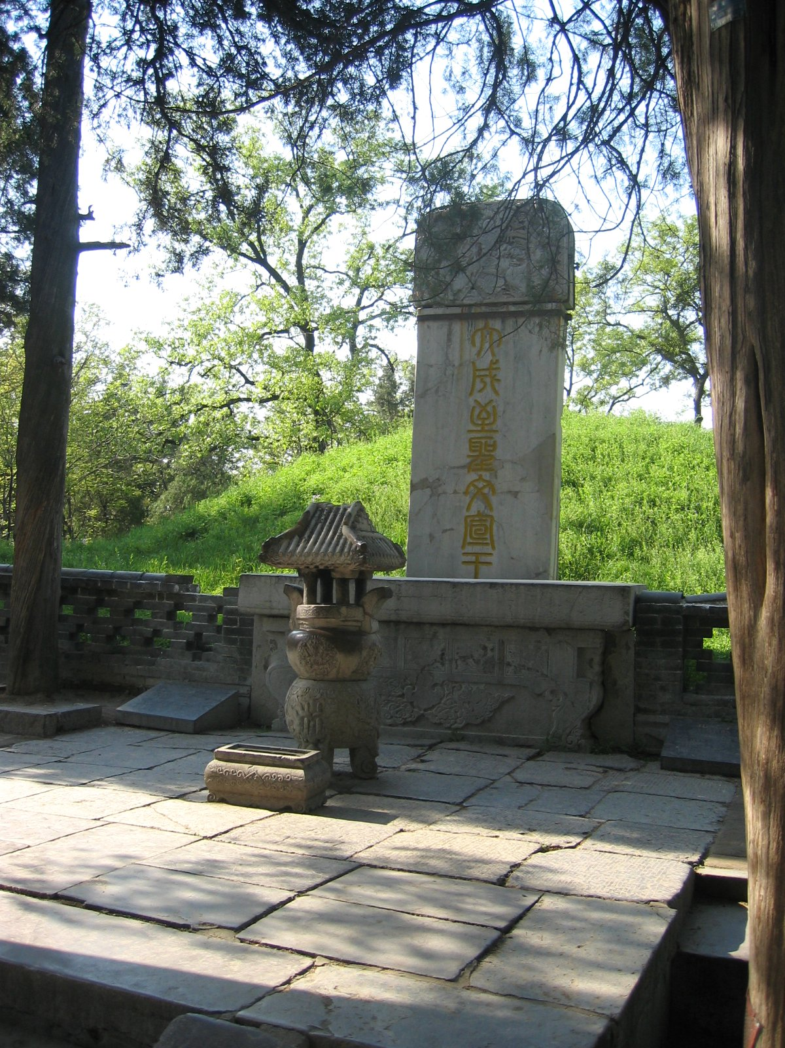
Tomb of 孔子 (Confucius)
(in Qufu, Shandong Province)
Photo by Rolf Mueller, 2005
Notes:
The grave of Confucius (Kǒngzǐ), founder of Confucianism, is in his home town of Qufu, Shandong Province, China. The grave of Confucius is located in a large cemetery where more than 100,000 of his descendants are also buried.

Slide 17
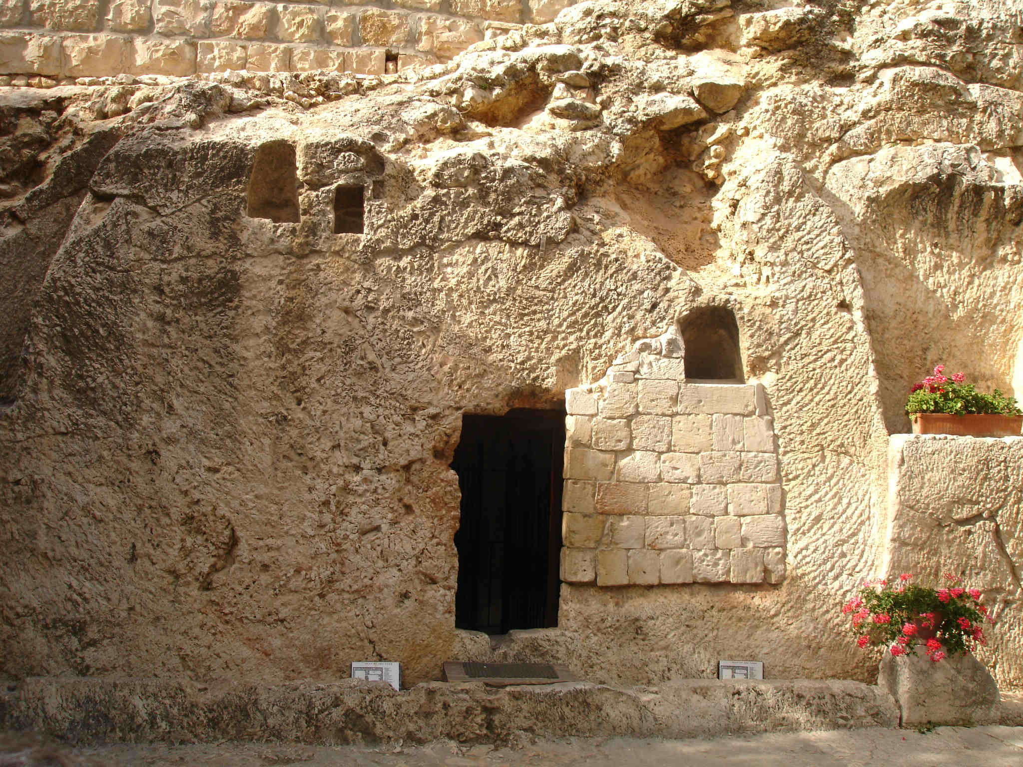
Tomb of Jesus?
(Founder of Christianity)
Photo by Cambene, 2008
Notes:
“When someone famous dies, their grave is memorialized. When a famous religious leader dies, their grave is enshrined.” (Mark Driscoll)
Because Jesus rose from the grave, His tomb was no longer significant to His followers. It was not preserved and did not become a place of worship. Although people speculate about which tomb might have been His “short term burial spot,” no one is really sure.
No religious figure in history has made the claims that Jesus made with the authority and hard proof to back it up. And no other religious figure in history has proved his authority over life and death by dying and coming back to life.

Slide 18
Some Reasons to Believe in the Resurrection
1 Corinthians 15:12-14 It is the critical truth of the Christian message
Prophecy foretold that it would happen
The bodily resurrection was a unique claim
The tomb was empty
The disciples were changed
The Sabbath was changed
Post resurrection appearances

Slide 19
Prophecy foretold that it would happen
Looking at the gospels, Jesus predicts the resurrection at least 16 times.
Matthew 16:21
Matthew 20:18,19
Luke 9:22
Many people can estimate their death, but no one else can predict their resurrection
John 2:18-22 Christ said that the resurrection would prove He is God

Slide 20
The Resurrection was a Unique Claim
We falsely assume that it is easier to fool first-century people than modern-scientific people. Not so…
The Greeks and Romans thought that a bodily resurrection was foolish. Plato taught them that at death, the “evil” body would remain in the grave to free up the “good” spirit.
Jewish Sadducees did not believe that there would be a resurrection (Matthew 22:23).
Jewish Pharisees believed in a bodily resurrection, but expected it to only occur at the end of time.
If someone found the body of Jesus, Christianity would self-destruct.

Slide 21
The tomb was empty
Matthew 27:62; 28:2-4,11-15. The most convincing evidence comes from the Jewish leaders who had Him killed in the first place: they never did disprove the empty tomb, just made up a crazy lie.
Why was the stone was removed? It was not so that Jesus could get out – it was so that we could look in and believe.
The linen wrappings which Nicodemus and Joseph bound Christ's body in were still in the empty grave (John 20:6,7). If someone had taken the body of Christ (or if He got up and walked away), why take off His clothes?
As Peter preaches the truth about the resurrection of Christ at Pentecost, 3000 people believe (Acts 2:32,41)! They were just a short walk from the tomb and could easily go to check it out.
Acts 15:5 Even some of the Pharisees who initially spread the lies became believers.
When a famous person or religious leader dies, their grave is made into a beautiful building or monument. But since Jesus’ tomb was empty, it was quickly forgotten (and probably reused).

Slide 22
The disciples were changed
John 20:19 – the disciples were hiding behind closed doors in fear.
John 21:3 – the disciples return to a life of fishing.
Acts 2:22,23 – Now Peter boldly accuses the same massive crowd that condemned Jesus of killing the Messiah, and instructed them to repent. Why?
Acts 1:3,8 – they were instructed and empowered by the risen Christ to go and preach the gospel. And they believed it so strongly that each one was willing to die for this truth.

Slide 23
The Sabbath was changed
Mark 3:2 The last day of the week (Saturday) was strongly revered as the Sabbath day. Over 1000 years of culture established this.
Acts 20:7 Christians quickly shifted to worshiping on “The Lord’s Day” – resurrection Sunday.
Other than the resurrection, historians have no other rational explanation as to why thousands of people would quickly shift over to worship on the first day of the week.

Slide 24
Post-resurrection appearances
Acts 1:3 Many times the Bible speaks of appearances that Christ made following His resurrection
1 Corinthians 15:6 claims that Christ appeared to over 500 people at one time, most of whom were still alive to confirm the truth of his writing.
A single, sad person might imagine (or hallucinate) that a loved one has returned from the dead, but 500 witnesses are enough to convince a court of law, and were enough to transform the city of Jerusalem (and the entire world).

Slide 25
So What?
In a broken world full of sin and sinners, God’s grace and love shines like the sun!
Our future hope is based on an historical fact.
We have the amazing privilege of praying to a risen, living Savior!
There is reasonable proof that Jesus actually did rise from the grave. God calls us to believe something that we did not see (faith), but doesn’t leave us without evidence.
Faith in the person of Christ and in His resurrection is the most important faith a person will ever have (Romans 10:8,9).

