Slide 1
Is there only one way to Heaven?
Some people say:
“It doesn’t matter what you believe, so long as you are sincere.”
Is this true?
Notes:
Wherever you go in the world, you will find that people feel some things are right and some things are wrong. While some of those beliefs are cultural, others are universal, things like theft, abuse, murder, etc.
All around the world, you will also find that people believe something about God, and because they know they’ve done wrong, they accept a religious belief system to try and become acceptable to God. Sometimes, people choose a religion, but often, a religion chooses them (e.g. they adopt the dominant cultural belief system).
Today, I want to address this big question: are some religions false while others are true?

Slide 2
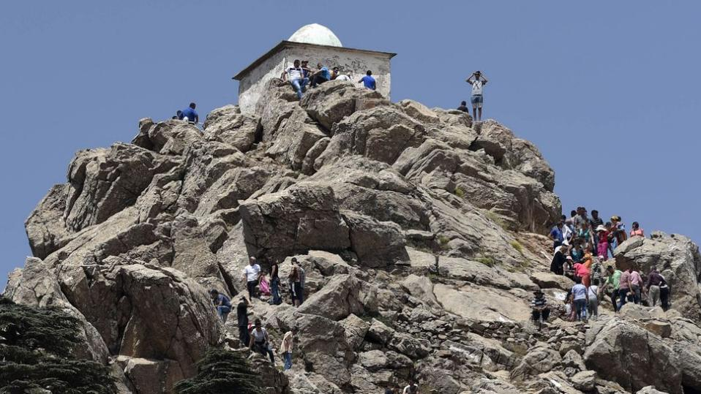
A common belief: “All religions are just different paths to the top of the same mountain.”
Notes:
It is very uncomfortable to criticize the religion of others, and in when it comes to matters of faith, we don’t like to act like we are the best or smartest. So we often find it easier to say that all religions are beautiful and all are equally true.
The most popular metaphor for this view portrays the great religions as different paths up the same mountain. “It is possible to climb life’s mountain from any side, but when the top is reached the trails converge,” writes philosopher of religion Huston Smith.
But is this true? Are all religions the same and do they lead to the top of the same mountain? And is God really on top of that mountain?

Slide 3

A Short Quiz : Question #1
What is the price of this beautiful mansion in Vero Beach, FL, USA?
$12.95
$1,295.00
$12,950.00
$12,950,000

Slide 4
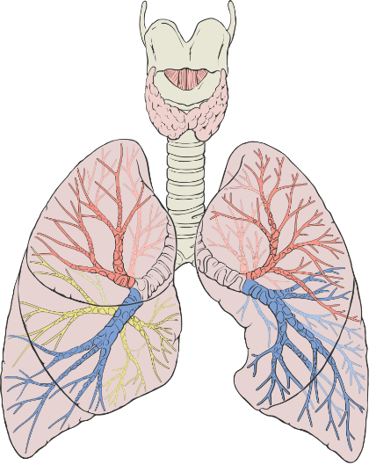
A Short Quiz : Question #2
What body part is shown in this picture?
Heart
Hand
Lungs
Brain
By Patrick J. Lynch, medical illustrator - Patrick J. Lynch, medical illustrator, CC BY 2.5, https://commons.wikimedia.org/w/index.php?curid=1496626

Slide 5

A Short Quiz : Question #3
Mark is the President of the United States.
TRUE
or
FALSE

Slide 6
Truth and Error
Some things are true:
    Mark and Susan live in the USA
    The moon is 384,400 kilometers from Earth
    Oxygen is necessary for human survival
Some things are false:
    Susan is president of the USA
    I can walk from California to Shenzhen
    You can fly if you flap your arms
Strong belief does not change facts about truth.
Notes:
OK, how did you do? How many of the questions above were true? How many were false? Are you sure? What if I want question 3 to be true – will my desire make it true for me? But what if I really, strongly desire for it to be true – can my strong desire make it true? Of course not.

Slide 7
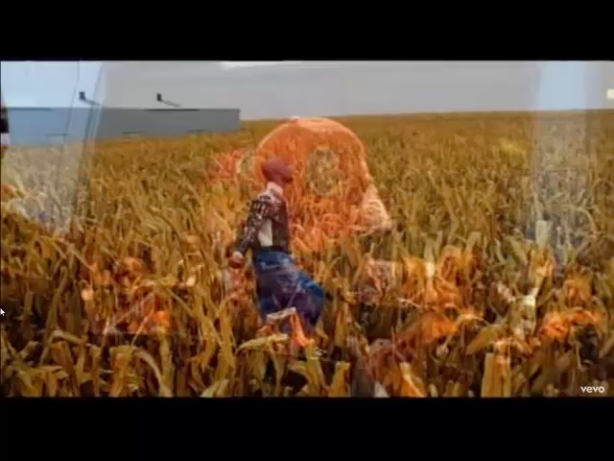
Sincere Belief Doesn’t Change Facts
I believe I can fly, I believe I can touch the sky
I think about it every night and day
Spread my wings and fly away
Belief is beautiful,
but truth is what
really matters!
“I believe I can fly”; 26-Nov-1996
Label: AtlanticJive; Written by: Robert Kelly

Slide 8
One more time…
Are some things true while other things are false?
If I really, really believe something is true, does my sincere belief make it true?
A common idea: “It doesn’t matter what I believe – just be very sincere.” Is that true?
If I really believe that I can fly, should I jump off of a tall building?
Which has more power: my belief or the law of gravity?
Notes:
Just to be sure that you don’t forget, let me ask you again: Are some things true while other things are false? And if I really want to believe that a false idea is true, does my sincerity make it true?
Even if I have a very, very strong belief that I can fly, if I jump off of a tall building and flap my arms, I will still fall to the ground, accelerating at the speed of 9.8 m/s². And even if my belief is very sincere, I will probably still die when I hit the ground.
The law of gravity applies to everyone, regardless of what you think and believe!

Slide 9
What is Sin?
Sin = to turn away from God and go your own way
Jeremiah 32:33 – “They have turned to me their back and not their face. And though I have taught them persistently, they have not listened to receive instruction.”
When we sin, we ignore God and His law. We substitute our ideas of right and wrong for His wise commands.
Colossians 3:5,6 – “Put to death, therefore, whatever belongs to your earthly nature: sexual immorality, impurity, lust, evil desires and greed, which is idolatry. Because of these, the wrath of God is coming.”
Notes:
It might be a small thing to ignore the request of a friend, but it is a dangerous thing to ignore the request of our boss (or our president). The evil of sin becomes even more clear when we consider the level of authority of God, the One we have truly offended!
God created us – He has complete authority!
When we choose to follow our own earthly ways, we are determining what is right or wrong based on ourselves and our culture.
Idolatry = putting our trust in that which is not God (usually, ourselves)

Slide 10
What is Sin?
Romans 1:21-23 – “For although they knew God, they did not honor him as God or give thanks to him, but they became futile in their thinking, and their foolish hearts were darkened. Claiming to be wise, they became fools, and exchanged the glory of the immortal God for images resembling mortal man and birds and animals and creeping things.”
When we sin, we eventually put ourselves in the place of God (a terrible choice!)
Treason (叛国罪) = to betray your country and take the place of your leader. What is the penalty for treason?
Sin is everyone’s biggest problem! What can be done?
Notes:
Romans 1:19-20 reminds us that everyone knows something about God: “For what can be known about God is plain to them, because God has shown it to them. For his invisible attributes, namely, his eternal power and divine nature, have been clearly perceived, ever since the creation of the world, in the things that have been made. So they are without excuse.”
When people create their own gods and methods of salvation, they are actually replacing God’s truth with their own ideas. (proud people want to have control and authority).
Although we might not think that we are taking the place of God, it becomes clear when we define our own morality, meaning, and salvation method.
叛国罪 (Pànguó zuì) The normal penalty for treason is death! (Romans 6:23)
Sin: the biggest problem of every human being!

Slide 11

Can people wash away sin in the shower?

Slide 12
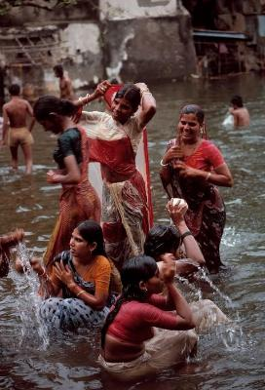
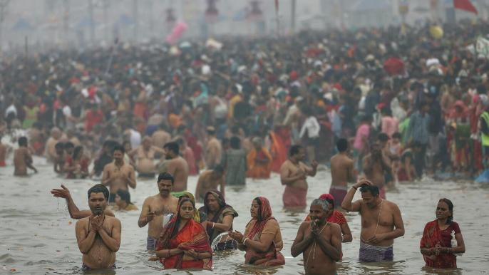

Can taking a bath was away sins?
Hindus believe that taking a dip in this sacred river will cleanse them of sins, purify their soul and liberate them from the cycle of birth and death. 400 Million people will come to bathe at the confluence of India's most sacred Ganges river with the Yamuna river and the mythical Saraswati in January and February this year. (BBC News, 12 January 2025)

Slide 13


Can I walk away my sin?

Slide 14
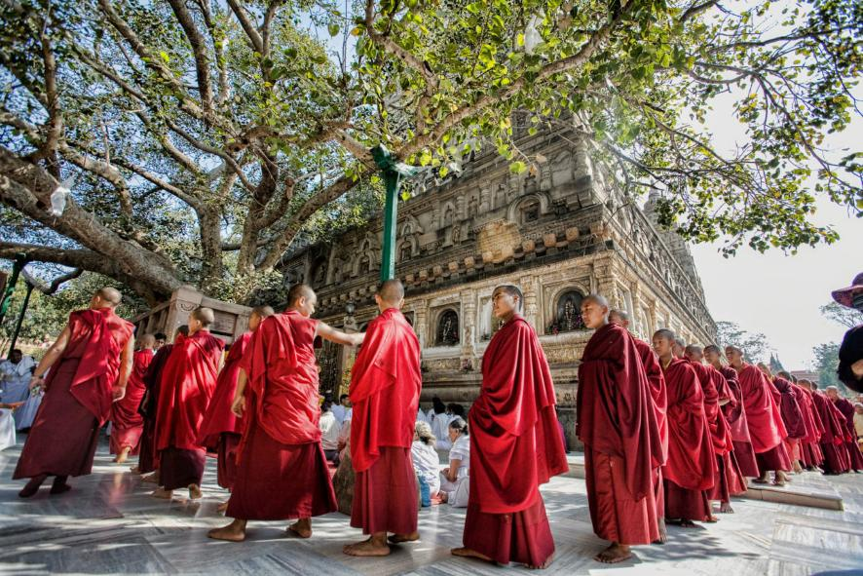
Can I walk away my sin?
Walking in a circle around religious objects is common in some religious traditions. Buddhists circumambulate to show devotion, pay tribute, cultivate their minds, and accumulate merit. Although the practice predates Buddhism, the Buddha mentioned it several times over his teaching career and said it purified negative karma and ensured a favorable rebirth.
Notes:
Circumambulation, the act of walking in a circle around an object of veneration, is common to many of the world’s religious traditions. Buddhists circumambulate to show devotion, pay tribute, cultivate their minds, and accumulate merit. Although the practice predates Buddhism, the Buddha mentioned it several times over his teaching career and said it purified negative karma and ensured a favorable rebirth.
In Buddhist circumambulation (pradakshina), the practitioner travels clockwise around a devotional object, keeping the object on their right while meditating, praying, or reciting mantras. The direction is significant because in Indian religion and culture, the right side is considered purer than the left, as the right hand is used for eating and the left hand for cleaning, making it ritually impure.
Buddhists circumambulate many different types of devotional objects: stupas (shrines), temples, statues, sacred mountains, even people. When the Buddha visited his ancestral home at Kapilavastu, the elders of his clan bowed to him, then circumambulated him as he sat in their midst as a sign of respect.

Slide 15


Will my hairstyle and clothes take away sin?

Slide 16
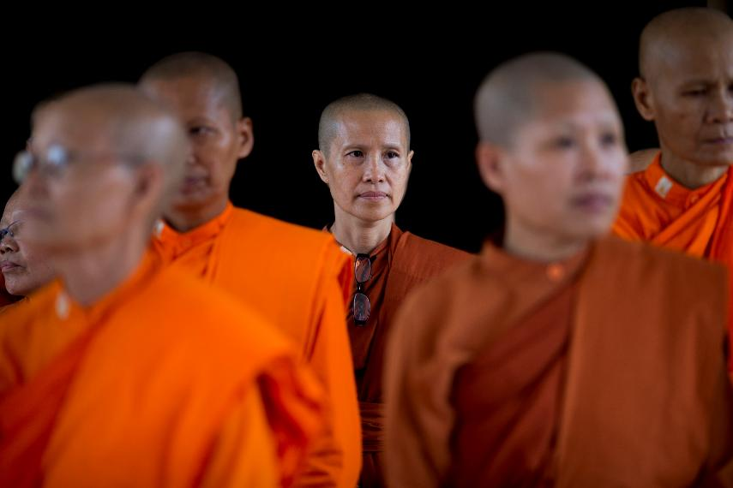
Will my hairstyle and clothes take away sin?
Notes:
Female monks in Thailand

Slide 17

Can I erase my sin with a spin?

Slide 18
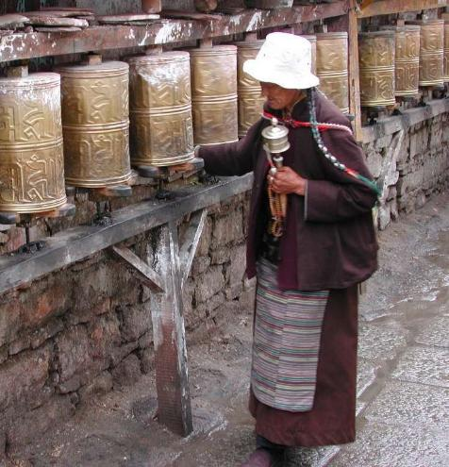
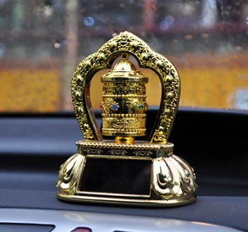
Can I erase my sin with a spin?
Notes:
Buddhist prayer wheels: manual and solar powered…

Slide 19
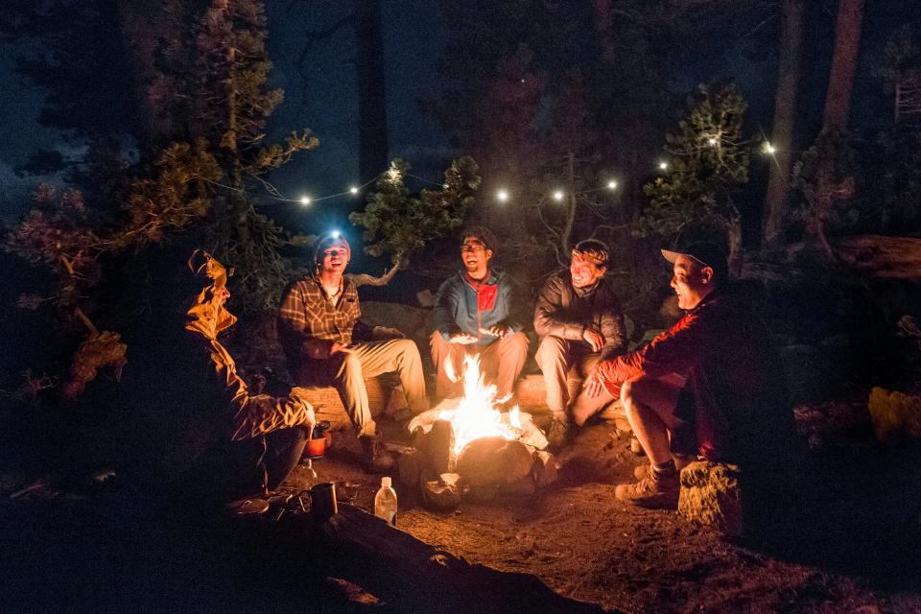
Can I burn away my sin with fire and smoke?

Slide 20
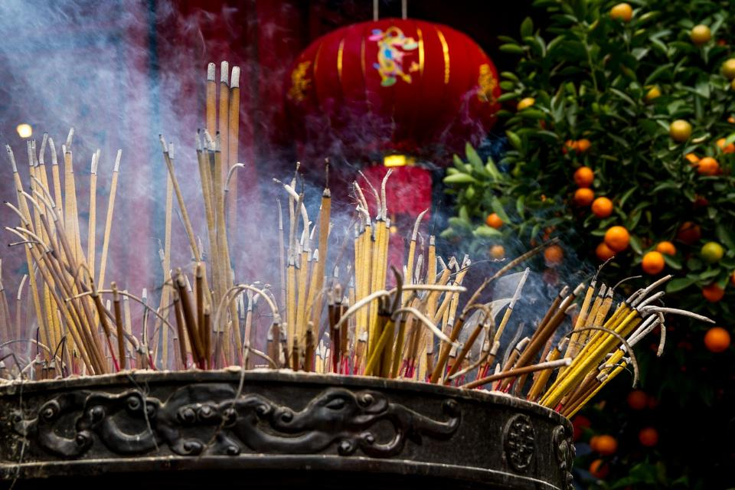
Can I burn away my sin with fire and smoke?
Notes:
A lot of incense is burned in temples

Slide 21
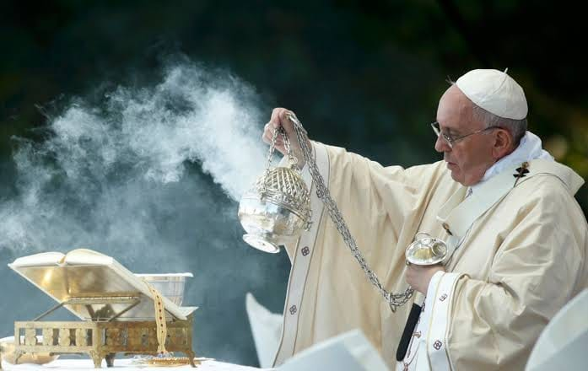
Can I burn away my sin with fire and smoke?
Notes:
A lot of incense is burned in Catholic churches

Slide 22
What is Religion?
Religion is system of beliefs and faith that guides our life.
Religion defines what is most important to us (people “worship” what has highest “worth”).
What are some things that people “worship”?
Notes:
Before we answer tonight’s question, it is important to ask the fundamental question: What is Religion? A simple fact is this: everyone has some form of religious belief. Because ultimately, everyone adopts a system of belief and faith that guides their lives. This is even true for people who reject the existence of God, a decision that is made by faith (believing in something unseen) and one that directs important life choices.
Practically speaking, we are all religious people, because each of us defines what we consider to be of supreme importance. The word “worship” comes from the idea of what something is worth. We all choose to worship something: God, money, position, power, family, knowledge, adventure, etc.

Slide 23
Some Important Religious Beliefs
God: Does God exist? What is God like? [Origin and Meaning]
Heaven: What comes after death? [Destiny]
Righteousness: Can I become good enough to please God? [Morality]
All religions are not the same…
Notes:
Many people have been taught that it’s wrong to point at someone else’s religion and say that it is false. But here is something that you must remember: just as there is truth and error in the physical world, there is also truth and error in the spiritual world. While it might feel better to say that everyone’s religion is right, our feelings cannot take something that is false and make it true. The fact is that truth is exclusive, and it doesn’t take too much thinking to see that everyone’s opinions and beliefs cannot be true. And when we see ideas that totally contradict each other, we quickly know that they cannot all be true.
Please note: I am not trying to judge the value of any person or their morality – I am simply comparing what the major world religions say about these three important things.

Slide 24
God
Atheism: God does not exist.
Islam: Allah is God and does not forgive (Koran, p.65)
Hinduism: there are (at least) 330 million gods, and people can become gods
Buddhism: There isn’t really a God, just an unending system of Karma
Taoism: God is “the shape without shape ... the image without substance” (33)
Christianity:
God created everything for His glory (including you)
God is perfectly righteous and just, but also loving
God has revealed Himself in the Bible and by becoming a man (Jesus, God in the flesh)
Notes:
Every religion has a different view of God. This is the most fundamental starting point of every religion.
What do you think? Are these beliefs the same (or even compatible)?

Slide 25
Heaven / Afterlife
Atheism – life is simply a chemical accident and people are totally gone at the point of death
Islam – if judged worthy, enter a sexual paradise (Koran p.406)
Hinduism: continual rebirth until mental skill helps break away from “me” and unite with God (p.69)
Buddhism – endure continual rebirths until good/bad balance (karma) allows exit (p.127, 100)
Taoism – “He who attains Tao’s virtue is like a babe. No poisonous insects sting him. Nor fierce beasts seize. Nor birds of prey strike him…” (TaoTeChing)
Christianity – after this one life comes judgment
  Heaven is a place of God’s presence (Revelation 21:3,4)
  Heaven is reserved for believers in Christ (1 Peter 1:3,4)
  We can know how to have eternal life (1 John 5:13)
Notes:
It’s quite clear that the major religions disagree about God. So what do they say about the afterlife?
Once again, each religion is very different!
Taoism - describes 81 different types of heaven, each for a different god. The state of those in heaven is described by Lao Tzu in "Tao Te Ching". "He who contains within himself the richness of Tao's virtue is like a babe. No poisonous insects sting him. Nor fierce beasts seize. Nor birds of prey strike him.... He who attains Tao is everlasting. Though his body may decay, he never perishes“

Slide 26
Righteousness
(solving the sin problem)
Atheism – Do what you think is best to achieve your goals
Buddhism – the Eightfold Path and laws of Karma govern destiny (p.105, 87)
  • Wisdom: 1) right view, 2) right intention
  • Ethical Conduct: 3) right speech, 4) right action, 5) right livelihood
  • Mental Development: 6) right effort, 7) right mindfulness, 8) right concentration
Islam – the five pillars:
  1. Declaring and believing the Shahada or Creed ("There is no god but Allah, and Mohammed is the messenger of Allah.")
  2. Observing daily prayers (Salat) and attending the Friday public services
  3. Fasting during Ramadan
  4. The giving of alms (Zakat).
  5. The pilgrimage to Mecca (Hajj).
Notes:
Ultimately, we all know our big problem – we all have sin in our hearts. What will we do about this? Ultimately, what matters the most is salvation. The Bible teaches us that our sin has separated us from the Holy God (Isaiah 59:1,2) and that everyone is sinful (Romans 3:23). When we look at the world around us (and the heart within us), we quickly agree that this is true. So we all have a basic need to be “saved” from sin and death. So, what do the major religions teach about this?
Since atheism rejects the idea of God and Heaven, it obviously doesn’t believe in sin or righteousness.
The Four Noble Truths of Buddhism:
1: of Suffering (Dukkha): This truth acknowledges that life inherently involves suffering, encompassing physical pain, emotional distress, and the general unsatisfactoriness of existence.
2: of the Origin of Suffering (Samudaya): This truth identifies the cause of suffering as attachment, craving, and ignorance, particularly the attachment to desires and a false sense of self.
3: of the Cessation of Suffering (Nirodha): This truth asserts that suffering can be overcome and that a state of liberation (Nirvana) is possible, achieved by releasing oneself from attachment and craving.
4: of the Path to the Cessation of Suffering (Magga): This truth outlines the path to liberation, which is the Noble Eightfold Path, a way of thinking, acting, and meditating that leads to the cessation of suffering.

Slide 27
Righteousness
(solving the sin problem)
Taoism – “go with the flow” (6); do not intimidate or attempt to influence the beliefs of others (69b); The Way cannot be spoken of or clearly defined (1) being beyond definition or limitations.
Hinduism – Focus entirely on Krishna at moment of death, (p. 126)
Christianity – Imperfect people can never please a perfectly holy God. Only God Himself can remove our sin and give us righteousness.
  He saved us, not because of righteous things we had done, but because of his mercy. (Titus 3:5)
  For the payment for our sin is death, but the gift of God is eternal life in Christ Jesus our Lord. (Romans 6:23)
  God made Him [Jesus] who had no sin to become sin for us, so that in Him we might become the righteousness of God. (2 Corinthians 5:21)
Notes:
There are no Noble Savages who will do “good” and act harmoniously apart from the influence of societal pressures and constraints of civilization (the cannibals in Paupa New Guinea remind us that “there is no one who does good, not even one.” Ps 14:3). Such are the false beliefs of many eastern philosophies (e.g. Taoism and Buddhism).

Slide 28
All religions are not the same!
They have different views of God, heaven, and salvation.
Most religions require followers to continue doing “good works,” and if they do enough, they earn righteousness:
  Hinduism requires disciplined meditation
  Buddhism requires people to follow the “Eightfold Path”
  Islam requires followers to obey the “Five Pillars”
  Taoism says that rules are the problem, not our behavior
But, one religion is different from all others – Christianity.
It is not a system of rules to do – the price has been paid and the work has been done. It is a gift to be received by faith.
  “Jesus said, ‘It is finished.’ With that, he bowed his head and gave up his spirit.” (John 19:30)
Christianity is a relationship with God, not just a religion.
  “Pray then like this: “Our Father in heaven,…” (Matthew 6:9)
Notes:
Every religion claims to be the one, exclusive true religion. If every religion claims to be true, they cannot all be true:
While Hinduism claims inclusivity, it excludes the exclusivists, “Hinduism does not recognize claims of exclusivity or a clergy. Anyone who claims to be the exclusive possessor of spiritual truth or the only ‘method’ of reaching God finds no place in Hinduism; a method or a message can only be one among many…Krishna, speaking as God in the Bhagavad-Gita, says, “All paths lead to me,” and also those who worship other gods with devotion worship me….Hinduism does not force itself on others through proselytization…”
Quran 3:19 “Indeed, the religion in the sight of Allah is Islam. And those who were given the Scripture did not differ except after knowledge had come to them - out of jealous animosity between themselves. And whoever disbelieves in the verses of Allah , then indeed, Allah is swift in [taking] account.”
Buddhism’s masters claim it to be exclusive: In the 13th century, the celebrated Zen master Dogen, who famously proclaimed that mountains and rivers have Buddha nature, was not so sure about Taoists and Confucians, writing, “Ignorant people state that Taoism, Confucianism, and Buddhism are ultimately one, only the entrances are different. These misguided foolish people have a superficial view of the Buddhist Way because they lack sufficient understanding of the dharma and its origin.”
As you can see above, all other religions are systems of works; Christianity is a work of faith (Titus 3:5). All other religions require people to keep “doing” something; Christianity is “done”, John 19:30.
“He himself bore our sins in His body on the cross, so that we might die to sins and live for righteousness; by His wounds you have been healed.” (1 Peter 2:24)

Slide 29
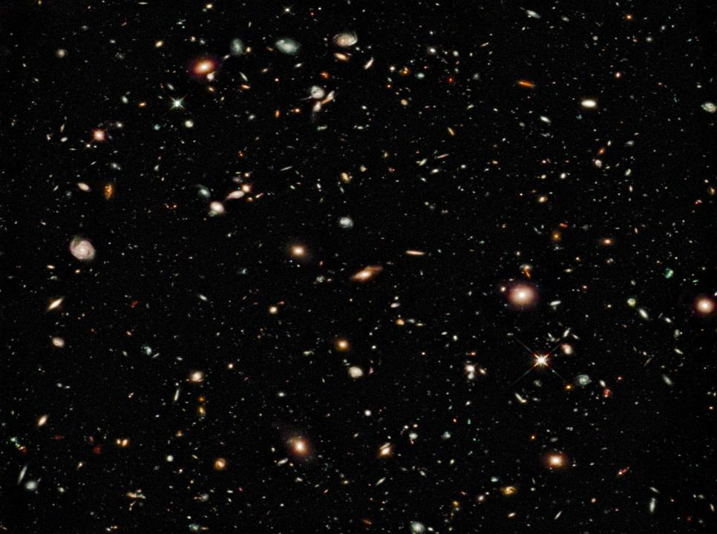
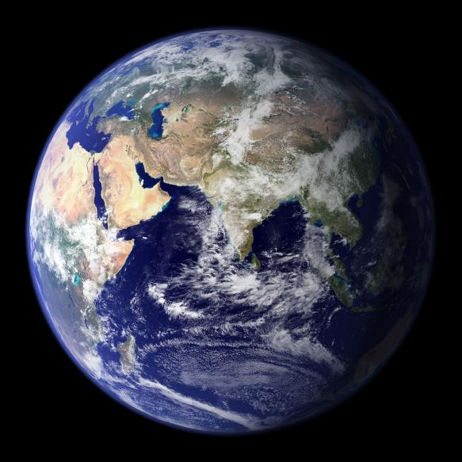
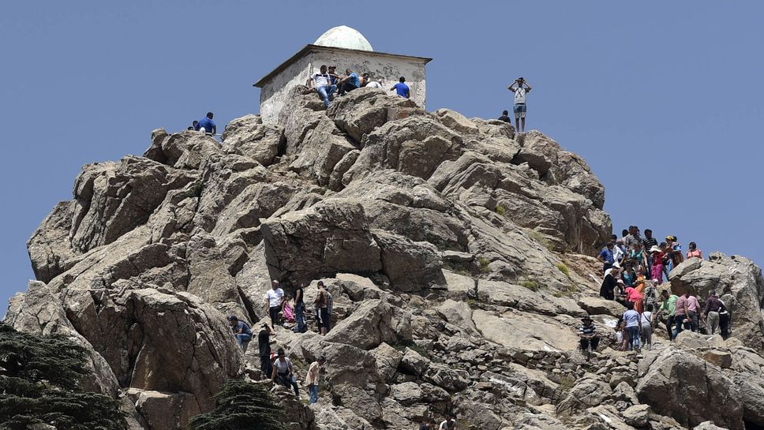
“All religions are just different paths to the top of the same mountain.”
“For my thoughts are not your thoughts, neither are your ways my ways,” declares the LORD. “As the heavens are higher than the earth, so are my ways higher than your ways and my thoughts than your thoughts.” Isaiah 55:8,9
Our only hope: God Himself will come down to save us. That is what Jesus did – He came from heaven to earth to die for us and give us new life!
Notes:
Many religions may lead to the top of the same mountain, but God does not live on top of an earthly mountain. If people reach the top of their religious mountain, they will still be infinitely far away from God:
“The God who made the world and everything in it is the Lord of heaven and earth and does not live in temples built by human hands.” Acts 17:24
“These things you have done, and I have been silent; you thought that I was one like yourself. But now I rebuke you and lay the charge before you.” Psalm 50:21
We only have one hope: that God Himself will come down to us, wherever we are on the Earth. That is exactly what Jesus did – God came down to us and took on a human body, suffered the punishment we deserved, rose again to conquer death, and invites us to come to Him as a gift by His amazing grace.

Slide 30
Closing words from the Bible:
Jesus answered, “I am the way and the truth and the life. No one comes to the Father except through me.” John 14:6
“Enter through the narrow gate. For wide is the gate and broad is the road that leads to destruction, and many enter through it. But small is the gate and narrow the road that leads to life, and only a few find it.” Matthew 7:13,14
“Salvation is found in no one else, for there is no other name under heaven given to mankind by which we must be saved.” Acts 4:12
Notes:
If every religion could save people, God would not have sent Jesus to die for us (Galatians 2:21). But that was not possible. And since He paid such an unimaginably high price for our salvation, it is clear that there cannot possibly be a man-made way to achieve the same goal.
In closing, I want you to consider three exclusive points made in the Bible:
Jesus was very clear about the narrow way: John 14:6, Matthew 7:13,14, Acts 4:12
The Father was very clear that there was no other way: Matthew 26:38,39, Galatians 2:21
Jesus gave his final command because His gospel is critical: Matthew 28:18,19, Jn 3:36
Obviously, Jesus didn’t think that all religions were the correct paths to heaven.
Let us see all this in largest perspective: God has planned to reclaim the world for himself (Gen 12:3). To this end, he sent his Son to be the Savior (John 3:16; 10:16) by satisfying the righteous demands of God against us (Rom 3:21–26). And to this end, he sent the apostles and future disciples into the world with the gospel (John 17:20; Matt 28:18–20) so that those who believed will be saved. One day, God’s mission will be complete, and we will all sing of it together (Rev 5:9).
Christianity faces the hard questions honestly and provides real answers. The uniqueness of Jesus and his saving work is the sole answer to the problem of sin. God is just. We all know it. We also know we all are accountable to him. We also know we are guilty, deserving of judgment. What we need is someone who can take our place – only Jesus qualifies.

