Slide 1
Time and Eternity
What is time and why am I here now?

Slide 2
What is “Time”?
Time is the irreversible progress of existence and events from the past to the present into the future.
Time is that dimension in which cause and effect phenomena take place. (Hugh Ross, The Creator and the Cosmos)
Two views: 1) Endless 2) Beginning & End
Notes:
We talk about time all of the time (see, I just did it!). But what is time, really…?

Slide 3
An Endless Universe?
Eternity = without beginning or end; timeless
In the past, many religions and philosophers believed the universe was eternal
Notes:
For most of the history of the world, astrologers and astronomers assumed that the universe had always existed (like a loop of rope). Without beginning and without end, it just went on continuously, regardless of how you sliced it.

Slide 4

The Expanding Universe
We now know that the universe had a beginning
Some scientists say it began 14 Billion years ago
Let this 40 foot long rope illustrate time…
Notes:
All of that changed in the last century. From Einstein’s general theory of relativity to the more recent studies by the Cosmic Background Explorer (COBE) satellite, cosmologists are now unanimous that our expanding universe had a definite beginning. Cosmologists have developed a model that says the universe began with a hot big bang, starting in the center and then spreading across the darkness as it cools down. By measuring the background radiation temperature (among other things), they suggest that the big bang occurred about 14 billion years ago. Let this 40’ rope illustrate time…

Slide 5

The Expanding Universe
Look closer to see your brief lifetime (8x too big)!
Notes:
By the way, the thread that I’ve used to represent your lifetime is a gross, over-exaggeration by at least a factor of 8, but I had to use something thick enough that you could see.

Slide 6
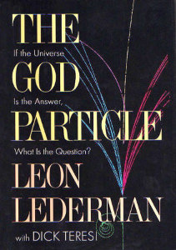
In the beginning…
“In the very beginning there was a void, a curious form of vacuum, a nothingness containing no space, no time, no matter, no light, no sound. … This story is about the beginning of the universe, and unfortunately, there are no data … none … zero. If you read or hear something about the birth of the universe, someone is making it up. We are in the realm of philosophy – only God knows what happened at the very beginning.”
Dr. Leon Lederman,
Fermilab Director and
Nobel Prize Winner (Physics)
In the beginning, God created the heavens and the earth. Genesis 1:1
Notes:
In the introduction to his book “The God Particle,” the high energy physicist Dr. Leon Lederman says that “In the very beginning there was a void, a curious form of vacuum, a nothingness containing no space, no time, no matter, no light, no sound. … This story is about the beginning of the universe, and unfortunately, there are no data … none … zero. If you read or hear something about the birth of the universe, someone is making it up. We are in the realm of philosophy – only God knows what happened at the very beginning.”
Dr. Lederman’s comments are only partially true. God is the one who knows what happened at the beginning, but He has written it down so that we also might know. In fact, while every element of 4000 year old conventional wisdom indicated that the universe was eternally existent, the Bible said something very different (Genesis 1:1,2) “In the beginning, God created…” Not only does it indicate that there was a beginning, but it also says that the universe was created {point at the start of the rope}.

Slide 7
Before the beginning…
“In the very beginning there was a void, a curious form of vacuum, a nothingness containing no space, no time, no matter, no light, no sound. … This story is about the beginning of the universe, and unfortunately, there are no data … none … zero. If you read or hear something about the birth of the universe, someone is making it up. We are in the realm of philosophy – only God knows what happened at the very beginning.”
Dr. Leon Lederman,
Fermilab Director and
Nobel Prize Winner (Physics)
Notes:
In the introduction to his book “The God Particle,” Dr. Leon Lederman says that “In the very beginning there was a void, a curious form of vacuum, a nothingness containing no space, no time, no matter, no light, no sound.”
It is interesting to see that, like Dr. Lederman, many cosmologists agree that time did not exist until the creation of the universe. Listen to a quote from Stephen Hawking…

Slide 8
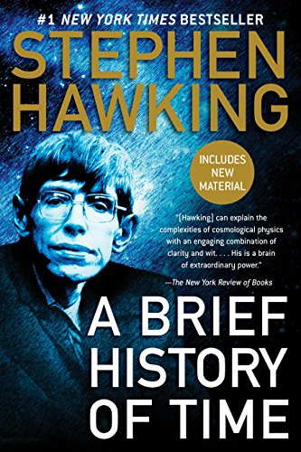
Before the beginning…
“As we shall see, the concept of time has no meaning before the beginning of the universe.”
Stephen Hawking
Notes:
Time did not exist before the universe began. This concept is particularly interesting as we consider what the Bible says about Time and Eternity…

Slide 9
Before the beginning…
…and after the end
“in the hope of eternal life, which God, who does not lie, promised before the beginning of time,” Titus 1:2
“He has saved us and called us to a holy life—not because of anything we have done but because of his own purpose and grace. This grace was given us in Christ Jesus before the beginning of time,” 2 Timothy 1:9
But you, Daniel, roll up and seal the words of the scroll until the time of the end. Many will go here and there to increase knowledge.” Daniel 12:4
The eternal God is your refuge, and underneath are the everlasting arms. Deuteronomy 33:27
Notes:
Long before anyone talked about a beginning of the universe and the space-time theorem, the Bible made clear statements about the facts that time had a beginning and will have an end. But interestingly, it also says that God is eternal (no beginning and no end). How does this work?

Slide 10
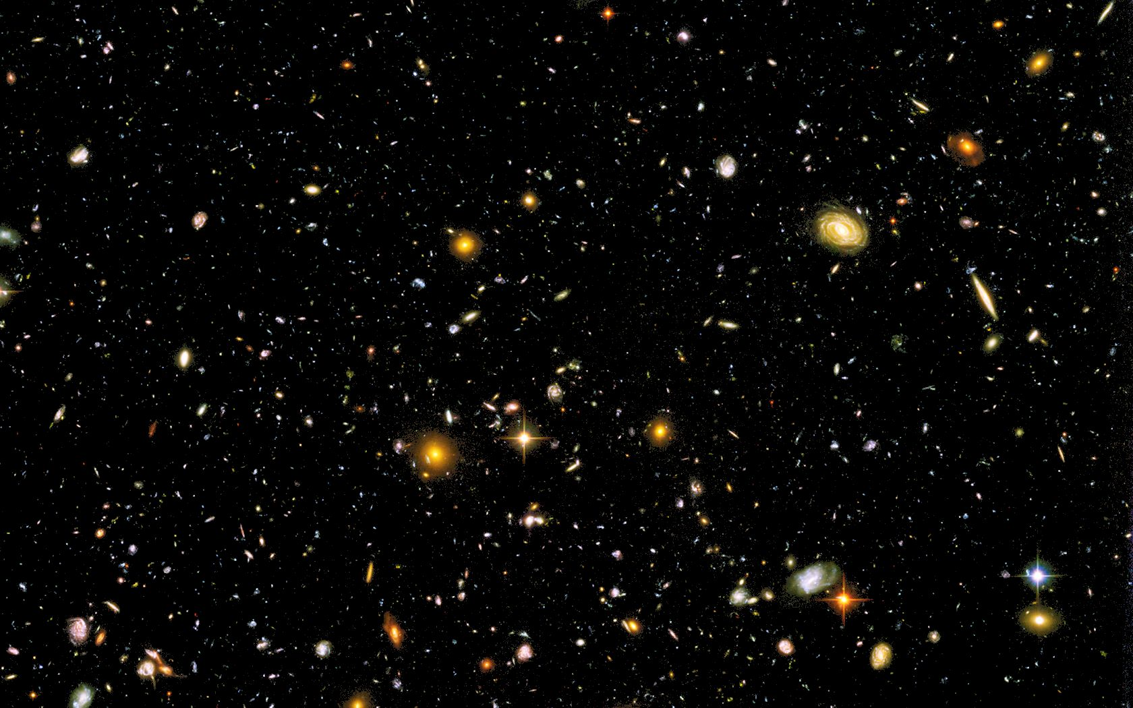
Outside of our time dimension
“If time's beginning is concurrent with the beginning of the universe, as the space-time theorem says, then the cause of the universe must be some entity operating in a time dimension completely independent of and pre-existent to the time dimension of the cosmos.” Hugh Ross
Eternity
Beginning
End
Notes:
Because God exists outside of time. Back to Hugh Ross, he makes the interesting statement on the slide…
So when we look at a “time line,” God speaks from His Word about events that happened before time existed. Remember – since time is a created entity, it exists within eternity (not the other way around).
In the beginning you laid the foundations of the earth, and the heavens are the work of your hands. They will perish, but you remain; they will all wear out like a garment. Like clothing you will change them and they will be discarded. But you remain the same, and your years will never end. Psalm 102:25-27

Slide 11
More about eternity
For since the creation of the world God’s invisible qualities—his eternal power and divine nature—have been clearly seen, being understood from what has been made, so that people are without excuse. Romans 1:20
I proclaim about Jesus Christ, in keeping with the revelation of the mystery hidden for long ages past, but now revealed and made known through the prophetic writings by the command of the eternal God, Romans 16:25,26
He has made everything beautiful in its time. He has also set eternity in the human heart; Ecclesiastes 3:11
Notes:
Even though we exist inside of a fixed-time universe, we can see a preview of eternity in creation and God’s Word:
* He made the world and we see His “fingerprints”
* He made us in His image, and we sense the reality of eternity

Slide 12
Two quotes to think about:
“If you are really a product of a materialistic universe, how is it you don't feel at home there? Notice how we are perpetually surprised at time. In heaven's name, why? Unless, indeed, there is something about us that is not temporal.” C.S. Lewis
“If each individual person passes out of existence when he dies, then what ultimate meaning can be given to his life? Does it really matter in the end whether he ever existed at all? William Lane Craig
Notes:
God has placed eternity in our hearts (Ecclesiastes 3:11) as a reminder that we were not made for this world. When you consider all of the natural explanations for our existence, consider the following quote from a letter that C.S. Lewis wrote to Sheldon Vanauken December 1950:
“If you are really a product of a materialistic universe, how is it you don't feel at home there? Do fish complain of the sea for being wet? Or if they did, would that fact itself not strongly suggest that they had not always, or would not always be, purely aquatic creatures? Notice how we are perpetually surprised at time. In heaven's name, why? Unless, indeed, there is something about us that is not temporal.”
Apart from the reality of eternal life, our lives are bankrupt, without meaning or purpose. As you can tell from this timeline, even the naturalist admits that the universe is winding down and will soon burn out. Like the ashes from a fireworks display, apart from eternal life, everything that we do eventually lies wasted in a ruined universe. Nothing that we do has any more significance than what is done by a swarm of mosquitoes or a pile of ants. But God does call us to an eternal purpose…

Slide 13
Some verses to think about:
“Why, you do not even know what will happen tomorrow. What is your life? You are a mist that appears for a little while and then vanishes.” James 4:14
“Then he said to them all: ‘Whoever wants to be my disciple must deny themselves and take up their cross daily and follow me. For whoever wants to save their life will lose it, but whoever loses their life for me will save it. What good is it for someone to gain the whole world, and yet lose or forfeit their very self?’” Luke 9:23-25
“Be very careful, then, how you live—not as unwise but as wise, making the most of every opportunity, because the days are evil. Therefore do not be foolish, but understand what the Lord’s will is.” Ephesians 5:15-17
Notes:
God has placed eternity in our hearts (Ecclesiastes 3:11) as a reminder that we were not made for this world. When you consider all of the natural explanations for our existence, consider the following quote from a letter that C.S. Lewis wrote to Sheldon Vanauken December 1950:
“If you are really a product of a materialistic universe, how is it you don't feel at home there? Do fish complain of the sea for being wet? Or if they did, would that fact itself not strongly suggest that they had not always, or would not always be, purely aquatic creatures? Notice how we are perpetually surprised at time. In heaven's name, why? Unless, indeed, there is something about us that is not temporal.”
Apart from the reality of eternal life, our lives are bankrupt, without meaning or purpose. As you can tell from this timeline, even the naturalist admits that the universe is winding down and will soon burn out. Like the ashes from a fireworks display, apart from eternal life, everything that we do eventually lies wasted in a ruined universe. Nothing that we do has any more significance than what is done by a swarm of mosquitoes or a pile of ants. But God does call us to an eternal purpose…

Slide 14
A wise man’s prayer
“Show me, LORD, my life’s end and the number of my days; let me know how fleeting my life is.”
“You have made my days a mere handbreadth; the span of my years is as nothing before you. Everyone is but a breath, even those who seem secure.”
“Surely everyone goes around like a shadow; in vain they rush about, heaping up wealth without knowing whose it will finally be.”
“But now, Lord, what do I look for? My hope is in you.”
Psalm 39:4-7
Notes:
Analysts attempt to break down things into their smallest components in order to explain away the wonder. From the smallest biological organisms to the awesome cosmos, scientists have attempted to break down and define the structure and workings of everything. Except for time. It’s interesting that people don’t spend a lot of energy examining time – perhaps they’re afraid of where it might lead.
When he 72 years old, my father was very active, strong and mentally sharp. He went out for his morning exercise walk and died of a heart attack in front of an athletic club. At his graveside, I opened the Bible and read these verses from Psalm 39:4-7. We often pray for good health, for wealth, and for many other things that will evaporate in a very short time. Let me encourage you to spend more time praying this prayer from Psalms, asking God to renew our understanding of how transient we are and refocus our attention on Him.

Slide 15
A wise man’s prayer
“Show me, LORD, my life’s end and the number of my days; let me know how fleeting my life is.”
“You have made my days a mere handbreadth; the span of my years is as nothing before you. Everyone is but a breath, even those who seem secure.”
“Surely everyone goes around like a shadow; in vain they rush about, heaping up wealth without knowing whose it will finally be.”
“But now, Lord, what do I look for? My hope is in you.”
Psalm 39:4-7
Notes:
Analysts attempt to break down things into their smallest components in order to explain away the wonder. From the smallest biological organisms to the awesome cosmos, scientists have attempted to break down and define the structure and workings of everything. Except for time. It’s interesting that people don’t spend a lot of energy examining time – perhaps they’re afraid of where it might lead.
When he 72 years old, my father was very active, strong and mentally sharp. He went out for his morning exercise walk and died of a heart attack in front of an athletic club. At his graveside, I opened the Bible and read these verses from Psalm 39:4-7. We often pray for good health, for wealth, and for many other things that will evaporate in a very short time. Let me encourage you to spend more time praying this prayer from Psalms, asking God to renew our understanding of how transient we are and refocus our attention on Him.

Slide 16
How old is everything?
“Apparent Age” – how old something looks
“Actual Age” – how old something really is
Example 1: God created the first man, Adam. As a man, his “apparent age” might be 21 years old, but his “actual age” was only 1 day old.
Example 2: God created planet earth ready to support living creatures. It might have a very old “apparent age,” but the “actual age” was only 1 day old.
Notes:
When reflecting on the age of the earth (and universe), many Bible scholars speak with respect to two types of ages: apparent and actual. When God created Adam in the garden of Eden, He didn’t make him as a brand new infant – He created a full grown man. As such, while Adam’s actual age was one day old, his apparent age might have been 21 years. And if he had to wait for the full development of the fruit trees in the garden, he would have starved to death. In my opinion, we waste our time to debate the actual age of the universe when we are only capable of perceiving the apparent age. Based on these verses, I suspect that many scientists will also make the same mistake about the end point of our universe.

