Slide 1
What is the Church?
1 Peter 2:4-6; 4:7-11; 5:1-5

Slide 2
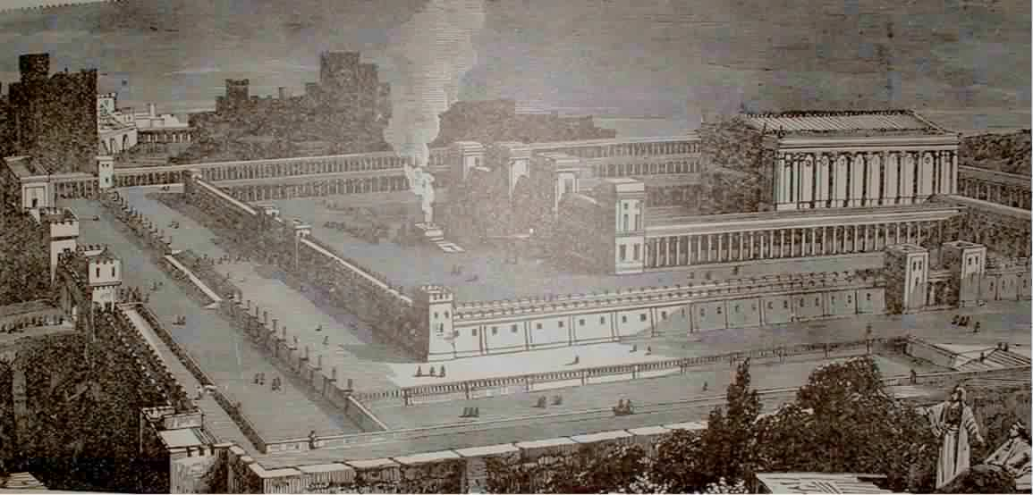
The Old Testament Temple
Constant Sacrifices (sin results in death)
The Temple Veil between the people and “Most Holy Place” (separation from God)
Reading of Old Testament Law (look forward to the promised Savior)

Slide 3
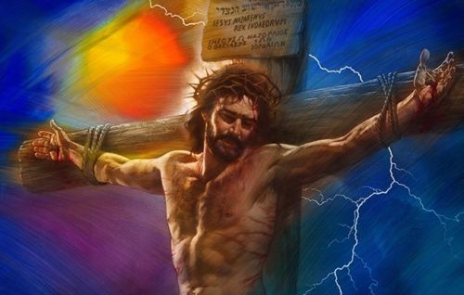
The Cross Changes Everything
God now lives in every believer – each person is His temple (1Corinthians 6:19)
Constant Sacrifices (sin results in death)
The Temple Veil between the people and “Most Holy Place” (separation from God)
Reading of Old Testament Law (look forward to the promised Savior)
------------------------------------------------------
The Final Sacrifice (Hebrews 10:10-12)
----------------------------------------------------------------------------------------------------------------
The Veil torn, providing a way for anyone to come to God (Matthew 27:50,51)
--------------------------------------------------------------------------------------------
The Savior has come and conquered death! (Matthew 28:5,6)

Slide 4
The Church
The church is not a temple
The church is not a building
Two Levels of Church (ekklesia – “called out ones”):
  “Universal Church” – all believers from all nations from all of time
  “Local Church” – small groups of people worshiping God and serving in their communities

Slide 5
The Universal Church
Matthew 16:13-18 : first mention of the church
v.16 Every believer’s testimony about Jesus: “You are the Christ” (petros – a stone)
v.18 On this rock (petra) I will build My church
Jesus is the rock of the church (1 Peter2:4-6)
Jesus takes His children from the world and puts us into His church (John 15:19)
Jesus Christ
The World
Universal Church

Slide 6
The Universal Church
“Hades” = “place of the dead.” Christians will overcome Hades (death) because of Jesus’ resurrection (1Corinthians 15:54-57, John 6:39).
Jesus is the head of the (“My”) church (Ephesians 1:22,23)
The church is “the bride” of Christ (Ephesians 5:25-27, John 3:29, Revelation 19:7-9).

Slide 7
The Local Church
First local church was in Jerusalem.
Rapid growth. 120 people (Acts 1:15); 3,000 more (Acts 2:41); 5,000 more (Acts 4:4)
Just because someone attends a local church, doesn’t mean that they are truly saved (Matthew 13:24-30)
The World
Local Churches

Slide 8
The Local Church
Local Churches are in cities (Acts 8:1; 13:1)
Also, small gatherings of believers in various places: homes (Acts 2:46), the temple (Acts 5:12) and in synagogues (Acts 13:5)
The early church met daily (Acts 2:46), each Lord’s Day (Acts 20:7), and came together to pray (Acts 3:1, 10:9).

Slide 9
The Local Church
The First local church in Jerusalem (Acts 2:40-47) met for the following purposes:
Fellowship with other baptized believers (verse 40-41)
The teaching of the Word of God (verse 42)
The breaking of bread – the Lord’s supper (verse 42)
Prayer (verse 42)
To help and minister to each other (verses 44-45)
To glorify and praise God (verse 47)
To discipline members as needed (Matthew 18:15-20)
The spread of the Gospel worldwide (Mark 16:15)

Slide 10
The Local Church
Paul compared the local church body to the HUMAN BODY (1 Corinthians 12:12-27, 1 Peter 4:7-11):
Each body is composed of many members (verse 12)
Each member has a different function (verses 14-20)
No one member can function alone (verse 21)
Each member’s contribution is important (verses 22-24)
A properly functioning body operates as a single unit (verses 25-27)
The best place for you to exercise your spiritual gift is to become a part of a local church.

Slide 11
Finding a Good Local Church
As you pray about which church you should attend, consider these things:
Authority of the Bible. Complete confidence that all of the Bible is absolutely true (Titus 1:9; Matt 5:17-20). No thing or person will have more authority than the Bible.
Jesus is God. Clarity about the person of Jesus – He is God who came to earth in a human body to die for our sins (John 1:1).
Salvation by grace alone. Clarity about salvation – it is a gift of God, given to all who repent and believe in Jesus (Romans 10:9,10).

Slide 12
Finding a Good Local Church
As you pray about which church you should attend, consider these things:
Liberty <-> Legalism. A proper balance of liberty (Galatians 5:1,13,17) and godly behavior (Freedom <-> Tradition).
Truth with Joyful Worship. Speaking truth to the minds of worshipers brings a true spirit of joy and praise (John 4:24). Avoid churches dominated by emotion instead of truth, or joyless churches that focus only on intellectual accumulation of facts (1Corinthians 8:1-3; 2 Timothy 2:22-26).
Biblical Leadership. Leadership by a qualified pastor (1Timothy 3:1-7; 1 Peter 5:1-5).
Member Participation. All members to working together, using their spiritual gifts as part of the body (1 Corinthians 12:14-27).

