Slide 1
Topical Studies
Choice | Topic
1 | How can I deal with Fear?
2 | Is it ever right to do wrong?
3 | How to be a good Parent/Child?
4 | How to be a good Employee?
5 | How to Deal with my Sin?
6 | What is a Good Church?
7 | What is Life after Life after Death?
8 | What if God Doesn't Answer my Prayer?
9 | How should I think about Money?
10 | How can I know the Will of God?
11 | What is the Meaning of Life?
12 | Can a person lose their Salvation?
12 | Aren't all religions the same?
13 | How does the Holy Spirit work?
14 | How should I relate to the Lost World
15 | What is Baptism?
16 | Can people really talk to God ((prayer)?
17 | How to recognize False Teachers?
19 | How long is Time and Eternity?
20 | Does God control everything?
21 | How can I share the Gospel?

Slide 2
Coping with Fear
In a broken, dangerous world
Notes:
This lesson gives some obvious answers about fear. Our problem isn’t that we don’t know them – it is that we fail to believe them and do them!
What are some common fears that people face? Death, dementia, weakness, failure, loss, suffering, attack, future, economic collapse, war, harm to child, condemnation, judgment, …
Which one of these fears dominates you?

Slide 3
Fear and Anxiety
What is the difference?
Fear
  Usually in response to a specific situation
    (e.g. COVID-19)
  Can lead to a constructive (helpful) response
    (e.g. handwashing, social distancing, etc.)
  Some fears are healthy
    (e.g. infection prevention)
Notes:
We live in a broken world, filled with many dangers that can harm us, and sometimes, kill us and those that we love. And as humans, God has given to us the wonderful ability to accumulate knowledge and predict possible future outcomes. This process can happen very fast. Perhaps you are crossing the street and there is a car driving towards you at high speed. Fear rapidly rises in your heart, adrenaline begins to pump, and you quickly run out of the way. In that case, fear can be a helpful thing.

Slide 4
Fear and Anxiety
What is the difference?
Fear
  Usually in response to a specific situation
  Can lead to a constructive (helpful) response
  Some fears are healthy
Anxiety (dread)
  Often in response to negative “what if?” scenarios
  Can control us with constant stress
  Can isolate and lead us to inaction
  Not healthy
Notes:
Healthy fear happens when we act in a constructive way to resolve a specific, serious problem. But there is something less constructive: anxiety. Anxiety is a different kind of fear, one that creates an endless series of negative, “what if” scenarios. Anxiety can control us, creating constant stress that rarely stops. It can paralyze us and lead to depression and despair, threatening our existence and identity.

Slide 5
Different Ways People Deal with Emotions
Deny your feelings, try to shut them down and ignore them.
Follow your heart – let your emotions guide your choices.
The best way – express your emotions to God, but don’t let them control your life.
  Examples from the Bible…
Notes:
Fear is a very strong emotion, perhaps one of the strongest. It might be the first powerful emotion felt by a baby when he is born, emerging from the security of the mother’s womb and into the cold exposure of the open world. Different people deal with strong emotions in different ways:
Some people might tell you to deny your emotions, shut them down and avoid feeling anything at all.
Other people might encourage you to follow your heart, letting your emotions guide your life.
But the Bible doesn’t take us in either of these directions...

Slide 6
Express your emotions to God, but don’t let them control your life.
Psalm 3:1,2 “O LORD, how many are my foes! Many are rising against me; many are saying of my soul, there is no salvation for him in God.”
Psalm 109:26 “Help me, O LORD my God! Save me according to your steadfast love!”
Genesis 15:1 “Fear not, Abram, I am your shield;”
Exodus 14:13 “Fear not, stand firm, and see the salvation of the LORD.”
Luke 12:32 “Fear not, little flock, for it is your Father's good pleasure to give you the kingdom.”
Revelation 1:17 “Fear not, I am the first and the last,”
Notes:
If you read the Psalms, you will see constant cries for help and expressions of fear, anger, sorrow, joy, peace, etc.
But you also hear words from God, constantly telling His people not to be anxious. Jesus constantly gives his disciples this message: “Fear Not!”
Basically, He is saying this: do not let fear of people or situations control your life – fear should not be your boss.
The Bible is full of times when godly people cried out to the Lord in fear, depression, shame, guilt, etc. It is OK to tell God how you feel – He knows what you’re feeling anyway!
But the most often repeated command in the Bible is “Do not fear!” I’ve heard that it is repeated 365 times – one time for every day of the year. That is because God is absolutely in control, never surprised, and has everlasting love for His children. Why should we be afraid of anything?

Slide 7
A lesson about faith and fear
Mark 4:35-38 The Situation
“That day when evening came, Jesus said to his disciples, “Let us go over to the other side.” There were also other boats with him. A furious storm came up, and the waves broke over the boat, so that it was nearly sunken. Jesus was in the stern, sleeping on a cushion. The disciples woke him and said to him, “Teacher, don’t you care if we drown?”
Mark 4:39-40 The Solution
“He got up, commanded the wind and said to the waves, ‘Quiet! Be still!’ Then the wind died down and it was completely calm. He said to his disciples, ‘Why are you so afraid? Do you still have no faith?’”
Mark 4:41 The Response
“They were terrified and asked each other, ‘Who is this? Even the wind and the waves obey him!’”
Notes:
Turn to Mark 4:35-41. In this passage, Jesus teaches His disciples about fear and faith. In the midst of a furious storm, the disciples were projecting into the future, anticipating death. Jesus was peacefully sleeping when they woke Him up., He got up, commanded the storm to be still, resulting in a great calm upon the sea. The result – the disciples feared the Lord and asked the most important question of all – “who is this?”
[As an aside, recognize that Matthew, Mark (Peter), and John all describe this same story. They were some of the principle actors in the story, but their behavior was embarrassing. Literary critics often judge the factual nature of a story using “the criteria of embarrassment.” A third party writer wouldn’t write this kind of story because they would not look like heroes – they are just as doubting and afraid as anyone else. When the gospels were written, these guys were still ministering. The only reason for the inclusion of this story was because it is true.]

Slide 8
A lesson about faith and fear
Mark 4:35-40 Some thoughts
  vs.35-37 A furious storm
  vs.38 Expectation of death
  vs.39-40 Why are you afraid? Where is your faith?
  vs.41 The second fear overwhelmed the first fear
Isaiah 8:11-12 When non-believers face bad things, their fear can overwhelm them with dread. Don’t be like them!
Isaiah 8:13 We are children of the LORD of all. He should be “our fear.” Since the greater fear overcomes the lesser fear, every fear of this world becomes small compared to His powerful glory!
Proverbs 9:10 Fear will not control us if we trust the One who is more powerful than everything!
Notes:
Their latter fear overwhelmed their former fear. For a moment, their confidence in Jesus overwhelmed their external fear. The key point – fear need not control us, because there is something more powerful than anything else we fear.
Later on, in Matthew 10:28-31, Jesus explains. Don’t be afraid of things that kill your body (only). He reminds them of something that everyone knows deep inside their heart – there is more to us than meets the eye. If you fear anything, fear the most powerful God who is absolutely sovereign (Proverbs 9:10). Sparrows have almost no value, but God cares about them and guides their lives. Much more, He cares for His children, and even knows every hair on your head. He considers you extraordinarily valuable. If we know this with confidence, it will change everything about what (and who) we fear.

Slide 9
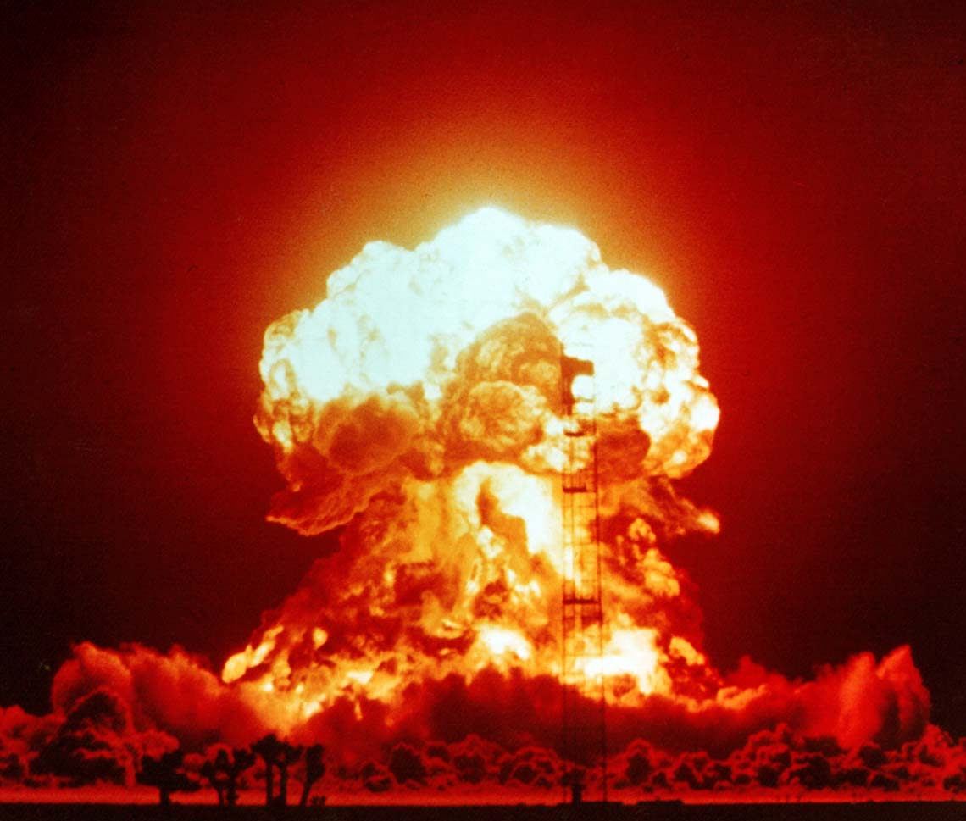

But if my house starts shaking and I look out the window and see this…
I am afraid when I see this guy aiming at me!
…the first fear fades away when faced with the greater fear!

Slide 10
Another Lesson about Faith and Fear (Matthew 14)
  v.22-24 “Immediately he made the disciples get into the boat and go before him to the other side, while he dismissed the crowds. And after he had dismissed the crowds, he went up on the mountain by himself to pray. When evening came, he was there alone, but the boat by this time was a long way from the land, beaten by the waves, for the wind was against them.”
  v.25-27 “And in the fourth watch of the night he came to them, walking on the sea. But when the disciples saw him walking on the sea, they were terrified, and said, ‘It is a ghost!’ and they cried out in fear. But immediately Jesus spoke to them, saying, ‘Take heart; it is I. Do not be afraid.’”
Notes:
vs.22 Jesus makes them go alone (but He is watching them)
vs.23 Among other things, Jesus was probably praying for them
vs.24 Another difficult journey
vs.25 The fourth watch (early morning while still dark). The “Sea of Gallilee” is big – it was no accident that Jesus walks withing their sight.
vs.26 Their fears culminate when He appears – they are terrified!
vs.27 “It is I. Don’t be afraid.” Literally, “I Am” (John 8:58)

Slide 11
Another Lesson about Faith and Fear (Matthew 14)
  v.28-29 “And Peter answered him, ‘Lord, if it is you, command me to come to you on the water.’ He said, ‘Come.’ So Peter got out of the boat and walked on the water and came to Jesus..”
  v.30-31 “But when he saw the wind, he was afraid, and beginning to sink he cried out, ‘Lord, save me.’ Jesus immediately reached out his hand and took hold of him, saying to him, ‘O you of little faith, why did you doubt?’”
  v.32-33 “And when they got into the boat, the wind ceased. And those in the boat worshiped him, saying, ‘Truly you are the Son of God.’”
Notes:
vs.28 Seeking guidance from Christ
vs.29 Taking a step of faith while looking to Jesus brings peace
vs.30 Taking your eyes off Jesus and looking at circumstances leads to fear
vs.31 He didn’t have zero fear, just little faith overwhelmed by big doubts
vs.32,33 When we remember Who Jesus is, our faith grows

Slide 12
Peace and Presence of God
Isaiah 26:3,4 Perfect Peace is possible when our mind is on Him
Isaiah 41:10 Who is guiding everything here?
Psalm 23:4 Even in the darkest place, “I will fear no evil, for you are with me;”
Psalm 23:5 Even in the presence of our enemies, He provides for us and blesses us.
1 Peter 5:7 He cares for you, so give Him your cares
Notes:
When you worship the One who mastered life and conquered death, you don’t need to let fear be your boss. Faith brings full meaning to Psalm 23:4,5 “Even though I walk through the valley of the shadow of death, I will fear no evil, for you are with me; your rod and your staff, they comfort me.
Even though Peter’s early life was filled with fear, he eventually spoke these words for all to read and believe (1 Peter 5:7): “cast all your cares on Him, because He cares for you.”

Slide 13
Peace and Presence of God
Matthew 10:28-31 Don’t be afraid of physical things – your eternal soul is infinitely more valuable. Trust the God who eternally loves His children (Rom 8:31-39).
Matthew 28:16-20 Our doubts and fears can be erased by faith in the One who has all authority!
Philippians 4:6,7 Pray about everything with thanksgiving – you can have the peace of God
Hebrews 2:14,15 Our greatest fear is conquered
Notes:
The apostles hid in fear after the crucifixion of Jesus (John 20:19), hated by the Jewish leaders and in danger. But after the resurrection, the empty tomb and risen Christ gave victory over anything that this broken world could produce. The apostles finally understood the full meaning of the message “fear not.” They came out of hiding, preached in the open, and changed the world. Basically, “fear not” changed the world. Why? because they lost their fear of death (Hebrews 2:14,15).

Slide 14
Some Sayings About Fear
If you look around, you'll be distressed. If you look within, you'll be depressed. If you look above, you'll be at rest.
If we’re not overwhelmed by God’s character, we’ll be overcome by fear.
Peace is not the absence of trouble – it is the presence of God.
Our greatest fear should not be of failure, but of succeeding at things in life that don't really matter.

