Slide 1
Topical Studies
Choice | Topic
1 | How can I deal with Fear?
2 | Is it ever right to do wrong?
3 | How to be a good Parent/Child?
4 | How to be a good Employee?
5 | How to Deal with my Sin?
6 | What is a Good Church?
7 | What is Life after Life after Death?
8 | What if God Doesn't Answer my Prayer?
9 | How should I think about Money?
10 | How can I know the Will of God?
11 | What is the Meaning of Life?
12 | Can a person lose their Salvation?
12 | Aren't all religions the same?
13 | How does the Holy Spirit work?
14 | How should I relate to the Lost World
15 | What is Baptism?
16 | Can people really talk to God ((prayer)?
17 | How to recognize False Teachers?
19 | How long is Time and Eternity?
20 | Does God control everything?
21 | How can I share the Gospel?

Slide 2
Life After Death
Death is not the end…

Slide 3
Important Truths from the Bible
Time and Eternity
Life after Death
Life after Life after Death

Slide 4
Old Days Timeline
22-July-2026
No Beginning
Bible Study
No
End

Slide 5
Old Days Timeline
1957
20XX
No Beginning
No
End
Mark
born
Mark
dies

Slide 6
Modified Timeline
The Universe
No Beginning
Beginning
No
End
Outside of time and space:
God
In the beginning,
“with the Lord one day is as a thousand years, and a thousand years as one day.” 2 Peter 3:8

Slide 7
Modified Timeline
The Universe
No Beginning
Beginning
No
End
Outside of time and space:
God
“in the hope of eternal life, which God, who does not lie, promised before the beginning of time.” Titus 1:2

Slide 8
Biblical Time
The Universe
No Beginning
The End
Beginning
No
End
Outside of time and space:
God
“But the day of the Lord will come like a thief, and then the heavens will pass away with a roar, and the heavenly bodies will be burned up and dissolved,” 2 Peter 3:10

Slide 9
Biblical Time and Eternity
The Universe
No Beginning
The End
Beginning
No
End
Mark
born
Mark
dies
“He has also set eternity in the hearts of men.” Ecclesiastes 3:11
God

Slide 10
Jesus’ Resurrection Gives Hope
“And if Christ has not been raised, your faith is futile and you are still in your sins. Then those also who have fallen asleep in Christ have perished.” 1Corinthians 15:17,18
“But in fact Christ has been raised from the dead, the firstfruits of those who have fallen asleep.” 1Corinthians 15:20
“Jesus said to her, ‘I am the resurrection and the life. Whoever believes in Me, though he die, yet shall he live, and everyone who lives and believes in Me shall never die. Do you believe this?’” John 11:25,26
“For since we believe that Jesus died and rose again, even so, through Jesus, God will bring with Him those who have fallen asleep.” 1Thessalonians 4:14

Slide 11
Spiritual Resurrection
“The poor man died and was carried by the angels to Abraham's side. The rich man also died and was buried, and in Hades, being in torment, he lifted up his eyes and saw Abraham far off and Lazarus at his side.” Luke 16:22-23
“And he said, ‘Then I beg you, father, to send him to my father's house—for I have five brothers—so that he may warn them, lest they also come into this place of torment.’ But Abraham said, ‘They have Moses and the Prophets; let them hear them.’” Luke 16:27-29
“Yes, we are of good courage, and we would rather be away from the body and at home with the Lord.” 2Corinthians 5:8
After death, people immediately go to their destiny.

Slide 12
Spiritual Resurrection
“If I am to live in the flesh, that means fruitful labor for me. Yet which I shall choose I cannot tell. I am hard pressed between the two. My desire is to depart and be with Christ, for that is far better.” Philippians 1:22,23
“Where, O death, is your victory? Where, O death, is your sting?” The sting of death is sin, and the power of sin is the law. But thanks be to God! He gives us the victory through our Lord Jesus Christ.” 1Corinthians 15:55-57
At the point of death, the spirit of a Christian immediately goes to be with Christ. (2 Corinthians 5:2-5)
This is Life after Death.

Slide 13
Life after Life after Death
Your body is important:
“Now may the God of peace himself sanctify you completely, and may your whole spirit and soul and body be kept blameless at the coming of our Lord Jesus Christ.” 1 Thessalonians 5:23
“Though our outer self is wasting away, our inner self is being renewed day by day. For this light momentary affliction is preparing for us an eternal weight of glory beyond all comparison. For we know that if the tent that is our earthly home is destroyed, we have a building from God, a house not made with hands, eternal in the heavens.” 2 Corinthians 4:16,17; 5:1
“For the Lord himself will descend from heaven with a cry of command, with the voice of an archangel, and with the sound of the trumpet of God. And the dead in Christ will rise first. Then we who are alive, who are left, will be caught up together with them in the clouds to meet the Lord in the air, and so we will always be with the Lord. ” 1 Thessalonians 4:16,17

Slide 14
Life after Life after Death
The Christian hope includes a body:
“So will it be with the resurrection of the dead. The body that is sown is perishable, it is raised imperishable; it is sown in dishonor, it is raised in glory; it is sown in weakness, it is raised in power; it is sown a natural body, it is raised a spiritual body.” 1 Corinthians 15:42-44
For the perishable must clothe itself with the imperishable, and the mortal with immortality. When the perishable has been clothed with the imperishable, and the mortal with immortality, then the saying that is written will come true: “Death has been swallowed up in victory.” 1 Corinthians 15:53-54
“But our citizenship is in heaven, and from it we await a Savior, the Lord Jesus Christ, Who will transform our lowly body to be like His glorious body, by the power that enables Him even to subject all things to Himself. Philippians 3:20-21

Slide 15
Life after Life after Death
We need a new body to survive in the presence of God! “And one called to another and said: “Holy, holy, holy is the LORD of hosts; the whole earth is full of his glory!” And the foundations of the thresholds shook at the voice of him who called, and the house was filled with smoke. And I said: “Woe is me! For I am lost; for I am a man of unclean lips, and I dwell in the midst of a people of unclean lips; for my eyes have seen the King, the LORD of hosts!” Isaiah 6:3-5
We need a new body to enjoy heaven personally! “In my Father's house are many rooms. If it were not so, would I have told you that I go to prepare a place for you? And if I go and prepare a place for you, I will come again and will take you to myself, that where I am you may be also.” John 14:1-3
We grieve, but not like others. “Brothers and sisters, we do not want you to be uninformed about those who sleep in death, so that you do not grieve like the rest of mankind, who have no hope.” 1 Thessalonians 4:13
This is Life after Life after Death.

Slide 16
What Now?
With this future in mind, how should we live today?
“Therefore, beloved, since you are waiting for these, be diligent to be found by him without spot or blemish, and at peace. And count the patience of our Lord as salvation, … You therefore, beloved, knowing this beforehand, take care that you are not carried away with the error of lawless people and lose your own stability. But grow in the grace and knowledge of our Lord and Savior Jesus Christ. To Him be the glory both now and to the day of eternity. Amen.” 2 Peter 3:14-18

Slide 17
What Now?
With this future in mind, how should we live today?
“Therefore, beloved, since you are waiting for these, be diligent to be found by him without spot or blemish, and at peace. And count the patience of our Lord as salvation, … You therefore, beloved, knowing this beforehand, take care that you are not carried away with the error of lawless people and lose your own stability. But grow in the grace and knowledge of our Lord and Savior Jesus Christ. To Him be the glory both now and to the day of eternity. Amen.” 2 Peter 3:14-18

Slide 18
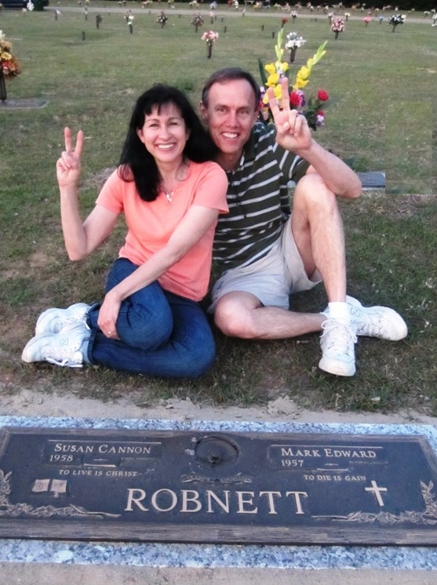
“So teach us to number our days that we may get a heart of wisdom.” Psalm 90:12
I write these things to you who believe in the name of the Son of God so that you may know that you have eternal life. 1John 5:13

