Slide 1
How to be a Good Parent
From the Bible (and old parents)

Slide 2
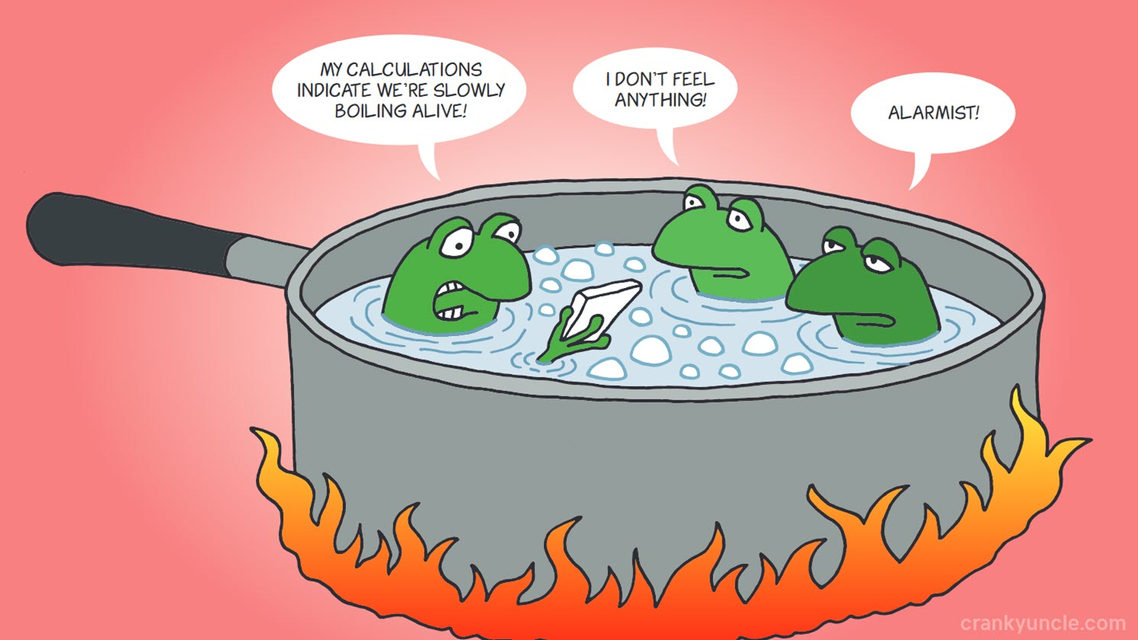
Our culture impacts our parenting
Sadly, as our culture drifts further from God, we are slowly adjusting our parenting approaches away from His Word.

Slide 3
Some Basic Principles of Parenting
Fill your home with love for God and each other:
  “Love the LORD your God with all your heart and with all your soul and with all your strength. Deuteronomy 6:5
  “Husbands, love your wives, as Christ loved the church and gave himself up for her,” Ephesians 5:25
  “Older women … teach what is good, and so train the young women to love their husbands and children,” Titus 2:3,4
When a child knows his parents love each other, they will be more secure, less stressed, and behave better.
Intentionally demonstrate love for each other every day
Notes:
As a parent, we have some very clear responsibilities. Deuteronomy 6:4-9 commands the parents to take the law of God into their hearts and train up their children in His ways. It was not just an occasional activity, but one that must saturate every area of life.
Teaching the Bible to our children doesn’t guarantee that they will become Christ followers, but apart from the Scripture, there is no other basis for faith.
“Couch Time” –

Slide 4
Some Basic Principles of Parenting
Fill your home and life with God’s Word:
  “These commandments that I give you today are to be on your hearts. Impress them on your children. Talk about them when you sit at home and when you walk along the road, when you lie down and when you get up.” Deuteronomy 6:6-7
  “I am reminded of your sincere faith, a faith that dwelt first in your grandmother Lois and your mother Eunice and now, I am sure, dwells in you as well.” “But as for you, continue in what you have learned and have firmly believed, knowing from whom you learned it and how from childhood you have been acquainted with the sacred writings, which are able to make you wise for salvation through faith in Christ Jesus.” 2 Timothy 1:5, 3:14-15
Not just as an external show, but genuinely loving God’s word, walking by His Spirit
Notes:
As a parent, we have some very clear responsibilities. Deuteronomy 6:4-9 commands the parents to take the law of God into their hearts and train up their children in His ways. It was not just an occasional activity, but one that must saturate every area of life.
Teaching the Bible to our children doesn’t guarantee that they will become Christ followers, but apart from the Scripture, there is no other basis for faith.

Slide 5
Some Basic Principles of Parenting
Love your children and meet their needs:
  “What father among you, if his son asks for a fish, will instead of a fish give him a serpent; or if he asks for an egg, will give him a scorpion? If you then, who are evil, know how to give good gifts to your children, how much more will the heavenly Father give the Holy Spirit to those who ask him!” Luke 11:11-13
Be a human example of their heavenly Father
Train your child’s actions AND their heart:
  “Children, obey your parents in everything, for this pleases the Lord. Fathers, do not provoke your children, lest they become discouraged.” Colossians 3:21,22
Notes:
In Ephesians 6:4, further instruction is given to fathers: do not exasperate your children, but bring them up in the training and instruction of the Lord.” Not only should a father care about what a child does, be he must also be concerned about how the child feels. It’s not enough to simply have your child’s obedience, a father must also be concerned about his heart. Imagine the amount of cultural stress that these words introduced during those days!

Slide 6
Some Basic Principles of Parenting
Children must be taught respect:
  “Honor your father and your mother, so that you may live long in the land the LORD your God is giving you.” Exodus 20:12
If we don’t teach them to respect their parents, they will not learn to respect God.
Expect children to obey godly requests:
  “Children, obey your parents in the Lord, for this is right. “Honor your father and mother” — which is the first commandment with a promise — “so that it may go well with you and that you may enjoy long life on the earth.” Ephesians 6:1-3
Discipline children for active rebellion (but not for childish mistakes).
  “Whoever spares the rod hates his son, but he who loves him is diligent to discipline him.” Proverbs 13:24
Notes:
But we can’t stop here and be true to the Bible. Look at Ephesians 6:1-3. The passage begins by reminding the child of their obligation to obey and honor their parents, consistent with the truth taught throughout the Bible. But it also includes the important phrase “in the Lord.” What does this mean? Note that Paul is writing this letter to the church – to Christians. When he writes this command, he is assuming that the requests of parents to their children will be consistent with scriptural principles and oriented to kingdom priorities.

Slide 7
What does Honor/Respect look like?
Looks like this:
Not like this:
Polite in words, attitudes and actions.
Listen carefully, ask questions, and think before speaking.
Be helpful, always being ready to serve in big and small ways.
Recognize and respect people in positions of authority
Try to resolve issues, forgive and forget.
Protect the dignity of others.
Love people – use things.
Rude, insulting, careless
Ignoring counsel, interrupting, rolling eyes, no eye contact, etc
Selfish, Walking away from opportunities to serve
Thinking about oneself higher than others
Anger, bitterness, complaining and shouting.
Critical “behind the back.”
Love things – use people.

Slide 8
An Important Goal of Parenting
Your children are sinners and need your help: “Foolishness is bound up in the heart of a child; the rod of discipline will remove it far from him.” Proverbs 22:15
“Fathers, do not exasperate your children; instead, bring them up in the training and instruction of the Lord.” Ephesians 6:4
“bring them up” = ektrepho: to rear up to maturity
Maturity is not just getting older or gaining independence (there are many immature older, independent people).
Maturity can be seen in three areas:
  Self-control; Responsibility; and Wisdom

Slide 9
Self-Control
(Proverbs 16:32, 25:28, 29:15; 1 Cor 6:12; James 1:19)
Self-Control is:
  Able to say “no” to self and “yes” to what is right
  Not mastered by human passions
  Able to obey the first time
  Doesn’t respond with anger
Lack of Self-Control is:
  Self-centered, impatient, complaining when asked to wait
  Ungrateful, demanding, uncaring for others
  Focused on self, pleasure, fun, entertainment
  Whines and complains when he doesn’t get what he wants
Notes:
Self-Absorbed people:
Live as if the world revolves around them
Push and lobby to get what they want, persisting even after being refused
Are seldom happy, complain and whine often, and are rarely content
Expect life to be exciting, demand entertainment, and are constantly bored
Have a low tolerance for waiting

Slide 10
Responsibility
(Proverbs 6:6-11, 13:4, 22:29; 1 Corinthians 15:58)
Responsibility is:
  Accepts personal accountability for his actions
  Can be counted on to do what is asked
  Faithful and conscientious in work habits
  Operates with integrity and reliability
Lack of Responsibility is:
  Makes excuses or blames others for his failures
  Unwilling to live with consequences of his choices
  Has a “victim” mentality, entitled to whatever he wants
  Compulsively plays when it is time to work
Notes:
Irresponsible people:
Nothing is ever their fault
Do not see their penalty as a consequence of their bad choice, but are angry at the person who caught them
Despise opportunities to serve others, particularly their siblings
Roll their eyes when asked to do a chore, complaining or disappearing
Rarely ask: “Is there anything more that I can do?”

Slide 11
Wisdom
(Proverbs 1:8-9, 13:1, 15:5, 22:6, 23:15)
Wisdom is:
  Not afraid to fail – learns from mistakes
  Thinks clearly and makes rational decisions
  Handles stressful problems with a calm attitude
  Can choose between “better” and “best”
Lack of Wisdom is:
  Pursues gratification without regard to consequences
  Not teachable, considering himself always right
  Wasteful with time, money, resources
  Makes foolish choices even though highly educated
Notes:
Wise people don’t just know the difference between good and bad, but better and best
Unwise people:
Reasoning facilities are clouded by their passions and obsessions
Squander money
Retaliate as if they were small children

Slide 12
Some Parenting Ideas
Ask: will this activity, entertainment, relationship, etc. develop maturity or immaturity?
Teach children that they can find contentment even when they don’t get their way (they don’t always get their first choice in this life).
Don’t finish a child’s job for them
Allow them to make age-appropriate decisions. When they fail, teach them that recovery is possible.
Design challenges for you children to teach self-control.
Participate in your child’s teenage activity (if possible)

Slide 13
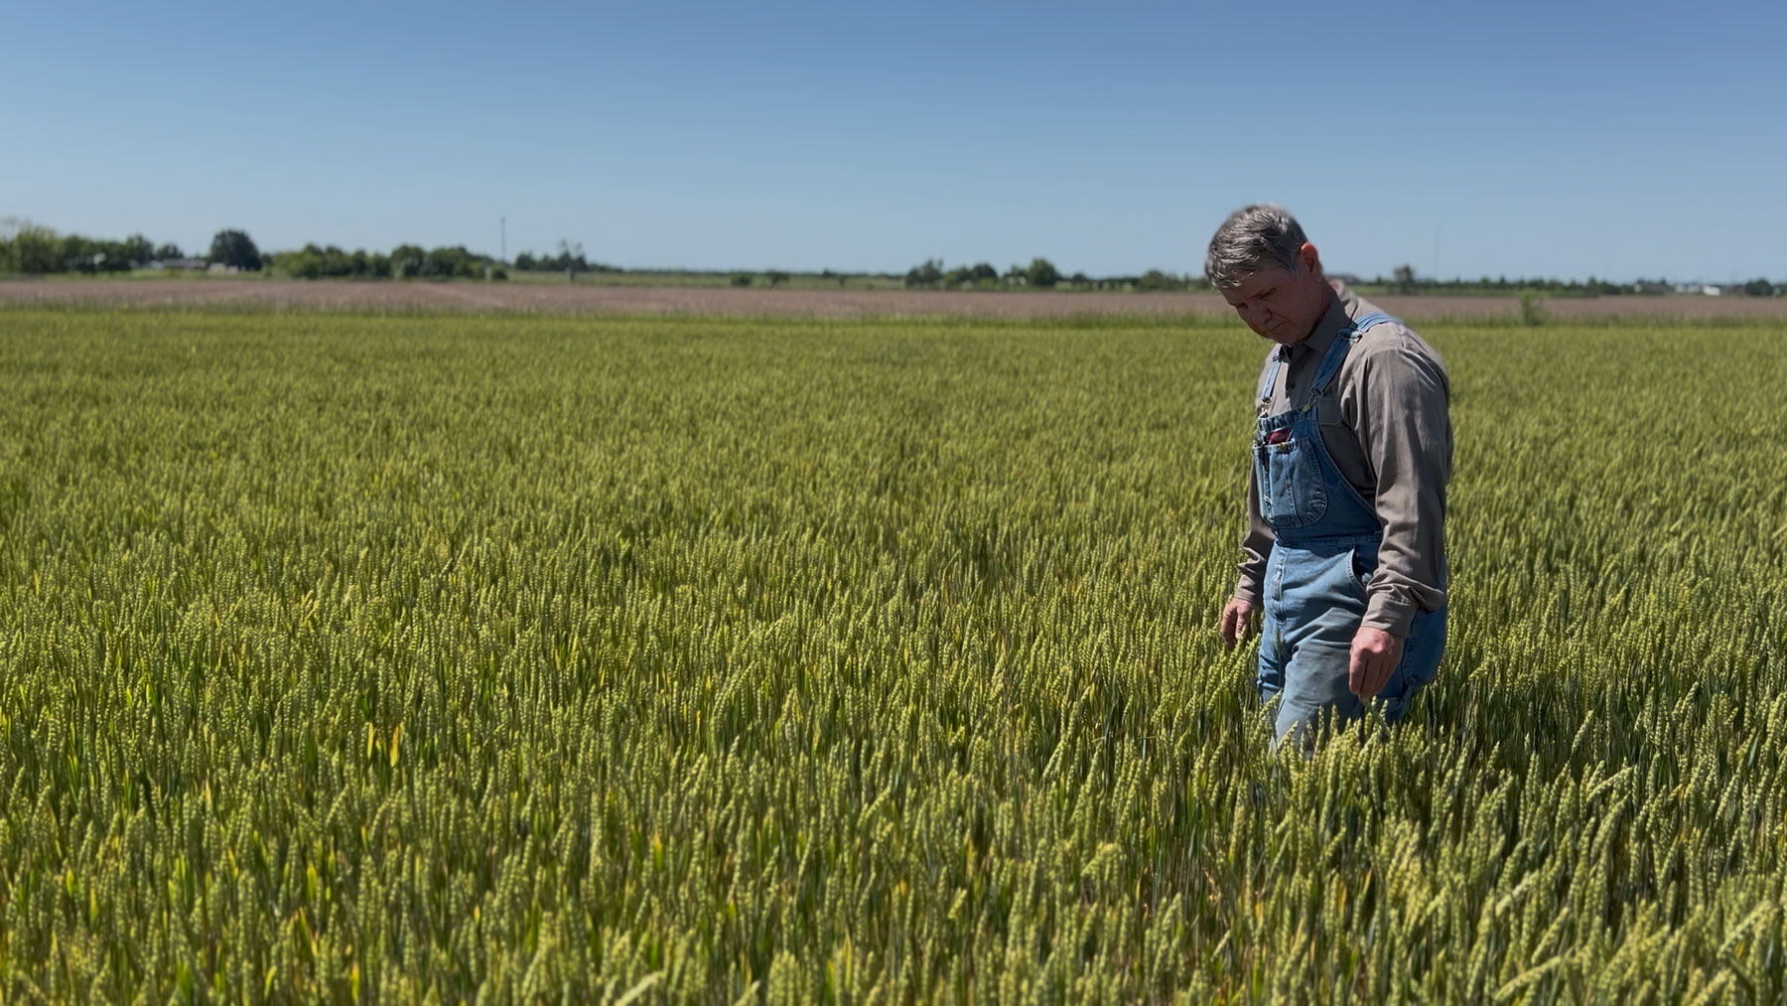
Wise Parents Pay Attention
A good farmer waters his crop, fertilizes it, removes unhealthy weeds and bugs, and brings it safely to market.
What does a good parent do to help his child flourish?
Notes:
So, with that as background, how to we relate to our parents and their expectations of us? First, recognize that when a person becomes a Christian, God changes them into a new person (2 Corinthians 5:17). They begin to show the fruit of the Spirit in their life as described in Galatians 5:22-23. When we believe in Jesus, the way that we treat our parents should be a great improvement, in actions and in attitude. It should be noticeably different, a difference that blesses our parents.

Slide 14
Some Takeaways
Fill your home with love for God, for each other, and for His word
Train your child’s actions and their attitude
Teach your children to honor their parents, honor God, and respect authorities
Train your children to become mature adults:
  Self-Control
  Responsibility
  Wisdom

Slide 15
Stages of Parenting
Additional Information
Adapted from “The Marriage Course”, 2015 Alpha International, London, UK

Slide 16
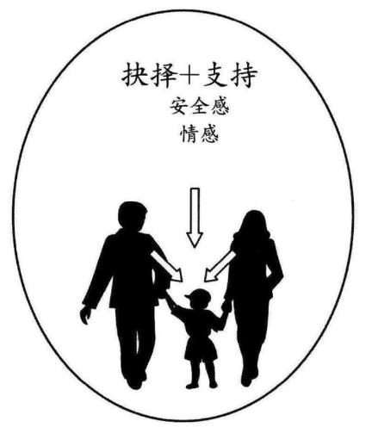
Parents of Young Children
Meet their physical and emotional needs
Set appropriate boundaries and make decisions
Provide stability and good role models
Show unconditional love
Decisions + Support
Encouragement
Affection
Comfort
Security

Slide 17
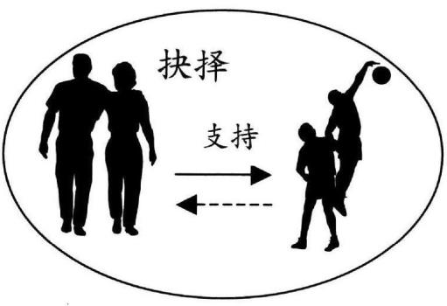
Parents of Teenage Children
Give increasing independence: allow decisions and failure
Continue meeting physical and emotional needs
Set appropriate boundaries
Teach them to serve others
Decisions
Support

Slide 18
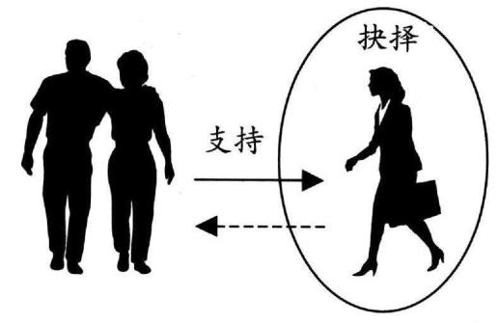
Parents of College/Young Adult Children
Give support and advice
Allow independence and encourage them to make their own decisions
Allow them to develop adult relationships
Decisions
Support

Slide 19
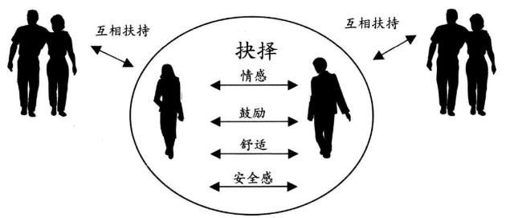
Parents of Newly Married “Children”
Allow new decision-making structures
Parents relate to the couple, not individuals
Respect appropriate boundaries, enabling marriage unity while supporting needs of parents
Mutual Support
Mutual Support
Decisions
affection
encouragement
“Therefore a man shall leave his father and his mother and hold fast to his wife, and they shall become one flesh.”
Genesis 2:24
comfort
security

Slide 20
Parents and Adult Children
Possible “stress points”
Children cannot discuss issues in a way that brings understanding and mutual respect
Education is king – everything else must wait.
Pressure to marry a certain person and have a child.
Pressure to buy a house and remain within parent’s social community.
Parents unfavorably compare you with others
Pressure to seek a prestigious career (or a stable job) that brings pride (or security) to parents.
Constant, guilty reminders of duty and obligation.
Pressure to “do what is expected,” not “do what seems right to me”
Something else…?
Notes:
Before we examine some Bible passages, I want to ask you this: In your culture, what is generally expected about how parents relate to their children (and vice versa)? In your family, what specific things might have been different vs. general cultural expectations?
What things do your parents need the most from you? Advice, Companionship, Conversation, Encouragement, Practical Help, Security, Understanding, Other Needs?

