Slide 1
Practical Prayer Pointers
Who, Why, When, Where, and How

Slide 2
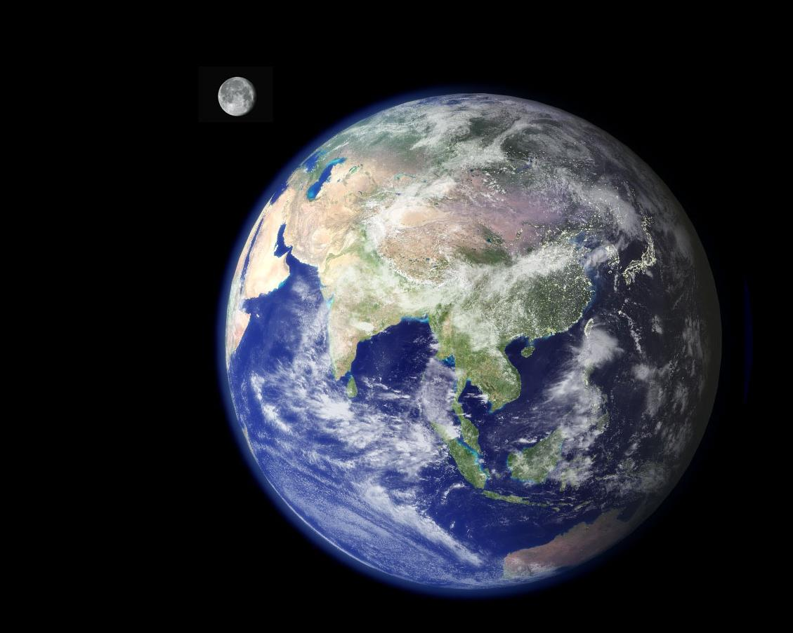
Planet Earth
8,000,000,000 People
Notes:
There are about 8 billion people on Planet Earth. You are just one voice among billions.

Slide 3
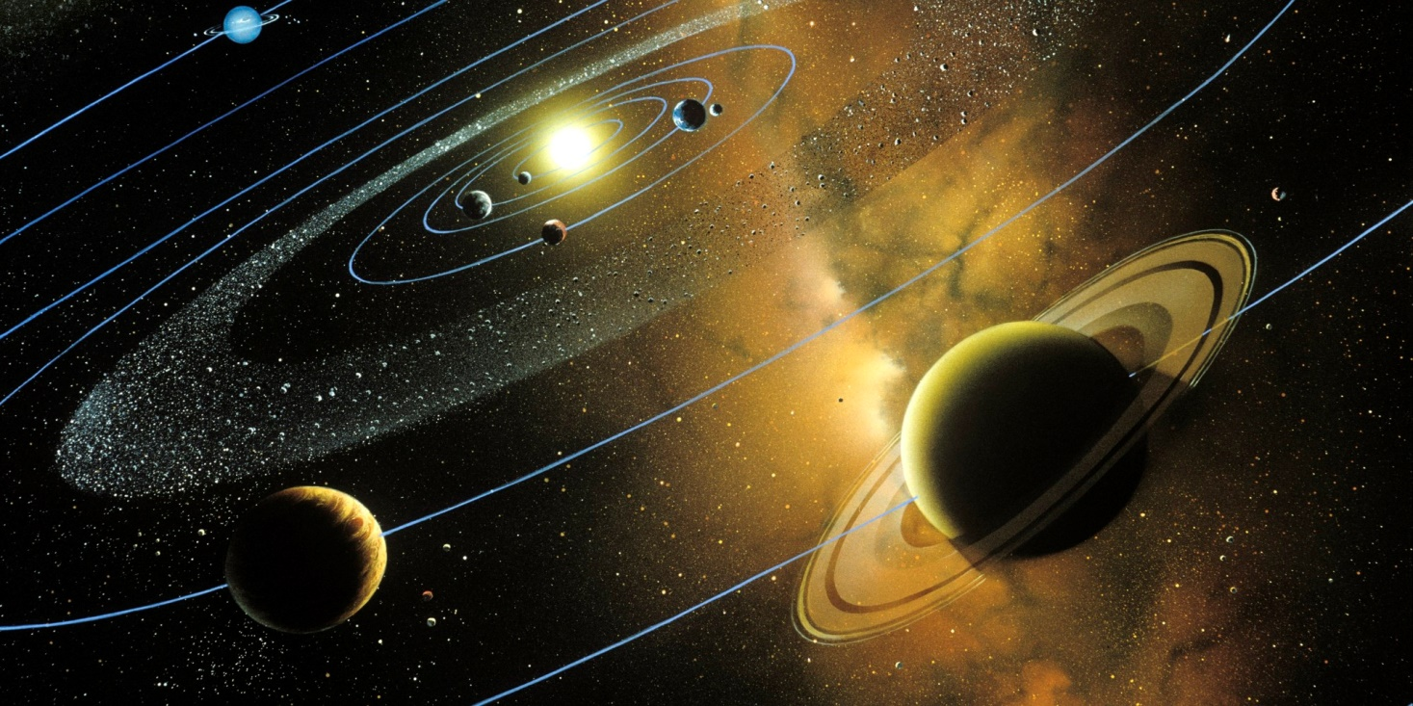
Our Solar System
One star, 9 planets, 1.5 light years across
Notes:
But Planet Earth is just one of 9 planets in our solar system (counting Pluto). Our solar system is big: 1.5 light years in diameter and contains one medium-sized star.

Slide 4
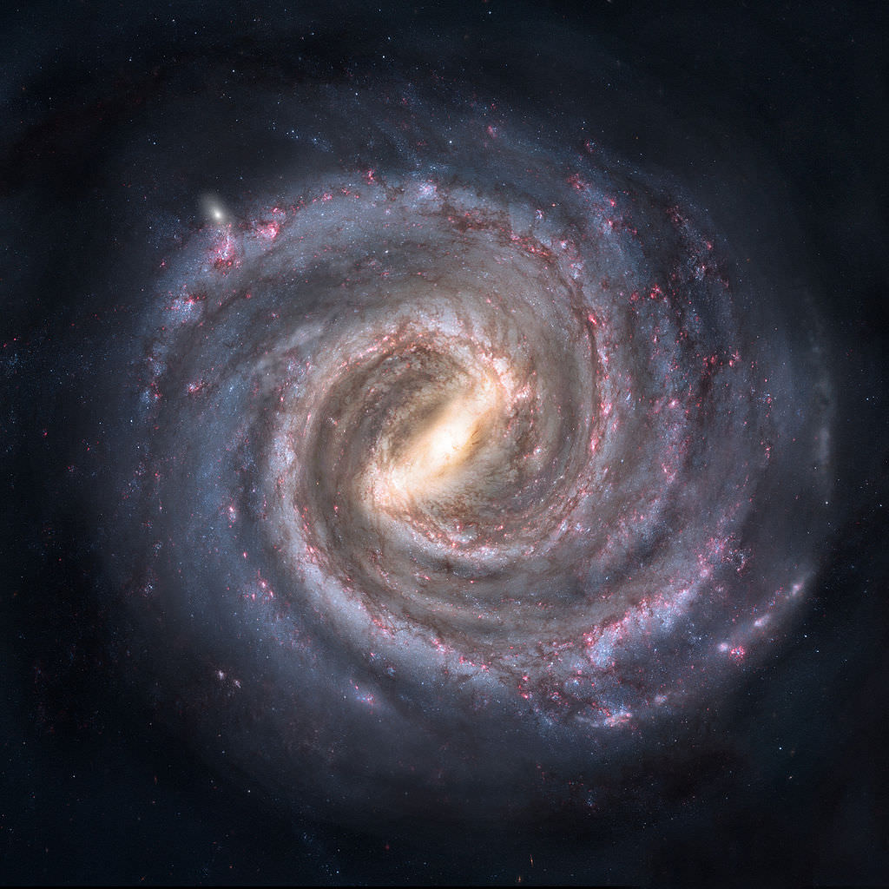
The Milky Way Galaxy
100,000 light years across
About 250,000,000,000 stars
Notes:
But our solar system is just one of the 250 Billion stars in the Milky Way galaxy, which is about 100,000 light years in diameter. Our solar system is just a tiny speck located about midway to the edge, between the Sagittarius arm and the Perseus Arm.

Slide 5
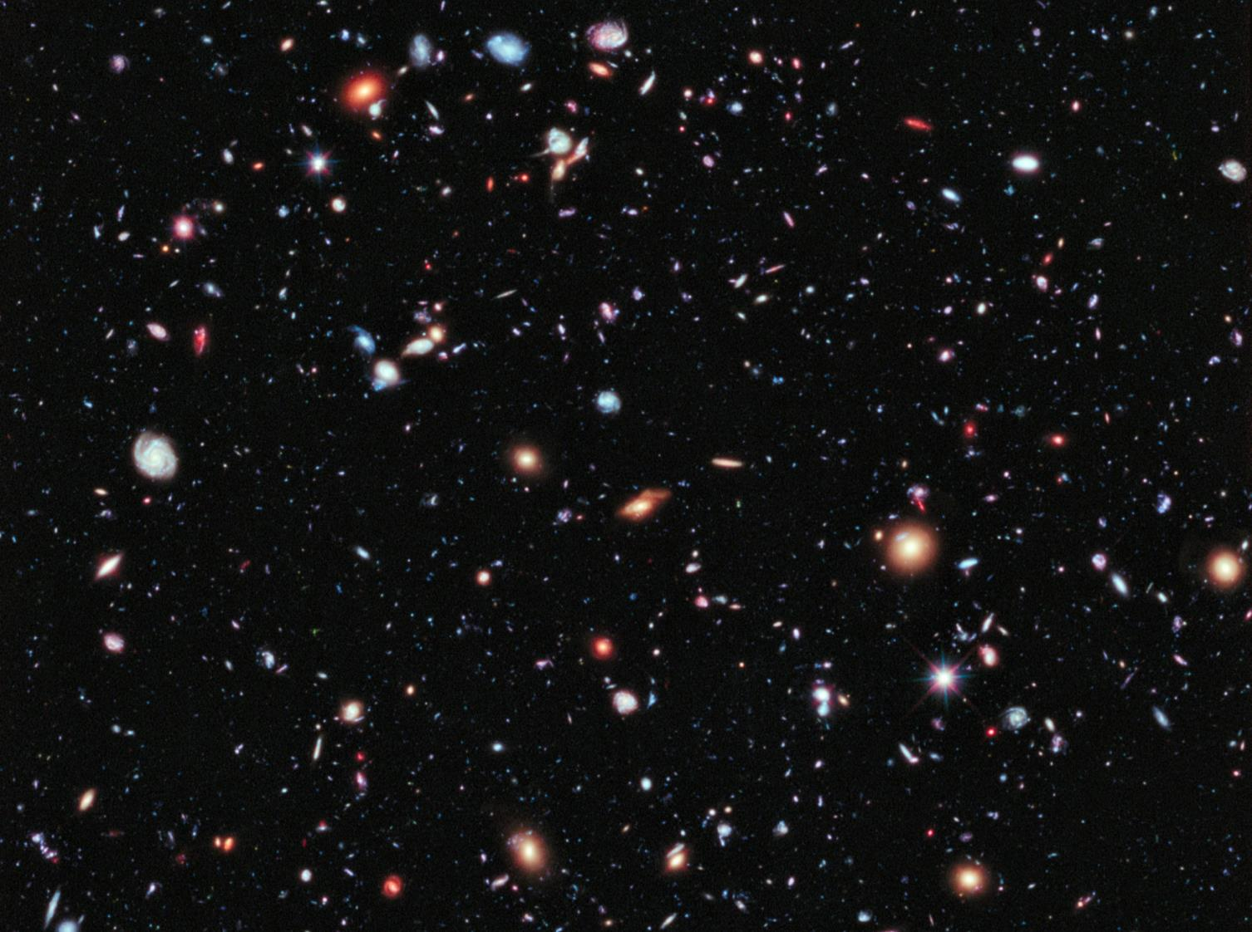
“To whom will you compare me? Or who is my equal?” says the Holy One. Lift up your eyes and look to the heavens: Who created all these? He who brings out the starry host one by one and calls forth each of them by name. Isaiah 40:25,26
The Universe
93,000,000,000 light years across
Notes:
But our galaxy is just one of 50 Billion in the universe. Recent estimates have determined that the universe is 93 billion light years across, an unimaginable distance.
When I consider the size of the universe, I think about the God who created it, the God who is infinitely bigger and more powerful. Think for a moment about God's majesty: infinitely greater than the rulers and "great men" of yesterday and of our time: Alexander, Nebuchadnezzar, Napoleon, Adolph Hitler, Mao Tse-Tung, George Washington… in comparison to God, they are meaningless, blown away and forgotten. And when we compare planet Earth to God, it vanishes into an insignificant speck.
And that brings me to the challenging question: Can human beings talk to Him?

Slide 6
“When I consider your heavens, the work of your fingers, the moon and the stars, which you have set in place, what is mankind that you are mindful of them, human beings that you care for them? Psalm 8:3,4
The Universe
93,000,000,000 light years across
In such a huge universe, why would we think that the Creator would listen to us?
Notes:
We have a huge struggle in life: when we think of someone who truly loves us, we think of our mother: close, but kind of weak. But when we think of someone powerful, we think about the kings and leaders of nations: strong, but distant ("your majesty"). We do not have an example of One who is both, and because we can’t think about things without a physical basis for comparison, our brains can’t connect the dots.
But the Creator God is not like anything we have ever experienced in the created world. From the very beginning, we see God’s presence with man in the garden, talking to him, calling out to him, caring for him, and saddened by human wickedness. This God is also the powerful huge enough to call order out of chaos and detailed enough to change the language of every human being at the tower of Babel.
Even though God is infinitely greater than anything we can imagine, He searches and knows each one of us, including words that we are yet to say (Psalm 139:1-6). His knowledge of every detail of everything is impossible for us to dream about. He knows about every hair on every head of everyone on the planet (Luke 12:6,7).

Slide 7

God’s desire for you
Strong tea requires boiling water and long soaking
Bible
Strong faith also requires boiling water and
long soaking
An easy, comfortable life … ?
(Proverbs 30:7-9)
Prayer
To Know Him
(2 Corinthians 12:7-10; Philippians 3:7-8)

Slide 8
Some Barriers to Prayer
BITTERNESS towards your spouse or friend. 1Peter 3:7; Ephesians 4:30-32
UNCONFESSED sin. Psalm 66:18-20
Asking with SELFISHNESS or other wrong motives. James 4:3
INSENSITIVITY to the Word of God. Proverbs 28:9
“Prayer is a war-time walkie-talkie, not a domestic intercom. We use prayer to call in troops and reinforcements during spiritual battles, not to call the butler to bring another pillow!” (John Piper)

Slide 9
Prayers that God “Hears” (Matthew 6)
NOT because we speak with skill to impress others (v.5)
But because we speak about our real life to the real God (v.6). It is a personal conversation.
NOT because we mindlessly repeat words (v.7)

Slide 10
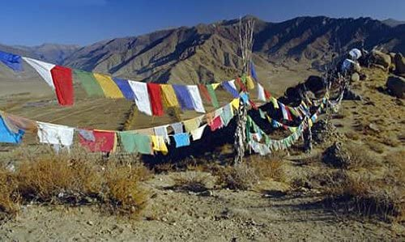
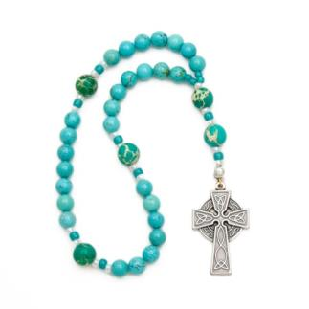
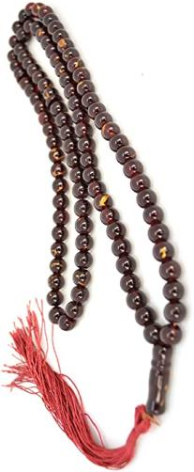
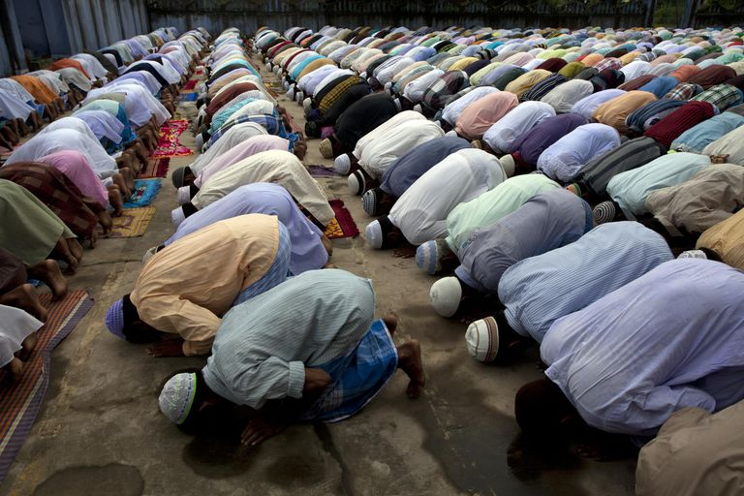
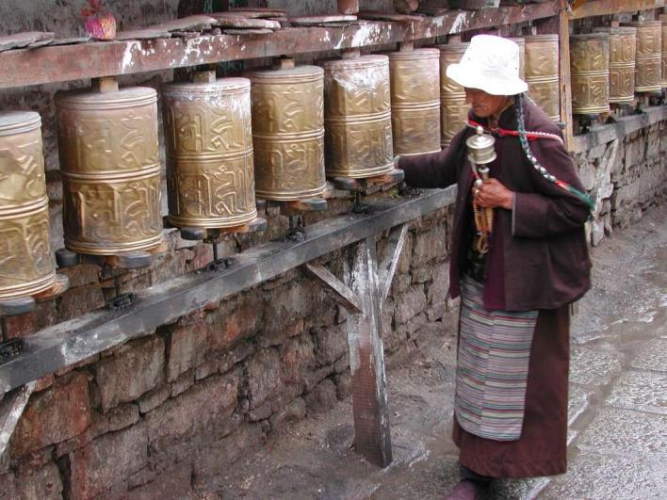
With Repetition (Matthew 6:7-8)

Slide 11
Prayers that God “Hears” (Matthew 6)
NOT because we speak with skill to impress others (v.5)
But because we speak about our real life to the real God (v.6). It is a personal conversation.
NOT because we mindlessly repeat words (v.7)
But because we know the God who understands our needs already (v.8), we come humbly before Him (1 Peter 5:6,7).

Slide 12
Humility sees the Truth about God
God replied to Moses, “I AM WHO I AM.” Exodus 3:14
“You know when I sit down and when I stand up; You understand my thoughts from far away. Before a word is on my tongue, You know all about it, LORD.” Psalm 139:2,4
“For My thoughts are not your thoughts, and your ways are not My ways.” For as heaven is higher than earth, so My ways are higher than your ways, and My thoughts than your thoughts.” Isaiah 55:8,9

Slide 13
Humility sees the Truth about Me
“as it is written: There is no one righteous, not even one. There is no one who understands; there is no one who seeks God. For all have sinned and fall short of the glory of God.” Romans 3:10,11,23
“you do not know what tomorrow will bring. What is your life? For you are a mist that appears for a little time and then vanishes.” James 4:14
“Humble yourselves, therefore, under the mighty hand of God so that at the proper time he may exalt you, casting all your anxieties on Him, because He cares for you.” 1 Peter 5:6,7

Slide 14
Prayers that God “Hears” (Matthew 6)
NOT because we speak with skill to impress others (v.5)
But because we speak about our real life to the real God (v.6). It is a personal conversation.
NOT because we mindlessly repeat words (v.7)
But because we know the God who understands our needs already (v.8), we come humbly before Him (1Peter 5:6,7).
But because He is Our Father and hears the prayers of His child (v.9); (Hebrews 4:15,16; 1 John 3:1)

Slide 15
Some Prayer Thoughts
What does it mean to pray “in Jesus’ name”? (e.g. John 14:13-14). This is not a “lucky charm” to get what you want. We pray consistent with His character, seeking His glory, and desiring to grow His kingdom.
Does my prayer have any effect? God is all-powerful and does whatever He pleases (Psalm 115:2,3), but He also says that effective prayer can accomplish much (James 5:16). When we obediently pray, we join God’s providential plan (e.g. Acts 8:25-40).
Pray anywhere and anytime. (1 Thessalonians 5:16-18; Nehemiah 2:4). A proper prayer life results in peace of heart and mind (Philippians 4:6-7).

Slide 16
Some Other Prayer Thoughts
Does God answer all my prayers? Yes, but not always the way or at the time you may want Him to. Trust Him as a good Father who gives the best to His children. We may not understand the ways of God (Isaiah 55:8,9), but we can always be confident in His love (Psalm 103:11). Silence does not mean absence (e.g. John 11:6).
Don’t expect apostolic healing. God can (and does) still perform miracles of healing but recognize that the apostles were given special gifts as testimony to prove the truth of the word spoken through them (2 Corinthians 12:12).
Pray, even in ignorance. Romans 8:26-27 makes it clear that we don’t always know how to pray or what to pray for. But the Holy Spirit intercedes for you in prayer. You don’t need to be perfect, just obedient.

Slide 17
Some Other Prayer Thoughts
Be honest with God. Almost half of the Psalms are desperate cries to God in the midst of distress (e.g. Psalm 6:1-7; Psalm 55:1-8). Since a Christian has been given a new heart, it is reasonable to feel sorrow more deeply. Remember, Jesus prayed agonizing words in the garden.
Tears of hope. You will experience times of weeping, but God makes an important promise – it will turn to joyful harvest (Psalm 126:5,6).
Keep prayer notes. You may want to keep a prayer journal to help you remember what to pray for and to be thankful for His answers.
Praying out loud can help you focus. If your mind begins to wander, pray out loud, even if you are alone.
Notes:
The position of your heart matters more than the position of your body.

Slide 18
A Framework for Prayer : PRAY
PRAY: Praise, Repent, Ask, Yield
This is not a formula, but a way to remember important parts of prayer.
Praise - We adore something when we see its beauty and our heart is filled with praise and worship.
  The Psalms provide helpful truth for meditation and worship (e.g. Psalm 34:1).
  The truth from God’s Word inspires us to adore Him (Isaiah 40:12-14, 21-24, and 25-26)
  Thank God for everything that He has done (Psalm 100:1-5; 1Thessalonians 5:16-18).

Slide 19
A Framework for Prayer : PRAY
Repent – The closer we get to the holy God, the more we become aware of our sinfulness
  We must not keep silent about our sin, but confess and receive forgiveness (Psalm 32:1-5).
  Ask God for help to understand sins that are hard to see (Psalm 139:23,24).
  God will cleanse us and restore our relationship with Him (1John 1:9).

Slide 20
A Framework for Prayer : PRAY
Ask – He is a good Father and knows the best way to meet your needs
  Don’t just pray for brief, earthly success – keep His eternal kingdom in mind. (Matthew 6:33; Philippians 1:4,9-11).
  It can be a sin NOT to pray for others (1 Samuel 12:23).
  God is your Father and cares deeply about your needs (Matthew 6:31-33).
  He knows your needs, but still desires for you to talk with Him (1 Peter 5:6,7; Matthew 6:11; 7:11; James 4:2).
  Don’t be afraid to ask others to pray for you (2Corinthians 1:11; 2 Thessalonians 3:1).

Slide 21
A Framework for Prayer : PRAY
Yield - Ask for God to soften our hearts and make our desires line up with His
  Sadly, it is natural to rebel and be hard hearted (like Pharaoh in Exodus 7:14). Ask for His grace to desire Him (Psalm 37:4,5).
  Blessing comes from surrender to God, not resistance. We need His grace to offer ourselves to Him and His will every day (Romans 6:13,14; 12:1,2)
  Ask for His grace to follow Him, even through the difficulties each day (Mark 8:34)
  The best example: Luke 22:39-42

