Slide 1
Living in a Troubled World
In the world, but not of it
Notes:
I don’t need to tell you that we live in a troubled world. More than ever, we look around and see nations bombing nations, businesses cheating people (e.g. “pig-butchering”), and individuals offending one another. By now, you know the root of the problem..

Slide 2

at the root of our troubled world…
Notes:
God created a beautiful world. But because of Adam’s sin, we have all inherited death…

Slide 3
Because of sin, two kinds of people:
(Ephesians 2)
2:1-2 “As for you, you were dead in your transgressions and sins, in which you used to live when you followed the ways of this world and of the ruler of the kingdom of the air, the spirit who is now at work in those who are disobedient.”
2:4-5 “But because of His great love for us, God, who is rich in mercy, made us alive with Christ even when we were dead in transgressions—it is by grace you have been saved.”
2:8 “For it is by grace you have been saved, through faith—and this is not from yourselves, it is the gift of God”
Romans 10:9 “If you declare with your mouth, ‘Jesus is Lord,’ and believe in your heart that God raised him from the dead, you will be saved.”
Notes:
The bad news: sin leaves every person separated from God – spiritually dead.
The good news: God loves people, and at great cost to Himself, has provided a way to be made alive again! It would be impossible for is to pay for our sin, so God did what we could never do: became a man and took our place to take our sin away and make us born again to new life.
To be saved is a wonderful gift, but like any gift, it can be received or refused.
To declare Jesus as Lord means that we abandon our own way (“I am Lord, my parents are Lord, my career is Lord…”)

Slide 4
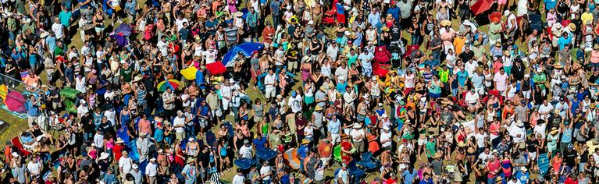
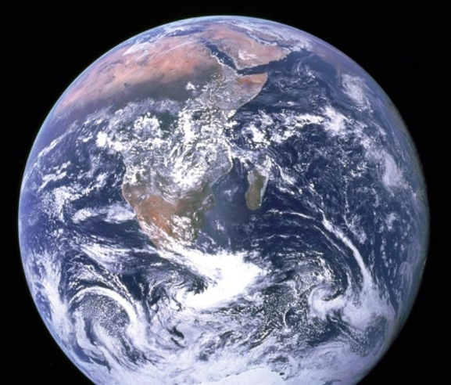
What is “The World”?
People (John 3:16)
The World
Purposes, Philosophy, Pride, Possessions
(1 John 2:15-17)
Planet (Genesis 1:31)
Notes:
While God loves the people of this world (John 3:16), He tells us that we should not love the world itself (1 John 2:15-17). What He means is this: do not love the pride, purpose, and possessions of this world. All of those things are passing away, but His kingdom will never pass away (2 Corinthians 4:18).

Slide 5
New People in a New Kingdom
Colossians 1:13
1 Peter 2:9,10
God’s Kingdom
Eternal, Unshakeable
(2 Corinthians 4:18)
(Hebrews 12:28)
The World
Purposes, Philosophy, Pride, Possessions
(1 John 2:15-17)
What are some of the things that the world considers important?
God loves the people of this world (John 3:16) but tells us that we should not love the world (1 John 2:15-17) that is passing away.
Christians have a new relationship with God (John 1:12) and have new desires (1 Peter 4:1,2; Colossians 3:1-3).
Notes:
According to 1 Peter 2:9,10, all non-believing people on earth are separated from God, in darkness and without mercy. But when you become a Christian, God saves you and moves you from the kingdom of this world to the Kingdom of Jesus.

Slide 6
New Relationships
We have a new relationship with God. We also have a new relationship with the world.
John 15:18,19 – Jesus Christ was opposed, and His followers will also be opposed.
2 Timothy 3:12 – If you live a godly life, you will be opposed. If you go along with the world, they will not notice and oppose you.
Proverbs 4:14-16 – As you become more like Jesus, some people will not like it (1 Peter 4:3-4).
Notes:
Because we have changed from the kingdom of the world to the kingdom of God, we also have changed relationships with people in this world. It should now be our desire to live for God. Your changed lifestyle will not go unnoticed, leading some people to abuse you (1 Peter 4:3-4). You will be opposed because JESUS CHRIST was opposed (John 15:18,19). You will be opposed only if you LIVE GODLY for Him. If you go along with the world, they will not oppose you (2 Timothy 3:12).

Slide 7
New Sources of Tension
Family and Friends. Those close to you who know you best (friends, family, coworkers) don’t want you to change (values and philosophy) (Matthew 10:34-36).
Society / culture. The world lifts up man and ignores God. The goals of society creep into our mind through the media (videos, TV, internet, etc.) and make us insensitive to God (Colossians 2:8; James 4:4-5)
Satan. He is your ADVERSARY (1 Peter 5:8). He cannot take away your salvation, so he wants you to compromise and ignore God’s purposes and plan (Ephesians 2:2; 2 Corinthians 4:4).
Notes:
Where will this opposition come from?
* Before a person is a Christian, he has one enemy – God. This is a big problem, but there is good news – although God is your enemy, He loves you and wants you to become His eternal child. But when a person puts their faith in Jesus, they have many new enemies:
* Your primary opposition will come from those closest to you who know you best – friends, family, fellow workers, and acquaintances. They want to keep you close to them and the things that they consider important. (What are those things that they consider important?) Matthew 10:35-36
* From society in general. (What things does our society / culture consider important?) The nature of this present world system is against God. This is communicated daily through the media (books, television, newspaper, internet etc.). If we are not careful, these ideas can slowly creep into our mind and make us insensitive to the things of God (James 4:4; Colossians 2:8)
* Of course, the mastermind behind this opposition is Satan (2 Corinthians 4:3-4). He is your ADVERSARY (1 Peter 5:8). Just like he was working in us before, he is currently at work in lost people (Ephesians 2:2).

Slide 8
How should I see the world?
By the grace of God, seek to love those who oppose you (Matthew 5:44) by what you say and what you do (John 13:34,35). Speak the truth in love (Ephesians 4:15).
Don’t be overcome by the cares of this world (Luke 8:7,14), but be “sober-minded,” alert and ready to serve God daily (1 Peter 1:13,14).
Balance boldness in what you say (Acts 4:19-20,29) with wisdom of when you say it (1 Kings 17:3; Mark 8:29,30).
Resist the temptation to behave like those who don’t know Jesus (Ephesians 4:17,22-25).

Slide 9
How should the world see me?
Give a soft answer. Avoid arguments whenever possible (1 Peter 3:15; 2Timothy 2:24,25)
Don’t complain about the world and your personal situation but stand out as a person with unshakeable hope, trusting God and His plan (Philippians 2:14,15).
Be separated from the ways of this world, but close to people (1 Corinthians 15:33; 1Corinthians 9:19-23).
Be diligent in your work, serving God – your real boss (Colossians 3:23).
Notes:
How should the lost world view me as a Christian?
* They should know you LOVE God – NOT by your mouth only, as much as by your life and action (John 13:34,35). Give a SOFT ANSWER. Avoid arguments whenever possible (Proverbs 15:1; 2 Timothy 2:24,25)
* Our behavior should shine a light into this dark world, drawing them to our Savior (Matthew 5:14-16). Don’t complain about the world and your personal situation, but stand out as a person who trusts God and His plan (Philippians 2:14,15).
* We should be separated from the ways of this world, but we should not be so strangely different that we lose our influence (1 Corinthians 9:19-23)
* Balance boldness in what you say (Acts 4:13,29) with carefulness of when you say it (Mark 7:36; Luke 5:14).
* Be diligent in your work, serving God (your real boss). Colossians 3:23

Slide 10
How can I stand strong and true?
Ask God to strengthen your faith by prayer, regular meditation on the Bible, and fellowship with other believers (Romans 10:17; Romans 12:2; Hebrews 10:24,25).
Ask God for grace to help you love people, including those who hate you. People can argue with your philosophy, but it is hard to argue with a life of love (Romans 12:14-18).
Pray (with pure motives) for those who hate you (Matthew 5:44).
Notes:
How can I stand true to God in the face of this opposition?
* PLEASE GOD with your life and have FAITH in Him (1 John 5:4-5). Ask God to strengthen your faith by regular meditation on the Bible (Romans 10:17; Romans 12:2).
* Ask God for grace to help your love people, including those who hate you. Jesus Christ loved His enemies enough to die for them when He didn’t have to do it. The world cannot understand this type of love, and those who are seeking the truth will be drawn to it. People can argue with your philosophy, but it is hard to argue with a life of love (Romans 12:14, 17, 18, 20-21).
* PRAY for those who hate you, and pray with pure motives (Matthew 5:44).
Spend time people who love God and want to serve Him (Hebrews 10:24,25). Do not enter deep, permanent bonds with unbelievers (2 Corinthians 6:14,15).

Slide 11
How should I view my life?
We have been created to reflect God’s glory (Isaiah 43:7) and now, we can do it. We should shine a light into this dark world (1 Peter 2:12; Matthew 5:14-16).
People around you are seeking fulfillment in temporary things. Make it your great desire to share the good news with others (Matthew 28:18-20; Colossians 4:5).
We are only short-term residents in this land (Hebrews 11:13; 1Peter 2:11). Our true home is in HEAVEN with our eternal Father (Philippians 3:20; John 14:2,3).
Notes:
How should I view my life in this the world?
* You are on a journey to your true country; temporary resident in this land (Hebrews 11:13; 1 Peter 2:11). Your true home is in HEAVEN with your eternal Father (Philippians 3:20; John 14:2,3).
* This world is a “mission field” to reach the lost for Jesus Christ (Acts 1:8; Matthew 28:18-20). As long as we are here, we should make it our great desire to share good news with others (Philippians 1:21-23).

