Slide 1
Salvation and Security
The Best News of All

Slide 2
A Terrible Choice
Genesis 2:16,17a – The command of God: “And the LORD God commanded the man, saying, “You may surely eat of every tree of the garden, but of the tree of the knowledge of good and evil you shall not eat,…”
Genesis 3:4,5 – The lie of Satan: “‘You will not certainly die,’ the serpent said to the woman. ‘For God knows that when you eat from it your eyes will be opened, and you will be like God, knowing good and evil.’”
Sin – to turn away from God and go your own way
When we sin, we actually put ourselves in the place of God (a terrible choice!)
Notes:
Satan is a deceiver. He tries to make what is good appear useless or evil, and what is evil appear good. Sin masquerades as beautiful and fulfilling, when actually it is ugly and destructive.
The evil of sin becomes even more apparent when we consider the level of authority of the One we have offended!
Although we might not think that we are taking the place of God, it becomes clear when we define our own morality, meaning, and salvation method.

Slide 3
The “Bad News” of the Bible
Jeremiah 32:33 – “They have turned to me their back and not their face. And though I have taught them persistently, they have not listened to receive instruction.”
Romans 1:21-23 – “For although they knew God, they did not honor him as God or give thanks to him, but they became futile in their thinking, and their foolish hearts were darkened. Claiming to be wise, they became fools, and exchanged the glory of the immortal God for images resembling mortal man and birds and animals and creeping things.”
Isaiah 59:2 – “Behold, the LORD's hand is not shortened, that it cannot save, or his ear dull, that it cannot hear; but your iniquities have made a separation between you and your God, and your sins have hidden His face from you so that He does not hear.”
Because of sin, we are all separated from God
Notes:
The evil of sin becomes even more apparent when we consider the level of authority of the One we have offended!
Although we might not think that we are taking the place of God, it becomes clear when we define our own morality, meaning, and salvation method.

Slide 4
The Good News of the Bible
Luke 19:10 “For the Son of Man came to seek and to save the lost.”
Mark 1:14,15 “Now after John was arrested, Jesus came into Galilee, proclaiming the gospel of God, and saying, “The time is fulfilled, and the kingdom of God is at hand; repent and believe in the gospel.”
Gospel: “good news”, from the Greek word “euanglion” which described a military victory or a physical rescue.
Repent: Admit our sinfulness, turn from our own way, and turn to follow Jesus
Believe: Trusting the sacrifice and resurrection of Jesus to save us, surrendering to Him as our Lord (Romans 10:9,10)
Notes:
The Old Testament was written in Hebrew and translated into Greek “Septuagint” (~250BC). The Greek word “euanglion” is used in Isaiah 40:9-10 to describe good news.
The English word “Gospel” comes from “euanglion” which described a military victory or a physical rescue.
In the original New Testament, “Gospel” didn’t describe a book – it referred to the message of salvation (the best possible good news).
(Jeremiah 52:31-34 set free from prison, like Jehoiachin who was released from prison and given a seat at the king’s table.)

Slide 5
Born Again – in His Image
When we repent and believe the gospel, we are saved from condemnation (Colossians 1:13,14)
When a person is saved, they are “born again” (John 3:3)
When we are born again, we enter God’s family by spiritual birth (John 1:12-13).
When you were born physically, it was recorded on a physical birth certificate.
When you were born spiritually, a heavenly record was made (Revelation 20:12). Your birth certificate was marked with a seal – the Holy Spirit of God (Ephesians 1:13).

Slide 6
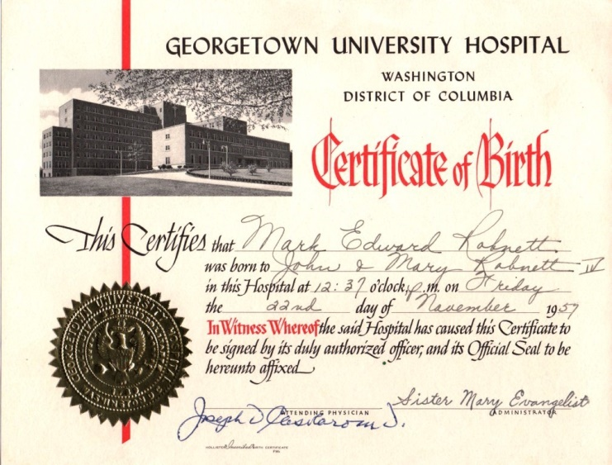

Slide 7
God is central and you are His child
1 Peter 1:3 God is the central figure in the universe. He has created us for His purposes – when we focus on this, we understand life much better.
Every Christian has a new Father: God Almighty! As a good Father, He:
  loves and cares for his child (1 Peter 5:7)
  guides and teaches his child (John 14:26)
  disciplines his child (Hebrews 12:5-6)
  has a plan for his child (2 Timothy 1:9,10)

Slide 8
Elect, Chosen, and Saved
1 Peter 1:1-2 Christians are “God’s elect,” … “who have been chosen according to the foreknowledge of God the Father…”
Ephesians 1:3-6 “He chose us in Him before the creation of the world … He predestined us for adoption…”
Amazing truth #1: God has guided years of history that you might hear the gospel and be His child today!
Romans 10:13 “Everyone who calls on the name of the Lord will be saved.”
Amazing Truth #2: Everyone who comes to Jesus will be saved!
Are we chosen by God or do we have a free will to choose belief in God? Yes – both are true.
Notes:
Matthew 23:37 “I longed to gather … you were not willing.”

Slide 9
Eternally Secure !
1 Peter 1:4-5 Amazing and wonderful promises:
  God has given us salvation and will not take it away.
  It is kept for us by His power, it will never fade away
  It is reserved for us in heaven.
John 10:27-29 No one (not even you) can cause you to lose your salvation, because your heavenly Father is GREATER THAN ALL men.
Ephesians 2:8-9 Salvation is by grace through faith, and not by works. No one can lose his salvation because no one earned his salvation.
We know that we are saved because of His promises, not because of our feelings! (1 John 5:13)

Slide 10
What can separate you from God’s love?
Romans 8:38-39
A. “Death” – you can’t lose it when you die
B. “Life” – you can’t lose it while you are alive.
C. “Angels” – holy angels can’t take it from you.
D. “Demons” – evil spirits can’t cause you to lose it.
E. “The present” – nothing happening right now can take it away.
F. “The future” – nothing in the future can make you lose it.
G. “any powers” – there is nothing more powerful than God
H. “Height” – nothing above you.
I. “Depth” – nothing below you.
J. “NOR ANYTHING ELSE in all creation, will be able to separate us from the love of God, that is in Christ Jesus our Lord.”

Slide 11
Remember this:
When you put your faith in Jesus, you are given new life. You are born again into God’s family and have a new Father and an eternal hope in heaven.
Your salvation is secure because it is protected by God Himself. You did not earn salvation by your “good works” and cannot lose salvation by “bad works” (or anything else).
Your hope as a Christian should be the source of your joy. As with every good thing, it should bring praise to the great God who has given it to us.

Slide 12
Living in a Broken World
1 Peter 1:6-7 Our life in this broken world is often hard and we “suffer grief.” Remember, this is normal and should be expected (4:12).
Because our faith is so valuable, God desires to purify it (just like gold is refined). This takes heat and pressure – trials that do not feel good to us at the time. Growth will result when we face trials with faith (James 1:2-4).
2 Corinthians 4:18 All physical things will eventually disappear, even the purest gold. But there is something more valuable than gold – our faith.

Slide 13
Living Joyfully in a Broken World
1 Peter 1:8-9 Jesus will wipe away every tear, remove all pain, and we’ll praise Him forever. If we keep our focus on Him, we will have joy!
1 Peter 1:3 God has given us a “living hope.” Jesus died for us, but He was resurrected and is now alive. The Christian hope is not wishful thinking, but a confident assurance based on the fact of the resurrection.
1 Peter 1:13 How do we live in a broken world? We live by keeping our eyes on Jesus and His amazing promises toward us.

