Slide 1
What is the Church?
1 Peter 2:4-6; 4:7-11; 5:1-5

Slide 2
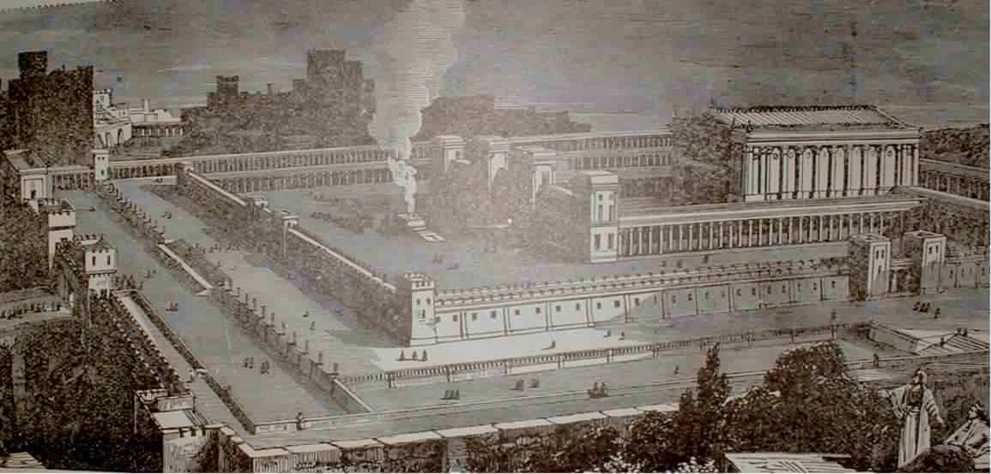
The Old Testament Temple
Constant Sacrifices (sin results in death)
The Temple Veil between the people and “Most Holy Place” (separation from God)
Reading of Old Testament Law (look forward to the promised Savior)
Made from large pieces of local limestone (carefully cut and fit together)
Notes:
For the Jews, this was more than just a building – it was the center of Jewish life. The basically worshiped the building and all of the traditions around it.
And if you think about it, the stones were “dead stones” – because limestone is made up from dead organisms.

Slide 3
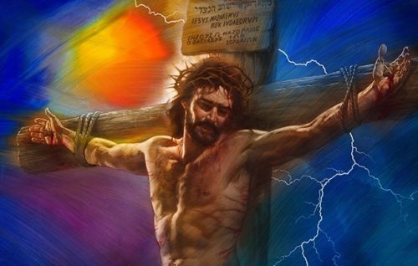
The Cross Changes Everything
God now lives in every believer – each person is His temple (1Corinthians 6:19)
------------------------------------------------------
The Final Sacrifice (Hebrews 10:10-12)
----------------------------------------------------------------------------------------------------------------
The Veil torn, providing a way for anyone to come to God (Matthew 27:50,51)
--------------------------------------------------------------------------------------------
The Savior has come and conquered death! (Matthew 28:5,6)
------------------------------------------------------------------------------------------------
Made from “living stones” – Christians in whom God’s Spirit now lives (1 Peter 2:5)
Constant Sacrifices (sin results in death)
The Temple Veil between the people and “Most Holy Place” (separation from God)
Reading of Old Testament Law (look forward to the promised Savior)
Made from large pieces of local limestone (carefully cut and fit together)
Notes:
But everything changed when Jesus came to fulfill all of the Old Testament prophecies. His final sacrifice paid for all sin: past, present, and future. As God’s children, His Holy Spirit came to live inside all believers. And because the physical temple was no longer needed, it was destroyed by the Romans in 70 AD and never rebuilt.
The new “spiritual house” of God is the universal church. It is not a building (教堂 – jiàotáng) but a group of called out people (教会 - jiàohuì); Greek “ekklesia” = called out ones

Slide 4
What about the Church?
The church is not a temple
The church is not a building (教堂)
The church is people (教会; Greek “ekklesia” = called out ones)
Two Levels of Church
  “Universal Church” – all believers from all nations from all of time
  “Local Church” – small groups of people worshiping God and serving in their communities
Notes:
教堂 Jiàotáng – a church building
教会 Jiàohuì – the people of the church

Slide 5
The Universal Church
Matthew 16:13-18 : first mention of the church
v.16 Every believer’s testimony about Jesus: “You are the Christ” (petros – a stone)
v.18 On this rock (petra) I will build My church
Jesus is the rock of the church (1 Peter2:4-6)
Jesus takes His children from the world and puts us into His church (John 15:19)
Jesus Christ
The World
Universal Church

Slide 6
The Universal Church
“Hades” = “place of the dead.” Christians will overcome Hades (death) because of Jesus’ resurrection (1Corinthians 15:54-57, John 6:39).
Jesus is the head of the (“My”) church (Ephesians 1:22,23)
The church is “the bride” of Christ (Ephesians 5:25-27, John 3:29, Revelation 19:7-9).

Slide 7
Pastor or Priest?
祭司 jìsī Priest (Hebrews 2:17)
长老 zhǎnglǎo Elder (1 Peter 5:1)
牧师 mùshī Pastor (not in ESV, CNVs or RCUVs)
In the Bible, a pastor is often referred to as an elder (长老 zhǎnglǎo) or a shepherd (牧养 Mùyǎng), and is responsible for teaching and guiding a group of Christians. Peter was considered a pastor, and a good description of his role is found in 1 Peter 5:1-3.
A priest was different. His job was to offer sacrifices for the sins of the people. In the Jewish system, sacrifices could only be offered by a priest. And without sacrifices, there was no forgiveness of sins.
In some religions, they still have priests (e.g. Catholic, Eastern Orthodox, Anglican). In their religious services, they actually have the priest offer a type of sacrifice – not a dead animal, but a ritual in which they pretend to turn bread and wine into the physical body and blood of Jesus.

Slide 8
The Local Church
First local church was in Jerusalem.
Rapid growth. 120 people (Acts 1:15); 3,000 more (Acts 2:41); 5,000 more (Acts 4:4)
Just because someone attends a local church, doesn’t mean that they are truly saved (Matthew 13:24-30)
The World
Local Churches

Slide 9
The Local Church
Local Churches are in cities (Acts 8:1; 13:1)
Also, small gatherings of believers in various places: homes (Acts 2:46), the temple (Acts 5:12) and in synagogues (Acts 13:5)
The early church met daily (Acts 2:46), each Lord’s Day (Acts 20:7), and came together to pray (Acts 3:1, 10:9).

Slide 10
The Local Church
The First local church in Jerusalem (Acts 2:40-47) met for the following purposes:
Fellowship with other baptized believers (verse 40-41)
The teaching of the Word of God (verse 42)
The breaking of bread – the Lord’s supper (verse 42)
Prayer (verse 42)
To help and minister to each other (verses 44-45)
To glorify and praise God (verse 47)
To discipline members as needed (Matthew 18:15-20)
The spread of the Gospel worldwide (Mark 16:15)

Slide 11
The Local Church
Paul compared the local church body to the HUMAN BODY (1 Corinthians 12:12-27, 1 Peter 4:7-11):
Each body is composed of many members (verse 12)
Each member has a different function (verses 14-20)
No one member can function alone (verse 21)
Each member’s contribution is important (verses 22-24)
A properly functioning body operates as a single unit (verses 25-27)
The best place for you to exercise your spiritual gift is to become a part of a local church.

Slide 12
Finding a Good Local Church
As you pray about which church you should attend, consider these things:
Authority of the Bible. Complete confidence that all of the Bible is absolutely true (Titus 1:9; Matt 5:17-20). No thing or person will have more authority than the Bible.
Jesus is God. Clarity about the person of Jesus – He is God who came to earth in a human body to die for our sins (John 1:1).
Salvation by grace through faith alone. Clarity about salvation – it is a gift of God, given to all who repent and believe in Jesus (Romans 10:9,10).

Slide 13
Core Theological Principles
Sola Scriptura ("Scripture Alone"): The Bible is the sole, inerrant, and final authority for faith and practice, standing above tradition or church leaders.
Sola Fide ("Faith Alone"): Salvation is received through faith alone, not by good works or human merit.
Sola Gratia ("Grace Alone"): Salvation is a free gift from God’s grace alone, unearned by human effort.
Solus Christus ("Christ Alone"): Jesus Christ is the only mediator between God and humanity, and his work is the only basis for justification.
Soli Deo Gloria ("Glory to God Alone"): All glory is due to God alone, as salvation is accomplished entirely through His will and effort.
Notes:
The Five Solas are Latin phrases (or slogans) developed during the 16th-century Protestant Reformation to summarize the core theological principles that separated them from Roman Catholic doctrine. They represent five foundational "alones" regarding salvation, authority, and glory: Sola Scriptura, Sola Fide, Sola Gratia, Solus Christus, and Soli Deo Gloria

Slide 14
Finding a Good Local Church
As you pray about which church you should attend, consider these things:
Truth with Joyful Worship. Speaking truth to the minds of worshipers brings a true spirit of joy and praise (John 4:24). Avoid churches dominated by emotion instead of truth, or joyless churches that focus only on intellectual accumulation of facts (1Corinthians 8:1-3; 2 Timothy 2:22-26).
Biblical Leadership. Leadership by a qualified pastor (1Timothy 3:1-7; 1 Peter 5:1-5).
Liberty <-> Legalism. A proper balance of liberty (Galatians 5:1,13,17) and godly behavior (Freedom <-> Tradition).
Member Participation. All members to working together, using their spiritual gifts as part of the body (1 Corinthians 12:14-27).

