Slide 1
What is the Meaning of Life?
A very important question!

Slide 2
Think about this:
If you could have anything or do anything in the world, what would it be?
Why would you want to have or do that?
For how long would that bring satisfaction?

Slide 3
Many things have short satisfaction
Age
Desire
Satisfaction
3
yr
old
Candy
5 Minutes
8
yr
old
Video game
1 month
16
yr
old
Girlfriend
3 months
23
yr
old
Global Travel
5 years
30
yr
old
Business
Mgr
20 years

Slide 4
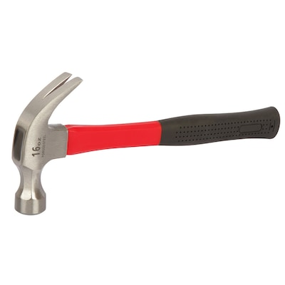


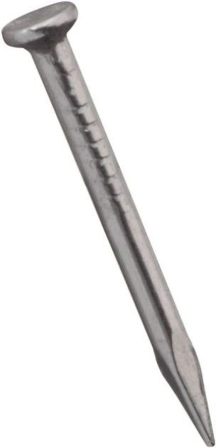
What is the purpose of this?
Simple Things – Simple Purpose

Slide 5
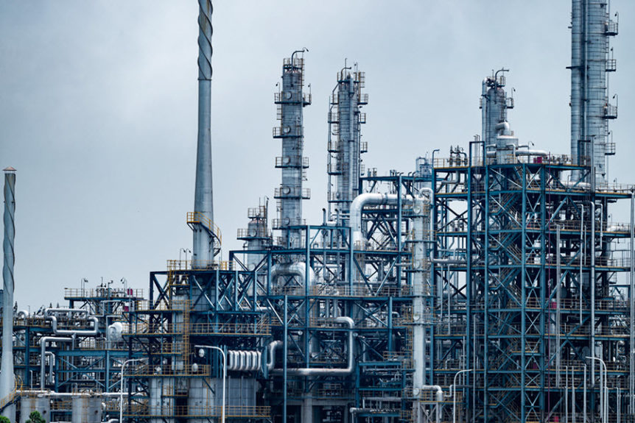
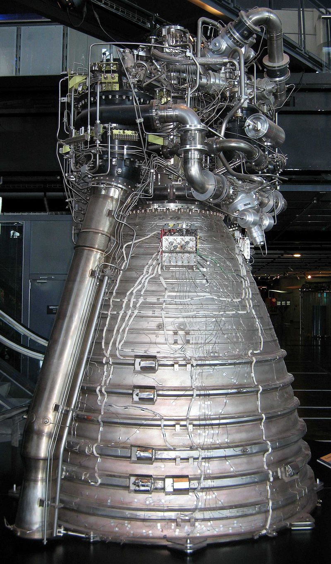
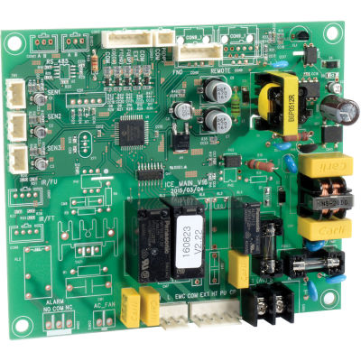
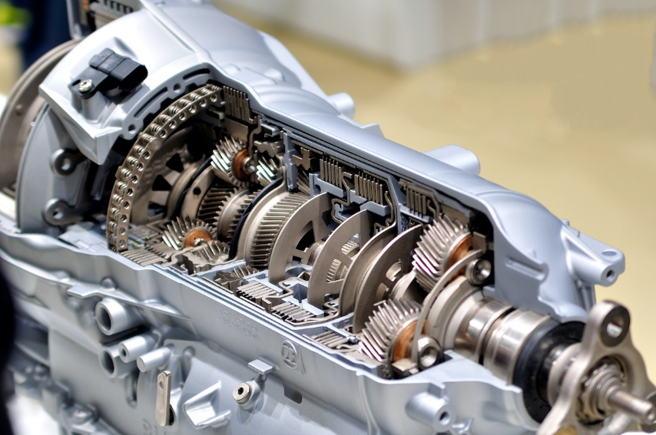
What is the purpose of this?
Complex Things – Complex Purpose

Slide 6

What is the purpose of this?
The Most Complex Thing of All…

Slide 7
Before the beginning…
God
Notes:
Before the beginning, there was no planet Earth, no stars, no universe – only God.
And God made a choice – a choice to create us, a planet on which we can live, and a universe surrounding the planet.
He created all of this for a purpose…

Slide 8
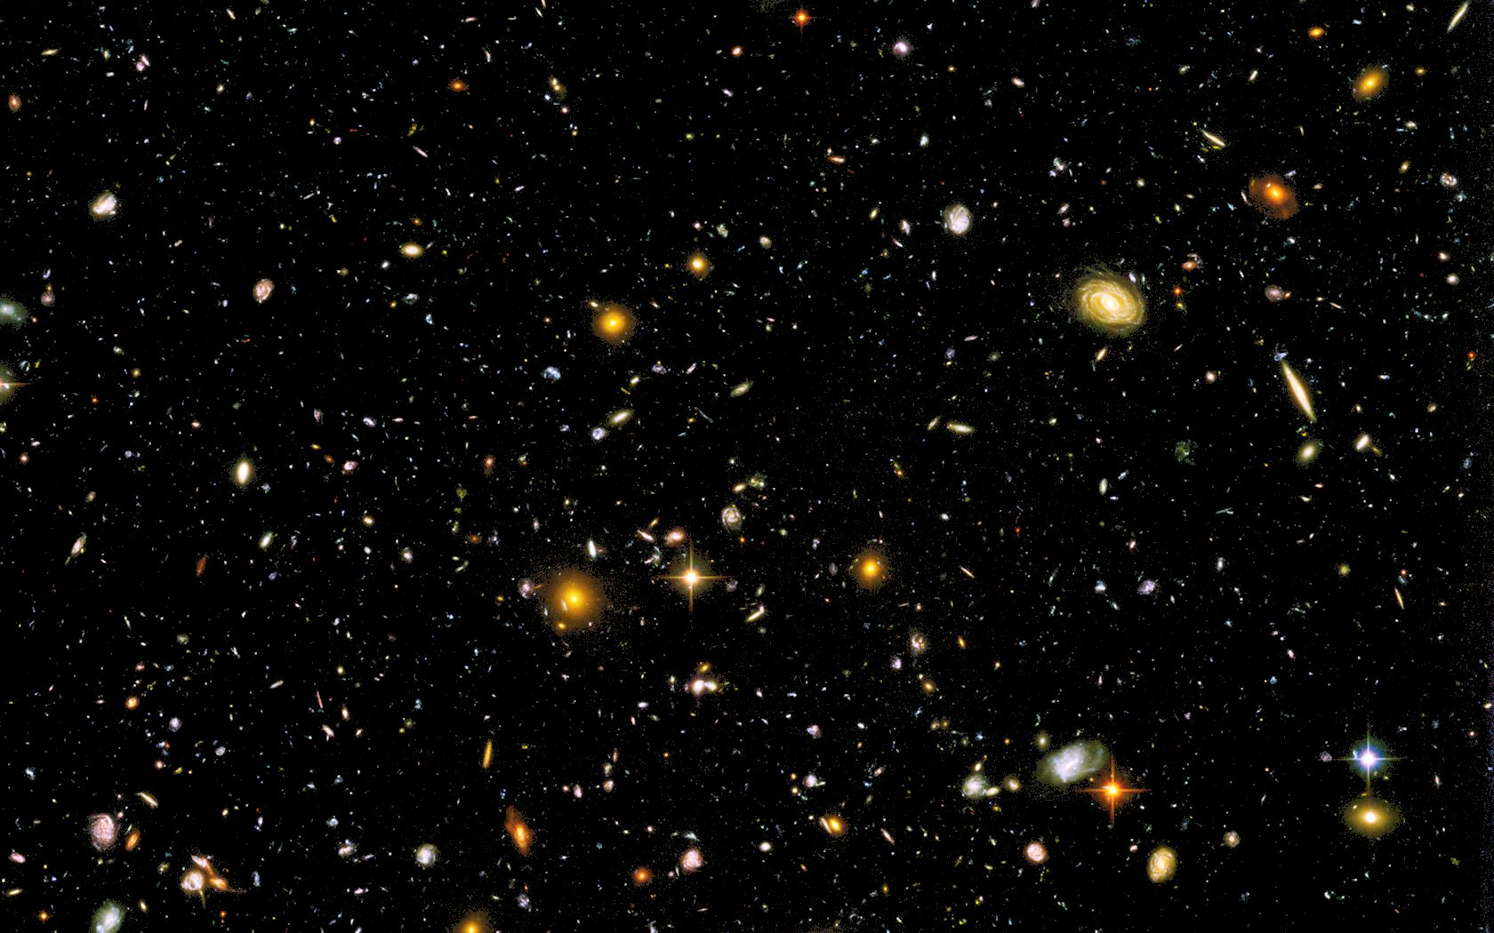
The Universe has a Purpose:
“The heavens declare the glory of God;
the skies proclaim the work of his hands.”
Psalm 19:1

Slide 9
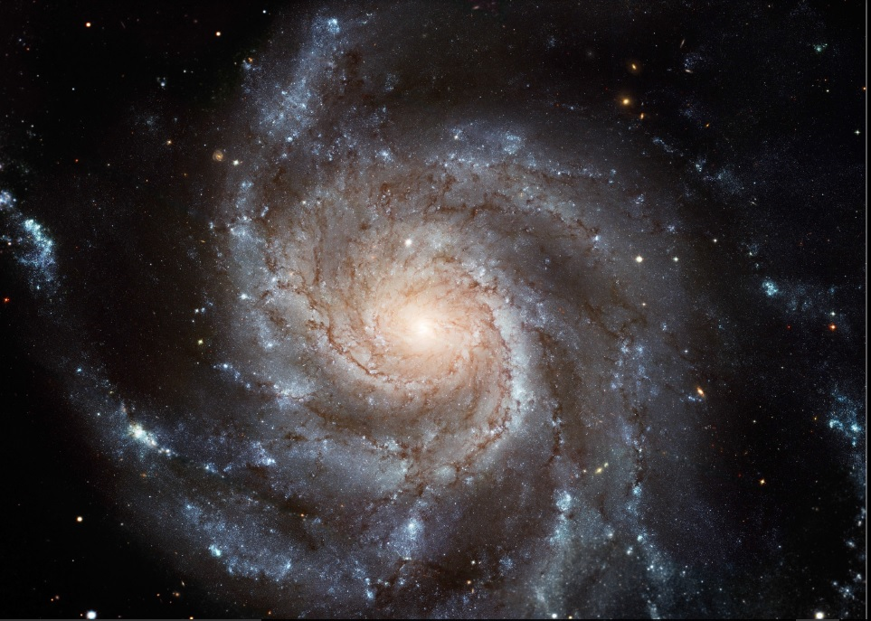
Planet Earth is carefully positioned in the galaxy and in the universe to enable life*
*Rare Earth, 2004, Ward and Brownlee

Slide 10
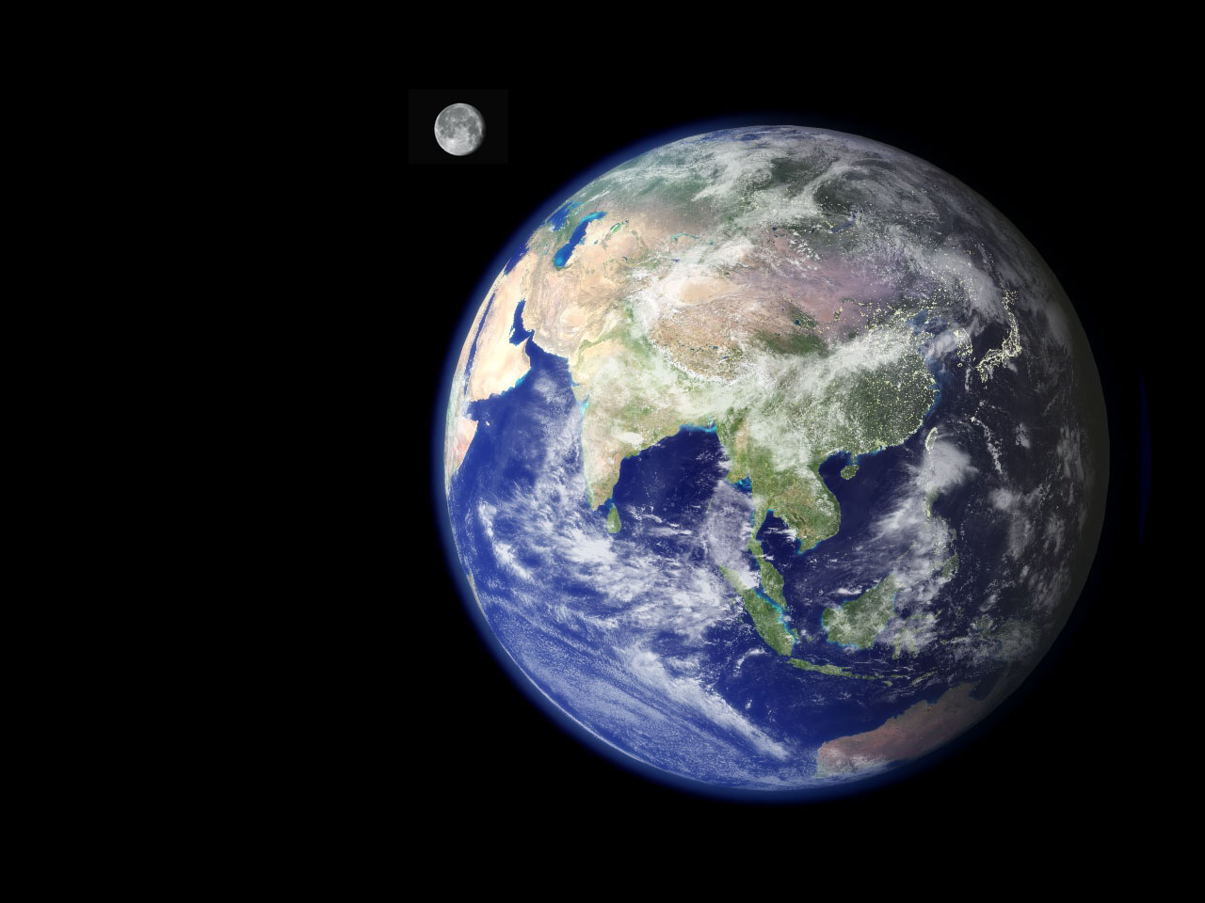
Earth is perfectly designed to enable life:
_{Liquid Water}
_{Oxygen & CO2}
_{Magnetic Field}
_{Stable Climate}
_{Gravity}
_{Chemical Nutrients}
_{Sun and Moon}
Notes:
Key Variables Making Earth Habitable:
Distance from the Sun (Goldilocks Zone): Earth is at the perfect distance for liquid water to exist, not too hot (boiling) or too cold (frozen), a crucial ingredient for life.
Liquid Water: Abundant surface water is essential for all known biological processes and provides a stable environment for life's origins.
Atmosphere:
Oxygen & CO2: Provides breathable oxygen for humans and carbon dioxide for plants (photosynthesis).
Protection: Traps heat (greenhouse effect) for stable temperatures and blocks harmful solar radiation (UV, X-rays).
Magnetic Field (Magnetosphere): Generated by Earth's core, it deflects dangerous charged particles from the Sun (solar wind).
Stable Climate & Temperature: Maintained by the atmosphere and orbit, preventing extreme swings that would kill life.
Gravity: Strong enough to hold the atmosphere and water, but not so strong it crushes organisms.
Energy Source (The Sun): Provides light and warmth, powering ecosystems through photosynthesis and other processes.
Chemical Ingredients & Nutrients: Presence of elements like carbon, nitrogen, and phosphorus, plus soil and minerals, essential for building and sustaining life.
Stable Sun: Our Sun is a relatively calm, long-lived star, unlike more volatile smaller stars.
Moon: Its size and distance stabilize Earth's axial tilt, leading to predictable seasons and influencing tides, which helps drive geological activity.
Geological Activity: Volcanism and plate tectonics cycle chemicals between the Earth's interior and oceans, creating pathways for energy extraction by life

Slide 11
“For this is what the LORD says — He who created the heavens, He is God; He who fashioned and made the earth, He founded it;
He did not create it to be empty, but formed it to be inhabited — He says: ‘I am the LORD, and there is no other.’”
Isaiah 45:18

Slide 12
God Creates Things on Purpose!
The universe has a purpose!
The planet has a purpose!
You have a purpose!
The Bible answers this question…
Notes:
Our problem is this: We ignore our Creator and tell ourselves that we know what is best for us. We deny him as King and set ourselves up as the kings of our little worlds. This is why Bible reading is essential. Every page of Scripture is there to remind us of God’s existence and his authority over our lives as Creator.

Slide 13
Our Purpose: to Glorify God
“Bring my sons from afar and my daughters from the ends of the earth – everyone who is called by my name, whom I created for my glory, whom I formed and made.” Isaiah 43:6,7
“For he chose us in him before the creation of the world to be holy and blameless in his sight, to the praise of his glorious grace, which he has freely given us in the One he loves.” Ephesians 1:4,6
“So whether you eat or drink or whatever you do, do it all for the glory of God.” 1 Corinthians 10:31
Notes:
The stars don’t choose to glorify God, but humans are given the opportunity to choose. And since we’ve all sinned, we can glorify God in was that the stars cannot – because of His amazing grace!

Slide 14
Our Purpose: to Know God
“This is what the LORD says: ‘Let not the wise boast of their wisdom or the strong boast of their strength or the rich boast of their riches, but let the one who boasts boast about this: that they have the understanding to know me, that I am the LORD, who exercises kindness, justice and righteousness on earth, for in these I delight,’ declares the LORD.” Jeremiah 9:23,24
True Success: to Know and Glorify God!
Notes:
To forfeit = to lose, to give up
“Our greatest fear should not be of failure, but of succeeding at things in life that don’t really matter.” Francis Chan

Slide 15
Our Purpose and Our Problem
The first man, Adam, chose to walk away from God and rule his own life.
What Adam wanted: to decide his own purpose and define right / wrong for himself.
What he got: separation from the source of life, a world of evil, slavery to sin, and destiny of death.
What we got: Adam’s inheritance (the same things – Romans 5:12).
“all have sinned and fall short of the glory of God,” Romans 3:23
Because of sin, people cannot fulfill their purpose!
Notes:
Sin makes us go crazy. We write our own moral rules. We tell ourselves that we know what is best for us. We willingly step over God’s wise and protective boundaries. We run after what God says is wrong and we chafe against what he declares is right. We forget his glory and live for the glory of our own pleasure, power, comfort, and ease.

Slide 16
Success in this World’s Eyes
Because of sin, people choose smaller goals: educational excellence, job success, praise of family and friends, more “likes” on social media…
Smiling on the outside but empty on the inside.
Ignoring God and eternity, hoping that everything will work out OK.
“Our greatest fear should not be of failure, but of succeeding at things in life that don’t really matter.” (Francis Chan)
Notes:
Apart from God, people search for meaning in the temporary goals and pleasures of this world. Solomon tested this and arrived at this conclusion: “So I hated life, because what is done under the sun was grievous to me, for all is vanity and a striving after wind.” Ecclesiastes 2:17

Slide 17
Success in this World’s Eyes
“Watch out! Be on your guard against all kinds of greed; life does not consist in an abundance of possessions.” Luke 12:15
“What good is it for someone to gain the whole world, yet forfeit their soul? Or what can anyone give in exchange for their soul?” Mark 8:36,37
“Yet when I surveyed all that my hands had done and what I had toiled to achieve, everything was meaningless, a chasing after the wind; nothing was gained under the sun.” Ecclesiastes 2:11
Notes:
To forfeit = to lose, to give up
Apart from God, people search for meaning in the temporary goals and pleasures of this world. Solomon tested this and arrived at this conclusion: “So I hated life, because what is done under the sun was grievous to me, for all is vanity and a striving after wind.” Ecclesiastes 2:17

Slide 18
This is VERY IMPORTANT!
Everything and everyone exists for an important purpose: to know and glorify God.
“For you were once darkness, but now you are light in the Lord. Live as children of light and find out what pleases the Lord.” Ephesians 5:8,10
Christians have a new identity
“Disciple” = follower
Discipleship is not what we do,
it is who we are (becoming).
Notes:
The Bible uses the word disciple 261 times. It is obviously a very important word, but what does it really mean?

Slide 19
Which Best Describes a Christian?
Do
I am a good person
I help other people
I teach others
I pray every day
I am a Child of God
Do
“Assignments”
Do
Do
Be
“Identity”
“But to all who did receive Him, who believed in His name, He gave the right to become children of God,”
John 1:12
Purpose of discipleship:
Become a fully surrendered Christ follower (Romans 12:1)
Notes:
Our goal in discipleship is not just to teach you what to do. We are called to “be disciples” (Matt 28:19,20). We don’t want to create “religious people” (like the Pharisees), we want to help new believers become fully surrendered Christ followers.
“Jesus answered them, “This is the work of God, that you believe in Him whom He has sent.” John 6:29

Slide 20
Glory – better than the stars
Every other created thing glorifies God naturally, without knowledge, choice, or feeling. But people are different:
A Mind to Know God: “Now this is eternal life: that they know you, the only true God, and Jesus Christ, whom you have sent. I have brought you glory on earth by finishing the work you gave me to do.” John 17:3,4
A Will to Choose God: “choose for yourselves this day whom you will serve … as for me and my household, we will serve the LORD.” Joshua 24:15
A Heart to Delight in God: “Delight yourself in the LORD, and he will give you the desires of your heart.” Psalm 37:4
Notes:
You have a choice – will you use all of your mind, soul, and heart to love the Lord God? (Deuteronomy 6:5,6)
You have been given understanding from the Spirit of God (you face is “unveiled”). Will you allow Him to transform you back into His image?
“And we all, with unveiled face, beholding the glory of the Lord, are being transformed into the same image from one degree of glory to another. For this comes from the Lord who is the Spirit.” 2 Corinthians 3:18

