Slide 1
Study Plan
 | Topic
 | Is the Bible Trustworthy?
2 | Did God Really Create the World?
3 | If God is Good, why does Suffering Exist?
4 | Why is Evil so Widespread and Powerful?
5 | What is the Purpose of the Ten Commandments?
6 | Why did Jesus Perform Miracles?
7 | What did Jesus Really Say?
8 | Is Death the End (or the Beginning)?

Slide 2
Did God Really Create the World?
And if so, does it really matter?

Slide 3
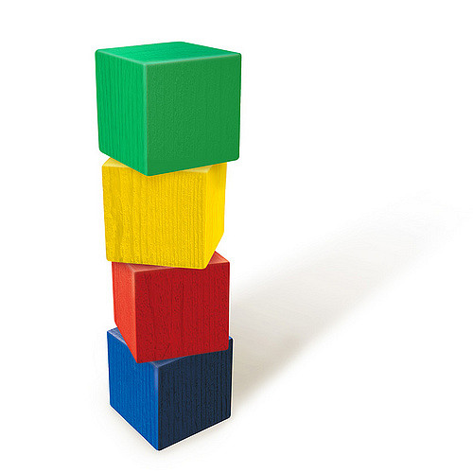
If you saw some blocks stacked on a table, what would you think?
Where did they come from?
How did they get stacked up like this?
Are you 100% certain?
We often select an option based on “most probable.”

Slide 4
A man comes to the hospital with chest pain…
* The doctor must decide what the problem is and what to do.
* Is the doctor 100% certain?
* What would you do?

Slide 5
Some Very Important Questions
Origin : Where did I come from?
Meaning : Why am I alive?
Morality : How to know right from wrong?
Destiny : What happens after I die?
The answer to the first question guides our thinking about all of the others!

Slide 6
You decide which is most probable
Evolution and Creation can both be studied logically, but both require faith (believing unseen events from the past).
We have been taught that evolution is fact proven by science. This is NOT true.
Be open to think for yourself.
Life requires choices – sometimes, with very important consequences!
Notes:
For the scientific method to work well, things must be observable, measureable, repeatable. Since the origin of the universe and life are none of these, we must use the evidentiary method to evaluate the questions of origin.

Slide 7
Where did everything come from? Two Ideas:
Evolution Creation
Everything came from A powerful Creator
nothing made everything
Life began by accident Life was created
Complex creatures Each living creature was
evolved by a series designed and made by
of random accidents an intelligent Creator

Slide 8
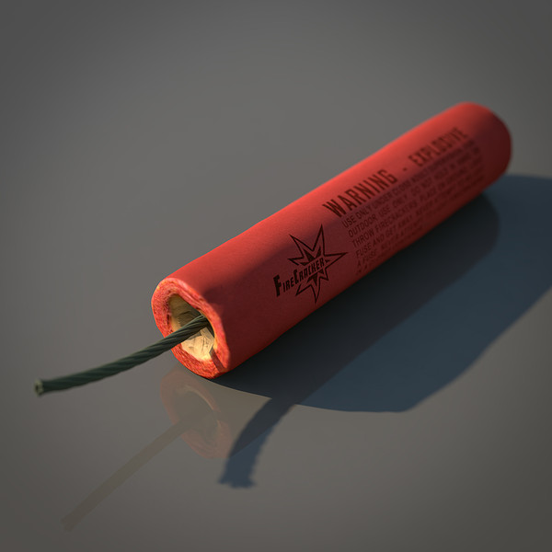
If you hear a loud “BOOM,” which is the most probable cause:
OR

Slide 9
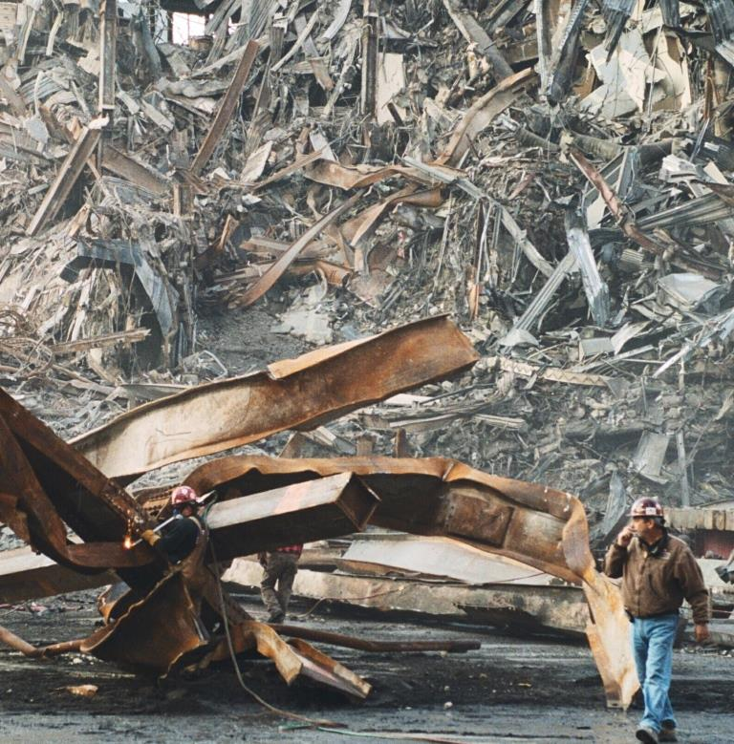
If you have an uncontrolled explosion, what is the most probable result:
OR

Slide 10
Two realities of science:
1. Something doesn’t come from nothing
(first law of thermodynamics)
2. Intelligent designs do not arise by accident
(statistical information theory)

Slide 11
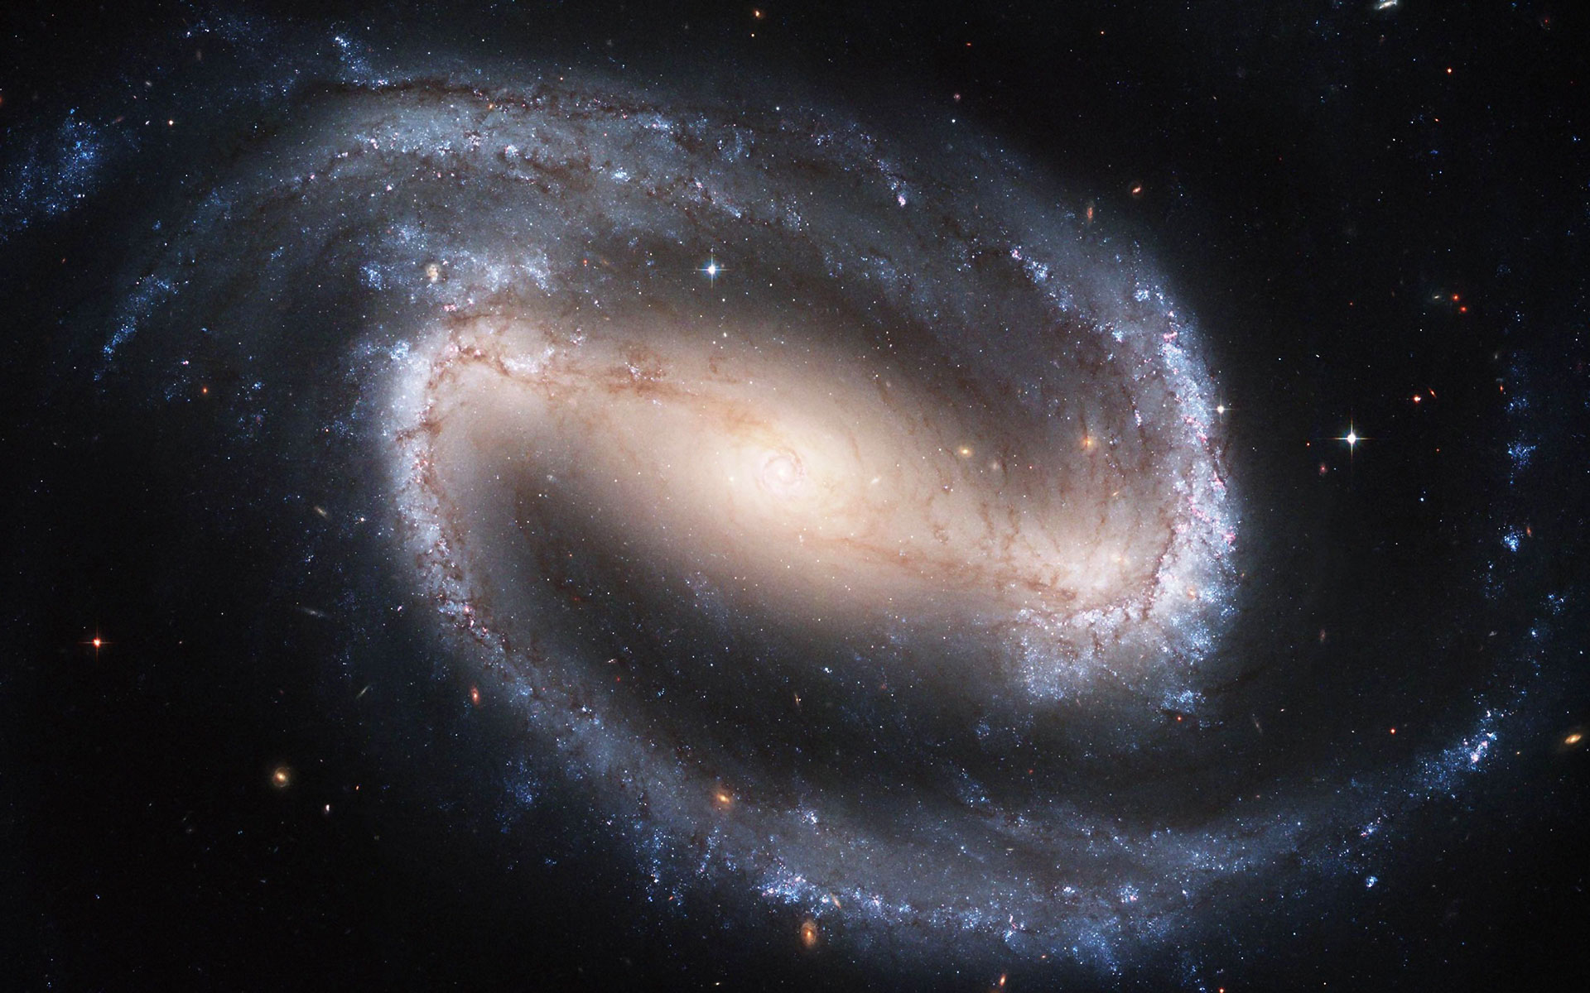
Did this come from nothing?

Slide 12
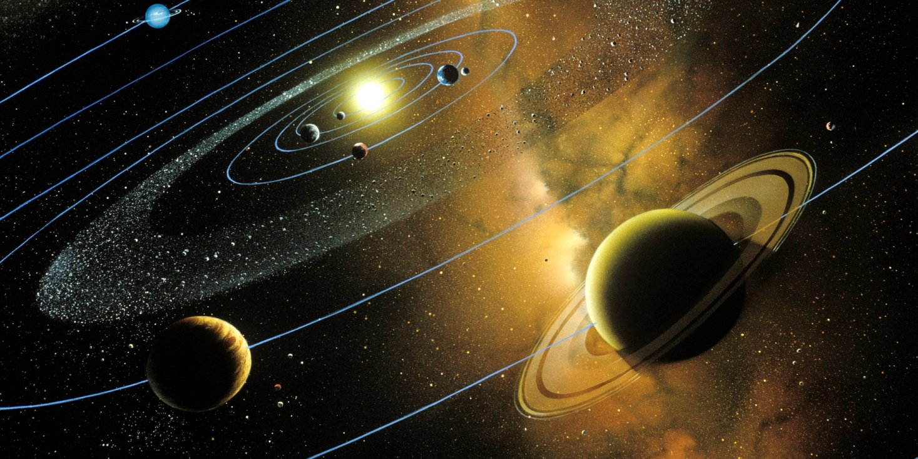
Did this design arise by accident?

Slide 13
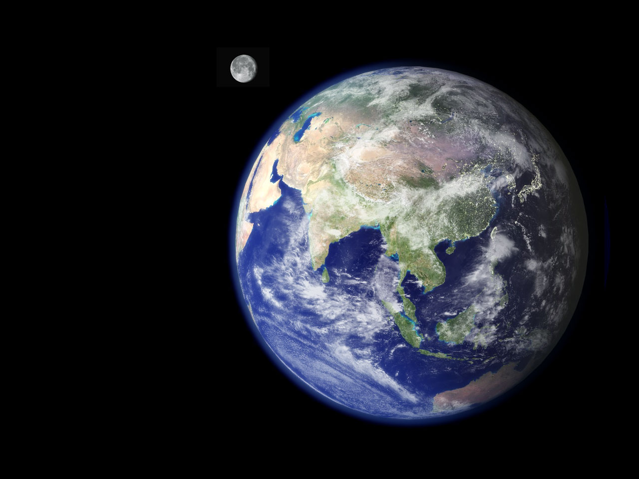
Was this planet designed for life?

Slide 14
You decide – which is most probable?
Evolution Creation
Everything came from A powerful Creator
nothing made everything

Slide 15
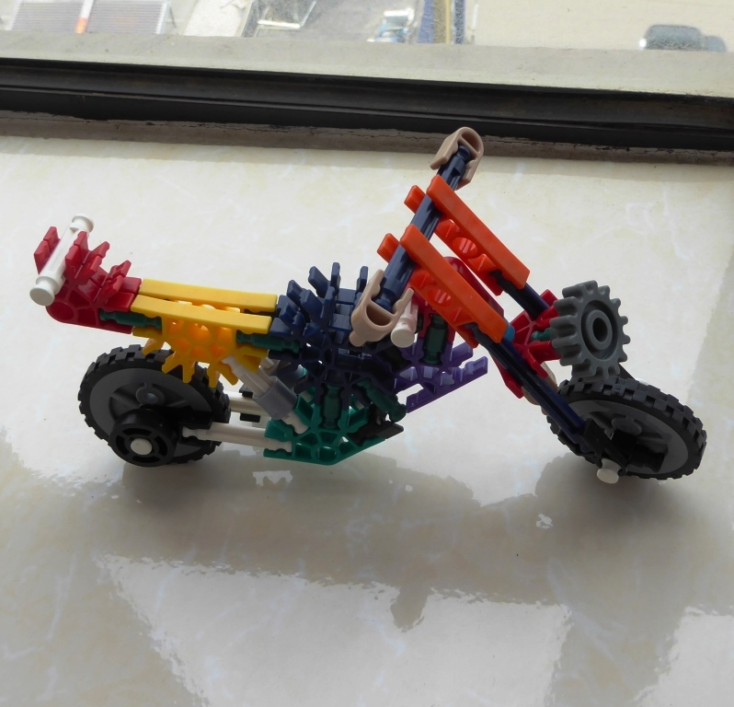
What is the difference?
How do you change this…
into this?
Can it happen by random accidents?

Slide 16
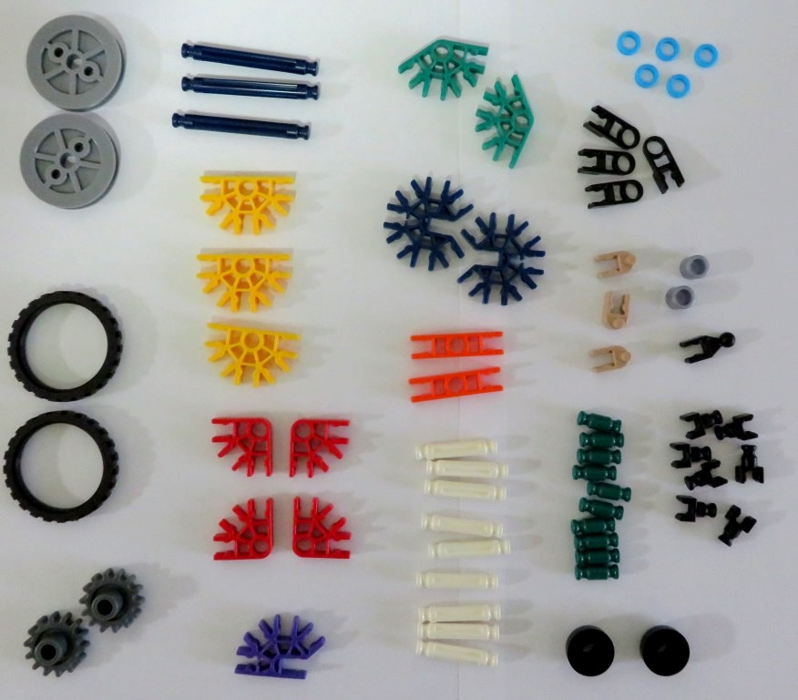
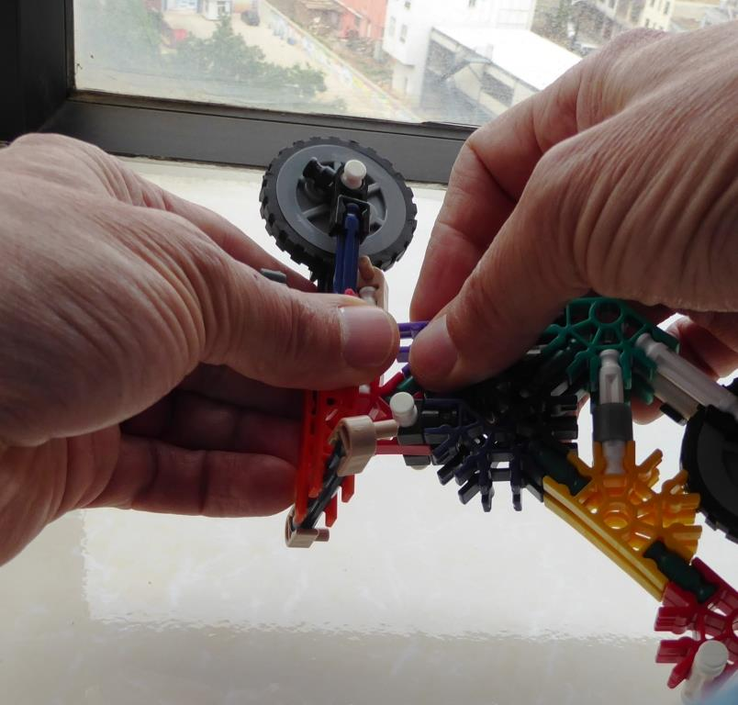
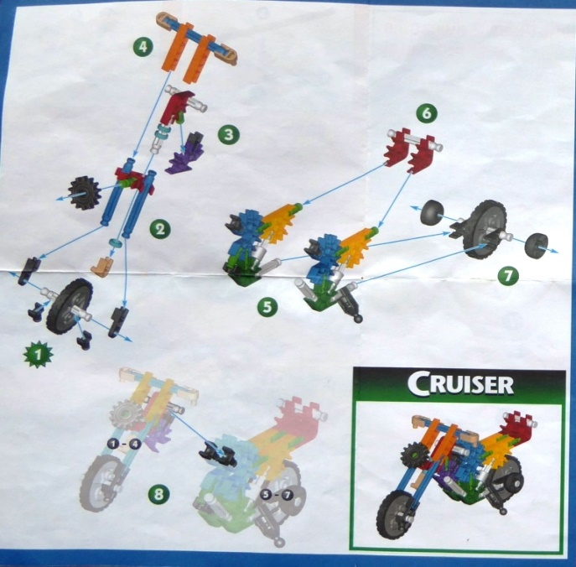
You need
this:
this:
and this:
The Right Pieces,
(66 pieces / 19 types)
a Design,
and a Process

Slide 17
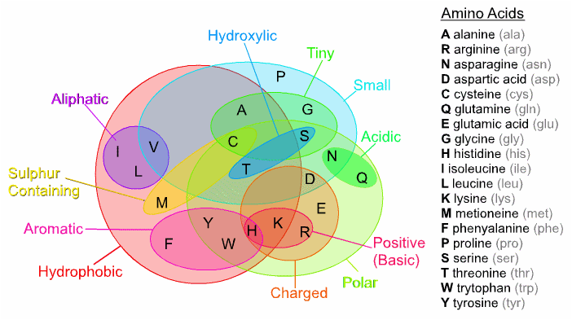
Every living thing is made of Proteins
Proteins are made from Amino Acids

Slide 18
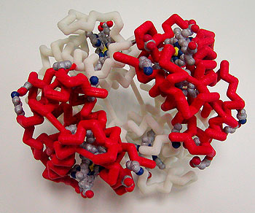
Hemoglobin protein, essential for life

Slide 19
What is the difference?
Not much!
Similar number of parts
Must be assembled in exact order to work

Slide 20
How to make this?
You need:
The right pieces
A design
A process

Slide 21
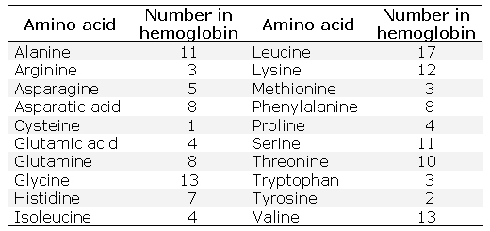
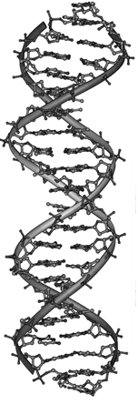
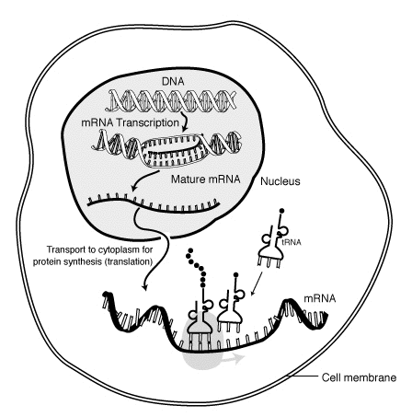
Specifically, you need: this this, and this
The Right Pieces,
(148 pieces / 20 types)
the Design,
and a Process

Slide 22
You decide – which is most probable?
Evolution Creation
Everything came from A powerful Creator
nothing made everything
Life began by accident Life was created

Slide 23
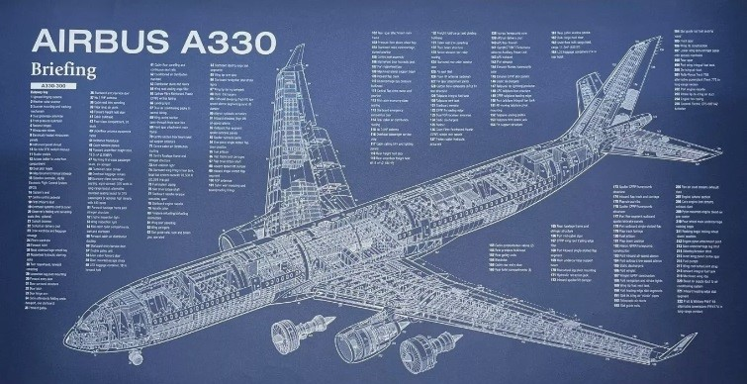
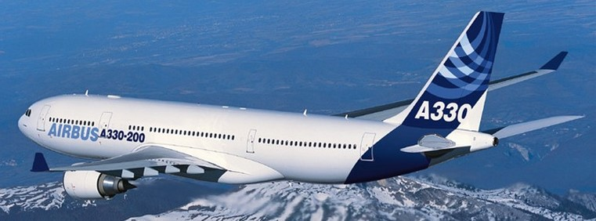
Every complex thing requires a design and a builder
No design + No builder = No airplane

Slide 24
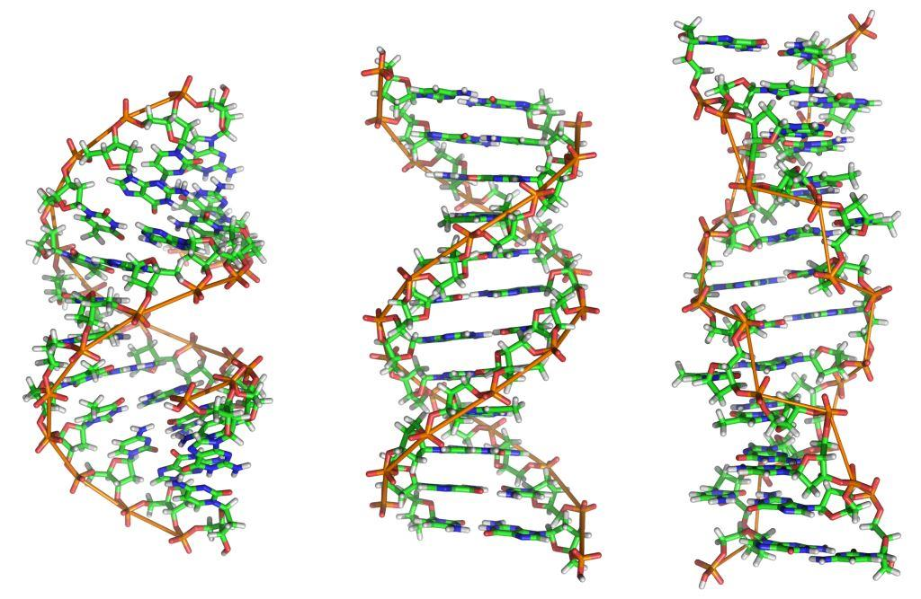
The design of life : DNA

Slide 25
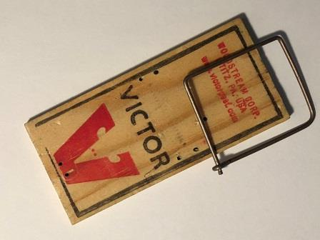
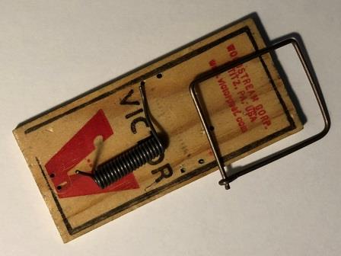
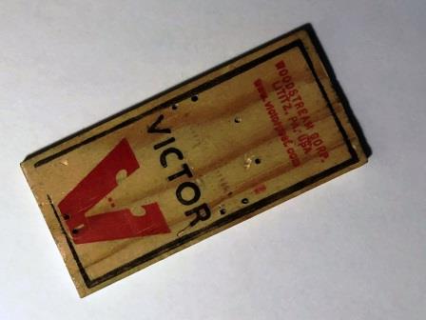
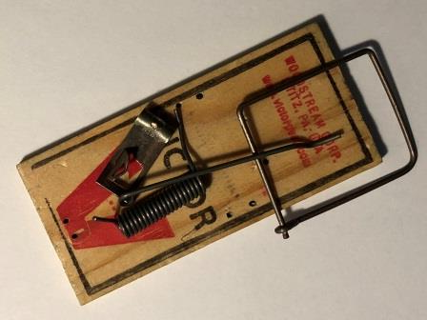
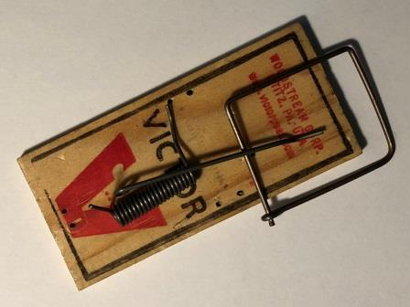
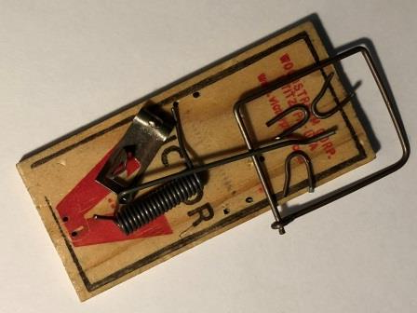
“Natural Selection” requires unguided, step-by-step improvements
How many mice will this catch?
How about this?
or this?
or this?
or this?
or this?

Slide 26
Evolution requires unguided, step-by-step improvements
But even simple machines do not work without all of the pieces in the right places

Slide 27
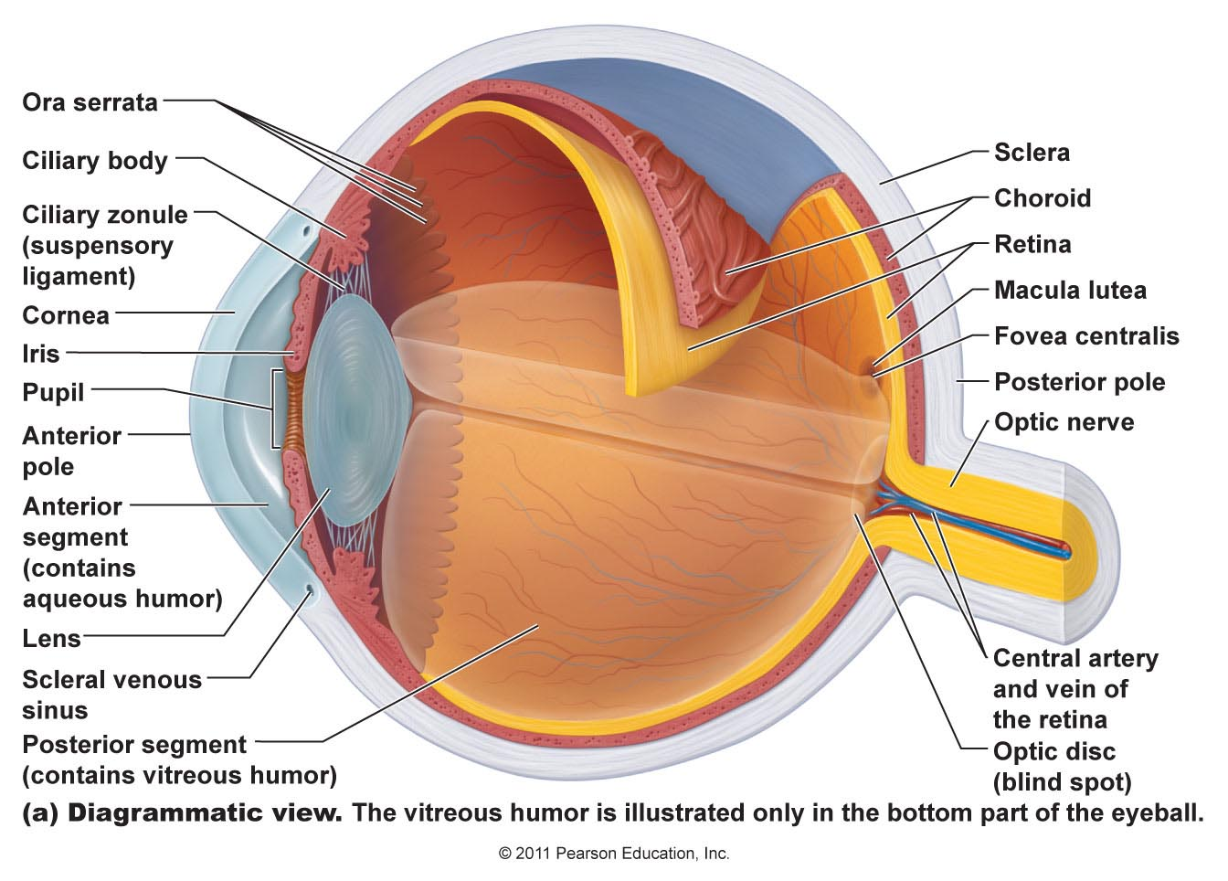
Your eye – a very complex machine
Origin of the Species – Charles Darwin

Slide 28
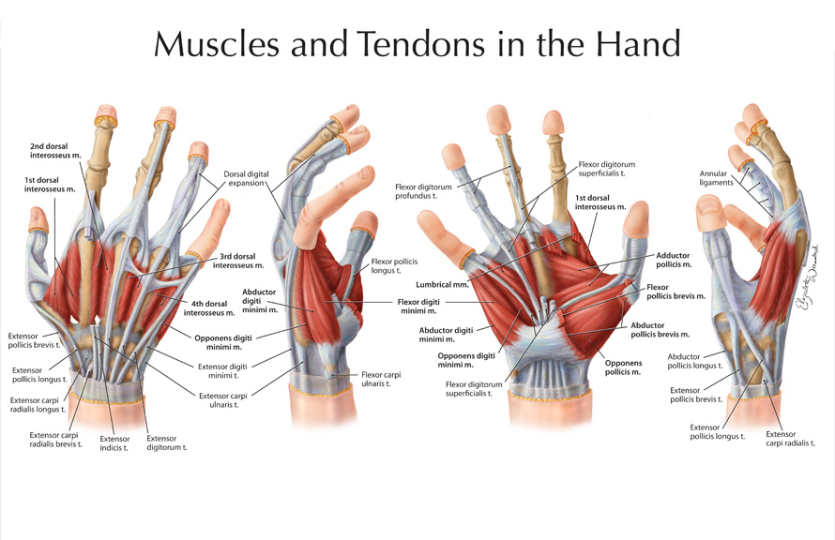
What does this look like to you? Design or Accident?

Slide 29
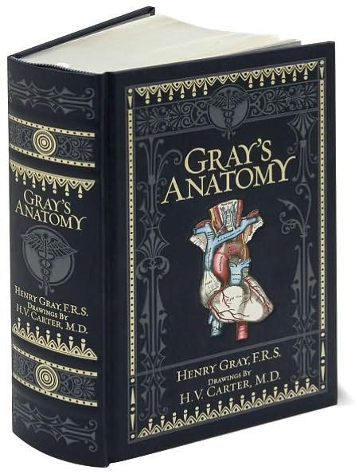
Is it reasonable to think this book could appear by accident?
How about the human body it describes?

Slide 30
You decide – which is most probable?
Evolution Creation
Everything came from A powerful Creator
nothing made everything
Life began by accident Life was created
Complex creatures Each living creature was
developed by a series designed and made
of random accidents by their Creator

Slide 31
From the Bible
Genesis 1:1
“In the beginning, God created the heavens and the earth.”

Slide 32
What is Faith?
Faith : believing something that you can’t see
(everyone has faith in something)
“By faith we understand that the universe was created by the word of God, so that what is seen was not made out of things that are visible.” Hebrews 11:3

Slide 33
Creation – Genesis 1
v.2-5 light/dark, day/night (time measurement system)
“The earth was without form and void, and darkness was over the face of the deep. And the Spirit of God was hovering over the face of the waters. And God said, ‘Let there be light,’ and there was light. And God saw that the light was good. And God separated the light from the darkness. God called the light Day, and the darkness he called Night. And there was evening and there was morning, the first day.”

Slide 34
Creation – Genesis 1
v.2-5 light/dark, day/night (time measurement system)
v.6-8 atmosphere, clouds and water cycle
“And God said, ‘Let there be an expanse in the midst of the waters, and let it separate the waters from the waters.’ And God made the expanse and separated the waters that were under the expanse from the waters that were above the expanse. And it was so. And God called the expanse Heaven. And there was evening and there was morning, the second day.”

Slide 35
Creation – Genesis 1
v.2-5 light/dark, day/night (time measurement system)
v.6-8 atmosphere, clouds and hydrologic cycle
v.9-13 dry land and …
“And God said, ‘Let the waters under the heavens be gathered together into one place, and let the dry land appear.’ And it was so. God called the dry land Earth, and the waters that were gathered together he called Seas. And God saw that it was good.” (9-10)

Slide 36
Creation – Genesis 1
v.2-5 light/dark, day/night (time measurement system)
v.6-8 atmosphere, clouds and hydrologic cycle
v.9-13 dry land and plants with seeds and fruit
“And God said, ‘Let the earth sprout vegetation, plants yielding seed, and fruit trees bearing fruit in which is their seed, each according to its kind, on the earth.’ And it was so. The earth brought forth vegetation, plants yielding seed according to their own kinds, and trees bearing fruit in which is their seed, each according to its kind. And God saw that it was good. And there was evening and there was morning, the third day.” (11-13)

Slide 37
Creation – Genesis 1
v.2-5 light/dark, day/night (time measurement system)
v.6-8 atmosphere, clouds and hydrologic cycle
v.9-13 dry land and plants with seeds and fruit
v.14-19 sun, moon, and stars
“And God said, ‘Let there be lights in the expanse of the heavens to separate the day from the night. And let them be for signs and for seasons, and for days and years, and let them be lights in the expanse of the heavens to give light upon the earth.’ And it was so. And God made the two great lights—the greater light to rule the day and the lesser light to rule the night—and the stars. … And God saw that it was good. And there was evening and there was morning, the fourth day.”

Slide 38
Creation – Genesis 1
v.2-5 light/dark, day/night (time measurement system)
v.6-8 atmosphere, clouds and hydrologic cycle
v.9-13 dry land and plants with seeds and fruit
v.14-19 sun, moon, and stars
v.20-23 fish and birds; reproduction in kind
“And God said, ‘Let the waters swarm with swarms of living creatures, and let birds fly above the earth across the expanse of the heavens.’ So God created the great sea creatures and every living creature that moves, with which the waters swarm, according to their kinds, and every winged bird according to its kind. And God saw that it was good. And God blessed them, saying, ‘Be fruitful and multiply and fill the waters in the seas, and let birds multiply on the earth.’ And there was evening and there was morning, the fifth day.”

Slide 39
Creation – Genesis 1
v.2-5 light/dark, day/night (time measurement system)
v.6-8 atmosphere, clouds and hydrologic cycle
v.9-13 dry land and plants with seeds and fruit
v.14-19 sun, moon, and stars
v.20-23 fish and birds; reproduction in kind
v.24-25 land animals
“And God said, ‘Let the earth bring forth living creatures according to their kinds—livestock and creeping things and beasts of the earth according to their kinds.’ And it was so. And God made the beasts of the earth according to their kinds and the livestock according to their kinds, and everything that creeps on the ground according to its kind. And God saw that it was good.”

Slide 40
Creation – Genesis 1
v.2-5 light/dark, day/night (time measurement system)
v.6-8 atmosphere, clouds and hydrologic cycle
v.9-13 dry land and plants
v.14-19 sun, moon, and stars
v.20-23 fish and birds; reproduction in kind
v.24-25 land animals; v.26,27 people
“Then God said, ‘Let us make man in our image, after our likeness. And let them have dominion over the fish of the sea and over the birds of the heavens and over the livestock and over all the earth and over every creeping thing that creeps on the earth.’ So God created man in his own image, in the image of God he created him; male and female he created them.”

Slide 41
Made in His Image
How can physical people be made in the image of a spiritual God? God gave us:
Heart – Deep Feelings (Gen 2:23)
To respond to God with love
Will – Ability to Choose (Gen 2:16,17)
To choose to follow God
Mind – Intellect (Gen 2:19,20)
To hear and understand God’s words
Authority – Rule over the Earth (Gen 1:28)
Responsibility to serve Him
Notes:
Guess why God has given us these four attributes of Himself?
“And you shall love the Lord your God with all your heart and with all your soul and with all your mind and with all your strength.” Mark 12:30

Slide 42
Made in God’s Image – Very Special
God gave us His breath of life (Genesis 2:7):
“then the LORD God formed the man of dust from the ground and breathed into his nostrils the breath of life, and the man became a living creature.”
He gave us an eternal destiny (Ecclesiastes 3:11)
“He has made everything beautiful in its time. Also, He has put eternity into man's heart,”

Slide 43
We live on a very good planet
“And God saw everything that He had made, and behold, it was very good.”
Genesis 1:31a

Slide 44
A very good planet with a purpose
“For this is what the LORD says — He who created the heavens, He is God; He who fashioned and made the earth, He founded it; He did not create it to be empty, but formed it to be inhabited — He says: “I am the LORD,
and there is no other.”
Isaiah 45:18

Slide 45
But we are small…

Slide 46
But we are small…

Slide 47
We are very small !

Slide 48
We are very small !

Slide 49
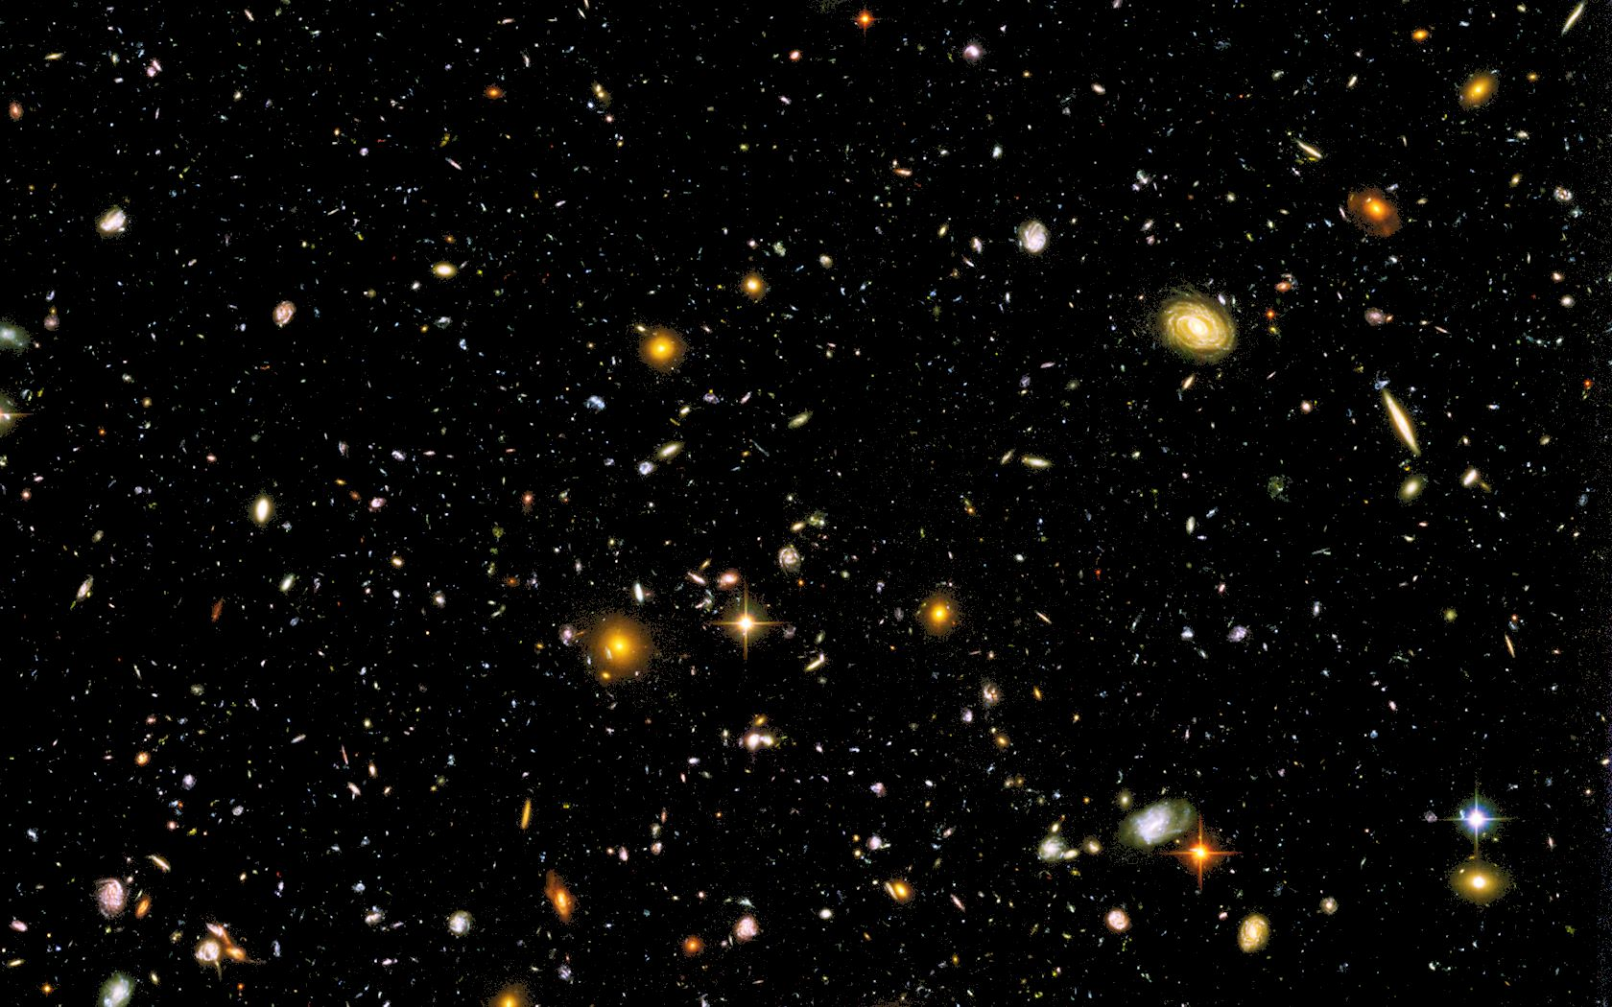
…in a Very Big Universe!
We are very, very small !

Slide 50
But everything is small when compared to God…
The heavens declare the glory of God,
and the sky above proclaims his handiwork.
Day to day pours out speech,
and night to night reveals knowledge.
There is no speech, nor are there words,
whose voice is not heard. Psalm 19:1-3

Slide 51
Just as the earth has a purpose, God created you for a purpose!
When I consider your heavens,
the work of your fingers,
the moon and the stars,
which you have set in place,
what is mankind that you are mindful of them,
human beings that you care for them?
Psalm 8:3-4
Notes:
The stars reveal the glory of God and the earth shows His power, but why did He create us? That is one of the important purposes of the Bible – it reveals our purpose!
But first, we need to understand what happened to this “very good world.” Why is it so broken?

Slide 53
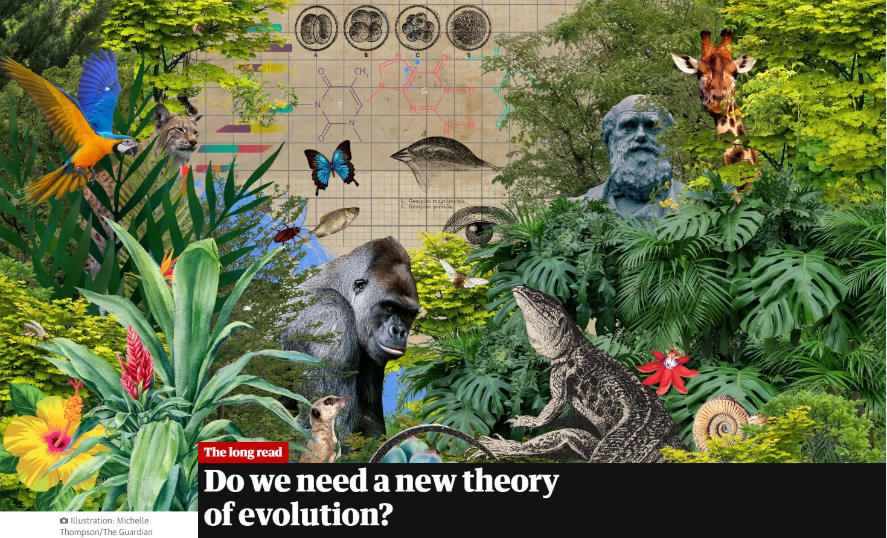
The Guardian Stephen Buranyi, 28 Jun 2022
“This is the basic story of evolution, as recounted in countless textbooks and pop-science bestsellers. The problem, according to a growing number of scientists, is that it is absurdly crude and misleading.”
“This classic idea of gradual change, one happy accident at a time, has so far fallen flat.”
“The issue at stake,” says Arlin Stoltzfus, an evolutionary theorist at the IBBR research institute in Maryland, “whether the idea of a grand story of biology is a fairytale we need to finally give up.”

Slide 54
Period of Time – Why?
What is the physical reason for each of these?
One year
One month
One day
One week
“So God blessed the seventh day and made it holy, because on it God rested from all His work that He had done in creation.” (Genesis 2:3)

Slide 55
Why do people choose Evolution?
It is NOT because of what they see through the telescope of the microscope
It is NOT based on scientific evidence
It is a choice from the heart:
“For although they knew God, they neither glorified him as God nor gave thanks to him, but their thinking became futile and their foolish hearts were darkened. Although they claimed to be wise, they became fools. They exchanged the truth about God for a lie, and worshiped and served created things rather than the Creator.” (Romans 1:21,22,25)

Slide 56
Look at creation with open eyes!
“For what can be known about God is plain to them, because God has shown it to them. For His invisible attributes, namely, his eternal power and divine nature, have been clearly perceived, ever since the creation of the world,” Romans 1:19,20
“The heavens declare the glory of God, and the sky above proclaims his handiwork. Day to day pours out speech, and night to night reveals knowledge.” Psalm 19:1,2

