Slide 1
Study Plan
 | Topic
 | Is the Bible Trustworthy?
 | Did God Really Create the World?
 | If God is Good, why does Suffering Exist?
 | Why is Evil so Widespread and Powerful?
 | What is the Purpose of the Ten Commandments?
 | Why did Jesus Perform Miracles?
 | What did Jesus Really Say?
8 | Is Death the End (or the Beginning)?

Slide 2
Is Death the End ?
(or the beginning)…
The ultimate sacrifice…

Slide 3
Sin
Death
Two great problems only God can solve
Guilty of
Breaking
God’s Law
Punishment
Notes:
As we’ve moved through our brief study of the Bible, we’ve focused on the two major problems of mankind: our sin leads to death, and our breaking of God’s laws requires punishment. Throughout the history of the world, people have been seeking solutions for these problems through:
good works, right thinking, social justice, religion, etc.
But when you’re trying to please the almighty, perfect God, none of these solutions are good enough.
Tonight, after two months of study, I want to show you the solution to these problems. As you might suspect, the only possible solution comes from God Himself.

Slide 4
From last week, remember…
John 1:29 “The next day he saw Jesus coming toward him, and said, ‘Behold, the Lamb of God, who takes away the sin of the world!’”
John 3:16 “For God so loved the world, that He gave His only Son, that whoever believes in Him should not perish but have eternal life.”
Mark 10:32-34 “And they were on the road, going up to Jerusalem, and Jesus was walking ahead of them. And they were amazed, and those who followed were afraid. And taking the twelve again, he began to tell them what was to happen to him, saying, ‘See, we are going up to Jerusalem, and the Son of Man will be delivered over to the chief priests and the scribes, and they will condemn him to death and deliver him over to the Gentiles. And they will mock him and spit on him, and flog him and kill him. And after three days he will rise.’”
John 1:29 – Jesus is the lamb of God who takes away the sin of the world
John 3:16 – God came down to sinful men to give them an opportunity to admit their sin and turn to Him
Mark 10:32-34 – Jesus knew what was about to happen…

Slide 5
Jesus is Always in Control
John 7:30-31 So they were seeking to arrest him, but no one laid a hand on him, because his hour had not yet come. Yet many of the people believed in him. They said, “When the Christ appears, will he do more signs than this man has done?”
32 The Pharisees heard the crowd muttering these things about him, and the chief priests and Pharisees sent officers to arrest him.
45-46 The officers then came to the chief priests and Pharisees, who said to them, “Why did you not bring him?” The officers answered, “No one ever spoke like this man!”
John 7: Religious leaders try to capture Jesus
  Verses 30-31 : His time had not yet come
  Verses 32 : the guards are sent to get Him
  Verses 45-46 : the guards are powerless against Jesus
Notes:
Not everyone wanted to see Jesus become king. The religious leaders were jealous of Him and afraid that He would harm their political relationships with the Roman government. In a way, this is good for us, because their failed attempts to prove that He was a fraud (fake) helps to confirm that these records are true. And since His enemies could not prove Him wrong, they sought to silence Him by catching and killing Him. It is interesting to read one such attempt in John 7:30-32; 45,46. Notice that Jesus was completely in control of what happened. The Jewish leaders wanted to take Him, but they could not do it until Jesus decided that the time was right.

Slide 6
Jesus is Always in Control
Mark14:1-2 It was now two days before the Passover and the Feast of Unleavened Bread. And the chief priests and the scribes were seeking how to arrest him by stealth and kill him, for they said, “Not during the feast, lest there be an uproar from the people.”
34-36 And he said to them, “My soul is very sorrowful, even to death. Remain here and watch.” And going a little farther, he fell on the ground and prayed that, if it were possible, the hour might pass from him. And he said, “Abba, Father, all things are possible for you. Remove this cup from me. Yet not what I will, but what you will.”
41-42 And he came the third time and said to them, “Are you still sleeping and taking your rest? It is enough; the hour has come. The Son of Man is betrayed into the hands of sinners. Rise, let us be going; see, my betrayer is at hand.”
Mark 14: Religious leaders try not to capture Jesus
  Verses 1-2 : Passover, the time to sacrifice the lamb
  Verses 34-36 : Jesus cries out to His Father, but there is no other way to save the world
  Verses 41-42 : The hour has come for Jesus to be taken
Notes:
The Passover was the time that all of the Jews remembered how God protected them from death, instructing them to kill a lamb and paint its blood on the doorposts. Every year during the Passover feast, the people of Israel would kill another lamb, remembering this historic event. But it was much more than just an historic event – it was a picture of the true Lamb of God, the One who would die to take away sin of the world.
For this reason, Passover was the right time for Jesus to sacrifice His life. In Mark 14:1,2, we see that this was one time where the Jewish leaders did not want to arrest Jesus and kill Him. But remember, Jesus is in control. After eating the last supper with His disciples, they go into a garden to pray. But this is not an easy time – Jesus is faced with the unthinkable. The perfectly holy God is about to drink in all of the sin of the world. Jesus cries out to the Father (Mark 14:34-36). But there is no other way.
So Jesus allowed Himself to be captured by the religious leaders, falsely accused, and turned over to the Romans for execution.

Slide 7
Jesus is Condemned by His Creatures
12-14 And Pilate again said to them, “Then what shall I do with the man you call the King of the Jews?” And they cried out again, “Crucify him.” And Pilate said to them, “Why, what evil has he done?” But they shouted all the more, “Crucify him.”
1-3 Then Pilate took Jesus and flogged him. And the soldiers twisted together a crown of thorns and put it on his head and arrayed him in a purple robe. They came up to him, saying, “Hail, King of the Jews!” and struck him with their hands.
14-15 Now it was the day of Preparation of the Passover. It was about the sixth hour. He said to the Jews, “Behold your King!” They cried out, “Away with him, away with him, crucify him!” Pilate said to them, “Shall I crucify your King?” The chief priests answered, “We have no king but Caesar.”
16-17 So he delivered him over to them to be crucified. So they took Jesus, and he went out, bearing his own cross, to the place called The Place of a Skull, which in Aramaic is called Golgotha.
Mark 15:12-14 : What will you do with Jesus?
John 19:1-3 : Jesus is crowned with thorns, whipped, and shamed
John 19:14-15 : Who is your king?
John 19:16-17 : The Son of God climbs the hill with the wood of sacrifice on His back – the Lamb is provided
Notes:
Even the Roman governor, Pilate, knows that Jesus is innocent, asking the people why He should be condemned (Mark 15:12-15). Jesus, Immanuel, God in the flesh, stands before them. This is the One who healed their sick and fed the hungry, the One who amazed people with His teaching. They are now given a choice: what will they do with Jesus? And in direct disobedience to the 1st commandment, they choose to turn from God and turn toward man (John 19:15,16).
Before His execution, the Romans whipped, tortured, and mocked Him (Mark 15:16-20). The Romans were experts at torture, and records from this period tell us about their flogging. The whip had many strips of leather. Pieces of metal and bone were tied onto the lashes so they would cut the back of the prisoner when he was beaten. The prisoner’s hands and legs were tied during this time so he couldn’t escape. This punishment cut the flesh, muscles, and nerves, often putting the victim into severe shock. Some prisoners died from the flogging itself.
So they placed a wooden cross on the back of Jesus (John 19:17) and made Him climb the hill of sacrifice.
Crucifixion was used by the Romans for the worst of criminals. This punishment was made even worse because usually the person did not die immediately. He would endure hours and sometimes days of intense physical pain before dying. For His crucifixion, Jesus was stripped naked and nails were driven through His hands and feet into a wooden cross. The cross was then placed in an upright position. The Holy and perfect Creator, lifted up above the crowd, hanging for hours in shame and agony (Mark 15:25).

Slide 8
Jesus Suffering on the Cross
Mark 15:25 And it was 9:00AM when they crucified him.
26 And the inscription of the charge against him read, “The King of the Jews.”
29-30 And those who passed by derided him, wagging their heads and saying, “Aha! You who would destroy the temple and rebuild it in three days, save yourself, and come down from the cross!”
31 So also the chief priests with the scribes mocked him to one another, saying, “He saved others; he cannot save himself.
32 Let the Christ, the King of Israel, come down now from the cross that we may see and believe.” Those who were crucified with him also reviled him.
Mark 15 – Jesus on the cross, naked and ashamed
  Verse 25 – Jesus is crucified – falsely accused, bleeding, naked and ashamed
  Verse 26 : The truth : Jesus is The King of the Jews
  Verses 29-30 : “come down” – the temptation of the devil tries to stop the only way of salvation
  Verse 31 : “He saved others” – a truth they could not deny
  Verse 32 : Jesus claimed to be the Christ – the promised Savior, and they knew it. They speak the important truth: “see and believe”
Notes:
Usually a sign was put above the criminal to indicate what crime he had committed. Because Jesus had committed no crime, the Romans could find nothing to charge Him with. To mock the Jews and their desire to be free from the control of the Romans, they put this title above Jesus’ head where everyone could read it (Mark 15:26). The words that they wrote were true, but they didn’t know it.
Some things that we must notice during this terrible event (Mark 15:29-32):
Through the words of the people, the devil was tempting Jesus to come down from the cross, halting the plan of salvation.
The chief priests admitted the truth about Jesus: “He saved others”
The priests were very clear about Jesus’ claim to be “the Christ”
They stated the critical issue: we must choose to “see and believe”

Slide 9
Why did Jesus Suffer?
Is 52:14-15 Just as many were appalled at Him – His appearance was so disfigured that He did not look like a man, and His form did not resemble a human being — so He will sprinkle many nations.
Mk 15:33-34 And when 12:00 Noon had come, there was darkness over the whole land until 3:00PM. And at 3:00PM Jesus cried with a loud voice, “Eloi, Eloi, lema sabachthani?” which means, “My God, my God, why have you forsaken Me?”
Is 53:5-6 But He was pierced for our transgressions; He was crushed for our iniquities; upon Him was the chastisement that brought us peace, and with His wounds we are healed. All we like sheep have gone astray; we have turned – every one – to his own way; and the LORD has laid on Him the iniquity of us all.
1 Peter 2:24 He himself bore our sins in his body on the tree, that we might die to sin and live to righteousness. By his wounds you have been healed.
John 19:30 When Jesus had received the sour wine, he said, “It is finished,” and he bowed his head and gave up his spirit.
Isaiah 52:14,15 A powerful prediction that the Messiah would suffer deeply
Mark 15:33-34 Not just physical suffering – Spiritual suffering: separation from the Father
Isaiah 53:5-6 Our guilt and punishment was put onto Jesus
1 Peter 2:24 Jesus took the punishment for our guilt, solving our 2nd big problem!
John 19:30 “It is finished.” Our debt – paid in full!
Notes:
For three hours, Jesus endured the physical torture of crucifixion. But then, things got much worse – at 12:00Noon, He began to endure the spiritual torture of suffering the payment for our sins. The Light came into the world, but now, darkness… (Mark 15:33-41)
Why did God turn His back on Jesus, His beloved Son? Jesus had always obeyed God and had never done anything wrong. Jesus willingly accepted the complete punishment for our sins so that God could freely forgive and accept us as His children (1 Peter 2:23,24). Jesus was tortured on the cross because of our second problem, guilt that requires punishment.

Slide 10
Jesus Died and was Buried
Matt 27:57-58 When it was evening, there came a rich man from Arimathea, named Joseph, who also was a disciple of Jesus. He went to Pilate and asked for the body of Jesus. Then Pilate ordered it to be given to him.
59-60 And Joseph took the body and wrapped it in a clean linen shroud and laid it in his own new tomb, which he had cut in the rock. And he rolled a great stone to the entrance of the tomb and went away.
62-66 The next day, that is, after the day of Preparation, the chief priests and the Pharisees gathered before Pilate and said, “Sir, we remember how that impostor said, while he was still alive, ‘After three days I will rise.’ Therefore order the tomb to be made secure until the third day, lest his disciples go and steal him away and tell the people, ‘He has risen from the dead,’ and the last fraud will be worse than the first.” Pilate said to them, “You have a guard of soldiers. Go, make it as secure as you can.” So they went and made the tomb secure by sealing the stone and setting a guard.
Matthew 27 – Jesus died and was buried
  Verses 57-58 : Jesus’ body is taken down by Joseph, a well-known leader
  Verses 59-60 : Jesus’ body was buried in a secure tomb
  Verses 62-66 : the religious leaders knew Jesus promised to rise again, so they did everything possible to prevent grave robbery
Notes:
Let’s turn to Matthew 27:50,51 for the rest of the story. Notice that Jesus “gave up His spirit.” Even in His death, Jesus is in control (His life was not taken from Him).
Usually, when criminals were crucified, the Romans left their dead bodies on the crosses as an example to anyone else who would resist their power. But with Jesus, something very important happens in Matthew 27:57-61. His body was carefully placed in a very secure tomb by a well-known member of the ruling council. You can see why this was so important in Matthew 27:62-66. Everyone knew that Jesus said He would rise again, so his enemies did everything possible to prevent any tricks by His followers.

Slide 11
Jesus Rises and Conquers Death!
Matt 28:1 Now after the Sabbath, toward the dawn of the first day of the week, Mary Magdalene and the other Mary went to see the tomb.
2-4 And behold, there was a great earthquake, for an angel of the Lord descended from heaven and came and rolled back the stone and sat on it. His appearance was like lightning, and his clothing white as snow. And for fear of him the guards trembled and became like dead men.
5-6 But the angel said to the women, “Do not be afraid, for I know that you seek Jesus who was crucified. He is not here, for He has risen, as He said. Come, see the place where He lay.
John 20:19-20 On the evening of that day, the first day of the week, the doors being locked where the disciples were for fear of the Jews, Jesus came and stood among them and said to them, “Peace be with you.” When He had said this, He showed them His hands and His side. Then the disciples were glad when they saw the Lord.
1 Cor:15:3-6 For I delivered to you as of first importance what I also received: that Christ died for our sins in accordance with the Scriptures, that He was buried, that He was raised on the third day in accordance with the Scriptures, and that He appeared to Cephas, then to the twelve. Then He appeared to more than five hundred brothers at one time, most of whom are still alive, though some have fallen asleep.
Matthew 28 – The empty tomb
  Verse 1 : Sunday morning, the women go to the tomb
  Verses 2-4 : A powerful angel rolled away the stone, terrifying the guards
  Verses 5-6 : “He is not here … He has risen, just as He said!”
John 20:19-20 The risen Lord and His apostles
1 Corinthians 15:3-6 The risen Jesus and 500 witnesses
Notes:
It is a good thing that they took such extreme steps to keep Jesus’ body in the grave. It adds so much more credibility to what we read in Matthew 28:1-10.

Slide 12
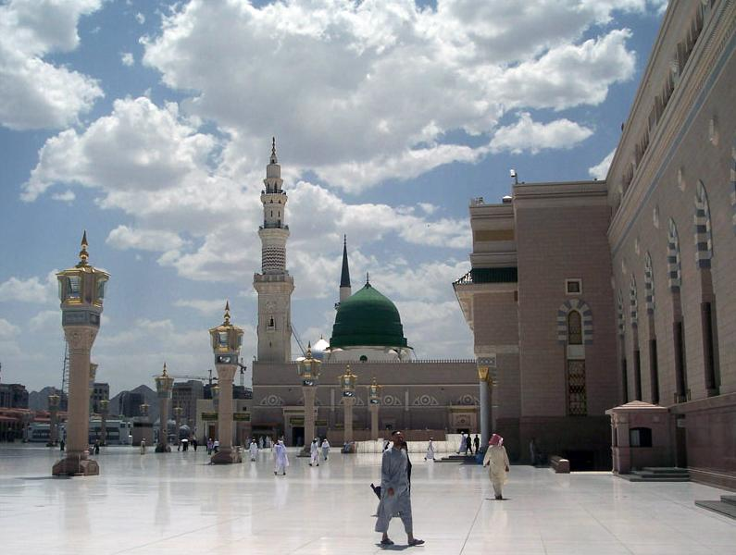
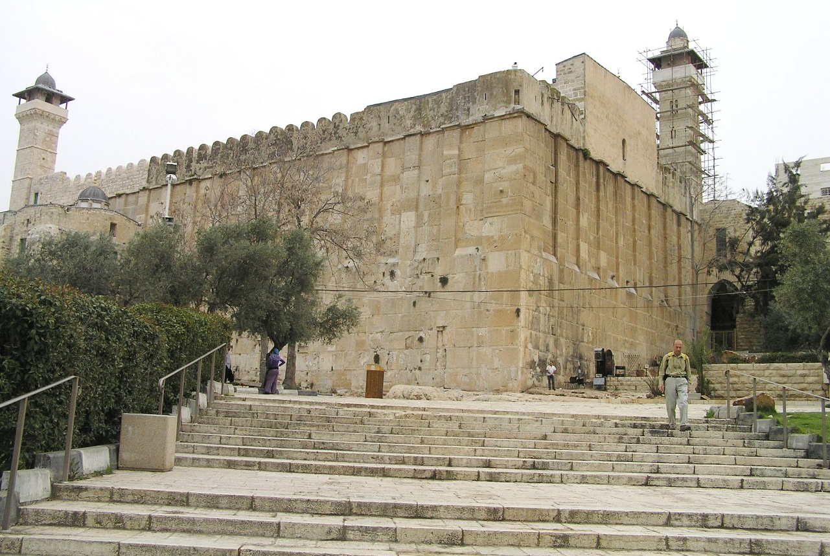
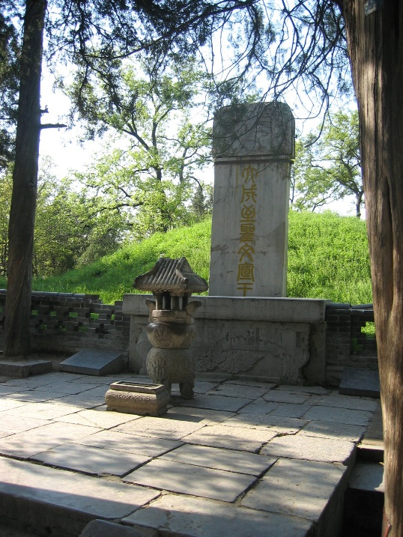
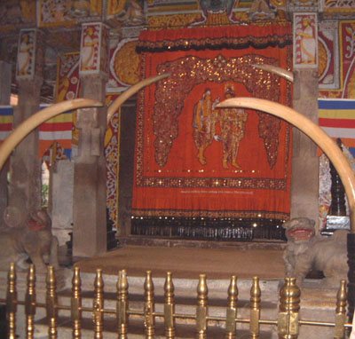
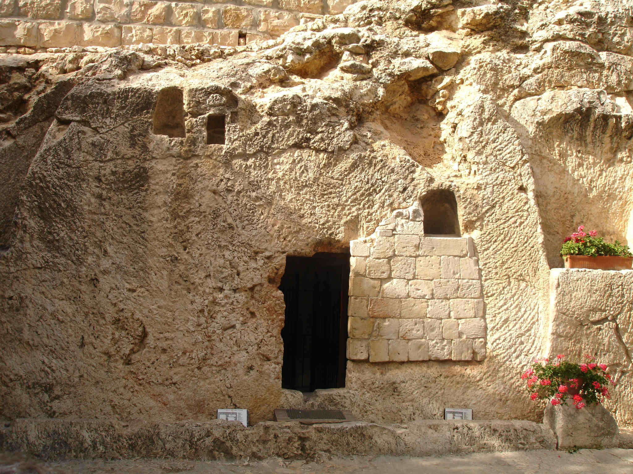
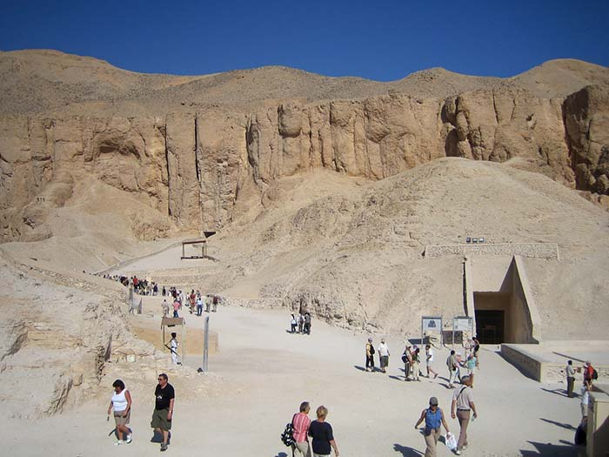
Tombs of Famous People
There are many tombs of famous leaders all over the world. Jesus’ tomb is different – it is empty!
Jesus died in our place. He then rose and conquered death, solving our 1st problem!
“Jesus said to her, ‘I am the resurrection and the life. Whoever believes in me, though he die, yet shall he live, and everyone who lives and believes in me shall never die.’” John 11:25-26
The Green Dome – tomb of Muhammad
Tomb of Abraham, Isaac, and Jacob
Tomb of 孔子 (Confucius)
Tomb of Jesus?
No one knows – it is empty…
Tomb of “King Tut” (Tutankhamun)
(Egyptian Ruler during 1300’s BC - deified)
Temple of the Tooth of Buddha
(contains some remains from Buddha)
Notes:
Just as He said, Jesus overcame the power of death, solving our first problem (sin leads to death). All over the world, there are many tombs of religious leaders. But there is something special about the tomb where Jesus was buried: it is empty.
Muhammad is buried in the Al-Masjid an-Nabawi ("Mosque of the Prophet") in the city of Medina in Saudi Arabia.
The Cave of the Patriarchs is located in the ancient city of Hebron (which lies in the southwest part of the West Bank, in the heart of ancient Judea)
The grave of Confucius (Kǒngzǐ), founder of Confucianism, is in his home town of Qufu, Shandong Province, China.
The Buddha's body was cremated and the relics were placed in monuments or stupas, some of which are believed to have survived until the present. For example, the Temple of the Tooth or Dalada Maligawa in Sri Lanka is the place where the right tooth relic of Buddha is kept at present.

Slide 13
Sin
Death
Two great problem that God has solved
Guilty of
Breaking
God’s Law
Righteous
(Not Guilty)
Jesus’
Punishment
Life
Jesus’ Resurrection
Punishment

Slide 14
Bad News / Good News
The bad news: because of our sin and guilt, we deserve death and punishment.
Religion and “good works” can never please the almighty, perfect God.
The good news: Jesus has solved these problems!
What will you do about it? What will you do with Jesus?
The payment for sin is death, but the gift of God is eternal life. How does a person receive this gift?
“We have all become like one who is unclean, and all our righteous deeds are like a polluted garment. We all fade like a leaf, and our iniquities, like the wind, take us away.” Isaiah 64:6
“Jesus said to him, ‘I am the way, and the truth, and the life. No one comes to the Father except through Me.’” John 14:6
“For the wages of sin is death, but the free gift of God is eternal life in Christ Jesus our Lord.” Romans 6:23
Notes:
For many weeks, we have seen the “bad news” from the Bible. If you ever felt hopeless, lost in sin, destined for death and punishment, it was a reasonable response to the truth of the Bible. But tonight, you have heard the “good news.” Turn with me to Romans 6:23 to see what you should do with this “good news.” Because we have all sinned, we deserve “wages” – death. But God offers something much better through Jesus – a gift of eternal life. Like all true gifts, it is not something that we earn or deserve – it is simply something that we receive.

Slide 15
Receiving the Best Gift of All !
Repent and Believe !
  Stop going your own way – turn around and follow God.
  Believe in your heart that Jesus died for your sin and that God raised Him from the dead
  Confess that Jesus is the Lord of all and surrender to Him as your Lord!
John 1:12 – Turn to the Father and believe, becoming a child of God!
Grace – God saves sinful people as a gift, by His work, not ours
“Jesus came into Galilee, proclaiming the gospel of God, and saying, ‘The time is fulfilled, and the kingdom of God is at hand; repent and believe in the gospel.’” Mark 1:14,15
“If you confess with your mouth that Jesus is Lord and believe in your heart that God raised Him from the dead, you will be saved.” Romans 10:9
“But to all who did receive Him [Jesus], who believed in His name, He gave the right to become children of God,” John 1:12
For by grace you have been saved through faith. And this is not your own doing; it is the gift of God, not a result of works, so that no one may boast. Ephesians 2:8,9
Notes:
So how do we receive it? Look at Romans 10:9-13.
Without Jesus, we are all lost. To receive this wonderful, gift, we must confess our sins before God, agreeing with Him that we have broken His law and deserve punishment. We must also confess with our mouth “Jesus is Lord” – not just an important historical figure, but the One who we will trust and follow instead of continuing on our sinful way. And we must believe in our heart, not just our head, that God raised Him from the dead. We must take a “step of faith.” Not just an intellectual understanding, but deep trust (v.11). Everyone who calls on his name, Jewish or Roman, Chinese or American, will be saved.
The entire world stands guilty, ready for judgment. But just like in the days of Noah, God has provided a “safe place” to escape judgment. But it is the only safe place – our problems are too big for any other solution. Tonight, I would like to encourage you to think deeply about this “good news.” If you believe that it is true, take a step of faith, trusting in Jesus. He has already solved your two biggest problems and offers eternal life to you. He is waiting for you to reach out, by faith, and receive his amazing gift.
As we finish tonight, I want you to look at one more thing. Christianity is much more than a religion – it is a relationship. Look at Galatians 4:6,7. When a person believes in Jesus, he actually becomes a child of God. Even more than a “legally adopted son,” but a child who can say “Daddy.” And when you are a child of God, you can run into His arms without shame. He adopts you, fully aware of all your sin, all your failures, and all your weaknesses. He knows everything about you, and still, He loves you.

Slide 16
Potential Topics for Future Discussion
C2C8 - Epilogue
What is the meaning of life?
Aren't all religions the same?
Can I really talk to God?
How long is Time and Eternity?
What does a good parent/child relationship look like?
How can I deal with Fear?
Is there Life after Death?
What is God's Will for My Life?
Is it ever right to do wrong?
How can I be a good Employee?
What does the Bible say about heaven and hell?
Does God control everything?
What does God hate? What does He love?
How can I recognize False Teachers?
What is the Christian Hope?

Slide 18
God’s solution to our big problems
In the garden, we all inherited 3 things: fear, guilt, and shame
  Guilt – punishment for breaking God’s law
  Fear – the fear of death because of our sin
  Shame – separation from a loving Father
Through Jesus, all 3 things can be solved:
  Through His death, He was punished for our guilt
  By His resurrection, Jesus conquered death (cancelling our greatest fear)
  By believing in Him, we become children of God (acceptance)
Notes:
In the Garden of Eden, we saw three effects of the very first sin: fear, guilt, and shame. Tonight, you saw how Jesus took our punishment on the cross, allowing us to be declared “righteous” – not guilty. And you saw how He rose from the grave, conquering death and giving us life.

Slide 19
World History – it’s His Story
History is not just a series of random events
Immediately after man sinned, God sacrificed a lamb to cover their shame
At Passover, a lamb was sacrificed to prevent death
On the cross, the Lamb of God was sacrificed for us
God has been guiding history to bring lost people back to Himself
Philippians 2:5-11 – Every knee will bow
Notes:
As we’ve studied the Bible together, we have covered several thousand years of history. Along the way, I hope that you have come to understand that history is not just a random series of events. History is really just that: “His Story.” (1 Corinthians 10:1-6). The true stories in the Bible were not just written down for our entertainment – they were written down to point us clearly to the truth of God’s saving plan through Jesus, “the rock of salvation.” In the Garden of Eden, God killed a lamb as a substitute for sinful people to covering their guilt and shame. And at the right time, God killed “The Lamb,” His only Son, as the perfect substitute for sinful people, taking away their guilt and shame.

Slide 20
The cross cancels the law
十
十
诫
你们从前因着过犯和肉体未受割礼，原是死的，然而 神赦免了我们的一切过犯，使你们与基督一同活过来， 抹去了那写在规条上反对我们、与我们为敌的字句，并且把这字句从我们中间拿去，钉在十字架上。
When you were dead in your sins and in the uncircumcision of your sinful nature, God made you alive with Christ. He forgave us all our sins, having canceled the written code, with its regulations, that was against us and that stood opposed to us; He took it away, nailing it to the cross. Colossians 2:13,14
Notes:
Look at Galatians 4:4,5. Here is the message: at the beginning of creation, God made a plan to save you. And when the time was just right, He sent Jesus to be born, to live, and to die. He did this because we are all born “under the law,” guilty of breaking His law, separated from Him. The only way to bring you back was for Jesus to come to earth and sacrifice His life, paying the penalty for your sin, rising again to give you new life.

