Slide 1
Study Plan
 | Topic
 | Is the Bible Trustworthy?
 | Did God Really Create the World?
 | If God is Good, why does Suffering Exist?
 | What is the Purpose of the Ten Commandments?
 | Why did Jesus Perform Miracles?
 | What did Jesus Really Say?
 | Is Death the End (or the Beginning)?

Slide 2
If God is Good, why do Evil and Suffering Exist?
It was very good, but then…

Slide 3
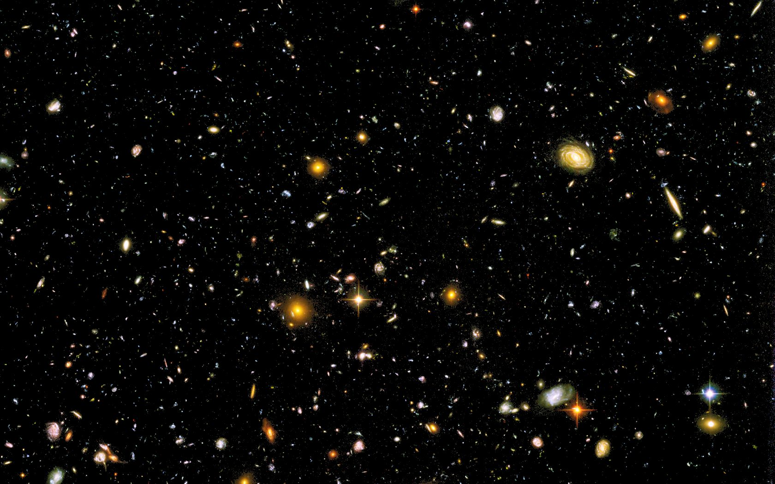
The Awesome, Perfect, Eternal God
To whom then will you compare me,
that I should be like him? says the Holy One.
Lift up your eyes on high and see: who created these?
He who brings out their host by number,
calling them all by name, by the greatness of his might,
and because he is strong in power not one is missing.
Isaiah 40:25,26
Notes:
As we begin, I want to remind you that every created thing had a beginning. As we back up into history, we eventually come to something that did not begin to exist – the only One who is eternally existing – the “first cause” of everything else. Of course, we are talking about the Awesome, Eternal God. Read these verses from Isaiah 40:25,26 and remember who He is and who we are by contrast. He is the center of all attention, not us. When we get that reversed, we set ourselves up for confusion and despair.

Slide 4
From Last Week:
In the beginning, God created… (Genesis 1:1)
God Spoke: “Let there be light…” (Gen 1:3)
Notes:
Last week, we saw three important things in Genesis 1:1 – In the beginning, God, and created. In verse 3, we saw the first example of what God often does – He sends forth His word into darkness, bringing light (physical and spiritual). Genesis 1:26 shows us how God made people special: in His image. He gave them a mind, a will, emotions, and authority.

Slide 5
From Last Week:
In the beginning, God created… (Genesis 1:1)
God Spoke: “Let there be light…” (Gen 1:3)
  In a world of darkness, God sends His word to bring light (physical and spiritual)
  “God saw all that He had made, and it was very good.” (Gen 1:31)
Notes:
Also, Genesis 1:26 shows us how God made people special: in His image. He gave them a mind, a will, emotions, and authority. God created us in His image so that we might know Him personally.
We ended by looking at Genesis 1:31 – God made a wonderful world, a beautiful garden (Eden), and created people in his image for an unhindered relationship with Himself. It was all “very good.” But when we look at our world today, it is far from perfect.

Slide 6
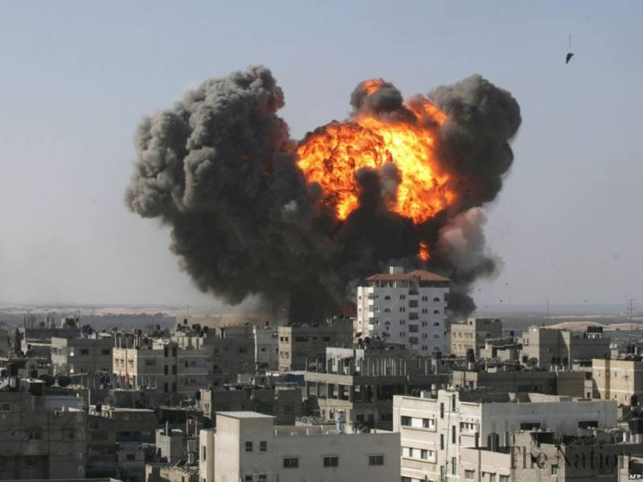
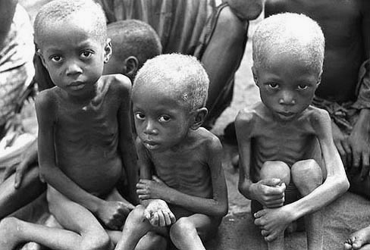
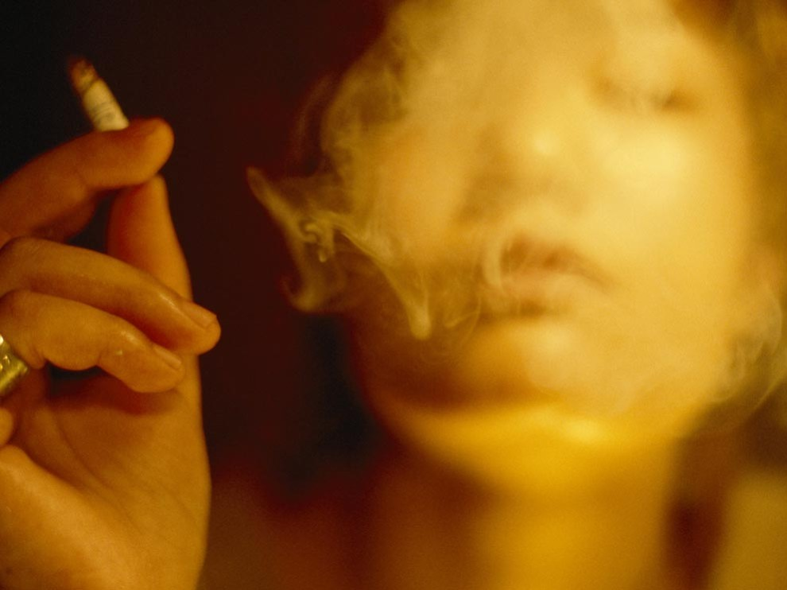
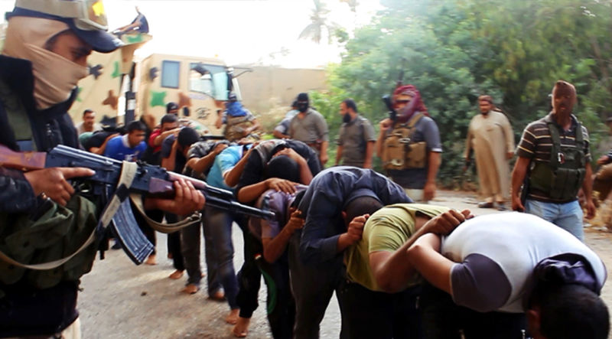
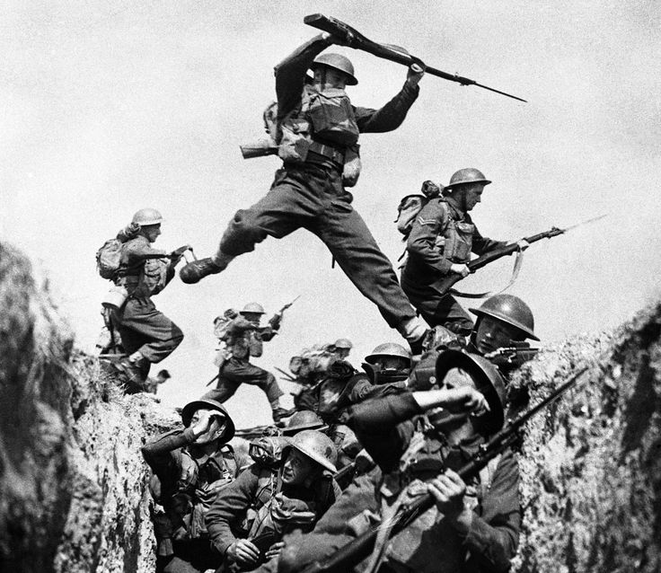
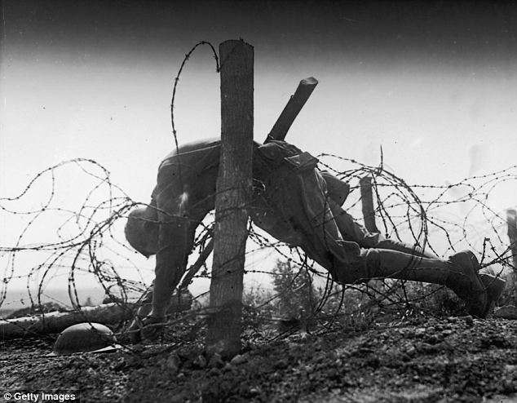
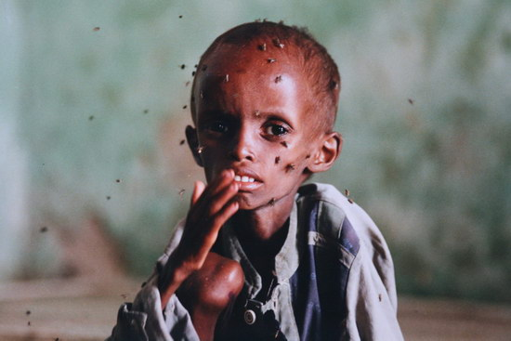

What happened?
We see evil all around us,
and (if we are honest),
We see evil inside of us
Why…?
Notes:
We see evil all around us: terrorism, abuse, disease, and death. And if we’re honest, we sense the evil within us: greed, lying, lust, and rebellion. What happened?

Slide 7
Before God created people…
God created Angels
  John 1:3 – God made everything
  “Through him all things were made; without him nothing was made that has been made.”
Notes:
Even before God created people, He created spirits to be His servants. God is greater than the spirits - He lived before them eternally, He made them, He gave them life. Spirits do not have physical bodies, like us - they can move about wherever they want to. In the beginning, the spirits were all God’s angels. Angels means “messengers” or “servants.”
John 1:3 - All things came into being through Him, and without Him not one thing came into being.

Slide 8
Before God created people…
God created Angels
  John 1:3 – God made everything
  Psalm 103:20 – servants and messengers
  “Bless the LORD, O you His angels, you mighty ones who do His word, obeying the voice of His word!”
Notes:
Psalm 103:20, 21 - Bless the LORD, O you His angels, … all His hosts, His ministers that do His will.
God didn't create all the spirits exactly the same. Some were more beautiful, some were more powerful than others.

Slide 9
Before God created people…
God created Angels
  John 1:3 – God made everything
  Psalm 103:20 – servants and messengers
Not all Angels are the same
Notes:
God didn't create all the spirits exactly the same. Some were more beautiful, some were more powerful than others. The greatest angel was called Lucifer. Lucifer means “morning star.”

Slide 10
Before God created people…
Lucifer, a powerful and beautiful angel
  Ezekiel 28:13-15 – a “guardian cherub”
  “Thus says the Lord GOD: “You were the signet of perfection, full of wisdom and perfect in beauty. You were in Eden, the garden of God; … You were an anointed guardian cherub … You were blameless in your ways from the day you were created, till unrighteousness was found in you.”
Notes:
God didn't create all the spirits exactly the same. Some were more beautiful, some were more powerful than others. The greatest angel was called Lucifer. Lucifer means “morning star.”

Slide 11
Before God created people…
Lucifer, a powerful and beautiful angel
  Ezekiel 28:13-15 – a “guardian cherub”
  Isaiah 14:12-14 – “I will be like God”
  “How you are fallen from heaven, O Day Star, son of Dawn! How you are cut down to the ground, you who laid the nations low! You said in your heart, ‘I will ascend to heaven; above the stars of God I will set my throne on high; I will sit on the mount of assembly in the far reaches of the north; I will ascend above the heights of the clouds; I will make myself like the Most High.’”
Notes:
God gave Lucifer a place of great authority over the other angels in Heaven. Lucifer was created blameless and perfect, but after a time, Lucifer became proud of his beauty and position and wanted to be “like the Most High.”

Slide 12
Moving away from the light of God
Into the darkness of rebellion
Lucifer
Satan
“Morning Star”
Enemy, Accuser
“I will ascend to heaven”
“I will raise my throne”
“I will make myself like the Most High”
Notes:
God is perfectly good. But when a creature chooses to go their own way, they move away from His light into darkness, choosing to be their own god. Lucifer was the first one to do this evil, an action for which he has been judged and will be condemned. Lucifer is also called Satan which means “enemy, adversary, opponent, or accuser.” Other angels followed Lucifer in his rebellion, and are now called demons. (2 Peter 2:4)

Slide 13
A Choice in the Garden
God did not make people like robots
  True love requires a choice
Genesis 2:16,17
“And the LORD God commanded the man, ‘You are free to eat from any tree in the garden; but you must not eat from the tree of the knowledge of good and evil, for when you eat from it you will certainly die.’”
Notes:
As we said above, life in the Garden of Eden was very good – perfect. Adam and Eve had everything they needed. God put Adam in position of manager over all the creation. God gave them a variety of plants and fruits and vegetables to eat, and they had a perfect friendship and fellowship with God and with each other (Genesis 2:25).
Because Adam was created in the image of God, he was given a will – the ability to choose obedience or disobedience. Therefore, God gave him the privilege to eat from any tree in the entire garden except for one: Genesis 2:16,17
God could’ve created Adam and Eve like the animals or like robots, only programmed to do good. But true love requires a choice, so he gave people a will – the ability to choose to follow or reject His leadership. Satan knew about God’s warning to Adam concerning the one tree. Because Satan hates God, he wanted to destroy the man and woman God made in His image. Therefore, Satan planned to deceive Eve.

Slide 14
A Choice in the Garden
God did not make people like robots
  True love requires a choice
Genesis 2:16,17
  The man and woman could have anything they wanted in the garden
  They had a perfect relationship with God and each other (Gen 2:25)
  Only one rule : do not eat the fruit of the forbidden tree
Notes:
As we said above, life in the Garden of Eden was very good – perfect. Adam and Eve had everything they needed. God put Adam in position of manager over all the creation. God gave them a variety of plants and fruits and vegetables to eat, and they had a perfect friendship and fellowship with God and with each other (Genesis 2:25).
Because Adam was created in the image of God, he was given a will – the ability to choose obedience or disobedience. Therefore, God gave him the privilege to eat from any tree in the entire garden except for one: Genesis 2:16,17
God could’ve created Adam and Eve like the animals or like robots, only programmed to do good. But true love requires a choice, so he gave people a will – the ability to choose to follow or reject His leadership. Satan knew about God’s warning to Adam concerning the one tree. Because Satan hates God, he wanted to destroy the man and woman God made in His image. Therefore, Satan planned to deceive Eve.

Slide 15
Satan tempted Eve
Genesis 3:1 – “Did God really say…?”
“Now the serpent was more crafty than any of the wild animals the LORD God had made. He said to the woman, ‘Did God really say, “You must not eat from any tree in the garden”’?”
Notes:
Genesis 3:1 Why did Satan ask Eve this question? – Two reasons: to create doubt about the truthfulness of God’s word, and to tempt them to think that God really didn’t love and care for them.

Slide 16
Satan tempted Eve
Genesis 3:1 – “Did God really say…?”
  He wanted Eve to doubt God’s Word
  He tempted Eve to doubt God’s love
Genesis 3:4-5 – “You will not die…”
“‘You will not certainly die,’ the serpent said to the woman. ‘For God knows that when you eat from it your eyes will be opened, and you will be like God, knowing good and evil.’”
Notes:
Satan is a deceiver. He tries to make what is good appear useless or evil, and what is evil appear good. Satan deceived Eve by coming to her in the form of a snake. Up until that time, the animals had not been harmful in any way to Adam and Eve or to each other, so Eve was not afraid (2 Corinthians 11:14).
Genesis 3:2-5 Satan had already rebelled against God’s authority. He wanted to be independent of God and rule his own life. Now Satan was suggesting to Eve that she should also rebel against God. Satan said that eating the fruit would make Eve like God in knowing good and evil. Satan wanted Eve to believe that she wouldn’t need God to tell her what was right and wrong. But the truth is that God did not make people to live by their own ideas and thoughts, and He made us to be guided by His own Word.

Slide 17
Satan tempted Eve
Genesis 3:1 – “Did God really say…?”
  He wanted Eve to doubt God’s Word
  He tempted Eve to doubt God’s love
Genesis 3:4-5 – “You will not die…”
  “You will be like God” (Satan’s original sin)
  “Believe in yourself - rule your own life!”
But God did not make us to live apart from Him. He made us to be guided by His word.
Notes:
Remember – they were already created in the image of God. Satan’s temptation to “be like God” really meant to “be like God”!
Perfect freedom does not come from the absence of wise rules…

Slide 18
Eve and Adam make a choice
Genesis 3:6 – The woman saw:
“When the woman saw that the fruit of the tree was good for food and pleasing to the eye, and also desirable for gaining wisdom, she took some and ate it. She also gave some to her husband, who was with her, and he ate it.”
Notes:
Genesis 3:6 What did God say would happen to them if they ate of the tree? – He told them that they would die. Even though Adam knew that God had said not to eat it, he deliberately disobeyed God’s command. Adam turned away from depending on God. Up to this point, he had personal experience with the goodness of God. Now, because he had chosen to follow Satan, he will become personally familiar with evil.
The Bible has an amazing consistency from beginning to end. We face these same three temptations today, ones which are described in 1 John 2:16.

Slide 19
Eve and Adam make a choice
Genesis 3:6 – The woman saw:
  The fruit looked like it would taste good
  The fruit was attractive to the eyes
  Eating could increase her wisdom and power
She ate, and then Adam ate
Notes:
Genesis 3:6 What did God say would happen to them if they ate of the tree? – He told them that they would die. Even though Adam knew that God had said not to eat it, he deliberately disobeyed God’s command. Adam turned away from depending on God. Up to this point, he had personal experience with the goodness of God. Now, because he had chosen to follow Satan, he will become personally familiar with evil.
The Bible has an amazing consistency from beginning to end. We face these same three temptations today, ones which are described in 1 John 2:16.

Slide 20
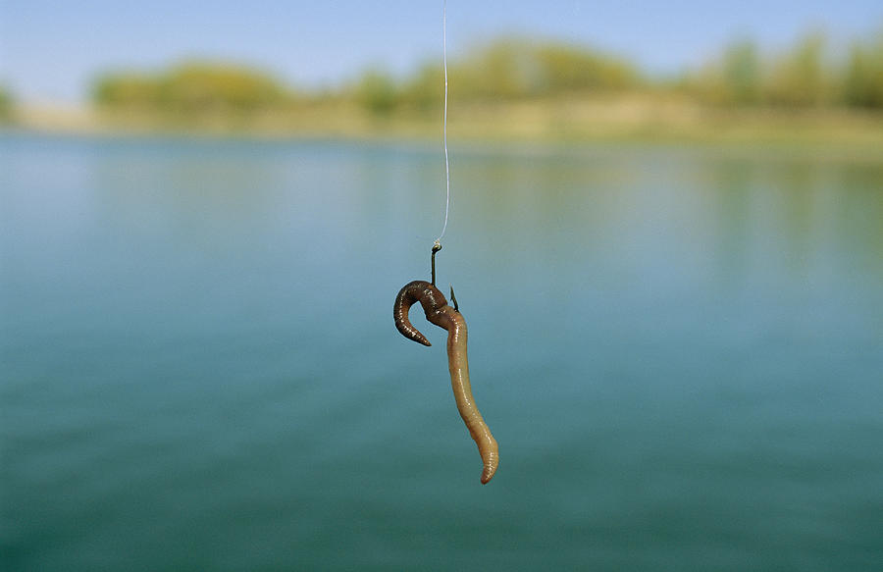
The bait might look tasty, but the hook is deadly

Slide 21
Moving away from the light of God
Into the darkness of rebellion
Satan
Enemy, Accuser
Man and Woman
“I will ascend to heaven”
“I will raise my throne”
“I will make myself like the Most High”

Slide 22
What is Death?
Genesis 2:16,17 – what did God say would happen whey they ate from the tree?
Isaiah 59:2 – sin separates us from God
“But your iniquities have separated you from your God; your sins have hidden His face from you, so that He will not hear.”
Notes:
When something dies, it becomes separated from the source of life. Physical death is the time when a person’s spirit is separated from their body. Spiritual death is the time when a man becomes separated from God (Isaiah 59:2).

Slide 23
What is Death?
Genesis 2:16,17 – what did God say would happen whey they ate from the tree?
Isaiah 59:2 – sin separates us from God
  When someone dies physically, their soul is separated from their body
  When someone dies spiritually, their spirit is separated from God
Genesis 3:8 – they hid themselves from God
“Then the man and his wife heard the sound of the LORD God as he was walking in the garden in the cool of the day, and they hid from the LORD God among the trees of the garden.”
Notes:
When something dies, it becomes separated from the source of life. Physical death is the time when a person’s spirit is separated from their body. Spiritual death is the time when a man becomes separated from God (Isaiah 59:2).
The first sign of separation from God we read about is that they tried to hide from God.

Slide 24
What is Death?
Genesis 2:16,17 – what did God say would happen whey they ate from the tree?
Isaiah 59:2 – sin separates us from God
  When someone dies physically, their soul is separated from their body
  When someone dies spiritually, their spirit is separated from God
Genesis 3:8 – they hid themselves from God
Death = separation from life
Notes:
When something dies, it becomes separated from the source of life. Physical death is the time when a person’s spirit is separated from their body. Spiritual death is the time when a man becomes separated from God (Isaiah 59:2). The first sign of separation from God we read about is that they tried to hide from God.

Slide 25

Are these flowers alive or dead?
Hint
Notes:
They are cut off from the source of life…

Slide 26
The results of sin (Genesis 3):
Verses 9-12 > Three Things:
“But the LORD God called to the man, ‘Where are you?’ He answered, ‘I heard You in the garden, and I was afraid because I was naked; so I hid.’ And He said, ‘Who told you that you were naked? Have you eaten from the tree that I commanded you not to eat from?’ The man said, ‘The woman you put here with me—she gave me some fruit from the tree, and I ate it.’”
Notes:
When Adam and Eve sinned, three things happened to them: fear (I was afraid), shame (I was naked), and guilt (I ate). All over the world, we see these three results of evil.
Could God see where they were hiding? Why did God call out? – He loved them, and wanted to give them an opportunity to confess their sin. We are responsible for our actions. Do you think God needed to ask them to find out what happened? No, but He was giving them an opportunity to agree with Him that what He said was truth and that they were wrong in believing and following Satan.
When God created Adam and Eve, He did not intend for them to die. Even though man did not die physically on the day that he ate from the tree, his genetics were now changed, eventually leading him to physical death. Death would now be routine for everything on earth.

Slide 27
The results of sin (Genesis 3):
Verses 9-12 > Three Things:
  Fear – “I was afraid”
  Shame – “I was naked”
  Guilt – “I ate”
Curses on People and Creation (verses 16-19):
“To the woman he said, “I will make your pains in childbearing very severe; with painful labor you will give birth to children. Your desire will be for your husband, and he will rule over you.” To Adam he said, “Because you listened to your wife and ate fruit from the tree about which I commanded you, ‘You must not eat from it,’ “Cursed is the ground because of you; through painful toil you will eat food from it all the days of your life. It will produce thorns and thistles for you, and you will eat the plants of the field. By the sweat of your brow you will eat your food until you return to the ground, since from it you were taken; for dust you are and to dust you will return.”
Notes:
When Adam and Eve sinned, three things happened to them: fear (I was afraid), shame (I was naked), and guilt (I ate). All over the world, we see these three results of evil.
Could God see where they were hiding? Why did God call out? – He loved them, and wanted to give them an opportunity to confess their sin. We are responsible for our actions. Do you think God needed to ask them to find out what happened? No, but He was giving them an opportunity to agree with Him that what He said was truth and that they were wrong in believing and following Satan.
When God created Adam and Eve, He did not intend for them to die. Even though man did not die physically on the day that he ate from the tree, his genetics were now changed, eventually leading him to physical death. Death would now be routine for everything on earth.

Slide 28
The results of sin (Genesis 3):
Verses 9-12 > Three Things:
  Fear – “I was afraid”
  Shame – “I was naked”
  Guilt – “I ate”
Curses on People and Creation (verses 16-19):
  Verse 16 > woman: painful childbirth and loss of freedom
  Verse 17-18 > man: thorns, pain, sweat, hard work
  Verses 19 > man and woman: death
Notes:
When Adam and Eve sinned, three things happened to them: fear (I was afraid), shame (I was naked), and guilt (I ate). All over the world, we see these three results of evil.
Could God see where they were hiding? Why did God call out? – He loved them, and wanted to give them an opportunity to confess their sin. We are responsible for our actions. Do you think God needed to ask them to find out what happened? No, but He was giving them an opportunity to agree with Him that what He said was truth and that they were wrong in believing and following Satan.
When God created Adam and Eve, He did not intend for them to die. Even though man did not die physically on the day that he ate from the tree, his genetics were now changed, eventually leading him to physical death. Death would now be routine for everything on earth.

Slide 29
Bad news for all of us
Romans 5:12
“Therefore, just as sin entered the world through one man, and death through sin, and in this way death came to all people, because all sinned”
Notes:
Romans 5:12 “Therefore, just as sin entered the world through one man, and death through sin, and in this way, death came to all men because all sinned.”
Even though tonight’s lesson began with the words “very good,” it ends on a very sad note: men have been separated from God and are now destined to live in a cursed world of evil and death. The question is this: is there any hope for mankind?

Slide 30
Bad news for all of us
Romans 5:12
  We all inherit sin – it’s not just what we do, it’s who we are
  Because of sin, we all are dead spiritually
  Because of sin, we all will die physically
The end of last lesson: “It was very good”
The end of this lesson: we are separated from God and will die because of our sin
The important question: Is there any hope?
Notes:
Romans 5:12 “Therefore, just as sin entered the world through one man, and death through sin, and in this way, death came to all men because all sinned.”
Even though tonight’s lesson began with the words “very good,” it ends on a very sad note: men have been separated from God and are now destined to live in a cursed world of evil and death. The question is this: is there any hope for mankind?
Theistic Evolution is very dangerous! It is important that Adam and Eve were the first real people who sinned directly against God’s clear commands: if not, the entire gospel message fails. Remember 1 Corinthians 15:45-49, “So it is written: “The first man Adam became a living being”; the last Adam, a life-giving spirit. The spiritual did not come first, but the natural, and after that the spiritual. The first man was of the dust of the earth; the second man is of heaven. As was the earthly man, so are those who are of the earth; and as is the heavenly man, so also are those who are of heaven. And just as we have borne the image of the earthly man, so shall we bear the image of the heavenly man.

Slide 31
Some “clues” of hope…
Genesis 3:9 > God came to the man and called out to him
“But the LORD God called to the man, ‘Where are you?’”
Notes:
The answer: yes, there is hope found in two clues above:
Even when man was hiding from God, God was calling out to him, giving him an opportunity to repent
God shed the blood of a substitute in order to cover the shame of the man
Now that you understand the problem of death, it helps you to better understand the message of the Bible. It is not just a book of rules to try and help sinful people get along better with each other. It is the story of God seeking man. It is the amazing story of what God will do to restore His relationship with people who turned away from Him.

Slide 32
Some clues of hope…
Genesis 3:9 > God came to the man and called out to him
  “Where are you?”
  God gives people an opportunity to confess sin and ask forgiveness
Genesis 3:21 > God covered their shame
“The LORD God made garments of skin for Adam and his wife and clothed them.”
Notes:
The answer: yes, there is hope found in two clues above:
Even when man was hiding from God, God was calling out to him, giving him an opportunity to repent
God shed the blood of a substitute in order to cover the shame of the man
Now that you understand the problem of death, it helps you to better understand the message of the Bible. It is not just a book of rules to try and help sinful people get along better with each other. It is the story of God seeking man. It is the amazing story of what God will do to restore His relationship with people who turned away from Him.

Slide 33
Some clues of hope…
Genesis 3:9 > God came to the man and called out to him
  “Where are you?”
  God gives people an opportunity to confess sin and ask forgiveness
Genesis 3:21 > God covered their shame
  What did God do to make their clothing?
  God killed a substitute for the man to cover his shame
The Bible is not just a book of rules
The Bible is the true story of God seeking man.
Notes:
The answer: yes, there is hope found in two clues above:
Even when man was hiding from God, God was calling out to him, giving him an opportunity to repent
God shed the blood of a substitute in order to cover the shame of the man
Now that you understand the problem of death, it helps you to better understand the message of the Bible. It is not just a book of rules to try and help sinful people get along better with each other. It is the story of God seeking man. It is the amazing story of what God will do to restore His relationship with people who turned away from Him.

Slide 34

耶和华我们的主啊！你的名在全地是多么威严，你把你的荣美彰显在天上。 我观看你手所造的天，和你所安放的月亮和星星。 啊！人算什么，你竟记念他？世人算什么，你竟眷顾他？ Psalm 8:1,3,4
Remember: He is God, we are not God
O LORD, our Lord, how majestic is your name in all the earth!
You have set your glory above the heavens. When I look at your heavens, the work of your fingers, the moon and the stars, which you have set in place, what is man that you are mindful of him, and the son of man that you care for him?
Notes:
As we conclude, I want you to remember an important fact, one that Satan confused in the mind of Adam and Eve: God is God and we are not God Psalm 8:1,3,4
He is the center of all things, and we only exist because He has chosen to make us. When we keep our attention clear about this, it changes everything!

Slide 36
A Correct View of Life
God
You
You
Me
You
You
You
You
You
You
For from Him and through Him and for Him are all things.
To Him be the glory forever! Amen. Romans 11:36
The Universe

Slide 37
Our (incorrect) view of life
My Comfort
God
God
My Control
Me
God
My Plan
My Rules
God
God
My Understanding
My Desires
God
The Universe

Slide 38
Our Incorrect View of Suffering
View 1:
View 2:
What we think:
Why is God doing this to me?!
If God was real, this would not happen to me.
Why we think it:
God should make my story easy and happy
Life is just a random string of events
The right view: God is at the center of all things. I was not created to be self-centered, I was created to worship and enjoy God forever.

